Slide 1
KET SPEAKING
Time allowed - 8-10 minutes
Normally you will do the speaking test with another candidate. The two of you will meet two examiners. One of the examiners will talk to you, the other does not participate in the conversations.
There are two parts to the speaking test:
Speaking part 1: short questions and answers between you and the examiner.
Speaking part 2: the examiner gives you some information or a card with some ideas for questions. You have to talk with the other candidate and ask or answer questions.
Scoring The Speaking section is worth 25% of the total score for the exam.
How to prepare for KET Speaking:
Speak as much as you can, with your friends
Practise asking and answering questions about daily life
Practise giving information about yourself

Slide 2
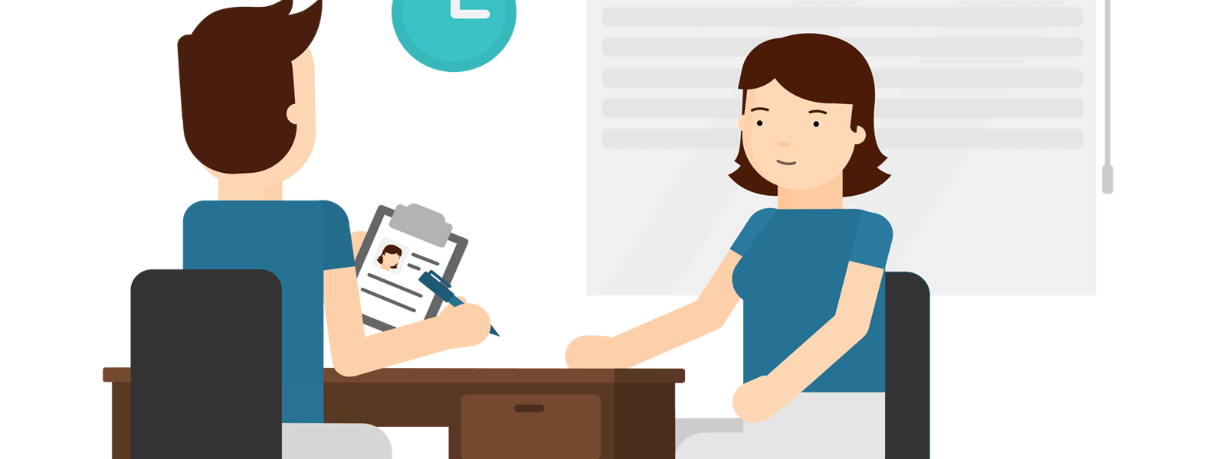
KEY ENGLISH TEST 5
Test 3 - Speaking

Slide 3
Part 1: Student – examiner interaction
Section 1:
The examiner will ask you:
Your name
Where you come from?
Provide full-sentence answers

Slide 4
Part 1: Student – examiner interaction
Section 2: You will be asked some questions that require longer answers. For example:
Why you like something
Details about a hobby…

Slide 5
Popular topic
family
best friend
hometown
your house
sport
computer
collecting
music

Slide 6
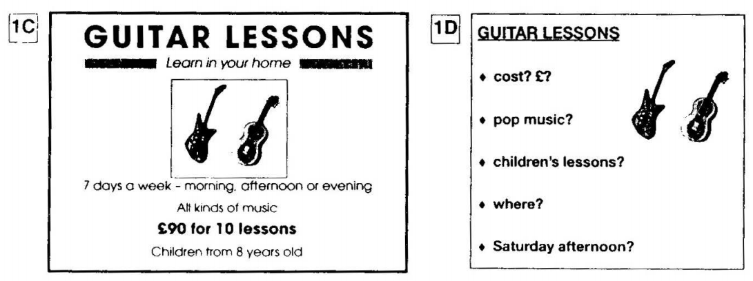
PART 2: Student – student interaction
Ask and answer questions based on the cue cards
For example:
Do not just read from the cards. Answer in full sentences.
Pay attention to the grammar.

Slide 7
SPEAKING PART 1

Slide 8
Part 1
Do you live in a flat or a house?
How many rooms are there in your house?
Is there a garden in your house?
Are there any plants in your house? What are they?
What's you favourite room? Why?

Slide 9
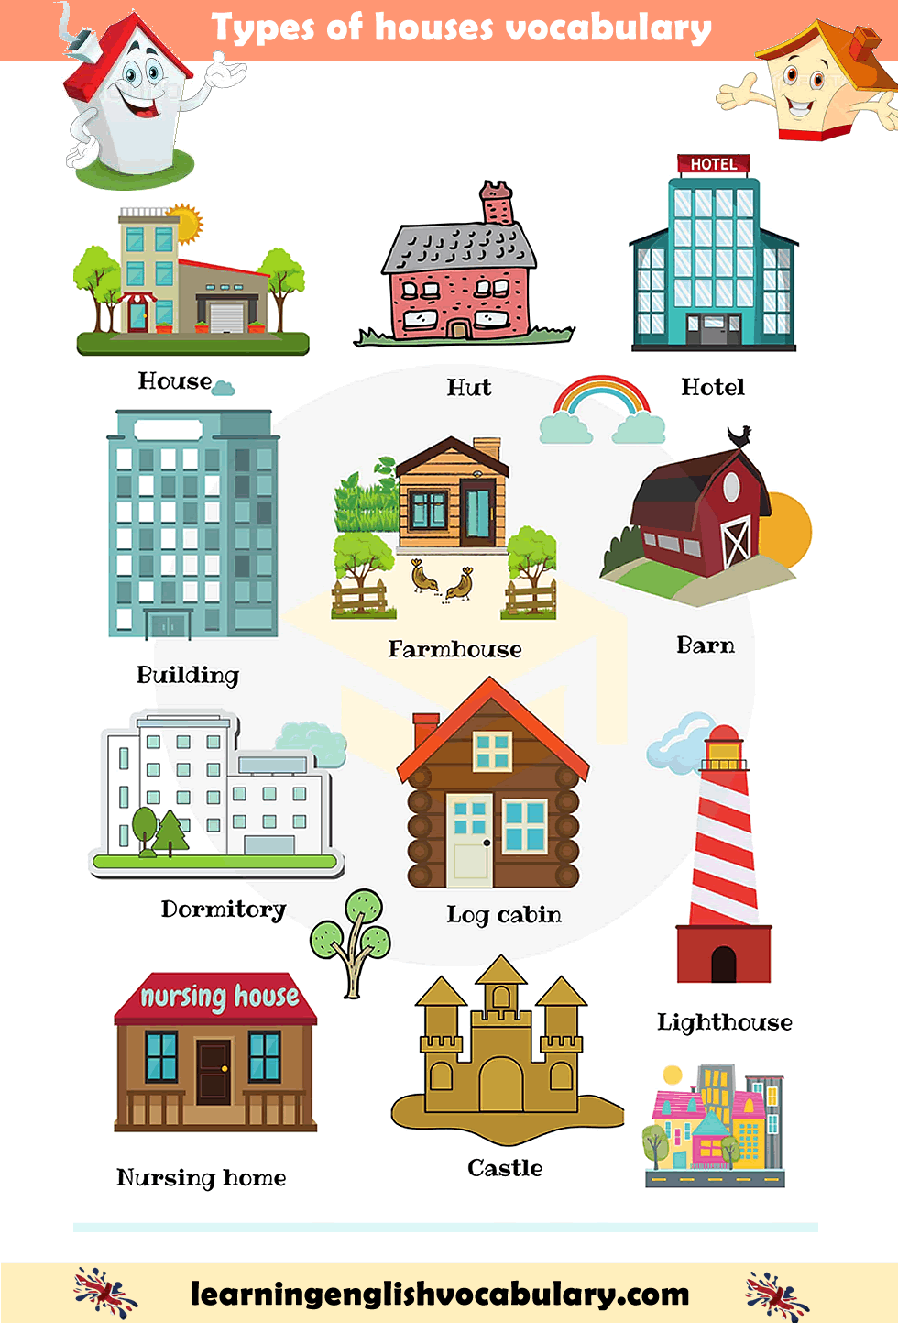

Slide 10
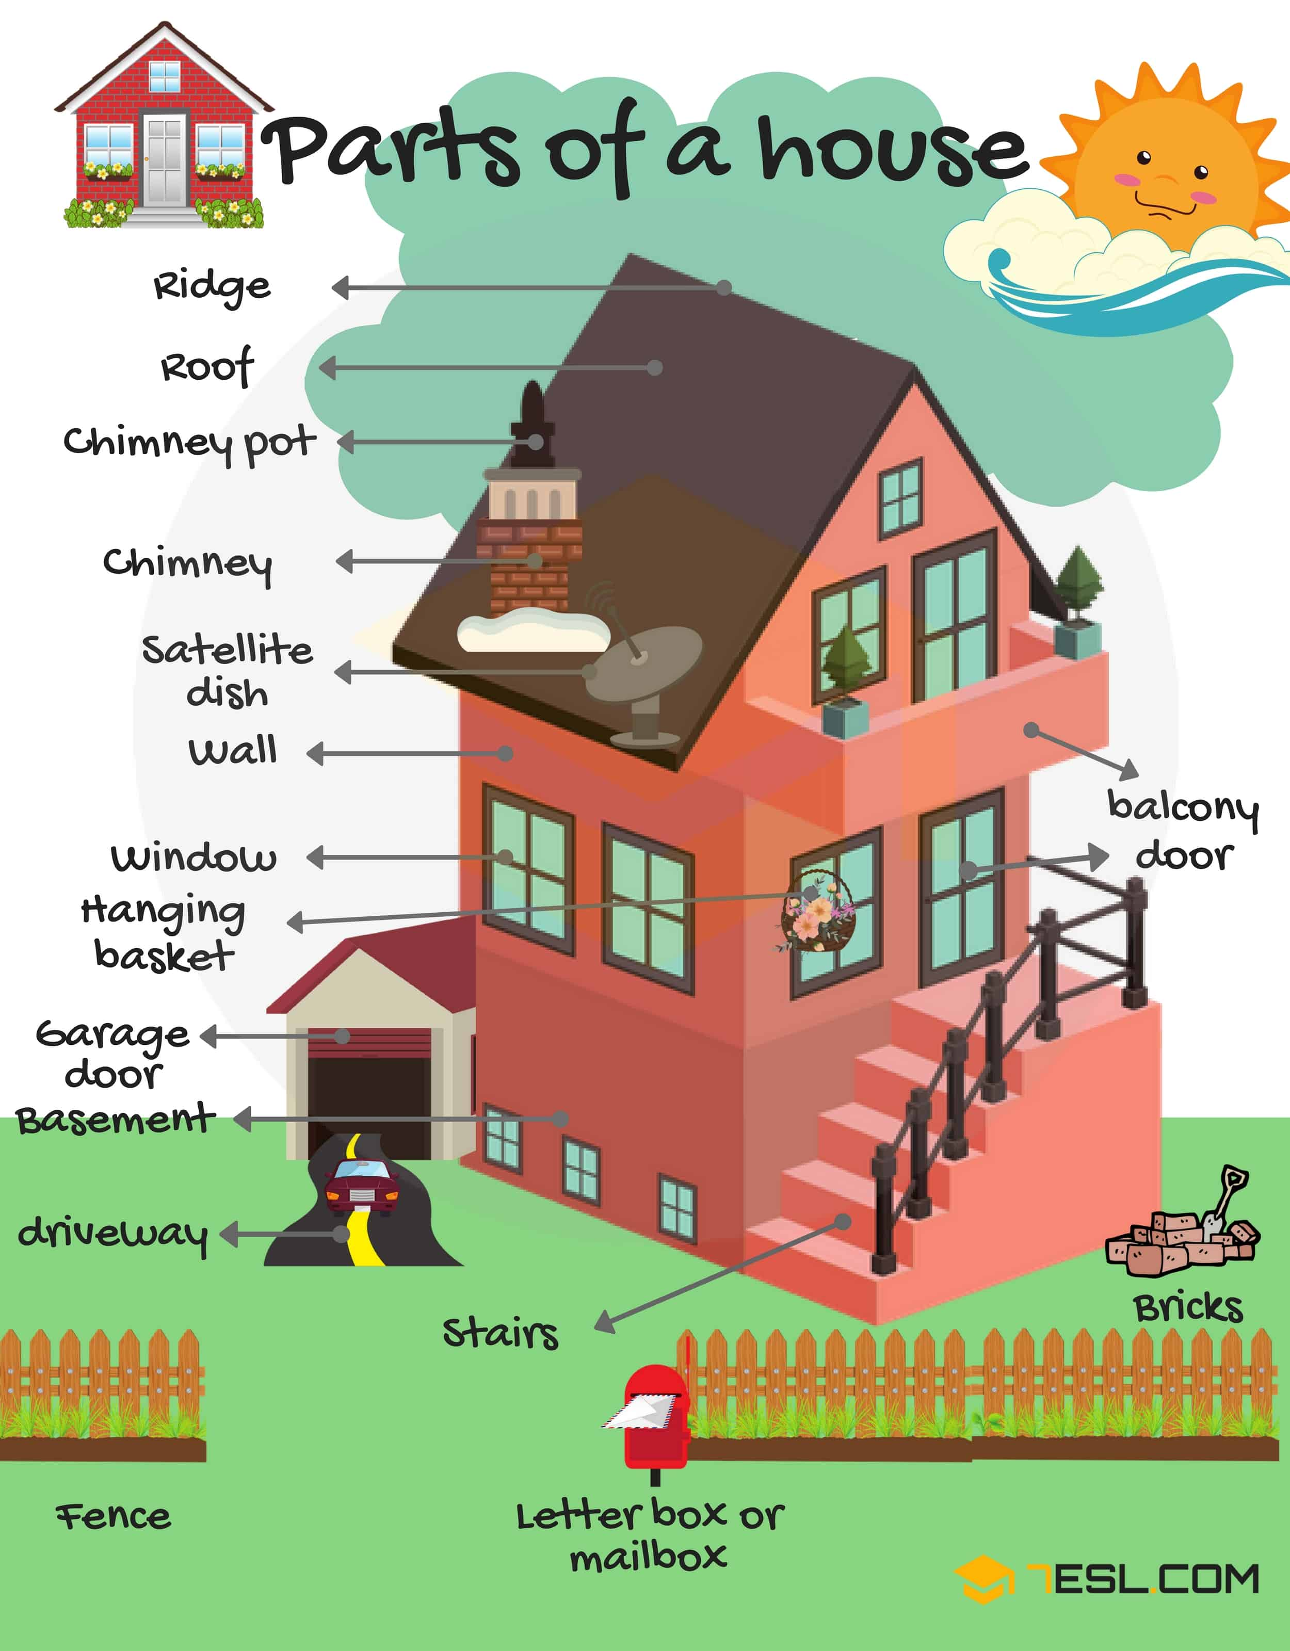
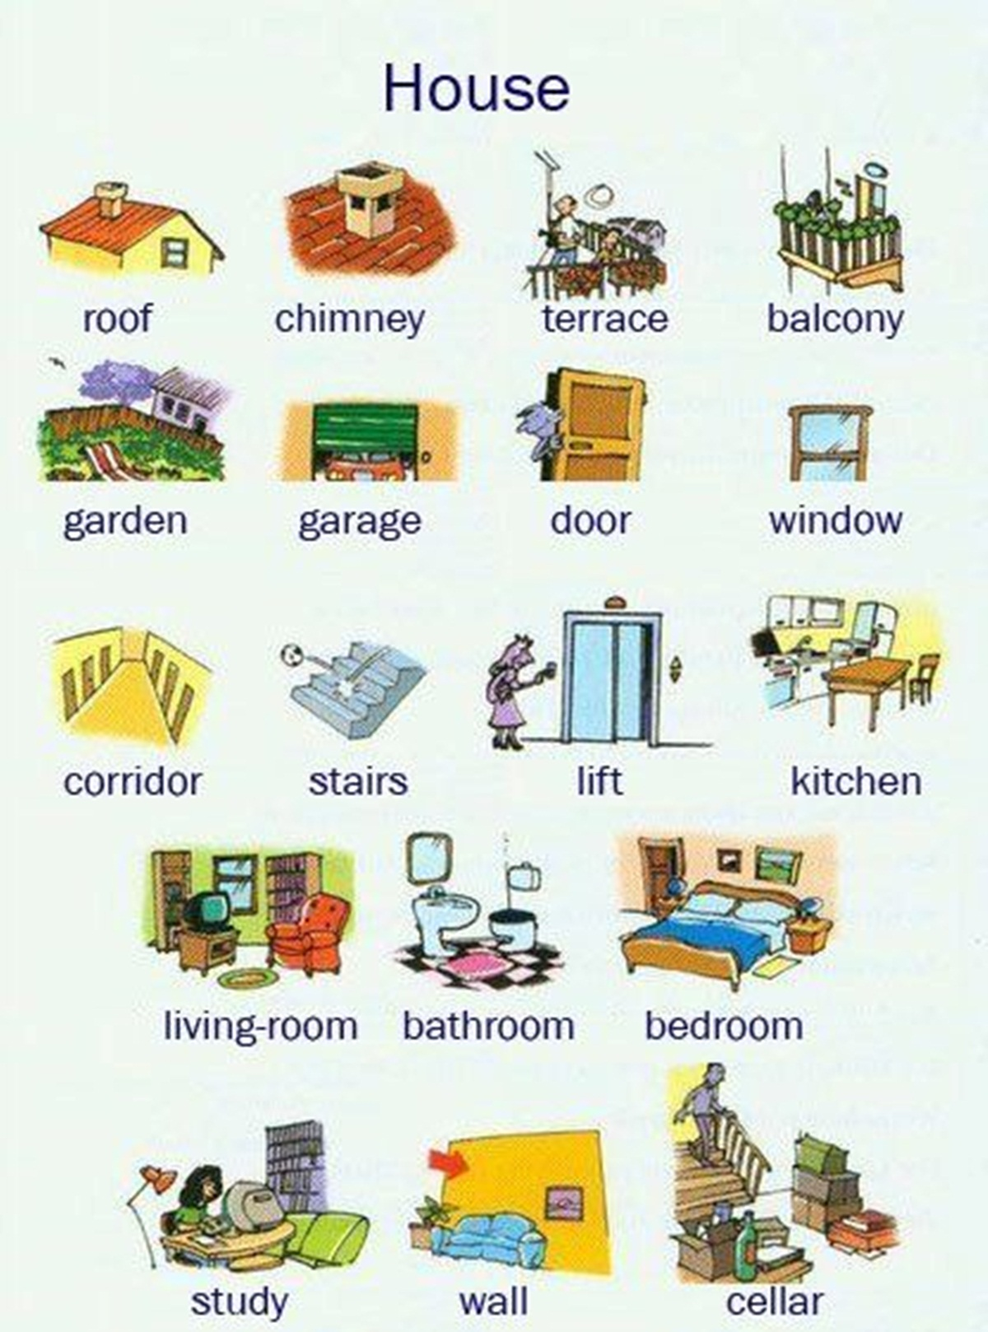

Slide 12
USEFUL VOCABULARY
accommodation – a building or set of rooms where someone lives or stays
a property – building and the land it is built on
bungalow – a house with only one storey; built all on one level
flat / apartment – a set of rooms for living in that are part of a larger building and are usually all on one floor
residential area – area in which most of the buildings are houses
close-knit community – a neighbourhood where people are helpful and supportive

Slide 13
What are the advantages of living in a house compared to an apartment?

Slide 14
What do you think living spaces will be like in the future?

Slide 15
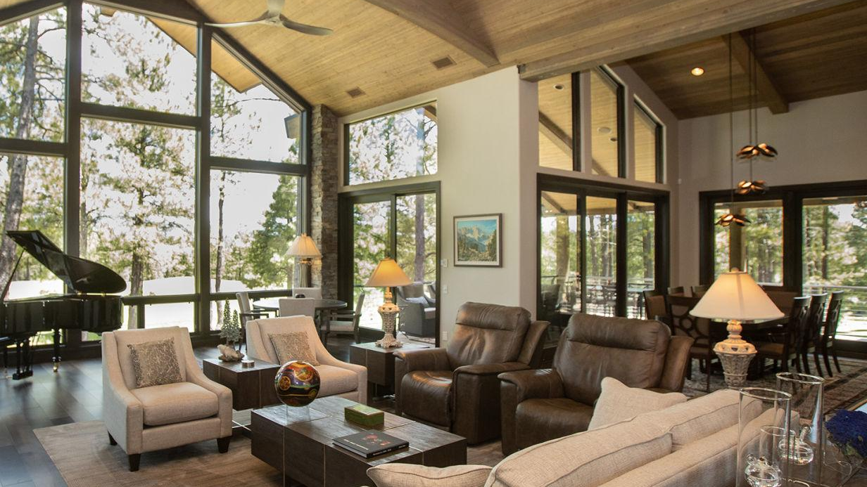
Talk about a home you have visited that you really liked.
Where it was
Whose house or apartment it was
What it was like
And explain why you liked it

Slide 16
SPEAKING PART 2
Asking and answering questions using these prompt cards

Slide 17
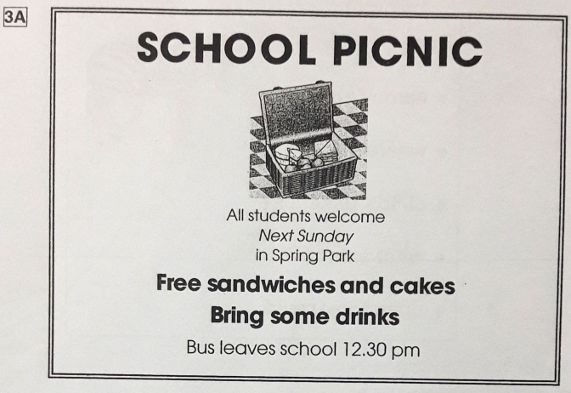
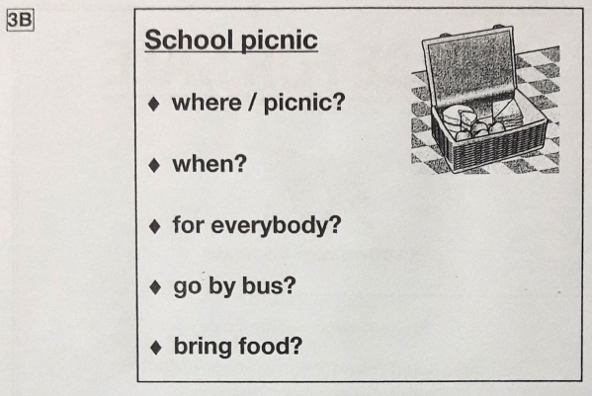
Ask and answer
Ask and answer questions using the words given.

Slide 18
Ask and answer
Ask and answer questions using the words given.
What are other questions and answers you can think of?

Slide 19
Based on the given information, talk about Ride on the Mountain Train.

