Slide 1


Slide 2



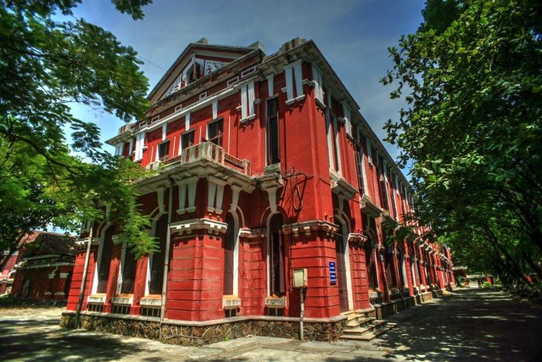
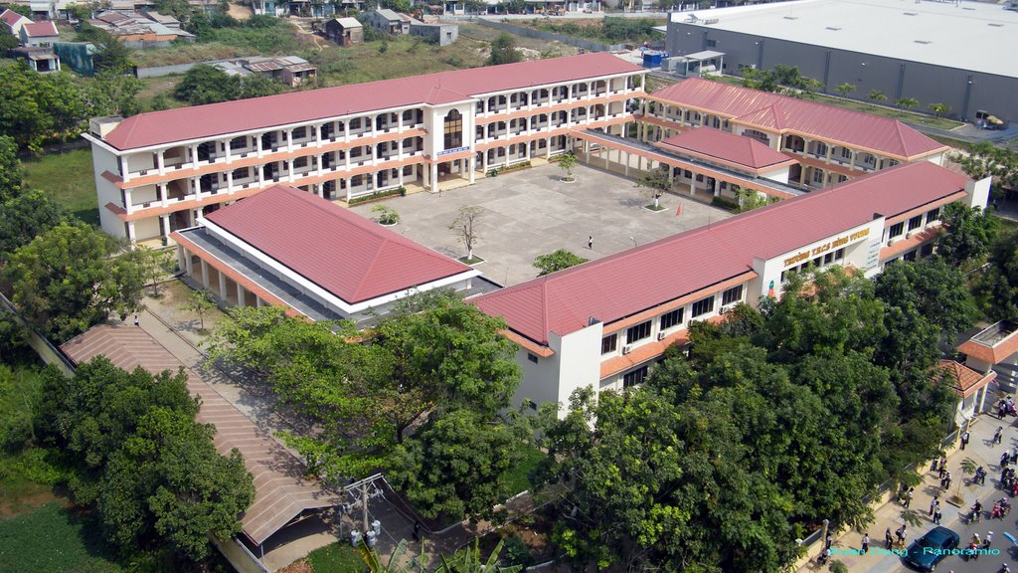
Unit
6
A VISIT TO A SCHOOL
LESSON 5: SKILLS 1
Unit
READING
SPEAKING

Slide 3

OBJECTIVES
By the end of the lesson, students will be able to:
develop reading skill about a famous school
develop speaking skill: talking about one’s school

Slide 4
LESSON 5: SKILLS 1
WARM-UP
Game: Who is faster?
* Vocabulary
Task 1: Look at the pictures and answer the questions.
Task 2: Read the passage and answer the questions.
Task 3: Read the passage again and complete the table. Then report it to the class.
READING
Task 4: Work in pairs. Answer the questions with the information in the table.
Task 5: Work in groups. Tell about your school.
SPEAKING
POST-READING
& SPEAKING
Evaluation
CONSOLIDATION
Wrap-up
Homework

Slide 5


LESSON 5: SKILLS 1
WARM-UP
Game: Who is faster?
Aims of the stage:
to introduce the topic of reading.
to enhance students’ skills of cooperating with team mates

Slide 6
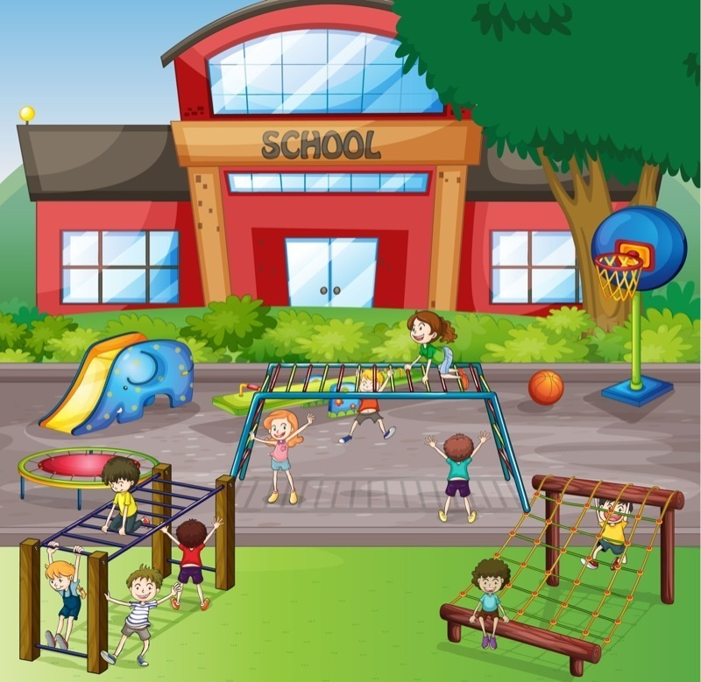
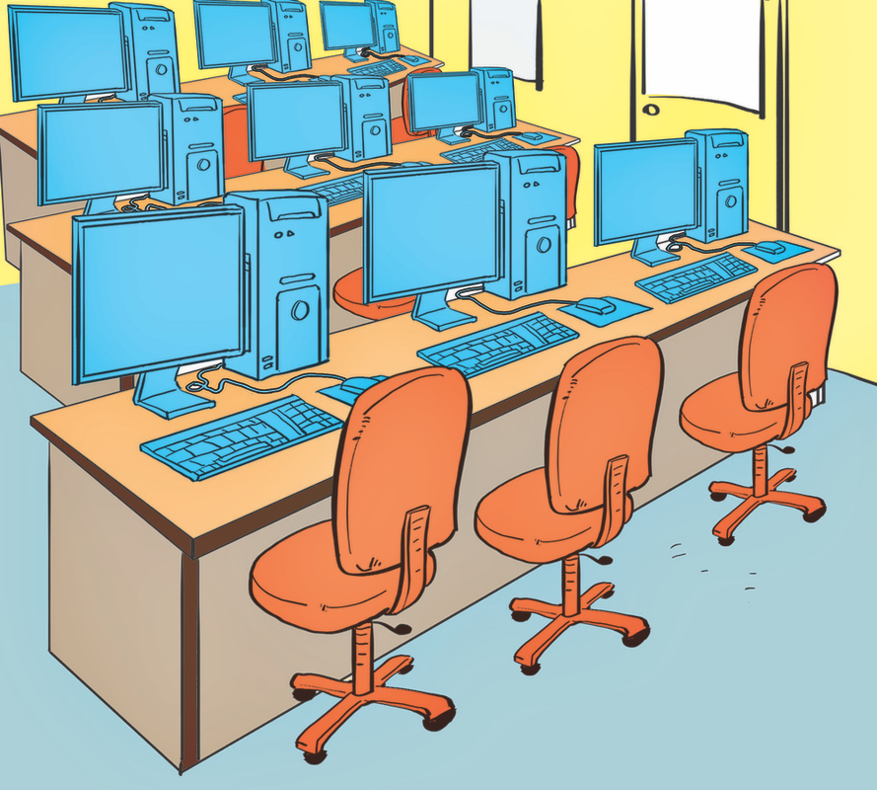
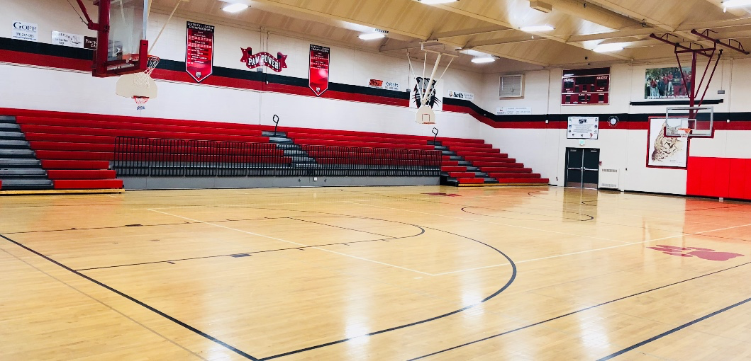
WARM-UP
Look at the posters, write the correct school facilities.
school playground
school gym
computer room

Slide 7
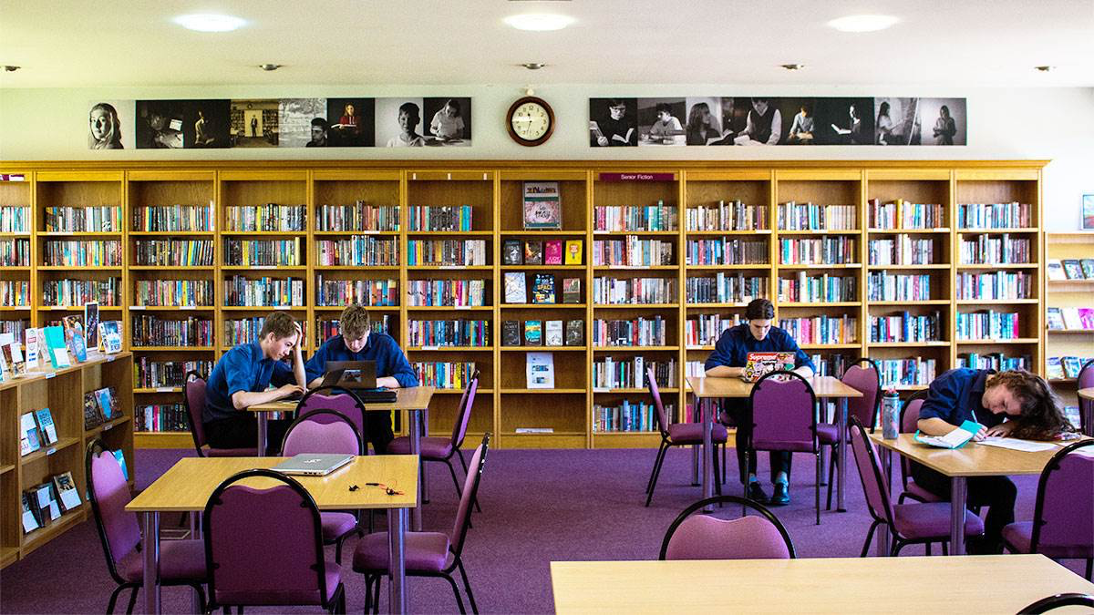
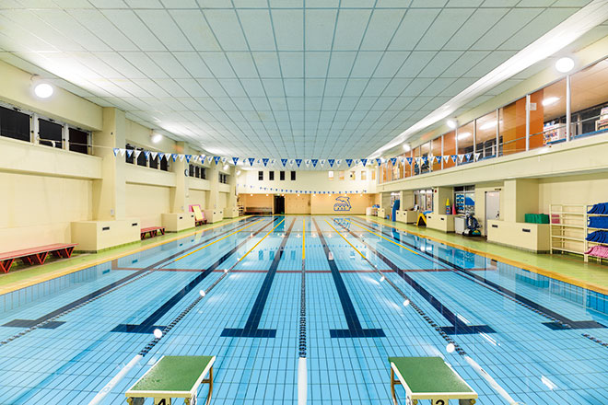
WARM-UP
Look at the posters, write the correct school facilities.
school library
swimming pool

Slide 8
LESSON 5: SKILLS 1
WARM-UP
Game: Who is faster?
* Vocabulary
Task 1: Look at the pictures and answer the questions.
Task 2: Read the passage and answer the questions.
Task 3: Read the passage again and complete the table. Then report it to the class.
READING

Slide 9

VOCABULARY
found (v)
/faʊnd/
thành lập

Slide 10

VOCABULARY
well-known (adj)
/ˌwel ˈnəʊn/
nổi tiếng

Slide 11
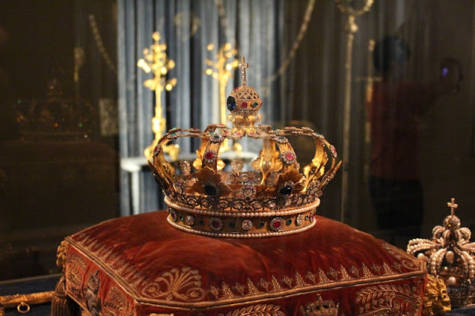
VOCABULARY
royal (adj)
/ˈrɔɪəl/
thuộc về hoàng gia

Slide 12
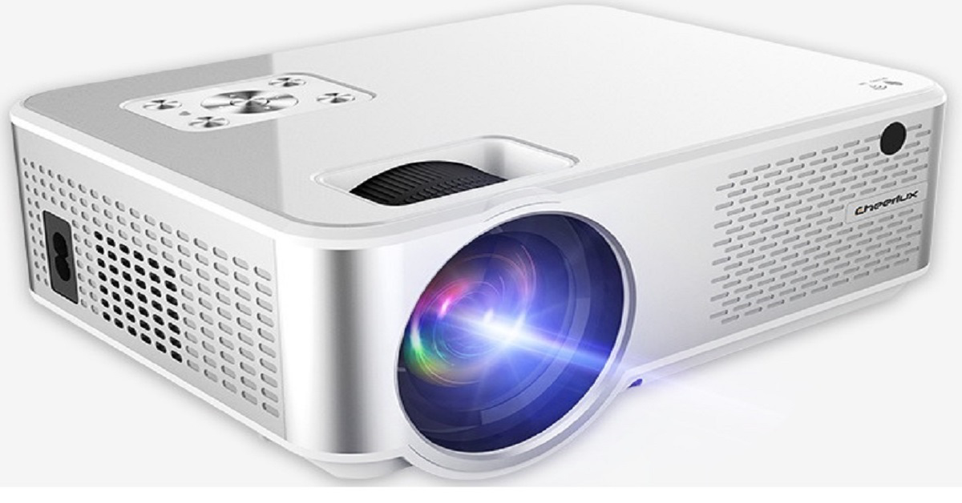
VOCABULARY
projector (n)
/prəˈdʒektər/
máy chiếu

Slide 13
VOCABULARY
New words | Pronunciation | Meaning
found | /faʊnd/ | thành lập
well-known | /ˌwelˈnəʊn/ | nổi tiếng
royal | /ˈrɔɪəl/ | thuộc về hoàng gia
projector | /prəˈdʒektər/ | máy chiếu

Slide 14

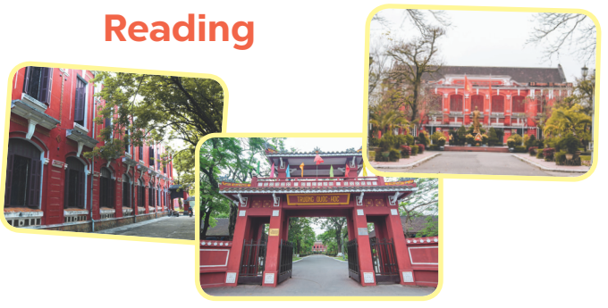
PRE-READING
1
Look at the pictures and answer the questions.
What can you see in the pictures?
What do you know about them?

Slide 15
WHILE-READING
2
Read the passage and answer the questions.
1. Where is Quoc Hoc – Hue?
2. Who were some of the well-known students of the school?
3. What are the students like?
4. How many English labs does it have?
It’s in Hue .
They were Ho Chi Minh, Vo Nguyen Giap, Xuan Dieu.
They were intelligent and hard-working.
It has two English labs.

Slide 16
WHILE-READING
3
Read the passage again and complete the table. Then report it to the class.
Name | Quoc Hoc - Hue
Location
Students
School facilities
On the bank of the Huong River, in Hue
Intelligent and hard-working
Over 50 classrooms (with TVs, projectors, computers), a swimming pool, a library, two English labs, four computer rooms, and many other modern facilities.
Example:
The name of the school is Quoc Hoc – Hue.

Slide 17
LESSON 5: SKILLS 1
WARM-UP
Game: Who is faster?
* Vocabulary
Task 1: Look at the pictures and answer the questions.
Task 2: Read the passage and answer the questions.
Task 3: Read the passage again and complete the table. Then report it to the class.
READING
Task 4: Work in pairs. Answer the questions with the information in the table.
Task 5: Work in groups. Tell about your school.
SPEAKING

Slide 18
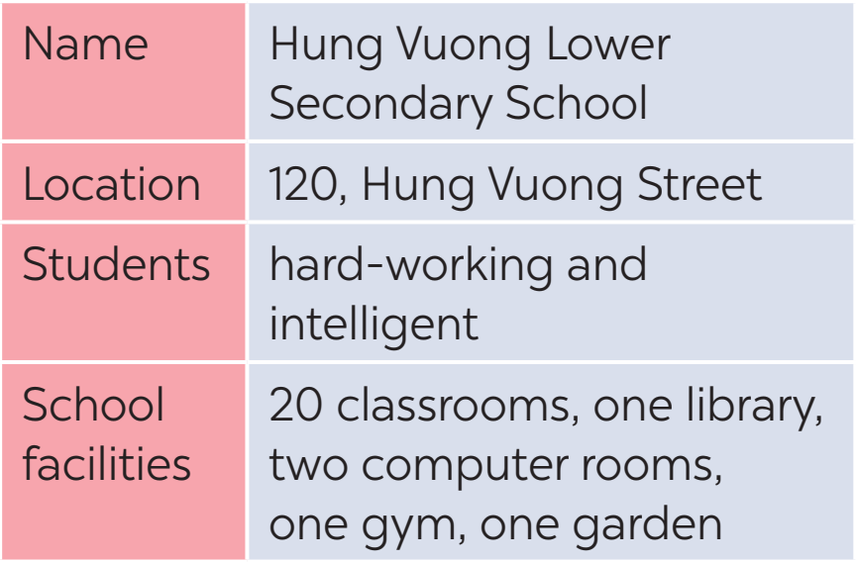
PRE-SPEAKING
4
Work in pairs. Answer the questions with the information in the table.
What is the full name of the school?
Where is it?
What are the students like?
What facilities does the school have?

Slide 19
WHILE-SPEAKING
5
Work in groups. Tell about your school. You can use the suggestions in Task 4 (full name, location, students, and school facilities).
Example:
I’d like to talk about my school …

Slide 20
LESSON 5: SKILLS 1
WARM-UP
Game: Who is faster?
* Vocabulary
Task 1: Look at the pictures and answer the questions.
Task 2: Read the passage and answer the questions.
Task 3: Read the passage again and complete the table. Then report it to the class.
READING
Task 4: Work in pairs. Answer the questions with the information in the table.
Task 5: Work in groups. Tell about your school.
SPEAKING
POST-READING
& SPEAKING
Evaluation

Slide 21

POST-READING & SPEAKING
Let’s give comments for your friends and vote for the most interesting and informative presentation.

Slide 22
LESSON 5: SKILLS 1
WARM-UP
Game: Who is faster?
* Vocabulary
Task 1: Look at the pictures and answer the questions.
Task 2: Read the passage and answer the questions.
Task 3: Read the passage again and complete the table. Then report it to the class.
READING
Task 4: Work in pairs. Answer the questions with the information in the table.
Task 5: Work in groups. Tell about your school.
SPEAKING
POST-READING
& SPEAKING
Evaluation
CONSOLIDATION
Wrap-up
Homework

Slide 23
CONSOLIDATION
1
WRAP-UP
READING
SPEAKING

Slide 24

CONSOLIDATION
2
HOMEWORK
Prepare for the next lesson: Skills 2

Slide 25

Website: hoclieu.vn
Fanpage: facebook.com/www.tienganhglobalsuccess.vn/

