Slide 1


Slide 2




Unit
11
TRAVELLING IN THE FUTURE
LESSON 3: A CLOSER LOOK 2
Grammar: The future simple & Possessive pronouns
Unit
HOBBIES

Slide 3

OBJECTIVES
By the end of the lesson, students will be able to:
know how to recognize The future simple
use possessive pronouns to demonstrate ownership

Slide 4
LESSON 3: A CLOSER LOOK 2
WARM-UP
Chatting
PRESENTATION
Grammar 1: The future simple
Grammar 2: Possessive pronouns
Task 1: Complete the sentences with will or won’t.
Task 2: Rearrange the words and phrases to make sentences.
Task 3: Use the correct form of the verbs in brackets to complete the conversation.
Task 4: Replace the underlined phrases with possessive pronouns.
PRACTICE
PRODUCTION
Task 5: Look at the pictures and tell your partner if you will / won’t travel by these means of transport. Give reason(s).
CONSOLIDATION
Wrap-up
Homework

Slide 5
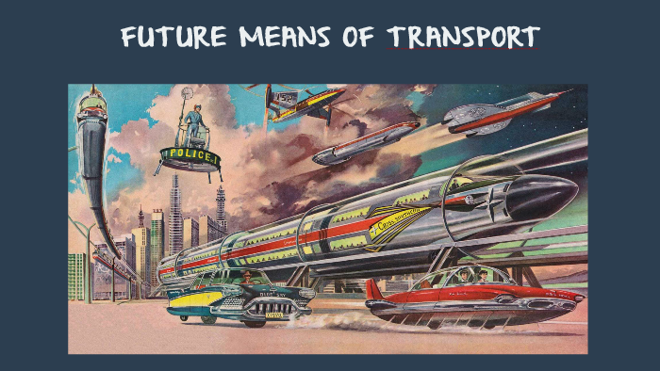
WARM-UP: CHATTING

Slide 6
PRESENTATION
GRAMMAR 1: THE FUTURE SIMPLE
+ Usage: to talk about future activities and to make predictions.
+ Form: (+) S + will + V
(-) S + will + not (won’t)
(?) Will + S + V?

Slide 7
PRESENTATION
GRAMMAR 2: POSSESSIVE PRONOUNS (REVIEW)
Personal pronouns | Possessive adjectives | Possessive pronouns
I
You
We
They
He
She
It
Examples:
This is your bicycle.
→ yours
That bicycle is her bicycle.
→ hers
my
mine
your
yours
our
ours
their
theirs
his
his
her
hers
it
its

Slide 8
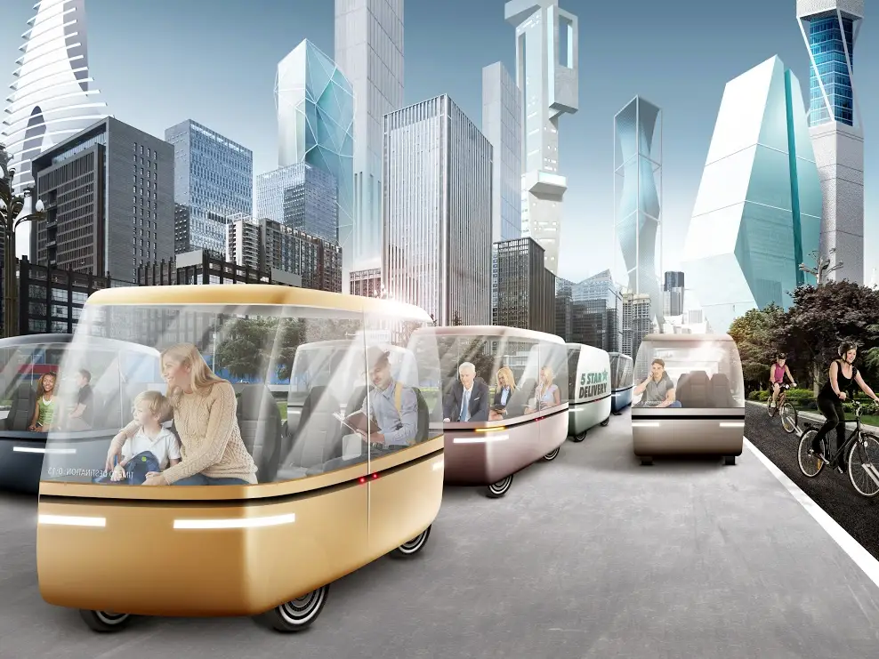
PRACTICE
1
Complete the sentences with will or won’t.
1. Petrol-powered cars are not eco-friendly, so they ______ be popular.
2. We ______ travel by teleporter soon because it is faster.
3. Rich people ______ choose to travel to other planets for their holidays.
4. People ______ take holidays in crowded places as in the past.
5. Bullet trains ______ soon become a popular means of transport in Viet Nam because they are green and safe.
won’t
will
will
won’t
will

Slide 9
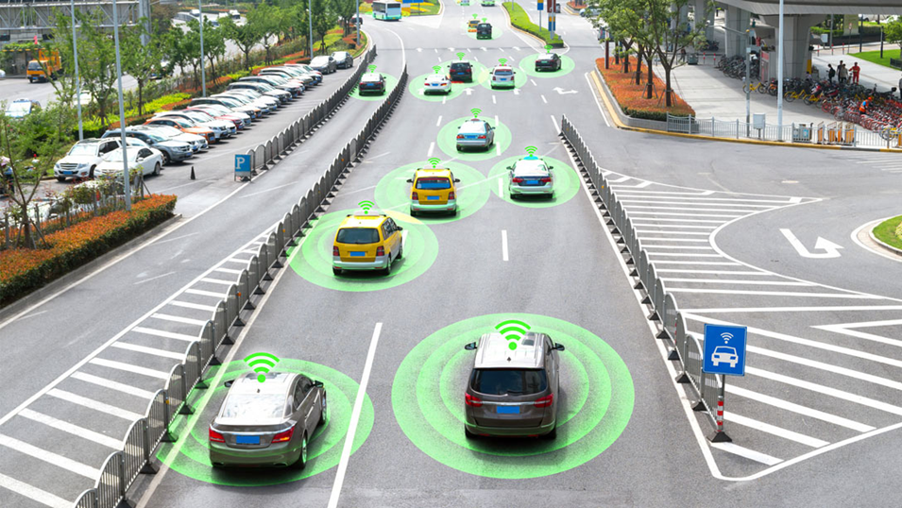
PRACTICE
2
Rearrange the words and phrases to make sentences.
1. driverless cars / we / will have / in 2030 /.
2. cars / cities / won’t allow / in 2050 /.
3. electric cars / will / popular / be /?
4. we / use / will / buses / soon / solar-powered/.
5. have / enough parking places / we / will / in ten years /?
→ We will have driverless cars in 2030.
→ Cities won’t allow cars in 2050.
→ Will electric cars be popular?
→ We will use solar-powered buses soon.
→ Will we have enough parking places in ten years?

Slide 10
PRACTICE
3
Use the correct form of the verbs in brackets to complete the conversation.
﻿Alice: Do you think travelling by teleporter will become possible soon?
Tom: Yes. I hear that it (1. take) _________ very little time to travel from one country to another.
Alice: Right. And we (2. not have) __________ to wait at the airport.
Tom: ______ we (3. have) ______ to learn to drive it?
Alice: No. We (4. not drive) __________ it. It makes us disappear then appear in another place in just seconds.
Tom: How wonderful! There (5. not be) ________ traffic jams any more, right?
will take
won’t have
Will
have
won’t drive
won’t be

Slide 11
PRACTICE
4
Replace the underlined phrases with possessive pronouns.
﻿1. My motorbike runs on electricity. How about their motorbikes?
2. Your bicycle is blue and my bicycle is red.
3. My dream is to travel to the moon. His dream is different.
4. My bus was late. Your bus was on time.
5. His car is a flying car. Our car is an electric one.
theirs
mine
His
yours
ours

Slide 12
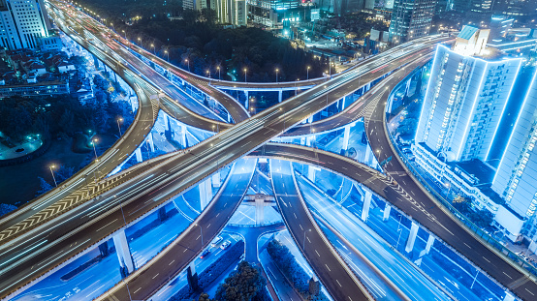
PRODUCTION
5
Look at the pictures and tell your partner if you will / won’t travel by these means of transport. Give reason(s).
Aim of the task:
To help Ss practise talking about some future means of transport
To help Ss learn reasoning skills by giving reasons for their choice

Slide 13
PRODUCTION
5
Look at the pictures and tell your partner if you will / won’t travel by these means of transport. Give reason(s).

Slide 14
CONSOLIDATION
1
WRAP-UP
Grammar: The future simple & Possessive pronouns

Slide 15

CONSOLIDATION
2
HOMEWORK
Do exercises in the workbook.

Slide 16

Website: hoclieu.vn
Fanpage: facebook.com/www.tienganhglobalsuccess.vn/

