Slide 1

Unit 9: English in the World
Lesson 2.2: Grammar
Page 72

Slide 2
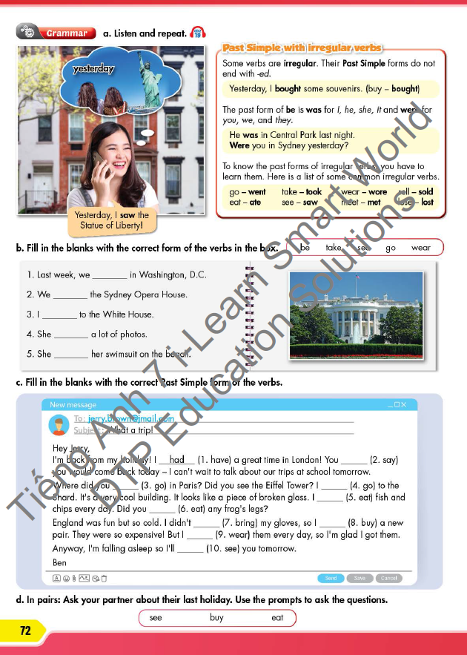


LESSON OUTLINE
Consolidation

Slide 3

By the end of this lesson, students will be able to…
use Past Simple with irregular verbs correctly.

Slide 4

Past Simple

Slide 5

WARM-UP

Slide 6


Click on the icon to hear the sound
Work in pairs.
Answer the questions:
1. What is the woman in the picture doing?
2. What did she see yesterday?
Suggested answer:
She is talking on the phone.
She saw the Statue of Liberty.

Slide 7



Slide 8
PRESENTATION
Past simple with irregular verbs

Slide 9
Rules
Some verbs are irregular.
Their Past Simple forms do not end with -ed.
E.g. Yesterday, I bought some souvenirs. (buy – bought)
The past form of be:
I, he, she, it + was.
you, we, they + were.
E.g. He was in Central Park last night.
Were you in Sydney yesterday?

Slide 10
Irregular verbs
Write the past simple of some common irregular verbs:
go
eat
take
see
wear
meet
sell
lose
went
ate
took
saw
wore
met
sold
lost

Slide 11

PRACTICE

Slide 12

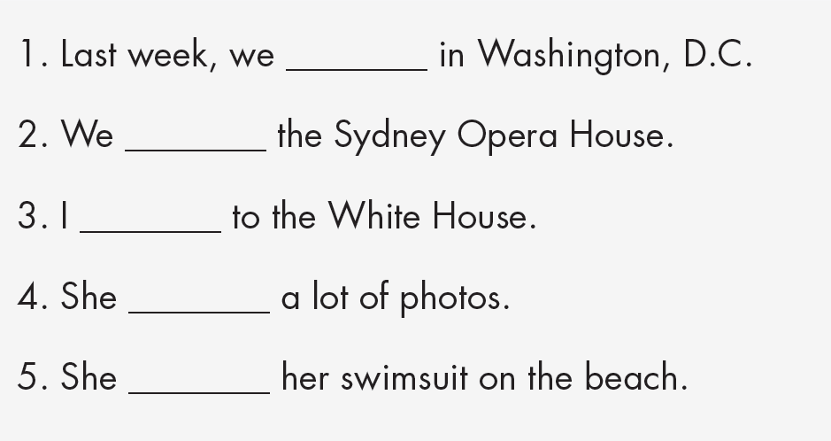
Fill in the blanks with the correct form of the verbs in the box.
were
saw
went
took
wore

Slide 13

Fill in the blanks with the correct Past Simple form of the verbs.
Hey Jerry,
I'm back from my holiday! I had (1. have) a great time in London! You ______ (2. say) you would come back today – I can't wait to talk about our trips at school tomorrow. Where did you ______ (3. go) in Paris? Did you see the Eiffel Tower? I ______ (4. go) to the Shard. It's a very cool building. It looks like a piece of broken glass. I ______ (5. eat) fish and chips every day. Did you ______ (6. eat) any frog's legs?
England was fun but so cold. I didn't ______ (7. bring) my gloves, so I ______ (8. buy) a new pair. They were so expensive! But I ______ (9. wear) them every day, so I'm glad I got them. Anyway, I'm falling asleep so I'll ______ (10. see) you tomorrow.
Ben
said
go
went
ate
eat
bring
bought
wore
see

Slide 14

FURTHER PRACTICE

Slide 15
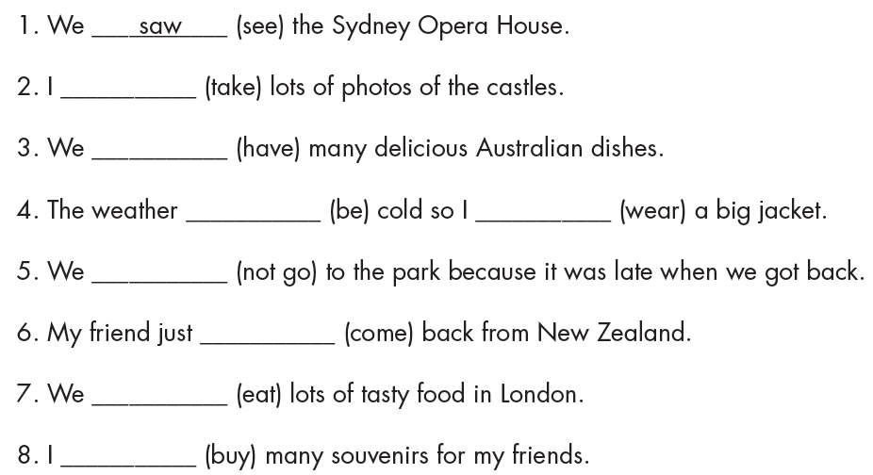

Fill in the blanks with the Past Simple form of the verbs.
Extra Practice
WB, page 53
Click on the icon to check answers
took
had
was
wore
didn’t go
came
ate
bought

Slide 16
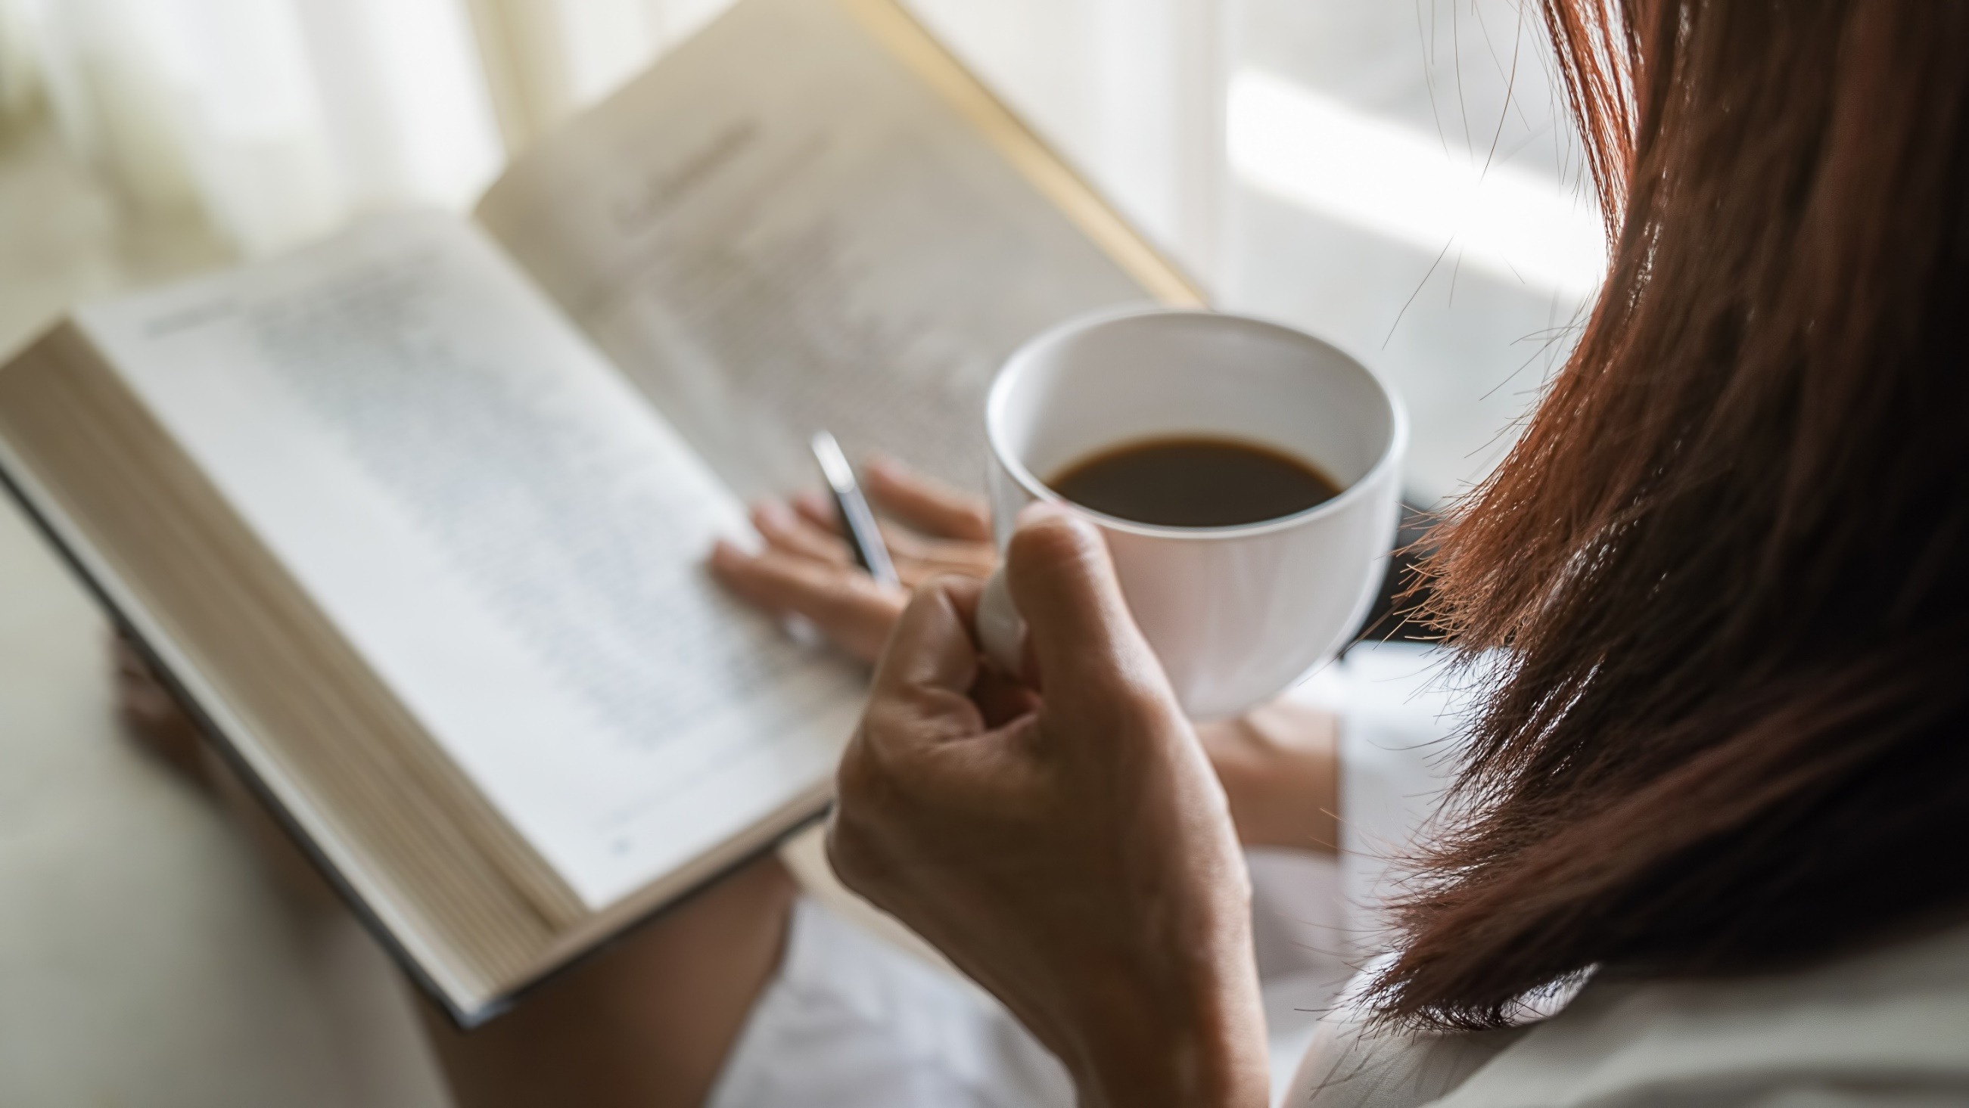
PRODUCTION

Slide 17
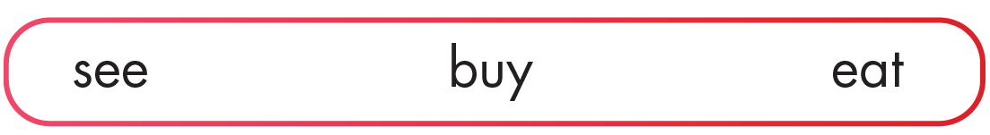
d. In pairs: Ask your partner about their last holiday. Use the prompts to ask the questions.

Slide 18
Answer the questions.
Extra Practice
WB, page 53
1. Where did you go on your last vacation?
____________________________________________
2. What did you do on your trip?
____________________________________________
3. Did you buy anything? What did you buy?
____________________________________________
4. Did you try any new food? Which was your favorite?
Which didn't you like?
____________________________________________

Slide 19

CONSOLIDATION

Slide 20
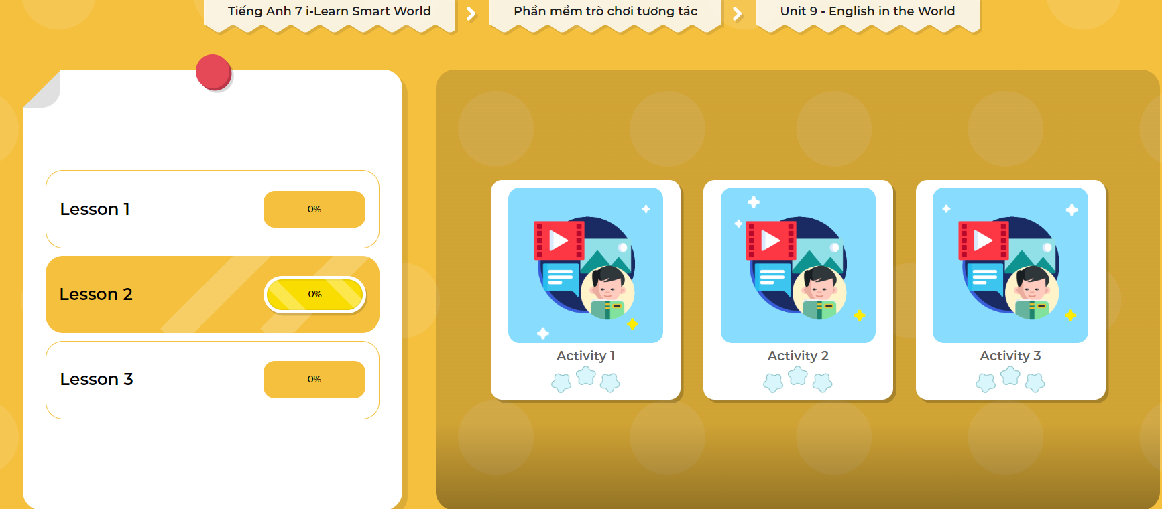
LET’S PLAY!
Click here to play the games!

Slide 21

How was your last vacation?
Write 60 to 80 words.

Slide 22

WRAP-UP

Slide 23
Today’s lesson
Past Simple with irregular verbs
Some verbs are irregular.
Their Past Simple forms do not end with -ed.
The past form of be:
I, he, she, it + was.
you, we, they + were.

Slide 24
Homework
Practice making sentences, using Past Simple.
Complete the grammar notes in Tiếng Anh 7 i-Learn Smart World Notebook (page 57).
Prepare the next lesson (page 73 SB).
Play the consolidation games in Tiếng Anh 7 i-Learn Smart World DHA App on www.eduhome.com.vn

Slide 25

Lesson 3
Stay positive and have a nice day!

