Slide 1


ENGLISH 7
UNIT 15: GOING OUT
A – VIDEO GAMES (A1)
Teacher:

Slide 2

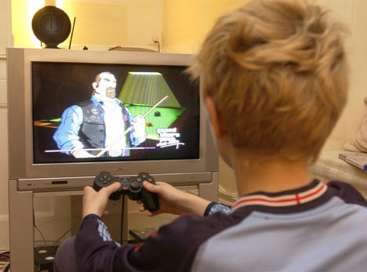
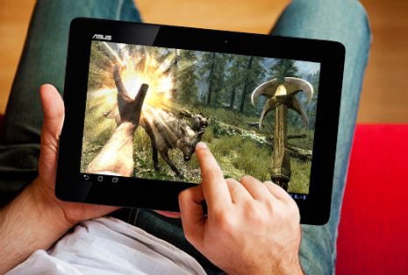
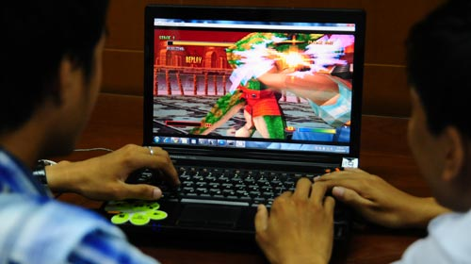
- What are they doing?
Do you like playing video games?
- How often do you often play video games?

Slide 3
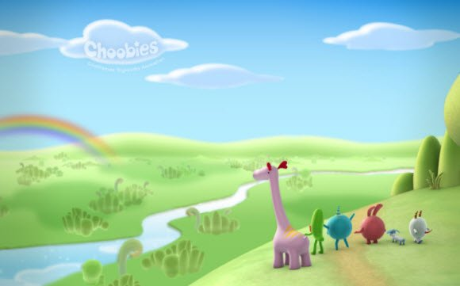



PERIOD 96: A – VIDEO GAMES (A1)
UNIT 15: GOING OUT

Slide 4
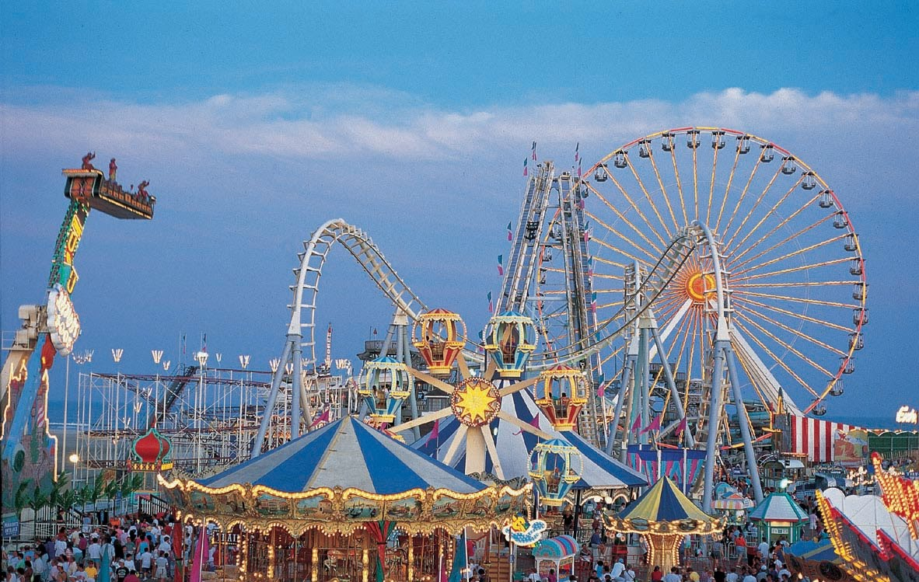
Amusement Center

Slide 5
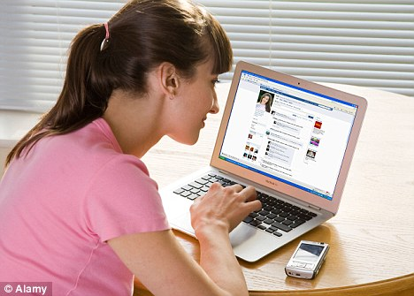
Ex: The internet can be additive

Slide 6
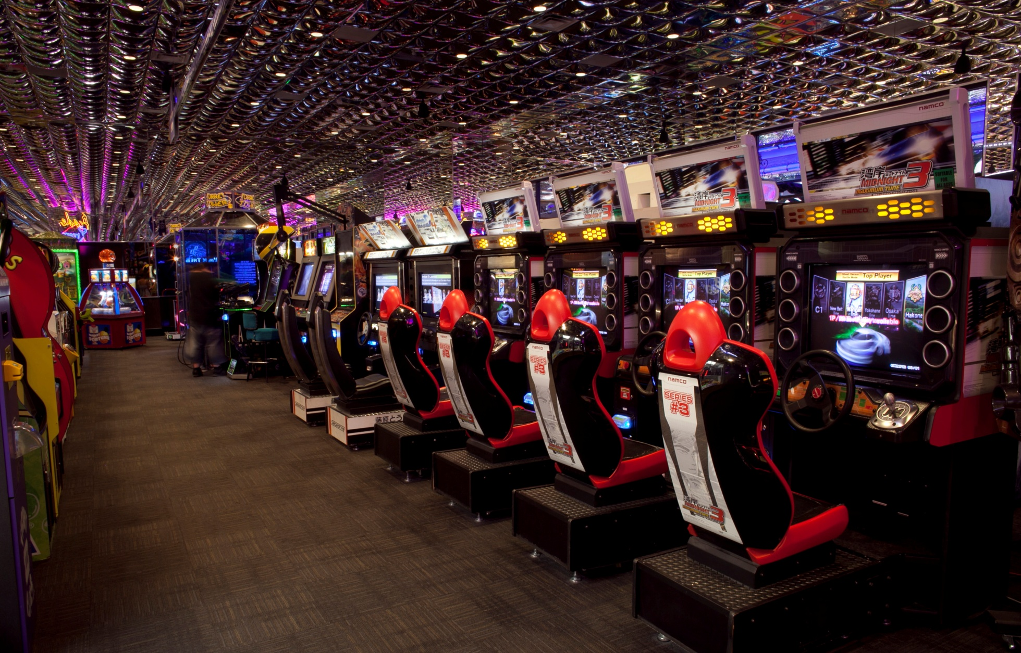
Arcade

Slide 7

I. New words:
Unit 15 : GOING OUT
Period 96: A. Video games (1)
Amusement center (n)
- Addictive (adj)
- Arcade (n)
: khu vui chơi giải trí
: (có tính) gây nghiện
: khu vui chơi, mua bán có mái vòm.

Slide 8
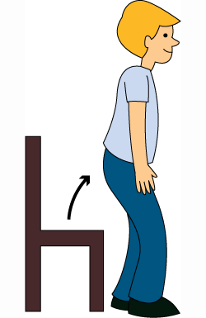
Stand up

Slide 9
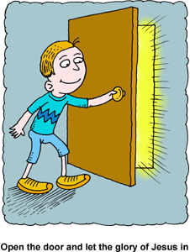
Open the door

Slide 10
II. Structure
Ex:
Don’t talk in class.
Form:
Don’t + bare infinitive …

Slide 11
Exercise1: Now, use these suggest to make the imperatives.
EX: Don’t stay up late.
Go over night.
Forget to do your homework.
Go to class late.
Play football in the street.

Slide 12
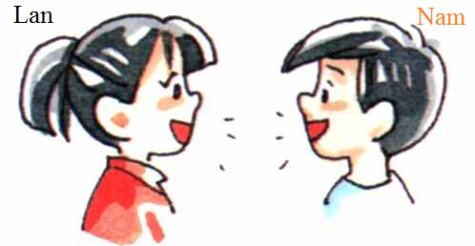
III. Listen. Then practice with a partner :
Lan : Where are you going , Nam ?
Nam : I’m going to the amusement center. I’m going to play video games there.
Lan : How often do you go ?
Nam : Not often. About once a week.
Lan: Isn’t it expensive ?
Nam : Not really. I usually stay for an hour . I don’t spend much.
Lan : You must be careful. Video games can be addictive. Don’t spend too much of your time in the arcade.
Nam : Don’t worry, I won’t .I have a lot of homework to do tonight, so I can only play games for a short time.

Slide 13
IV. Answer the questions :
a. Where is Nam going?
b. What is he going to do?
c. How often does he go?
d. Does he spend a lot of money?
e. How long does he usually stay?
f. Why must Nam be careful?
g. What will Nam do later?

Slide 14
a. Where is Nam going?
-He’s going to the amusement center.

Slide 15
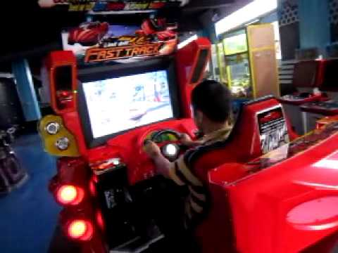
b. What is he going to do?
- He’s going to play video games.

Slide 16

c. How often does he go?
- He goes to the amusement center about once a week.

Slide 17
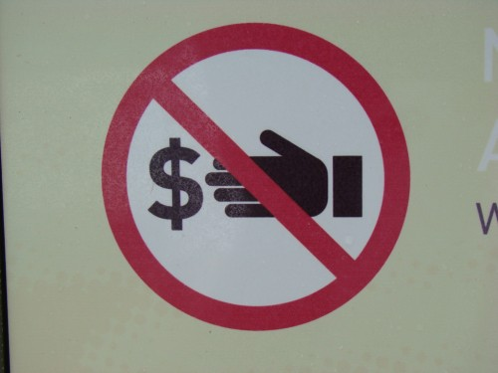
d. Does he spend a lot of money?
- No, he doesn’t. He doesn’t spend much money.

Slide 18

e. How long does he usually stay?
He usually stays for about half an hour.

Slide 19
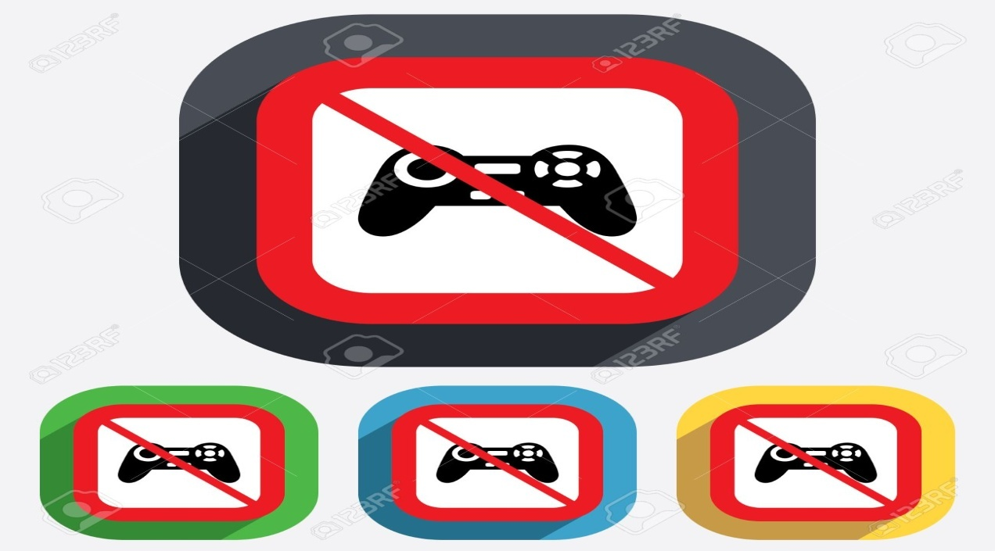
f. Why must Nam be careful?
Nam must be careful because video games can be addictive.

Slide 20
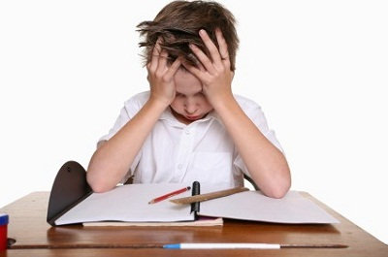
g. What will Nam do later?
He'll do his homework later.

Slide 21
Answer keys:
He’s going to the amusement center.
He’s going to play video games.
He goes to the amusement center about once a week.
No, he doesn’t. He doesn’t spend much money.
He usually stays for about half an hour.
Nam must be careful because video games can be addictive.
He'll do his homework later.

Slide 22
Exercise 3: Discuss. Find out the bad effects of video games :
Eyesore
Tired.
Headache
Waste time and money.
….

Slide 23
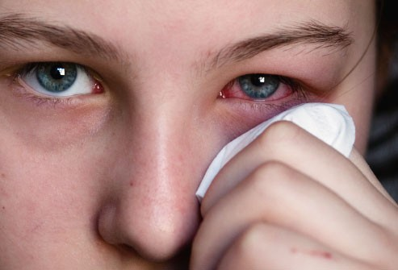
Eyesores

Slide 24
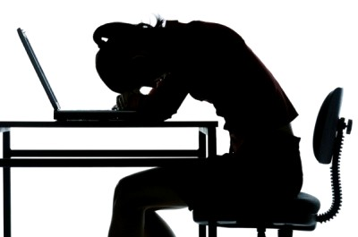
Tired.

Slide 25

Headache

Slide 26
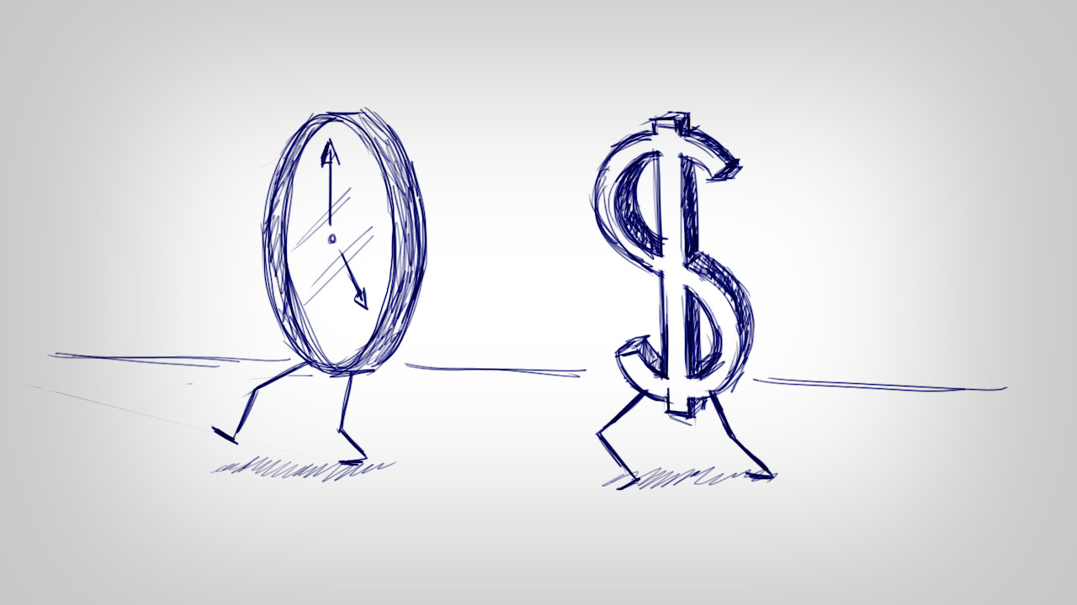
Waste time and money.

Slide 27
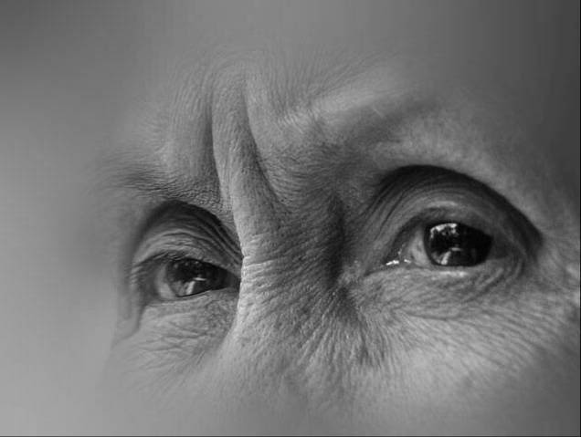


Some bad effects
make parents upset
learn worse
Backache

Slide 28


HOME WORKS
Learn by heart the new words and the new structure.
Prepare the new lesson: Unit 15: A2

Slide 29






Thank you very much
for your attention.

