Slide 1

Unit 5: London Was Great!
Overview
Pages 86 & 87

Slide 2
Lesson Outline
Warm-up
Vocabulary
Listening
Consolidation
Wrap-up

Slide 3
Objectives
By the end of this lesson, students will be able to…
- learn vocabulary about famous people: actor, actress, painter, writer, physicist, stateswoman, singer, queen, princess.
listen for specific information.
practise saying dates.
talk about famous people.

Slide 4

WARM-UP

Slide 5
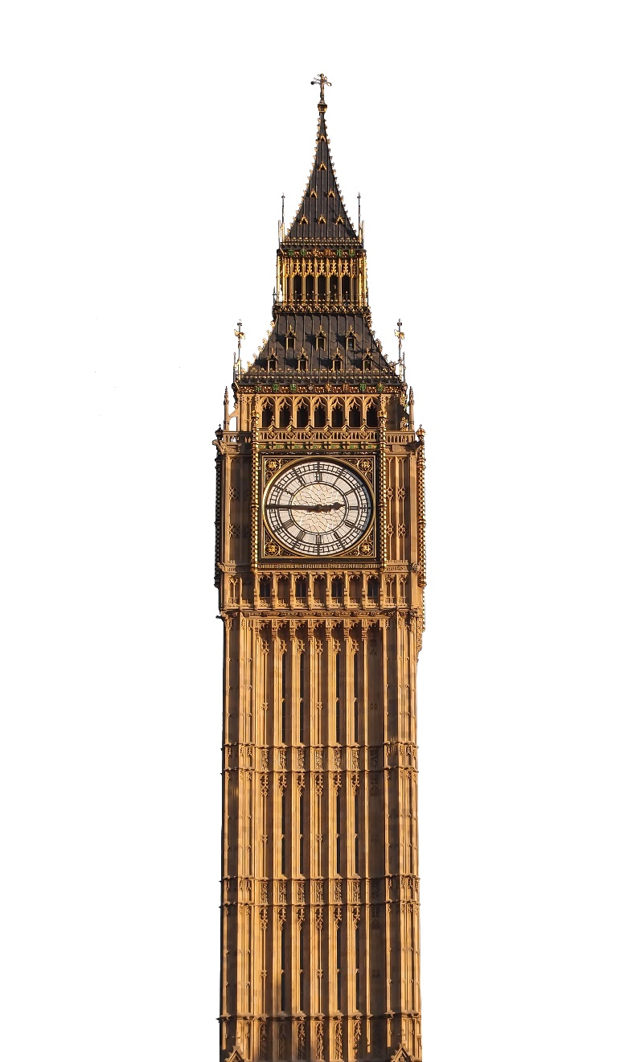
Do you know it?
Big Ben tower

Slide 6
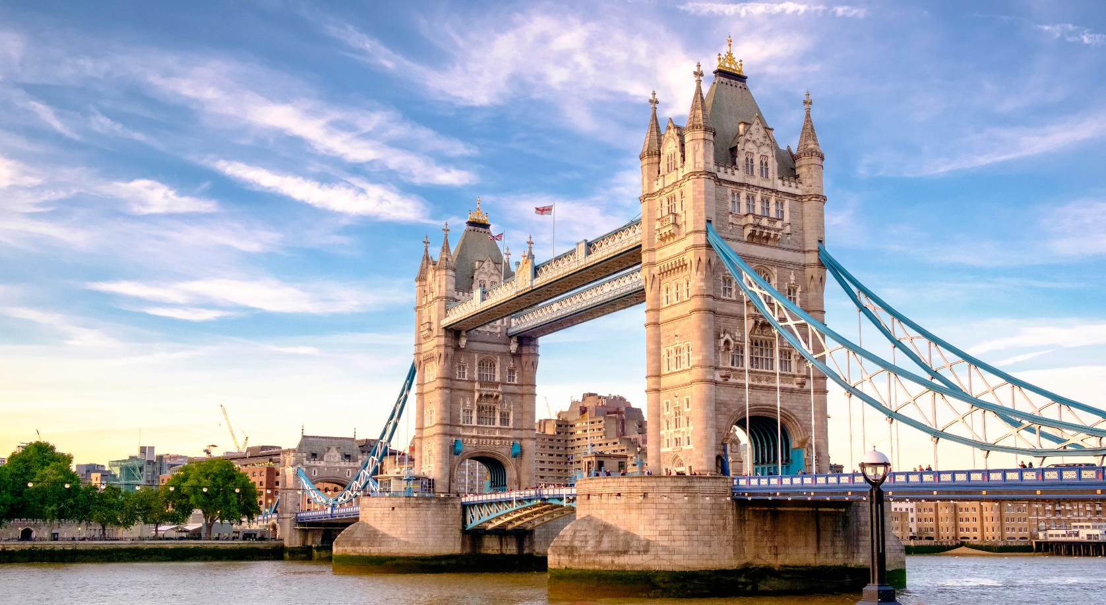
Do you know it?
Golden Bridge

Slide 7
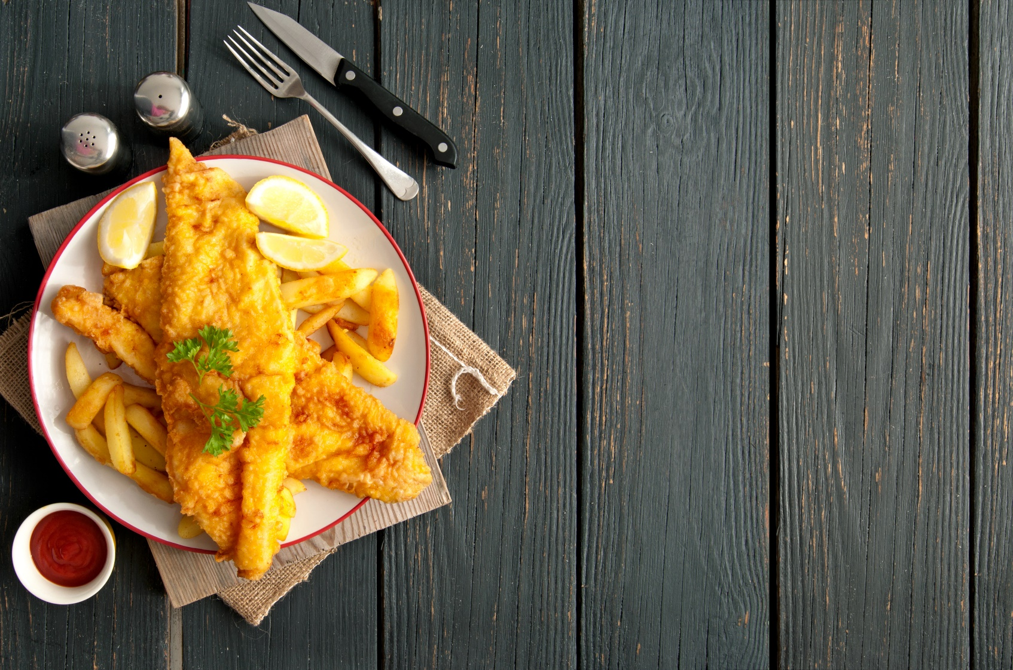
Do you know it?
Fish and chips

Slide 8
Which city are we talking about?

Slide 9

Work in pairs.
Do you know any famous people?
Where are they from?

Slide 10

It’s time to learn …

Slide 11
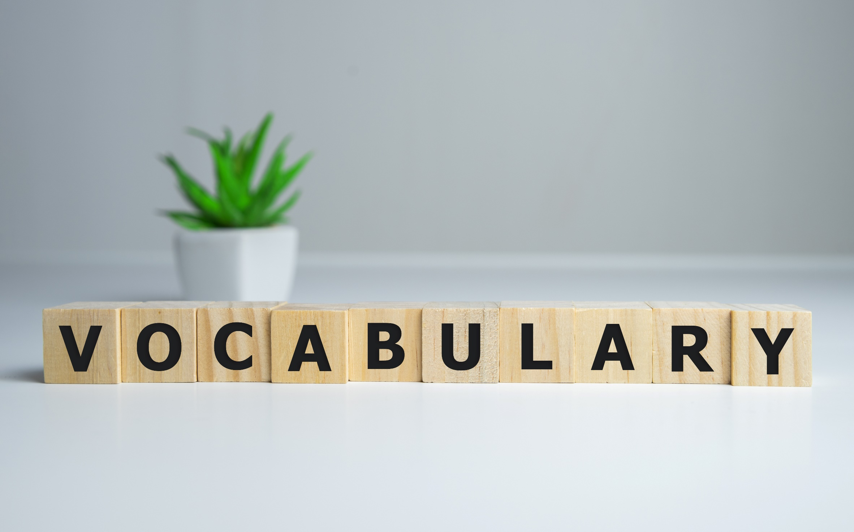


Slide 12

New words
actor, actress,
painter, writer, physicist, stateswoman, singer, queen, princess

Slide 13

Listen and repeat. (Click each word to hear the sound)
actor (n) /ˈæktə/ diễn viên nam
actress (n) /ˈaktrəs/ diễn viên nữ
painter (n) /ˈpeɪntə/ họa sĩ
writer (n) /ˈraɪtə/ nhà văn
physicist (n) /ˈfɪzɪsɪst/ nhà vật lý học
stateswoman (n) /ˈsteɪtswʊmən/ nữ chính khách
singer (n) /ˈsɪŋə/ ca sĩ
queen (n) /kwiːn/ nữ hoàng, hoàng hậu
princess (n) /prɪnˈses/ công nương, công chúa
Notes:
GV click vào từng cụm nghe âm thanh

Slide 14
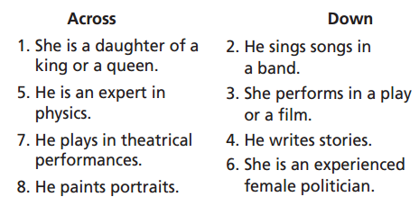
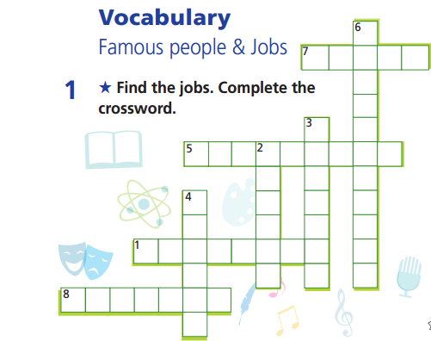
Extra practice-WB p. 44
Answer:
Across:
1. princess
5. physicist
7. actor
8. painter
Down:
2. singer
3. actress
4. writer
6. stateswoman

Slide 15

Listening

Slide 16
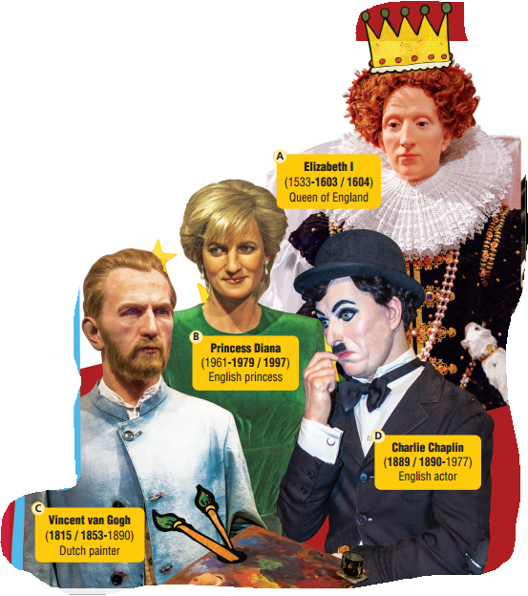
Pre-Listening
Do you know who they are?

Slide 17
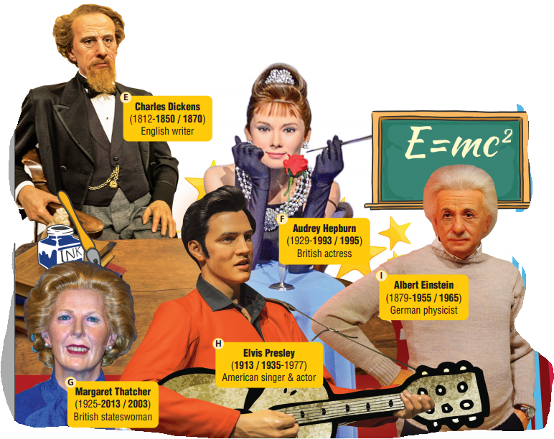
Pre-Listening
Do you know who they are?

Slide 18
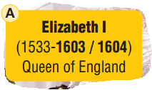
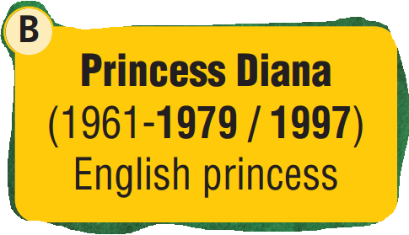
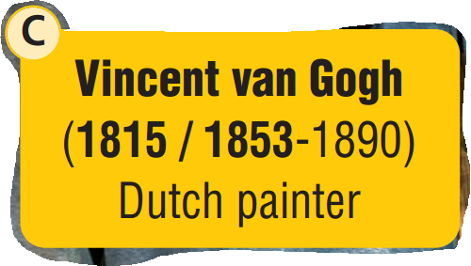
Read the instruction quickly. Underline the key words.
Listen and circle the correct year.
Pre-Listening
Born or
Died?

Slide 19
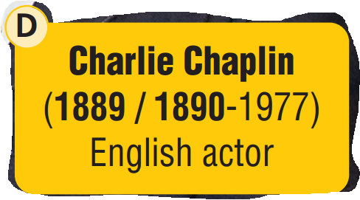
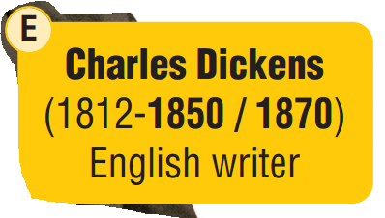
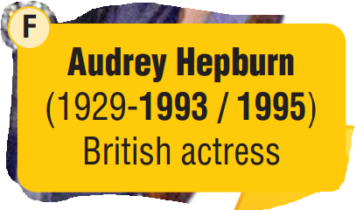
Read the instruction quickly. Underline the key words.
Listen and circle the correct year.
Pre-Listening
Born or
Died?

Slide 20
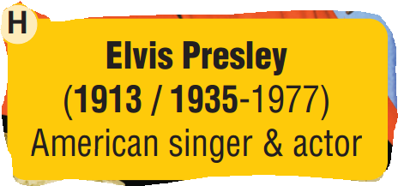
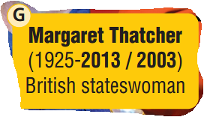
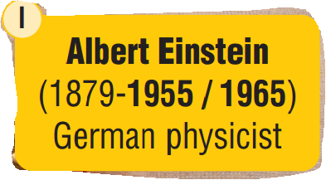
Read the instruction quickly. Underline the key words.
Listen and circle the correct year.
Pre-Listening
Born or
Died?

Slide 21
While-Listening
Now listen and circle the correct answer.  FIRST TIME
☞ YOUR ANSWER?
☞ WHY?

Slide 22
While-Listening
Now listen and circle the correct answer.  FIRST TIME
☞ YOUR ANSWER?
☞ WHY?

Slide 23

While-Listening
Now listen and circle the correct answer.  FIRST TIME
☞ YOUR ANSWER?
☞ WHY?

Slide 24

While - listening
Now listen again and check.  SECOND TIME
M1: ……, but when did she die? Was it in 1603 or 1604? Yes, Mark?
M2: She died in 1603.
M1: That’s … correct!

Slide 25
While - listening
Now listen again and check.  SECOND TIME
M1: …… When did she die? 1979 or 1997? Mark?
M2: She died in 1997.
M1: That’s correct!

Slide 26
While - listening
Now listen again and check.  SECOND TIME
M1: Next, Vincent van Gogh, the Dutch
painter, died in 1890, but when was he born? Was
it in 1815 or 1853? Fiona, what do you think?
F: It was in 1853.
M1: That’s right!

Slide 27
While - listening
Now listen again and check.  SECOND TIME
M1: Now, Charlie Chaplin, the English actor. He died in 1977,
but when was he born? Was it in 1889 or 1890? Fiona again.
F: It was in 1890.
M1: That’s … wrong, I’m afraid. The correct answer is 1889.

Slide 28
While - listening
Now listen again and check.  SECOND TIME
M1: Question 5 is about Charles Dickens, the English writer.
He was born in 1812. When did he die – 1850 or 1870? Yes, Mark?
M2: He died in 1870.
M1: Correct again, Mark!

Slide 29
While - listening
Now listen again and check.  SECOND TIME
M1: Next is Audrey Hepburn, the famous British actress.
She was born in 1929 but when did she die? 1993 or 1995?
Yes, Fiona?
F: 1993
M1: Correct Fiona.

Slide 30
While - listening
Now listen again and check.  SECOND TIME
M1: Next question, Margaret Thatcher, the famous British stateswoman, was born in 1925. When did she die? Was it
2013 or 2003? Yes, Mark.
M2: She died in 2013.
M1: Correct again, Mark!

Slide 31
While - listening
Now listen again and check.  SECOND TIME
M1: Next is Elvis Presley, the American singer and actor.
He died in 1977. When was he born? Was it in 1913 or 1935?
Fiona, you were first.
F: It was in 1935.
M1: Well done, Fiona.

Slide 32
While - listening
Now listen again and check.  SECOND TIME
M1: OK, last question of this part. Albert Einstein was a German
physicist. He was born in 1879, but when did he die? 1955 or 1965? Mark …
M2: I think it was 1965.
M1: Sorry, Mark, but that’s not correct. The answer is 1955.

Slide 33
Listen again and complete the answers.
Extra task
1. Who is Queen Elizabeth I?
→ She is _______________________.
2. Who is Princess Diana?
→ She was a member of the _______________________ and mother of Prince William and Prince Harry.
3. How old was Vincent van Gogh when he died?
→ He was _______________________.
4. When did Charlie Chaplin die?
→ He did in _______________________.
5. When was Charles Dickens born?
→ He was born in _______________________.
6. What job did Audrey Hepburn do?
→ She was a/an _______________________.
7. How many points did Fiona and Mark get?
→ They both got _______________________.
the Queen of England
the British royal family
37
1977
1812
actress
three points

Slide 34
M1: So the next part of our quiz is about famous people. Question 1: Queen Elizabeth I, the Queen of England, was born in 1533, but when did she die? Was it in 1603 or 1604? Yes, Mark?
M2: She died in 1603.
M1: That’s ... correct! Next, Princess Diana was a member of the British royal family and mother of Prince William and Prince Harry. She was born in 1961. When did she die? 1979 or 1997? Mark?
M2: She died in 1997.
M1: That’s correct! Next, Vincent van Gogh, the Dutch
painter, died in 1890, but when was he born? Was it in 1815 or 1853? Fiona, what do you think?
F: It was in 1853.
M1: That’s right! He was just 37 when he died. Now,
Charlie Chaplin, the English actor. He died in 1977,
but when was he born? Was it in 1889 or 1890? Fiona again.
F: It was in 1890.
M1: That’s … wrong, I’m afraid. The correct answer is 1889. Question 5 is about Charles Dickens, the English writer. He was born in 1812. When did he die – 1850 or 1870? Yes, Mark?
M2: He died in 1870.
M1: Correct again, Mark! Next is Audrey Hepburn, the famous British actress. She was born in 1929 but when did she die? 1993 or 1995? Yes, Fiona?
F: 1993
M1: Correct Fiona. Next question, Margaret Thatcher, the famous British stateswoman, was born in 1925. When did she die? Was it 2013 or 2003? Yes, Mark.
M2: She died in 2013.
M1: Correct again, Mark! Next is Elvis Presley, the American singer and actor. He died in 1977. When was he born? Was it in 1913 or 1935? Fiona, you were first.
F: It was in 1935.
M1: Well done, Fiona. You needed that point. OK, last question of this part. Albert Einstein was a German physicist. He was born in 1879, but when did he die? 1955 or 1965? Mark …
M2: I think it was 1965.
M1: Sorry, Mark, but that’s not correct. The answer is 1955. And that’s the end of this part. You both got three points there…

Slide 35
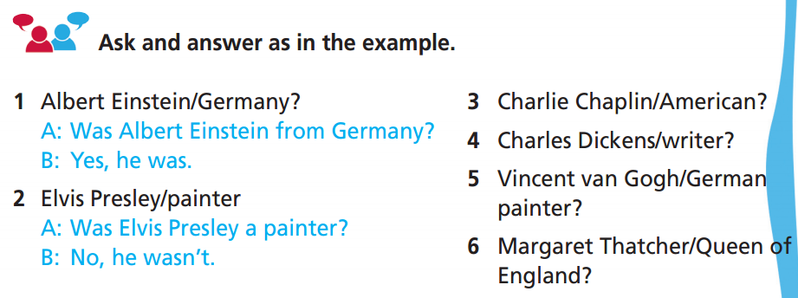
Post-listening:

Slide 36
Post-listening:
3 Charlie Chaplin/American?
______________________________________
4 Charles Dickens/writer?
______________________________________
5 Vincent van Gogh/German painter?
______________________________________
6 Margaret Thatcher/Queen of England?
______________________________________
A: Was Charlie Chaplin American? B: No, he wasn’t.
A: Was Charles Dicken a writer? B: Yes, he was.
A: Was Vincent van Gogh a German painter? B: No, he wasn’t.
A: Was Margaret Thatcher the Queen of England? B: No, she wasn’t.

Slide 37
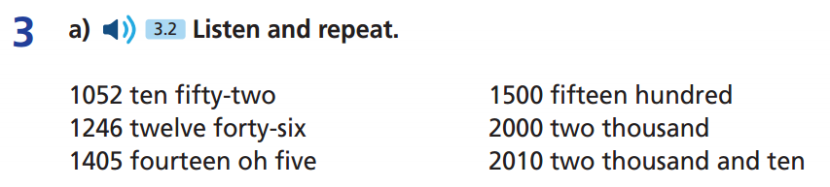

Slide 38
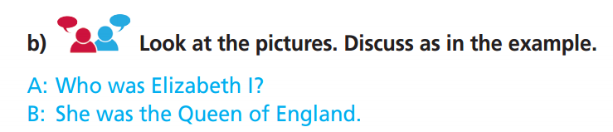

Slide 39
Work in pairs. Practice the conversation and complete the information in the table
 | Who?
Princess Diana
Charlie Chaplin
Vincent van Gogh
Charles Dickens
Margaret Thatcher
Albert Einstein
Elvis Presley
Audrey Hepburn

Slide 40
Work in pairs. Take turns to ask and answer about a famous person you know.
A: I’m thinking about ……..
B: Who was he/she?
A: He/She was a/an……..
B: When was he/she born?
A: He/She was born in…..
B: When did he/she die?
A: He/She died in…..

Slide 41

CONSOLIDATION

Slide 42
Write some sentences about a famous person you remember from the lesson. Try to answer these questions:
Who are you writing about?
Who was that person?
When was he/she born?
When did he/she die?

Slide 43

WRAP-UP

Slide 44
Today’s lesson
Listening
Listen for details.
Vocabulary
actor actress
singer painter
physicist stateswomen
queen princess
writer
Speaking
Practise saying dates.
Talking about famous people.

Slide 45
Homework
Practise the vocabulary and make sentences using them.
Do the exercises in TA 6 Right on WB (p. 44).
Prepare for the next lesson (p. 88 SB).
Do the exercise in TA 6 Right on Notebook (pp. 44 & 45).

Slide 46
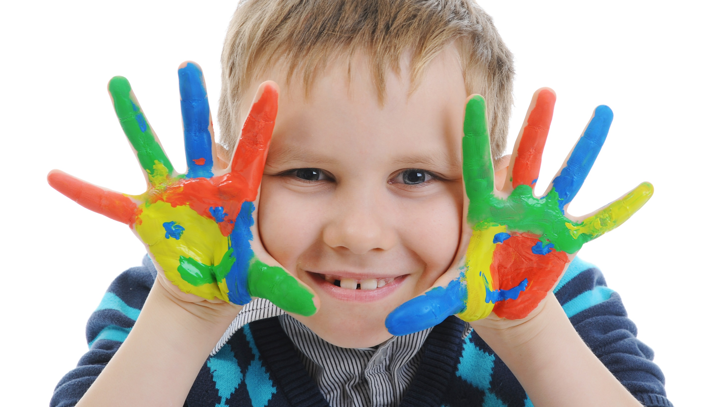
Enjoy your day!

