Slide 2





Unit 9
CAREER PATHS
WRITING YOUR CV
LESSON 6
WRITING

Slide 3


LESSON 6
WRITING
WARM-UP
Warm-up: Quiz
PRE-WRITING
Task 1: Work in pairs
WHILE-WRITING
Task 2: Write your own CV
POST-WRITING
Wrap-up
Homework
CONSOLIDATION

Slide 4

WARM-UP
CHOOSE
THE
CORRECT
INFORMATION
ABOUT
WRITING
YOUR CV

Slide 5

1. What does CV stand for?
Central Vision
Curriculum Vitae
Career Venture
Current Validation

Slide 6
2. Which of the following is NOT typically included in a CV?
Personal statement
Hobbies and interests
Education History
Social media passwords

Slide 7
3. What is the purpose of a personal statement on a CV?
To list educational achievements
To include contact information
To provide a brief summary of skills and goals
To showcase professional experience

Slide 8
4. How should you format your CV to make it visual appealing and easy to read?
Use a tiny font to fit more information
Avoid using headings and subheadings
Print it in color to stand out
Organize information with clear headings and bullet points

Slide 9
5. Which section of the CV should include your academic qualifications and achievements?
Education
Work experience
Hobbies and interests
Personal statement

Slide 10
6. What should you include in the "Work Experience" section of your CV?
Details about relevant jobs, internships, or volunteer experiences
Your favorite food
Your favorite TV shows
A list of friends

Slide 11
7. Why is it important to tailor your CV for each job application?
It's not necessary; a generic CV works for all jobs
To include every detail about yourself
To save time in the application process
To showcase specific skills and experiences relevant to the job

Slide 12
8. How far back in time should you go when listing work experience on a CV?
Only include the most recent job
Limit to the last 10-15 years
Exclude all work experience
Include every job, regardless of how long ago

Slide 13
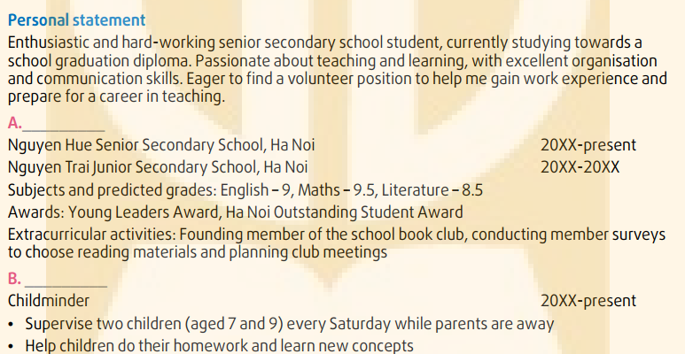
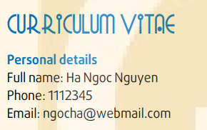
PRE-WRITING
1
Work in pairs. Look at the following job advert and the CV of a student applying for the job. Match the headings in the box to the correct sections.

Slide 14

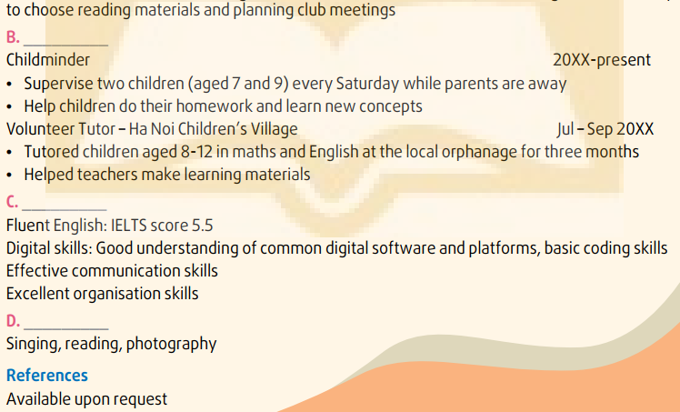
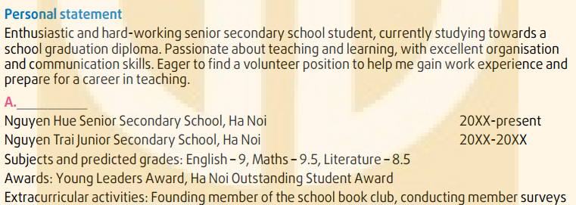
PRE-WRITING
Work experience
Skills
Education and Interests
Hobbies

Slide 15
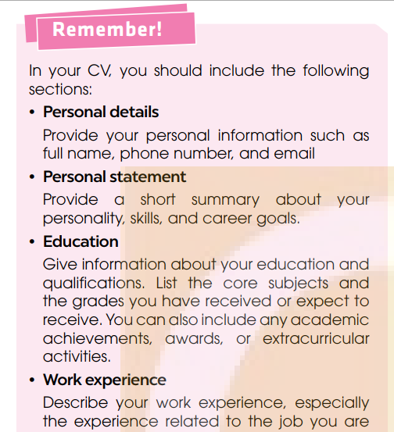
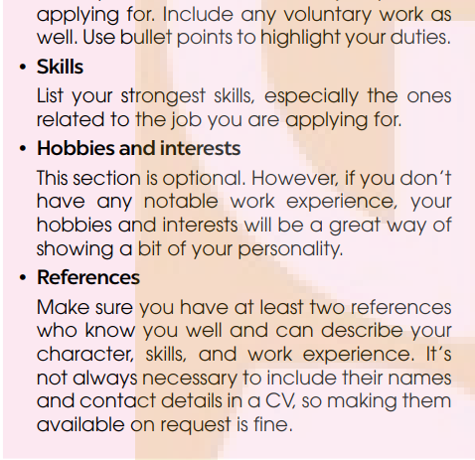
PRE-WRITING

Slide 16



WHILE-WRITING
2
Look at the job advert in 1 again. Imagine that you also want to apply for the job. Write your own CV.

Slide 17
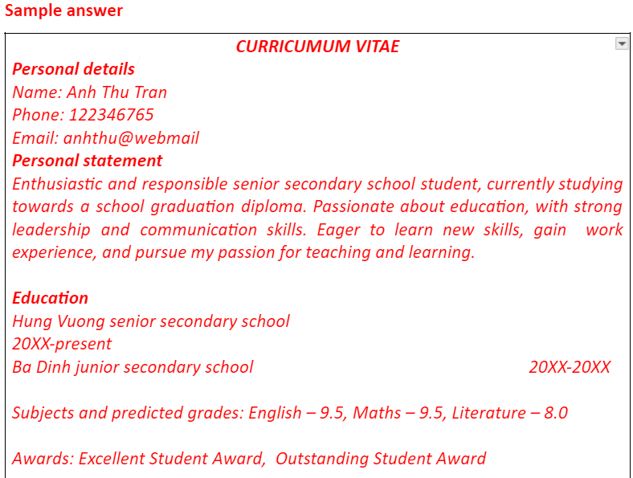
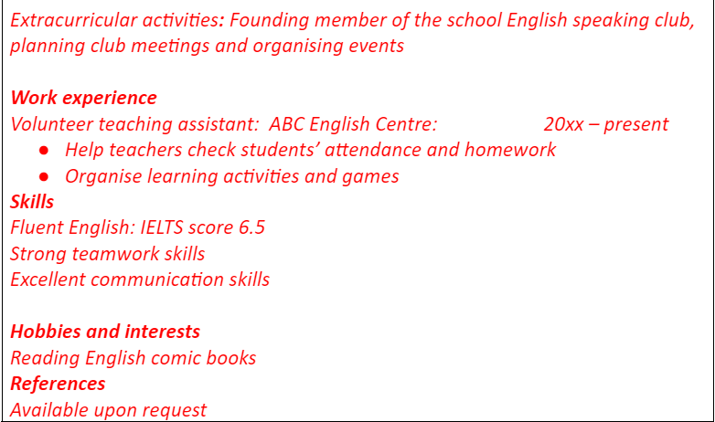
WHILE-WRITING

Slide 18
POST-WRITING
Cross-checking
Suggested writing rubric
1. Organization: …/10
2. Legibility: …/10
3. Ideas: …/10
4. Word choice: …/10
5. Grammar use: …/10
TOTAL: …/50

Slide 19

CONSOLIDATION
1
Wrap-up
What have you learnt today?
Some lexical items about writing CV
Reading for specific information

Slide 20

CONSOLIDATION
2
Homework
Learn new words by heart.
Do exercises in the workbook.
Prepare Lesson 7 – Unit 9.

Slide 21
Website: hoclieu.vn
Fanpage: facebook.com/www.tienganhglobalsuccess.vn

