Slide 1

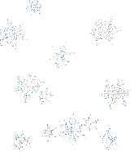

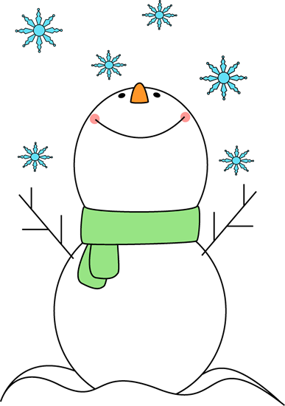
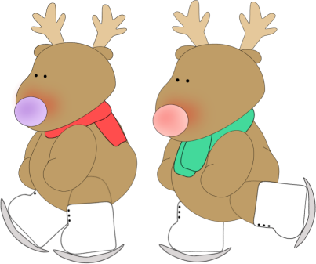
What are they doing?

Slide 2
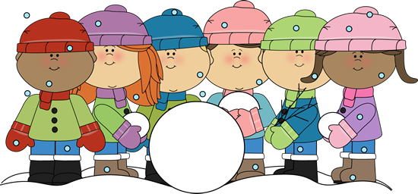
They __________ a snowman.
A. are make
B. are makeing
C. are making

Slide 3
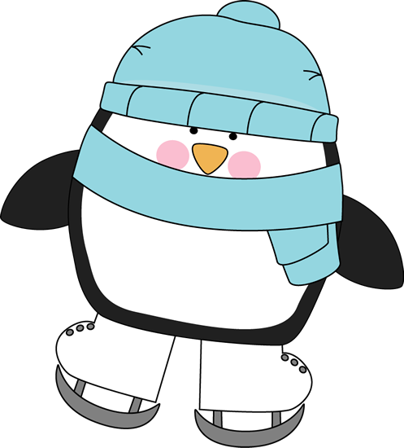
Pinni _________ .
A . is skateing
B . is skiing
C . is skating

Slide 4
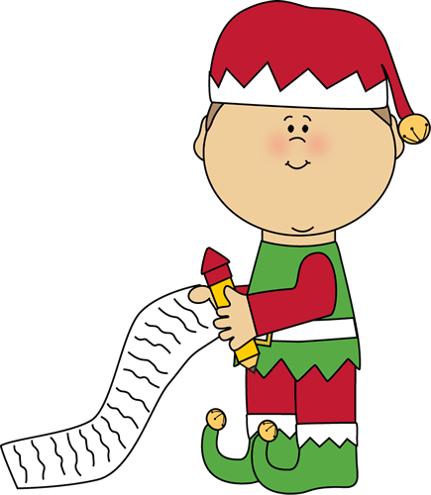
This elf _______
a Christmas list.
A . is writting
B . is writeing
C . is writing

Slide 5
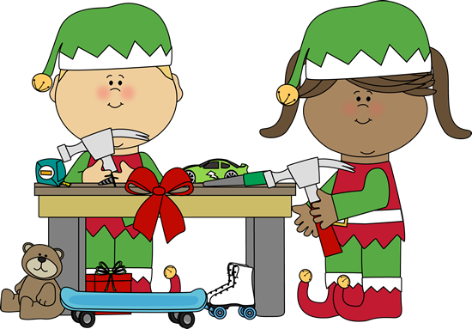
We ________ toys.
A . are making
B . is making
C . are make

Slide 6
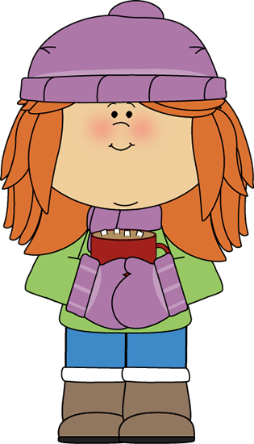
I ________ hot cocoa .
A . is drinking
B . am drinking
C . are drinking

Slide 7
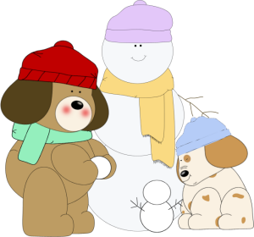
The friends________
outside.
A . are plaing
B . are playing
C . am playing

Slide 8
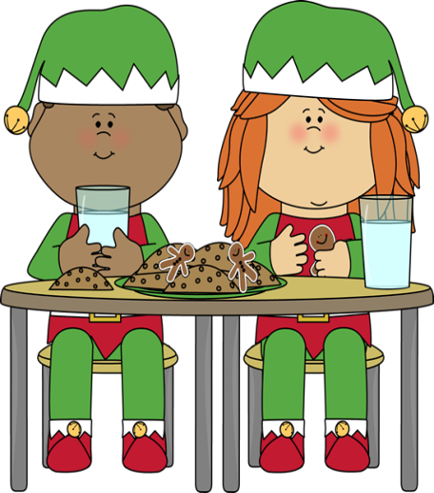
We ______ dinner now .
A . are having
B . having
C . are have

Slide 9
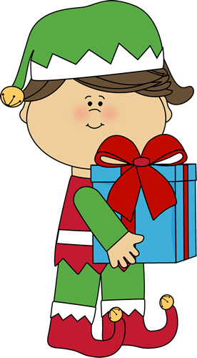
I ______ a Christmas gift.
А . am carrying
B . am carring
C . am carry

Slide 10
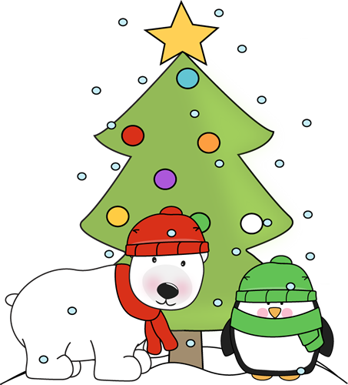
The animals _____
under a Christmas tree.
A . am standing
B . are stand
C . are standing

Slide 11
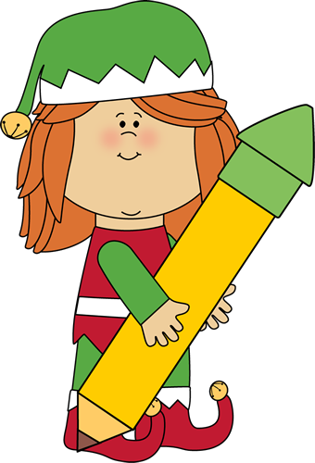
I ______ a big pencil.
A . is holding
B . are holding
C . am holding

Slide 12
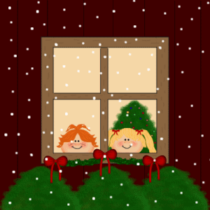
We ________ for a holiday.
A . are wait
B . are waiting
C . are waitting

Slide 13
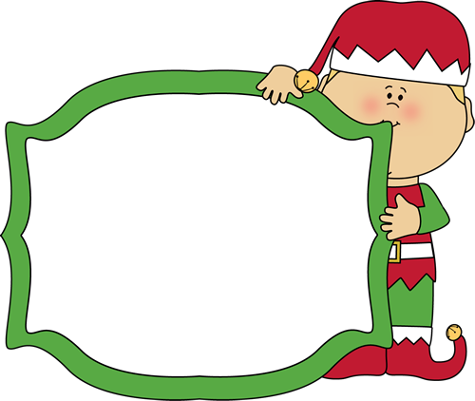
Well done!

Slide 14
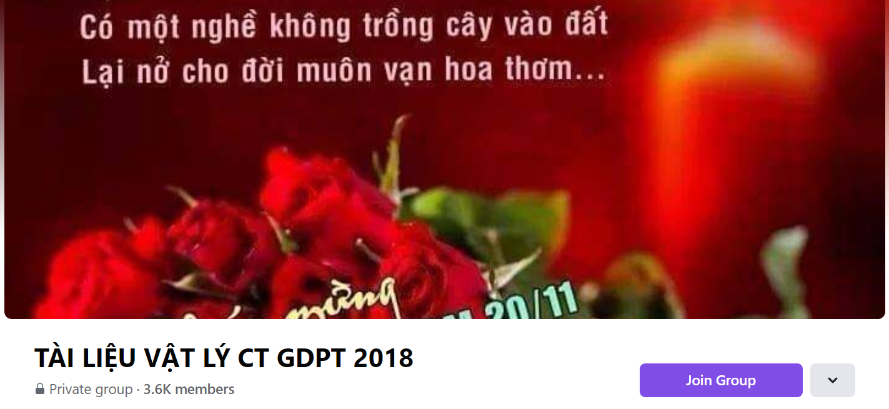
SƯU TẦM: ĐOÀN VĂN DOANH, NAM TRỰC, NAM ĐỊNH
LINK NHÓM DÀNH CHO GV BỘ MÔN VẬT LÝ TRAO ĐỔI TÀI LIỆU VÀ CHUYÊN MÔN CT 2018
https://www.facebook.com/groups/299257004355186

