Slide 1




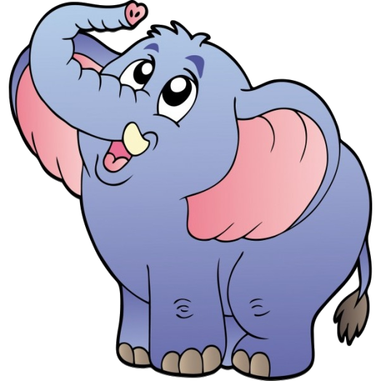





1
2
3
4
5
6
7
8
9
10
11
12
13
14
15
16
17
18
Bomb
19
20
+4
Click
on the
cups
+2

Slide 2
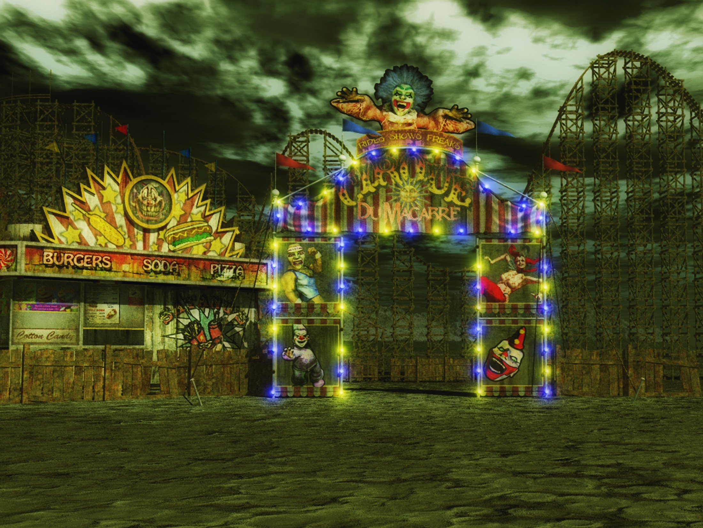


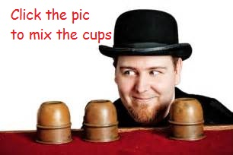
The windmill is moving _____
2
3
slowly.
Notes:
DICE ROLL GAME

Slide 3
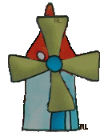
The windmill is moving _____
1
1
quickly.
Notes:
DICE ROLL GAME

Slide 4

The flower is dancing _____
1
1
softly
Notes:
DICE ROLL GAME

Slide 5
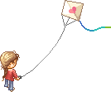
The child is flying the kite _____
1
1
happily
Notes:
DONE

Slide 6


The wind is blowing _____
strongly
Notes:
DONE

Slide 7



The wind is blowing _____
2
3
2
3
gently
Notes:
DONE

Slide 8
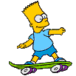
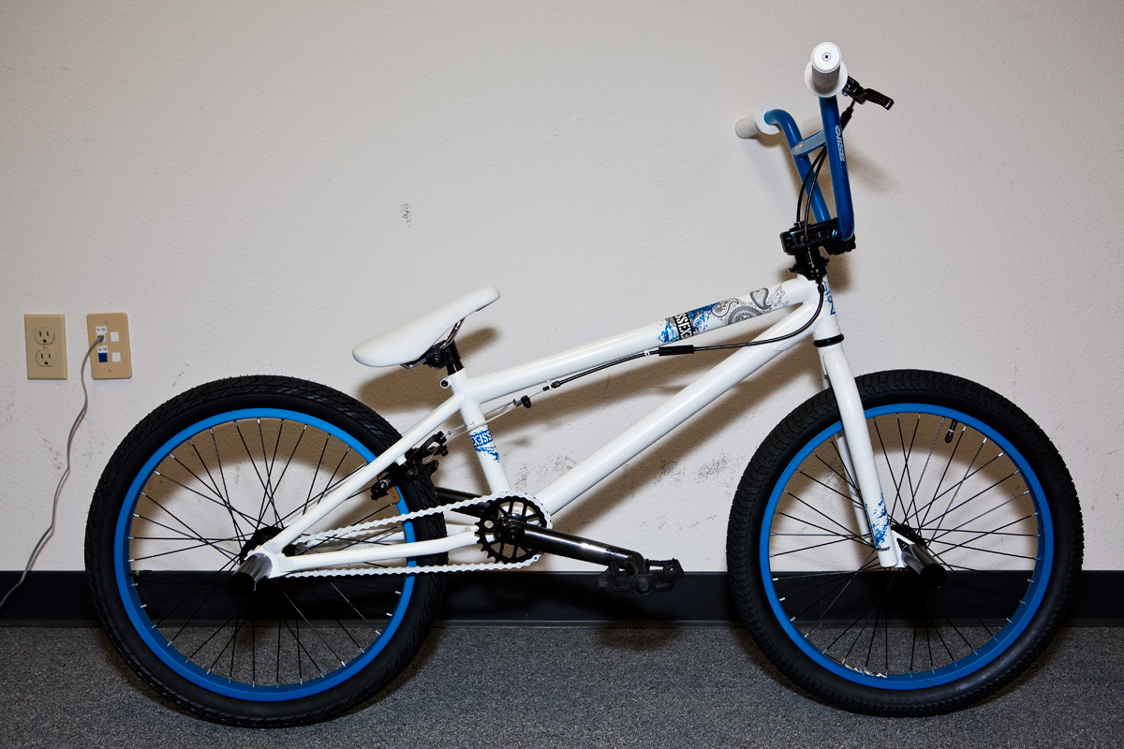
He is skating _____
2
quickly
Notes:
DONE

Slide 9

She is singing _____
happily
Notes:
DONE

Slide 10

She is walking _____
2
2
sadly
Notes:
DONE

Slide 11
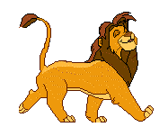
He is walking _____
happily
Notes:
DONE

Slide 12

She is running ____
slowly
Notes:
DONE

Slide 13

She is running ____
2
2
1
3
3
1
quickly
Notes:
DONE

Slide 14
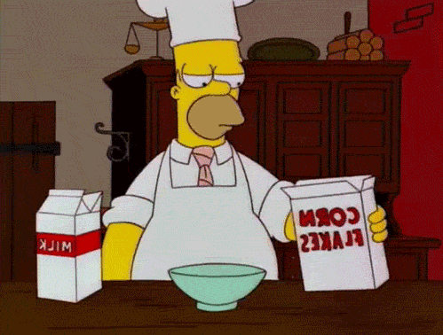
He is cooking ____
badly
Notes:
DONE

Slide 15

He is cooking ____
well
Notes:
DONE

Slide 16
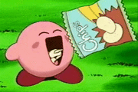
She is eating____
1
hungrily
Notes:
DONE

Slide 17
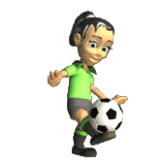
She is kicking the ball ____
3
3
gently / softly
Notes:
DONE

Slide 18
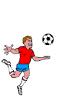
He is kicking the ball ____
strongly
Notes:
DONE

Slide 19

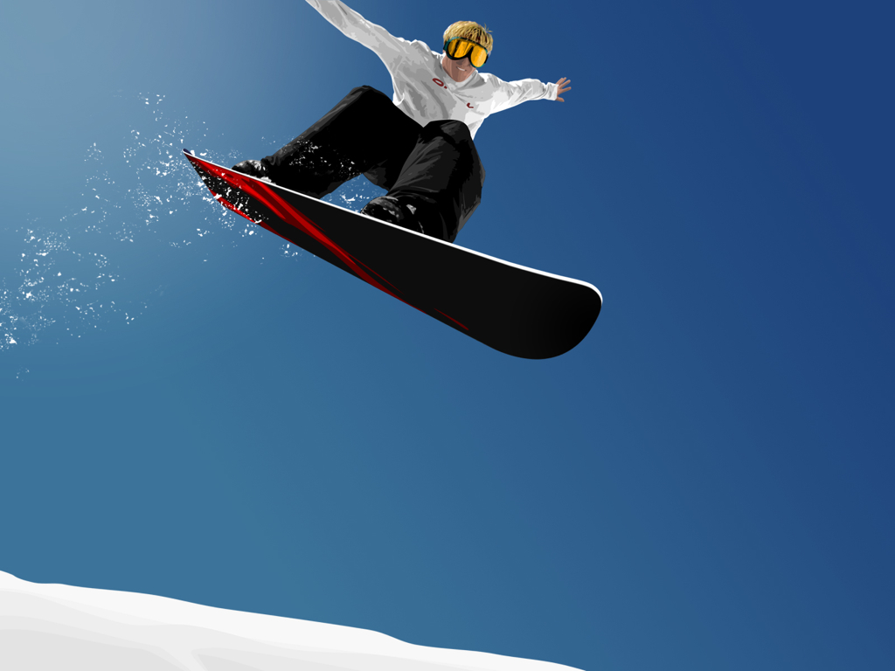
He is reading ____
2
2
quickly
Notes:
DONE

Slide 20

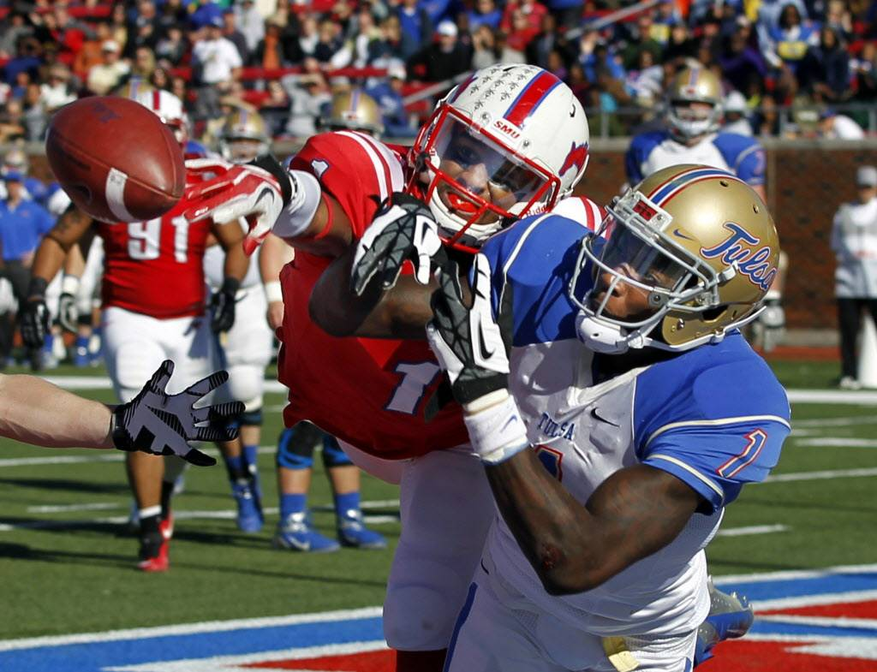
He is writing ____
quickly
Notes:
DONE

Slide 21

It is flying ____
2
slowly
Notes:
DONE

