Slide 1

Unit 3: All About Food
Lesson 3e: Grammar Page 61

Slide 2
Lesson Outline
Warm-up
Presentation
Practise
Production
Consolidation
Wrap-up

Slide 3
Objectives
By the end of this lesson, students will be able to…
- use superlatives correctly.

Slide 4

WARM-UP

Slide 5
Choose the word whose underlined part is pronounced differently form that of the others.
1. A. hate B. add C. taste D. grate
/heɪt/ /æd/ /teɪst/ /ɡreɪt/
2. A. tea B. meat C. bean D. bread
/tiː/ /miːt/ /biːn/ /bred/
3. A. lunch B. child C. chef D. chip
/lʌntʃ/ /tʃaɪld/ /ʃef/ /tʃɪp/

Slide 6
PAIRWORK
Make comparison about these things.
bikes / motorbikes
English / French
city / countryside
potatoes / cucumbers
Vietnam / China
Bikes are slower than motorbikes.

Slide 7

It’s time to learn …

Slide 8

Presentation

Slide 9



Australia: 7.688.000 km²
The USA: 9.834.000 km²
Canada: 9.985.000 km²
Which country is the largest?
Canada is the largest.

Slide 10
Australia: 25,69 million
The USA: 329,5 million
Canada: 38,01 million
Which country is the most crowded?
The USA is the most crowded.

Slide 11
Complete the rules
 | Superlative | Example
short adjectives
long adjectives
the + adj + -EST
the largest
the + MOST + adj
the most crowded

Slide 12
Spelling rules
• adjectives + -est
long – longest
• -e + -st
nice – nicest
• one-syllable adjectives ending in vowel + consonant ➝ double consonant + -est
thin – thinnest
• -y ➝ -y + -iest
happy – happiest

Slide 13
Note:
clever, common, friendly, narrow form their superlative with -est or the most
Ex: friendly – the friendliest/ the most friendly
Irregular adjectives:
Special case: a lot of ➝
good ➝
little ➝
the worst
bad ➝
many/ much ➝
the best
the most
the least
the most

Slide 14

Practise

Slide 15
Write the superlative form.
1 cheap – ________________
2 clever – ________________
3 good – ________________
4 crowded – ________________
5 difficult – ________________
6 spicy – ________________
7 a lot of – ________________
8 a little – ________________
the cheapest
the most difficult
the cleverest/
the most clever
the spiciest
the most
the best
the least
the most crowded

Slide 16
6. Put the adjectives in brackets into the superlative form.
1 Marco’s is ___________________ (popular) restaurant in town.
2 This is ____________________ (easy) dish ever!
3 This café is _____________________ (old) in the area.
4 This is ___________________ (good) place to eat Thai fish pie.
5 This is _____________________ (delicious) dish on the menu.
the most popular
the easiest
the oldest
the best
the most delicious

Slide 17
Look at the table and make sentences, using superlatives.
 | Nam | Hung | Lam
Height | 140 cm | 150 cm | 130 cm
Weight | 55 kg | 50 kg | 45kg
Diet | - Milk (300ml/day) - Fast food (3 times/week) - Vegetables and fruit (no) | - Milk (500ml/day) - Fast food (2 times/week) - Vegetables and fruit (every day) | - Milk (200ml/day) - Fast food (once/week) - Vegetables and fruit (3 times/week)

Slide 18
Possible answers:
Hung is the tallest.
Lam is the shortest.
Nam is the heaviest.
Hung drinks the most milk.
Nam drinks the least milk.
Nam eats the most fast food.
Lam eats the least fast food.

Slide 19
Circle the correct item.
1 Paul’s restaurant is the more/most crowded in the area.
2 Burgers are tastier/tastiest than hot dogs.
3 He is the friendlier/friendliest waiter of all.
4 Dan is taller/tallest than James.
5 This café is the older/oldest in the village.

Slide 20
6 Jane is the prettier/prettiest of all the waitresses here.
7 This restaurant is more/most popular than Jim’s.
8 Niko’s is the bigger/biggest restaurant in the city.
9 This restaurant is one of the most popular/more popular ones in the area.
10 Oranges are juicier than/of apples.

Slide 21
7. Put the adjectives in brackets into the comparative or superlative forms.
1 Mario’s is __________________ (expensive) restaurant in the area.
2 Fruit juices are _________________ (healthy) than sugary drinks.
3 This cake recipe needs _______________ (many) eggs than that one.
4 Ramsay is one of ___________________ (famous) chefs in the world.
5 Thai fish pie is ___________________ (tasty) meal of all.
the most expensive
healthier
more
the most famous
the tastiest

Slide 22

Production

Slide 23
8 Use the adjectives in Exercise 5 in the comparative and superlative form in sentences of your own.
Potatoes are the cheapest food.
My sister is cleverer than me.
That’s the best restaurant in the city!
This restaurant is more crowded than that one.
This is the most difficult recipe in the book.
This dish is the spiciest in the menu.
I’ve got more recipes than Jane.
She has less money than me.

Slide 24

CONSOLIDATION

Slide 25
Write six sentences, comparing the following things. Use comparatives and superlatives correctly.
bananas/ oranges/ strawberries
vegetables/ fast food
your mother/ your father
Da Lat/ Nha Trang/ Phu Quoc
Landmark 81/ Bitexco building
dogs/ rabbits/ cheetahs

Slide 26

WRAP-UP

Slide 27
Today’s lesson
Grammar
Superlatives and comparatives

Slide 28
Homework
Practise making comparisons, using comparatives and superlatives.
Do exercises 3, 4 in TA 6 Right on WB (p. 32)
Complete the grammar notes in TA 6 Right on Notebook
(p. 32)
Prepare the next lesson (p. 62 SB)

Slide 29
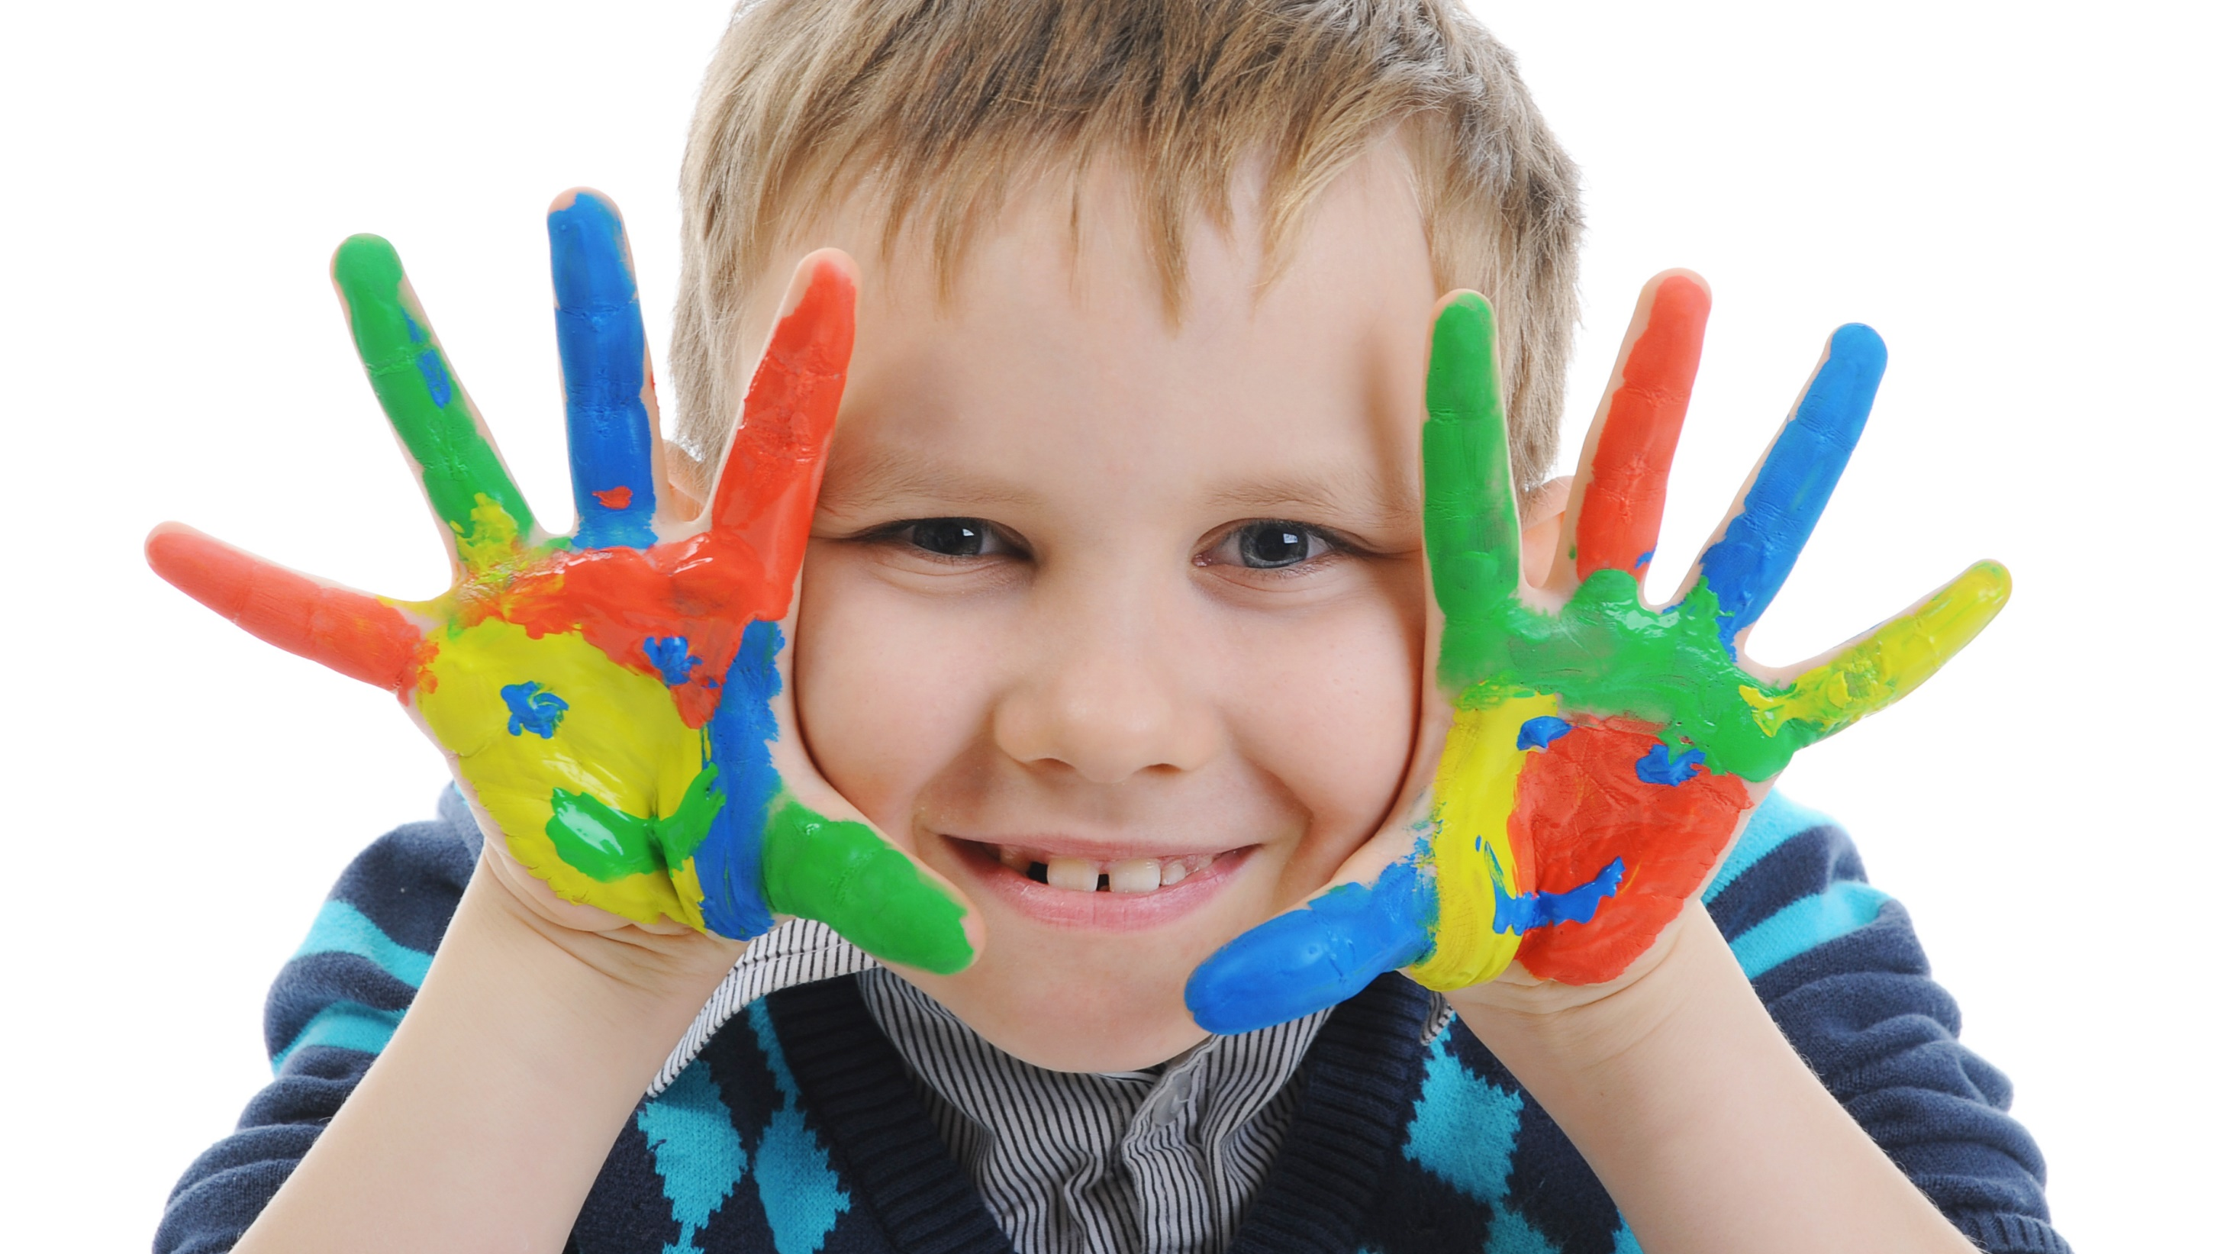
Enjoy your day!

