Slide 1


Slide 2

Unit
6
1
Unit
FAMILY LIFE
GENDER EQUALITY
LESSON 4
SPEAKING
Programmes for communities

Slide 3

Unit
1
1
FAMILY LIFE
Family Life
Unit
OBJECTIVES
- Understand how to express opinions
- Discuss and express opinions about a project or a programme that can benefit your local area
Knowledge
- Develop communication skills and creativity
- Be collaborative and supportive in pair work and team work
- Develop presentation skills
Core competence
- Understand more about programmes for communities
- Develop self-study skills
Personal qualities

Slide 4
LESSON 4
SPEAKING
GETTING STARTED
Warm-up: Quiz
WARM-UP
Task 1: Complete the conversation about a UNICEF programme with the sentences in the box. Then practise it in pairs.
PRESENTATION
Task 2: Work in pairs. Student A looks at the table below. Student B looks at the table on page 85. Ask each other the questions in 1 to complete your table.
Task 3: Work in groups. Discuss and decide which programme or project in 1 and 2 will bring more benefits to people in your local area. Then share your ideas with the whole class
PRACTICE
CONSOLIDATION
Wrap-up
Home work

Slide 5
LESSON 4
SPEAKING
GETTING STARTED
WARM-UP
Warm-up: Quiz

Slide 6
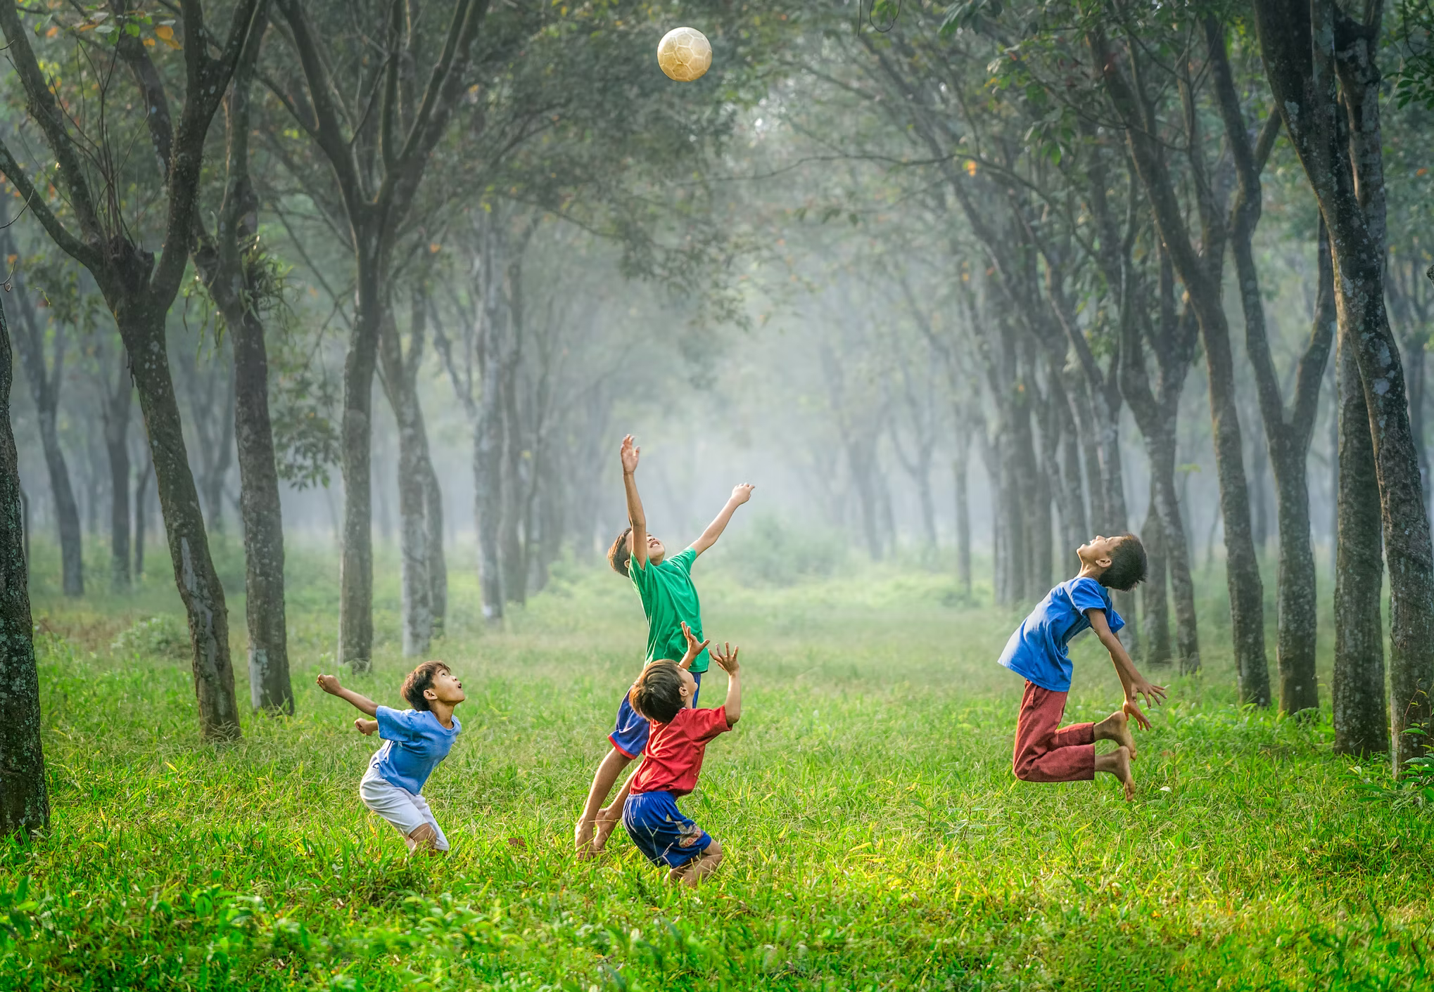
WARM-UP
UNICEF quiz: Intro to child rights
https://create.kahoot.it/pages/32c22a99-b815-4a16-8bf1-ec2915c82986?_=1571351723

Slide 7
LESSON 4
SPEAKING
GETTING STARTED
Warm-up: Quiz
WARM-UP
Task 1: Complete the conversation about a UNICEF programme with the sentences in the box. Then practise it in pairs.
PRESENTATION

Slide 8
PRESENTATION
1
Complete the conversation about a UNICEF programme with the sentences in the box. Then practise it in pairs.
1
A: What is the name of the programme? B: (1) __________ A: What does this programme focus on? B: (2) __________ A: What are the activities of this programme? B: (3) __________ | It offers young people job training and career advice. It also teaches them essential skills for the job market. It is Education for Disadvantaged Young People. It focuses on helping disadvantaged teenagers continue their education.

Slide 9
PRESENTATION
1
Complete the conversation about a UNICEF programme with the sentences in the box. Then practise it in pairs.
1
A: What is the name of the programme? B: (1) _____b_____ A: What does this programme focus on? B: (2) _____c_____ A: What are the activities of this programme? B: (3) _____a_____ | It offers young people job training and career advice. It also teaches them essential skills for the job market. It is Education for Disadvantaged Young People. It focuses on helping disadvantaged teenagers continue their education.

Slide 10

PRACTICE
2
Work in pairs. Student A looks at the table below. Student B looks at the table on page 85. Ask each other the questions in 1 to complete your table.
1
Suggested answer:
Conversation 1:
Student A: What is the name of the UNDP project?
Student B: It’s called Poverty Reduction.
Student A: What does it focus on?
Student B: It focuses on reducing poverty and developing economy in disadvantaged areas.
Student A: What are the activities of this project?
Student B: It aims to provide technical support and helps develop solutions to local issues.
Suggested answer:
Conversation 2:
Student B: What is the name of the UNICEF programme?
Student A: It’s called Vaccines for Children.
Student B: What does it focus on?
Student A: It focuses on protecting children with life-saving vaccines.
Student B: What are the activities of this programme?
Student A: Its activities include educating people about the benefits of vaccines and vaccinating as many children as possible.

Slide 11
LESSON 4
SPEAKING
GETTING STARTED
Warm-up: Quiz
WARM-UP
Task 1: Complete the conversation about a UNICEF programme with the sentences in the box. Then practise it in pairs.
PRESENTATION
Task 2: Work in pairs. Student A looks at the table below. Student B looks at the table on page 85. Ask each other the questions in 1 to complete your table.
Task 3: Work in groups. Discuss and decide which programme or project in 1 and 2 will bring more benefits to people in your local area. Then share your ideas with the whole class
PRACTICE

Slide 12
PRACTICE
3
Work in groups. Discuss and decide which programme or project in 1 and 2 will bring more benefits to people in your local area. Then share your ideas with the whole class.
1
Useful expressions:
I think / believe that the project / programme … is more important / necessary for my local area because …
This project / programme helps local people … / brings local people more opportunities to …
In our group, most of us agree that … But one member thinks that …
Example:
A: Now, let’s decide which programme or project will bring more benefits to people in our village. B, what do you think?
B: Well, I think Education for Disadvantaged Young People will be a very useful programme for our village. You see, many teenagers here drop out of school and start working to earn a living. They really need help.
A: You’re right, B.
...

Slide 13
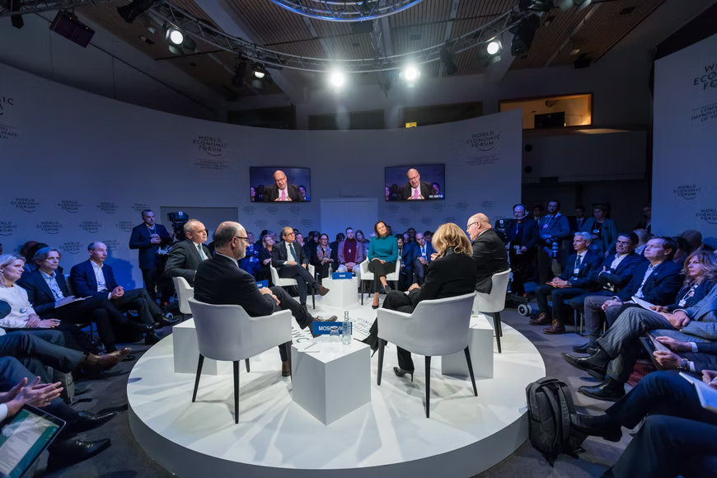
PRACTICE
3
Work in groups. Discuss and decide which programme or project in 1 and 2 will bring more benefits to people in your local area. Then share your ideas with the whole class.
1
Debate: UNICEF or UNDP programme?
Two teams debate which one is better for our local area.
The whole class: Vote for the most convincing team!
Be polite and respectful to the opponent team!
Preparation: 5 minutes
Speaking time:
+ 2 minutes/speaker
+ Closing/Summary: 1 minute/team

Slide 14
LESSON 4
SPEAKING
GETTING STARTED
Warm-up: Quiz
WARM-UP
Task 1: Complete the conversation about a UNICEF programme with the sentences in the box. Then practise it in pairs.
PRESENTATION
Task 2: Work in pairs. Student A looks at the table below. Student B looks at the table on page 85. Ask each other the questions in 1 to complete your table.
Task 3: Work in groups. Discuss and decide which programme or project in 1 and 2 will bring more benefits to people in your local area. Then share your ideas with the whole class
PRACTICE
CONSOLIDATION
Wrap-up
Home work

Slide 15
CONSOLIDATION
1
Wrap-up
Check if you learned to:
- Understand how to express opinions;
- Discuss and express opinions about a project or a programme that can benefit your local area.

Slide 16
CONSOLIDATION
2
Homework
- Workbook exercises
- Prepare the presentation for Project lesson

Slide 17


