Slide 1
NHÌN HÌNH
ĐOÁN NGHỀ
PLAY

Slide 2
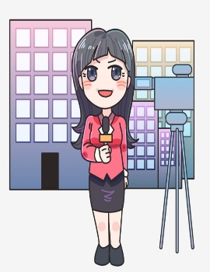
DOCTOR
1/8
JENNY
GREG
LINDA
PETER

Slide 3
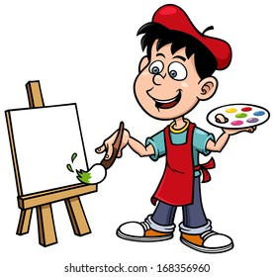
SINGER
2/8
MINA
ADAM
MIKE
JENNY

Slide 4
REPORTER
6/8
PETER
GREG
JENNY
LINDA

Slide 5
NURSE
3/8
MIA
JENNY
LINDA
GREG

Slide 6
TEACHER
4/8
PETER
MIA
MIKE
ADAM

Slide 7
BUILDER
8/8
GREG
ADAM
MINA
PETER

Slide 8
CHEF
5/8
PETER
LINDA
ADAM
JENNY

Slide 9
ARTIST
7/8
MIKE
GREG
MINA
PETER

