Slide 2
Unit 3
GREEN LIVING
LESSON 5
LISTENING
Creating a compost pile

Slide 3
LESSON 5
LISTENING
WARM-UP
Video watching
PRE-LISTENING
Task 1: Match the words and phrases with the pictures.
Task 2: Number the pictures.
Task 3: True or false.
WHILE-LISTENING
POST-LISTENING
Task 4: Discussion.
CONSOLIDATION
Wrap-up
Homework

Slide 4

WARM-UP
Notes:
Link: https://www.youtube.com/watch?v=LxNumOifkT0

Slide 5
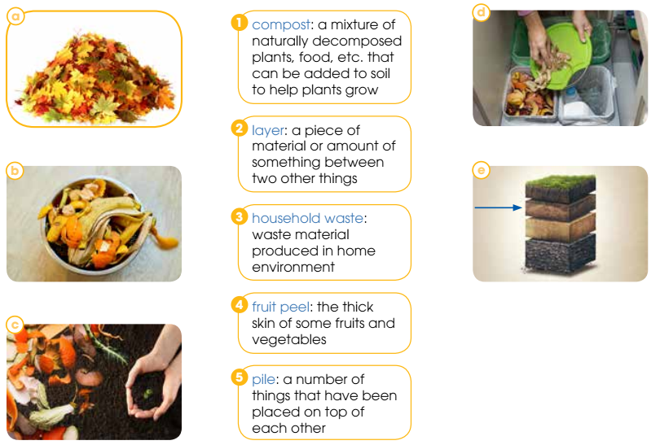
PRE-LISTENING
1
Match the words and phrases with the pictures.
1. c
2. e
3. d
4. b
5. a

Slide 6

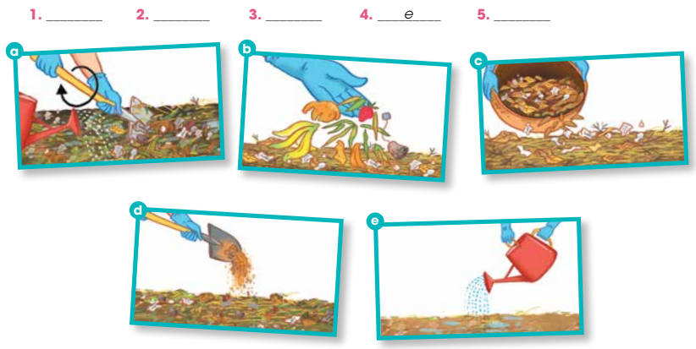
WHILE-LISTENING
2
Listen and number the pictures.
c
b
d
a

Slide 7
WHILE-LISTENING
3
True or false.
 | T | F
1. Use dry leaves as green materials.
2. Use fruit peels as green materials.
3. Add additional layers in the same order.
4. Leave the pile dry for many days.
5. Add chemical fertilisers.
✓
✓
✓
✓
✓

Slide 8
POST-LISTENING
4
Work in groups. Discuss these questions.
How do you manage your household and garden waste?
Is it environmentally friendly?

Slide 9
CONSOLIDATION
1
Wrap-up
What have you learnt today?
Some lexical items about green living
Listening for specific information

Slide 10
CONSOLIDATION
2
Homework
Do exercises in the workbook.
Prepare for the next lesson – Writing.

Slide 11
Website: hoclieu.vn
Fanpage: facebook.com/www.tienganhglobalsuccess.vn

