Slide 2


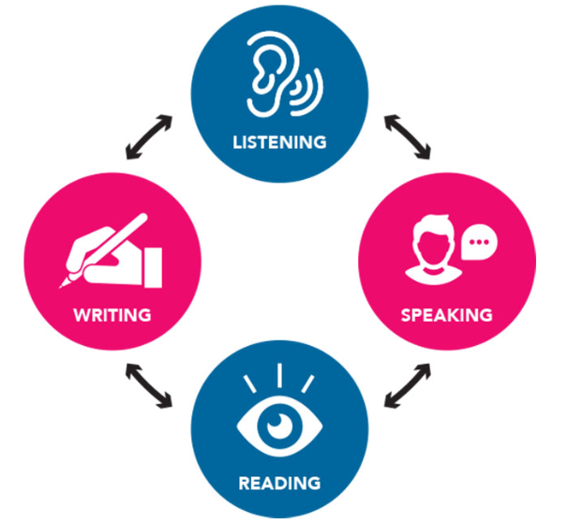
REVIEW
4
LESSON 2: SKILLS
1

Slide 3
LESSON 2: SKILLS
LESSON 1: GETTING STARTED
WARM-UP
Keyword guessing
Task 1: Read the article. Choose the best option A, B, C, or D.
READING
Task 2: Work in groups. Imagine a job that may be popular in the future. Discuss the answers to the questions about the job and report them to the class.
SPEAKING
Task 3: Listen to Mark talking about the solar system. Fill in each blank with no more than TWO words.
LISTENING
Task 3: Write an email (100 – 120 words) to your friend telling him / her about an organisation which protects the ocean. You can use the ideas below.
WRITING
Wrap-up
Homework
CONSOLIDATION

Slide 4
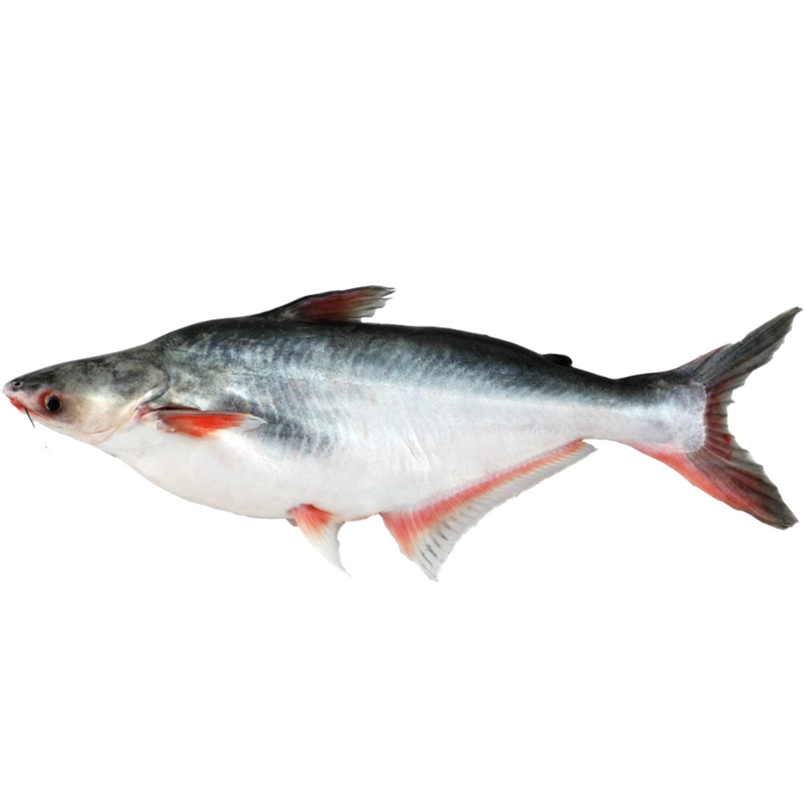
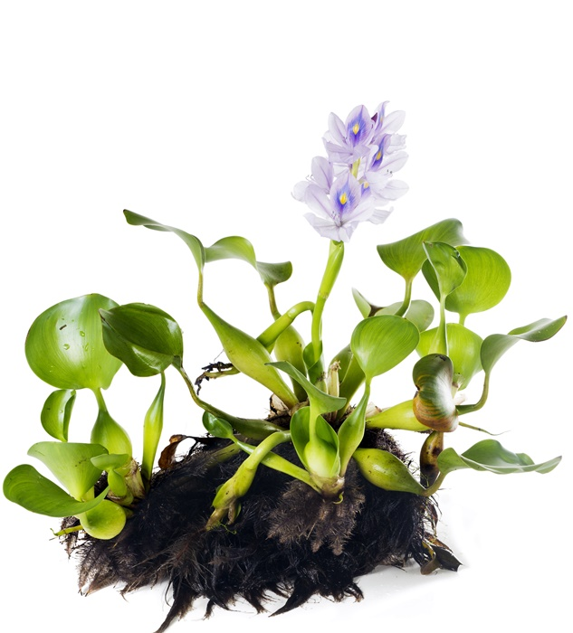
WARM-UP
Can you name this fish and plant in Vietnamese?!
SILVER CARP WATER HYACINTH
VI BÈO
CÁ BA SA
Key word: INVASIVE SPECIES

Slide 5
READING
1
Read the article. Choose the best option A, B, C, or D.
Invasive species are the foreign plants or animals which come into a place and badly affect it. Invasive species can harm local living things and people's health.
In the 1970s, fish farmers brought silver carp into the United States with the hope to improve water quality in fish ponds. Many carp then escaped into the Mississippi River. They have gradually taken over the resources of paddlefish in the river. Their population have grown so rapidly that paddlefish don't have enough food and are dying out.

Slide 6
READING
1
Read the article. Choose the best option A, B, C, or D.
Water hyacinth, which is native to South America, came to Africa in the 1980s. At first, people planted it for its beautiful purple flowers. Since then, the plant has spread very quickly and covered Lake Victoria, the largest lake in Africa. Water hyacinth blocks the flow of lake water and creates homes for mosquitoes and insects.
Since invasive species cause many types of problems, there should be stricter laws to stop people from taking plants and animals to a new place.

Slide 7
READING
1
Read the article. Choose the best option A, B, C, or D.
1. What is the article mainly about?
A. Definition of invasive species.
B. Some troubles caused by invasive species.
C. How local environments affect new species.
D. The impact of invasive animals on local people.
2. How do silver carp affect paddlefish in the Mississippi River?
A. They eat paddlefish.
B. They become food for the paddlefish.
C. They use up most of the paddlefish’s food.
D. They make the river water dirty.

Slide 8
READING
1
Read the article. Choose the best option A, B, C, or D.
3. People in Africa first used water hyacinth as a type of ______.
A. decorative plant B. herb medicine
C. fish food D. insect killer
4. Which of the following is true about water hyacinth in Lake Victoria?
A. It is poisonous to local people.
B. It feeds the paddlefish in the lake.
C. It helps clean up the lake water.
D. It allows mosquito populations to increase.

Slide 9
READING
1
Read the article. Choose the best option A, B, C, or D.
5. he text suggests preventing the spread of invasive species by ______.
A. introducing stricter laws
B. taking animals to a new place
C. raising people’s awareness
D. growing new types of plants

Slide 10
SPEAKING
2
Work in groups. Imagine a job that may be popular in the future. Discuss the answers to the questions about the job and report them to the class.
1. What may be a popular job in the future?
2. What type(s) of training does it require?
3. What skill(s) do you need to do it?
4. What personal qualities are necessary to do the job well?

Slide 11
SPEAKING
2
SAMPLE
Hello everyone. We will talk about a promising future job: a drone operator. It is expected to rise due to their increasing use in agriculture, construction, and delivery services. To become a drone operator, one might need to obtain many certificates and gain experience through flight training programs or internships. Key skills include strong hand-eye coordination, spatial awareness, proficiency in drone technologies, problem-solving, and quick decision-making. Personal qualities such as responsibility, safety, detail-orientedness, and good communication are also essential for this job. Thanks for listening.

Slide 12

LISTENING
3
Listen to a conversation between Trang and Tom. Fill in each blank with no more than TWO words.
electronic devices
1. Trang is reading about newly invented _______________.
2. Trang wants to have a _________.
3. Trang wants the View-me window to show the ___________ all day.
4. Tom says that with the blue hat, Trang doesn’t need to carry along a ___________.
5. Trang doesn’t like the blue hat because it’s not _______.
pet robot
ocean view
music player
elegant

Slide 13
GRAMMAR
4
Write an email (100 – 120 words) to your friend telling him / her about an organisation which protects the ocean. You can use the ideas below.
Name of the organisation: Save the Oceans
Importance of ocean habitats: produce half of the earth’s oxygen; adjust the climate; create homes for plants and animals
Current situation: habitat loss due to overfishing and pollution
What the organisation does: promotes smart fishing; encourages people to use fewer plastic bags; organises campaigns to clean up the beach and the sea

Slide 14
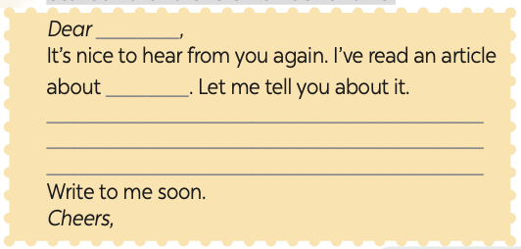
GRAMMAR
4
Write an email (100 – 120 words) to your friend telling him / her about an organisation which protects the ocean. You can use the ideas below.
Start and end the email as follows:

Slide 15
WRITING
4
SAMPLE
Dear Peter,
It’s nice to hear from you again. I’ve read an article about Save the Oceans. Let me tell you about it.
The ocean habitats are very important because they produce half of the earth’s oxygen and create homes for plants and animals. However, there is serious habitat loss due to overfishing and pollution. Save the Oceans is helping oceans in many ways. It promotes smart fishing. It also encourages people to use fewer plastic bags. Besides, it organises campaigns to clean up beaches and seas.
I admire the actions of Save the Oceans. Hope that I can join them in the future.
Do you know other organizations which help the oceans?
Write to me soon.

Slide 16

CONSOLIDATION
1
Wrap-up
What have we learnt in this lesson?
review the skills of Unit 10, 11, 12.

Slide 17

CONSOLIDATION
2
Homework
Do the exercises in the workbook.
Prepare for the final test

Slide 18
Website: hoclieu.vn
Fanpage: facebook.com/www.tienganhglobalsuccess.vn/

