Slide 1


Slide 2
Unit
1
Preserving our heritage
Unit
FAMILY LIFE
LESSON 3
READING
Teenagers’ ideas for preserving heritage

Slide 3
LESSON 3
READING
WARM-UP
Brainstorming
Vocabulary
PRE-READING
- Task 2. Read the article and circle the correct meanings of the highlighted words and phrases.
- Task 3. Match the following headings (1-4) with the appropriate paragraph (A-C)
- Task 4. Read the article again and decide which paragraph includes the following information.
WHILE-READING
POST-READING
Discussion
Wrap-up
Homework
CONSOLIDATION

Slide 4
WARM-UP
BRAINSTORMING
- Work in 4 groups.
- Discuss: What can we do to protect our heritage?
- 3 minutes to discuss and write.
- All groups stick your paper on the board.
- The group with the most ideas will be the winner.

Slide 5
WARM-UP
Suggested ideas
- Organize nature walks/excursions to local parks, areas of bio-diversity
- Organize site visits to museums, interpretation centres, and archaeological sites
- Organize essay competitions on literature (in English and local languages)
- Carry out small research projects for students that can be put up as mini-exhibitions/bulletin board displays on heritage.
- Involve students in documenting local living heritage like festivals, performing arts or craftsmen and women.
- Establish clubs for heritage debates, quizzes, discussions and activities like presentations, field trips and documentation.
- Organizing painting and drawing competitions for students at built heritage sites
- Clean up the environment, investigate its local official and oral history.

Slide 6
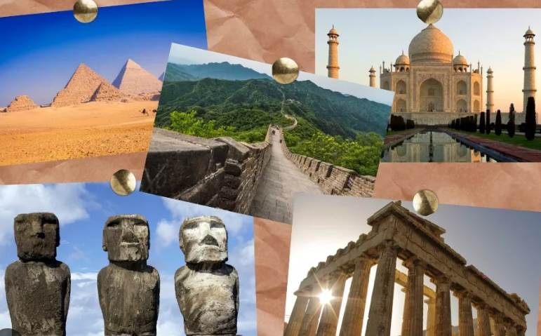
PRE-READING
1
Work in pairs. Ask and answer the questions.
Why do people visit heritage sites?
What can we do at heritage sites?
What can we learn from them?

Slide 7


PRE-READING
appreciate (v)
/əˈpriːʃieɪt/
to recognize the good qualities of somebody/something

Slide 8

PRE-READING
challenge (n)
/ˈtʃælɪndʒ/
an invitation or a suggestion to somebody that they should enter a competition, fight, etc.

Slide 9

PRE-READING
trending (adj)
/ˈtrendɪŋ/
being discussed a lot on social media

Slide 10
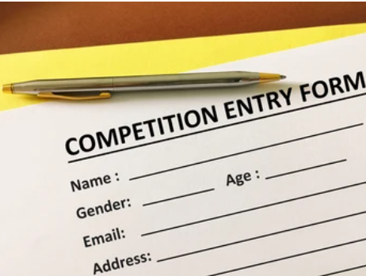
PRE-READING
entry (n)
/ˈentri/
something that you do, write or make to take part in a competition, for example answering a set of questions

Slide 11
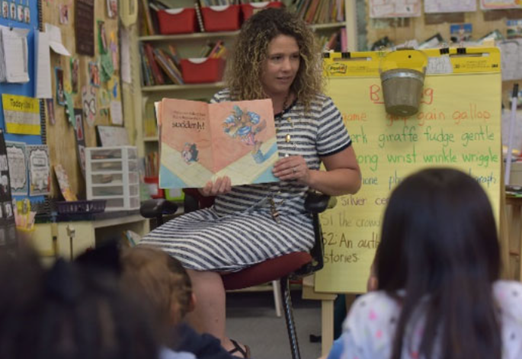
PRE-READING
keen (adj)
/kiːn/
[usually before noun] strong or deep
E.g. She took a keen interest in her daughter’s education.

Slide 12
PRE-READING
Form | Pronunciation | Meaning | Vietnamese equivalent
1. appreciate (v) | /əˈpriːʃieɪt/ | to recognize the good qualities of somebody/something | Trân trọng
2. challenge (n) | /ˈtʃælɪndʒ/ | an invitation or a suggestion to somebody that they should enter a competition, fight, etc. | Thử thách
3. trending (adj) | /ˈtrendɪŋ/ | being discussed a lot on social media | Theo xu hướng
4. entry (n) | /ˈentri/ | something that you do, write or make to take part in a competition, for example answering a set of questions | Bài dự thi
5. keen (adj) | /kiːn/ | [usually before noun] strong or deep | Mạnh mẽ, sâu sắc

Slide 13
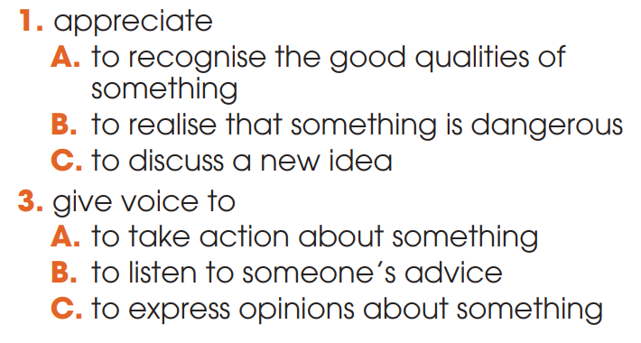
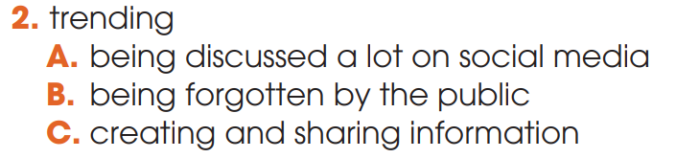
WHILE-READING
2
Read the article and circle the correct meanings of the highlighted words and phrases

Slide 14
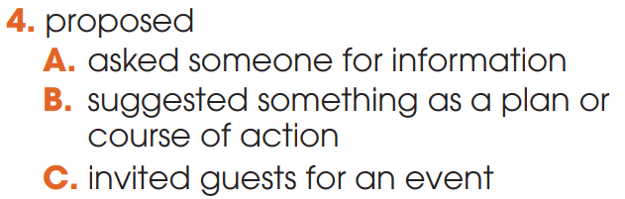
WHILE-READING
2
Read the article and circle the correct meanings of the highlighted words and phrases

Slide 15
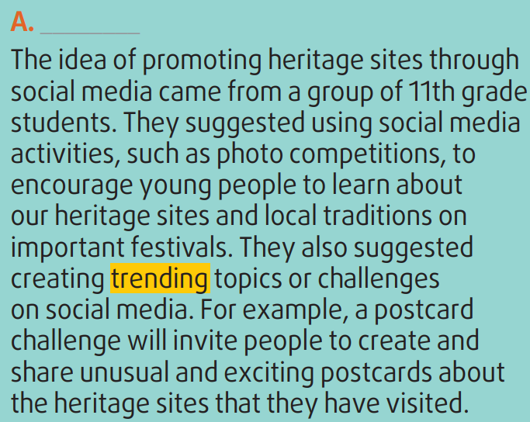
WHILE-READING
3
Read the article again. Match the section (A-C) with the heading (1-5) below. There is ONE extra heading.
3. Making use of social media to promote heritage

Slide 16
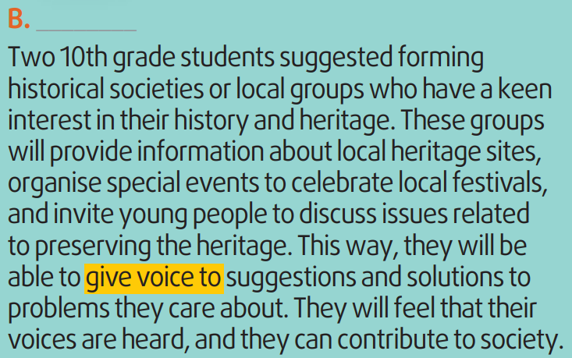
WHILE-READING
3
Read the article again. Match the section (A-C) with the heading (1-5) below. There is ONE extra heading.
4. Opportunities to learn about heritage and be involved in problem-solving

Slide 17
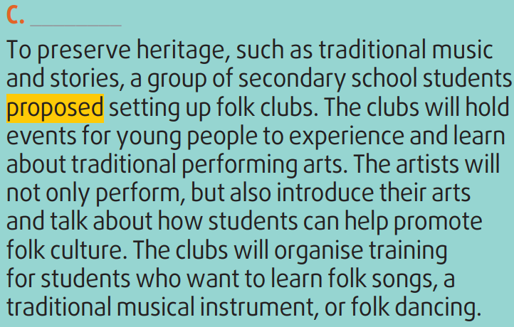
WHILE-READING
3
Read the article again. Match the section (A-C) with the heading (1-5) below. There is ONE extra heading.
2. Promoting and developing the folk arts

Slide 18
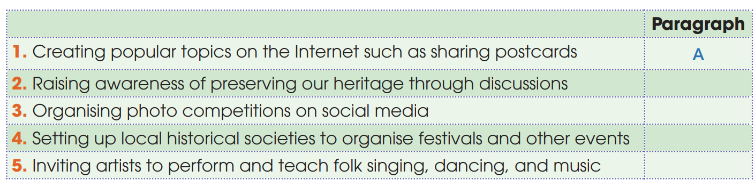
WHILE-READING
4
Read the article again and decide which paragraph includes the following information
B
A
B
C

Slide 19

POST-READING
5
Discussion
Which of the ideas in the text do you like most?
How will it help preserve heritage?

Slide 20
CONSOLIDATION
1
Wrap-up
What have you learnt today?
Some lexical items about preserving heritage;
Reading for main ideas and specific information

Slide 21
CONSOLIDATION
2
Homework
Do exercises in the workbook.
Prepare for Lesson 4 - Unit 6.

Slide 22

Website: hoclieu.vn
Fanpage: facebook.com/sachmem.vn/

