Slide 1
World Diabetes Day Infographics
Here is where your infographics begin

Slide 2
ABOUT World Diabetes Day Infographics
This template contains an assortment of complementary infographic resources for the World Diabetes Day presentation
These infographics are adapted to the style of the aforementioned presentation, so you can insert them easily and have them completely integrated at once. You just need to do the following:
  Select the element that you want to copy
  Right-click and choose “Copy”
  Go to the slide where you want the element to appear
  Right-click and choose “Paste”

Slide 3
World Diabetes Day Infographics
DIABETES IN THE WORLD
37 MILLION
people have diabetes
1 out of 10
1 out of 5 doesn’t know

Slide 4
World Diabetes Day Infographics
DIABETES MEDICINE IN THE US
WITH
$$$
$327 BILLION
Jupiter is the biggest planet of them all
Mercury is the closest planet to the Sun and the smallest of them all
WITHOUT
$
Mars is actually a very cold place

Slide 5
World Diabetes Day Infographics
SYMPTOMS OF DIABETES
mercury
jupiter
Mercury is quite a small planet
Jupiter is the biggest planet of them all
50%
80%
saturn
mars
Saturn is a gas giant and has rings
Mars is actually a very cold place
30%
10%

Slide 6
World Diabetes Day Infographics
USUAL INSULIN DOSAGE
TYPE 2 DIABETES
Mercury is the closest planet to the Sun and the smallest one in the Solar System—it’s only a bit larger than the Moon
50ML/DAY

Slide 7
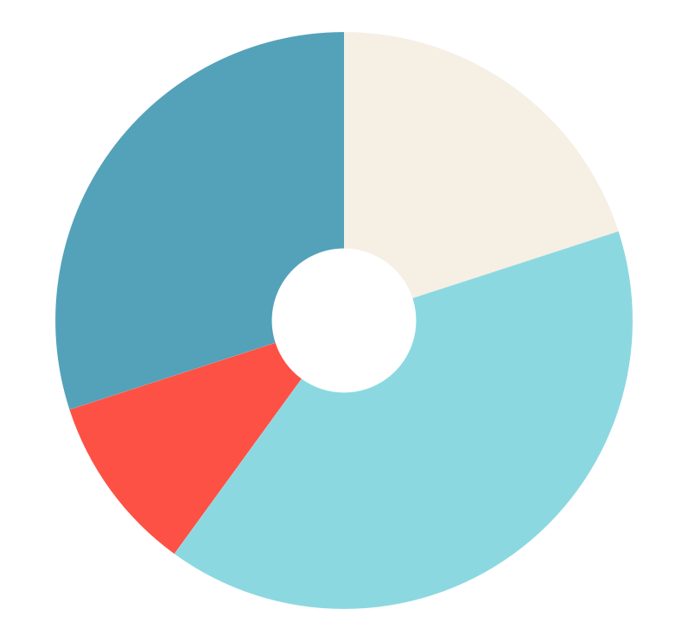
World Diabetes Day Infographics
MOST USED MEDICINES FOR DIABETICS
30%
mercury
40%
jupiter
Mercury is quite a small planet
Jupiter is the biggest planet of them all
10%
saturn
20%
mars
Saturn is a gas giant and has rings
Mars is actually a very cold place
Follow the link in the graph to modify its data and then paste the new one here. For more info, click here

Slide 8
World Diabetes Day Infographics
MANDATORY DIET
 | WEEK 1
 | MON | TUE | WED | THU | FRI
BREAKFAST | Mercury | Venus | Mars | Neptune | Saturn
LUNCH | Earth | Jupiter | Sun | Moon | Stars
DINNER | Ceres | Pluto | Galaxy | Uranus | Mercury

Slide 9
World Diabetes Day Infographics
DAILY INJECTIONS
1ST DOSE
2ND DOSE
3RD DOSE
Saturn is a gas giant and has rings
Mercury is quite a small planet
Jupiter is the biggest planet of them all

Slide 10
World Diabetes Day Infographics
HOW TO PREVENT DIABETES
50%
25%
25%
DIET
WEIGHT
EXERCISE
Saturn is a gas giant and has rings
Mercury is quite a small planet
Jupiter is the biggest planet of them all

Slide 11
World Diabetes Day Infographics
WHO IS AT RISK?
1 OUT OF 3
AT HIGH RISK
Mercury is the closest planet to the Sun and the smallest of them all

Slide 12
World Diabetes Day Infographics
DIABETIcS CAN ALSO DEVELOP:
saturn
mars
mercury
jupiter
Saturn is a gas giant and has rings
Mars is actually a very cold place
Mercury is quite a small planet
It’s the biggest planet of them all
50%
30%
80%
10%

Slide 13
World Diabetes Day Infographics
TYPE 2 DIABETES
90% - 95%
$13,700
of all diagnosed cases
AVERAGE SPENT BY PATIENT
Mercury is the closest planet to the Sun and the smallest of them all
Venus has a beautiful name and is the second planet from the Sun

Slide 14
World Diabetes Day Infographics
HEALTH RISKS
STROKE
BLINDNESS
HEART DISEASE
KIDNEY FAILURE
LOSS OF LEGS
& MORE…

Slide 15
World Diabetes Day Infographics
PREDIABETES
96 MILLION
MORE THAN 8 IN 10
don’t know they have it
have prediabetes

Slide 16
World Diabetes Day Infographics
COMMON TYPES OF DIABETES
TYPE 1 | BODY DOESN’T PRODUCE ENOUGH INSULIN
AGE | PREVENTION | IN ADULTS | IN YOUTH
Any age | No | 5-10% | 18,000
TYPE 2 | BODY CAN’T USE INSULIN PROPERLY
AGE | PREVENTION | IN ADULTS | IN YOUTH
Any age | Most cases | 90-95% | 6,000

Slide 17
World Diabetes Day Infographics
risk factors for type 2 diabetes
01
OVERWEIGHT
02
FAMILY HISTORY
1.4 MILLION
03
INACTIVITY
diagnosed with type 2 diabetes in 20XX
04
OLDER THAN 45

Slide 18
World Diabetes Day Infographics
PREVENTING OR MANAGING DIABETES
PREVENT OR DELAY TYPE 2 DIABETES
 | Eat healthy
 | Be more active
 | Lose weight
WAYS TO MANAGE YOUR DIABETES
 | Work with professionals
 | Eat healthy
 | Stay active
or

Slide 19
World Diabetes Day Infographics
DEATH RATES
3.7m
deaths due to high blood glucose
1.5M
deaths caused by diabetes
THAT IS 1 PERSON IN 11

Slide 20
World Diabetes Day Infographics
TYPE 2 DIABETES IN YOUTH
1 IN 5
HOW TO PREVENT IT?
aged 12-18
Venus has a beautiful name and is the second planet from the Sun
Mercury is the closest planet to the Sun and the smallest one in the Solar System
1 IN 4
aged 19-34
PREDIABETES IS HIGHER IN MALES

Slide 21
World Diabetes Day Infographics
DIABETES IN THE US
TOTAL | 25.8M
DIAGNOSED | 18.8M
UNDIAGNOSED | 7M
PREDIABETES | 79M
NEW CASES | 1.9M
MORE THAN 8% HAVE DIABETES

Slide 22
World Diabetes Day Infographics
IDENTIFY YOUR SYMPTOMS
YES | ALWAYS TIRED | NO | FREQUENT URINATION
NO | ALWAYS HUNGRY | NO | SYSTEMIC WEIGHT LOSS
YES | SEXUAL PROBLEMS | NO | WOUNDS THAT WON’T HEAL
NO | ALWAYS THIRSTY | YES | BLURRY VISION
YES | NUMBNESS OF HANDS & FEET | YES | VAGINAL INFECTIONS

Slide 23
World Diabetes Day Infographics
STEPS FOR LIVING BETTER WITH DIABETES
01
02
03
04
EAT HEALTHY
MONITOR
Saturn is a gas giant
Mercury is quite small
BE ACTIVE
MEDICATION
Mars is actually cold
Jupiter is huge

Slide 24
World Diabetes Day Infographics
IMPORTANT FACTS
OVER 700M
people living with diabetes by 2045
half of all
people living with diabetes are undiagnosed
1 in 2 people
who need insulin can’t access or afford it

Slide 25
World Diabetes Day Infographics
BLOOD TESTS
 | A1C TEST | FASTING BLOOD SUGAR TEST | GLUCOSE TOLERANCE TEST
DIABETES | 6.5% or above | 126 mg/dl or above | 200 mg/dl or above
PREDIABETES | 5.7-6.4% | 100-125 mg/dl | 140-199 mg/dl
NORMAL | Below 5.7% | 99 mg/dl or below | 139 mg/dl or below

Slide 26
World Diabetes Day Infographics
KEY ACTIONS
FOR EVERYONE
Eat healthy
Be active
Check blood glucose
Follow medical advice
FOR GOVERNMENTS
TO ENSURE:
Healthy environments
Better diagnosis & treatment
Better Data

Slide 27
World Diabetes Day Infographics
RISK FACTORS FOR TYPE 2 DIABETES
bad diet
OBESITY
Mercury is the smallest planet of them all
Jupiter is the biggest planet of them all
75%
60%
inactivity
OVERWEIGHT
Saturn is a gas giant and has several rings
Despite being red, Mars is a cold planet
50%
25%

Slide 28
World Diabetes Day Infographics
TYPE 1 DIABETES
TYPE 2 DIABETES
Non-preventable
Preventable
CASES
CASES
5-10%
90-95%
RISK FACTORS
RISK FACTORS
Unknown
Obesity, overweight, lack of physical activity, family history, smoking

Slide 29
World Diabetes Day Infographics
PREVENT TYPE 2 DIABETES
PHYSICALLY ACTIVE
HEALTHIER DIET
Mercury is the smallest planet of them all
Jupiter is the biggest planet of them all
GET PLENTY OF FIBER
QUIT SMOKING
Saturn is a gas giant and has several rings
Despite being red, Mars is a very cold place

Slide 30
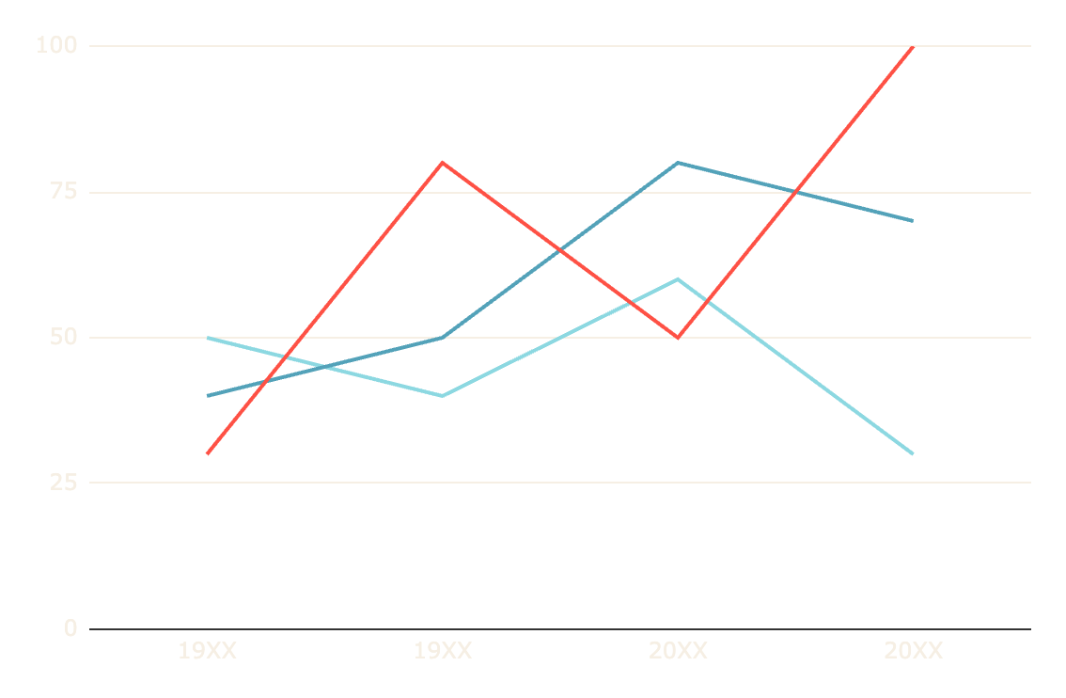
World Diabetes Day Infographics
PEOPLE WITH DIABETES
PREDIABETES
Mercury is quite small
TYPE 1
Saturn is a gas giant
TYPE 2
Mars is actually cold
Follow the link in the graph to modify its data and then paste the new one here. For more info, click here

Slide 31
World Diabetes Day Infographics
DIABETES TODAY
537M
643M
1 in 2
Saturn is a gas giant with rings
Mercury is quite a small planet
Mars is actually a cold place
4 in 5
6.7M
$966B
Neptune is far away from us
Earth is a planet that has life
Venus has a beautiful name

Slide 32
World Diabetes Day Infographics
DIABETES TREATMENT AND PREVENTION
PREVENTION
TREATMENT
ANALYSIS
TEST A
EXERCISE
TEST B
GOOD DIET
MEDICINE

Slide 33
Instructions for use
If you have a free account, in order to use this template, you must credit Slidesgo in your final presentation. Please refer to the next slide to read the instructions for premium users.
As a Free user, you are allowed to:
- Modify this template.
- Use it for both personal and commercial projects.
You are not allowed to:
- Sublicense, sell or rent any of Slidesgo Content (or a modified version of Slidesgo Content).
- Distribute Slidesgo Content unless it has been expressly authorized by Slidesgo.
- Include Slidesgo Content in an online or offline database or file.
- Offer Slidesgo templates (or modified versions of Slidesgo templates) for download.
- Acquire the copyright of Slidesgo Content.
For more information about editing slides, please read our FAQs or visit Slidesgo School:
https://slidesgo.com/faqs and https://slidesgo.com/slidesgo-school

Slide 34
Instructions for use (premium users)
As a Premium user, you can use this template without attributing Slidesgo.
You are allowed to:
Modify this template.
Use it for both personal and commercial purposes.
Share this template in an editable format with people who are not part of your team.
You are not allowed to:
Sublicense, sell or rent this Slidesgo Template (or a modified version of this Slidesgo Template).
Distribute this Slidesgo Template (or a modified version of this Slidesgo Template) or include it in a database or in any other product or service that offers downloadable images, icons or presentations that may be subject to distribution or resale.
Use any of the elements that are part of this Slidesgo Template in an isolated and separated way from this Template.
Register any of the elements that are part of this template as a trademark or logo, or register it as a work in an intellectual property registry or similar.
For more information about editing slides, please read our FAQs or visit Slidesgo School:
https://slidesgo.com/faqs and https://slidesgo.com/slidesgo-school

Slide 35
Infographics
You can add and edit some infographics to your presentation to present your data in a visual way.
Choose your favourite infographic and insert it in your presentation using Ctrl C + Ctrl V or Cmd C + Cmd V in Mac.
Select one of the parts and ungroup it by right-clicking and choosing “Ungroup”.
Change the color by clicking on the paint bucket.
Then resize the element by clicking and dragging one of the square-shaped points of its bounding box (the cursor should look like a double-headed arrow). Remember to hold Shift while dragging to keep the proportions.
Group the elements again by selecting them, right-clicking and choosing “Group”.
Repeat the steps above with the other parts and when you’re done editing, copy the end result and paste it into your presentation.
Remember to choose the “Keep source formatting” option so that it keeps the design. For more info, please visit Slidesgo School.

