Slide 1
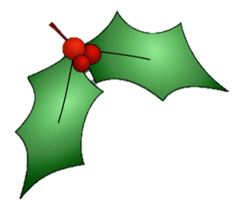
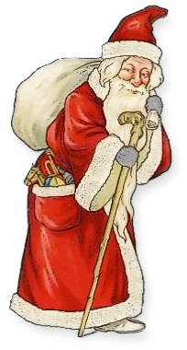
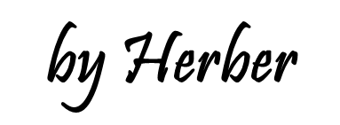

Slide 2
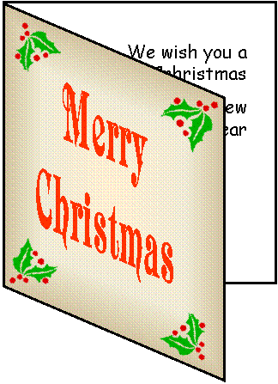
Something you send to say “Merry Christmas” that rhymes with yard.
card

Slide 3
Something Santa gives you that rhymes with lift.
gift

Slide 4
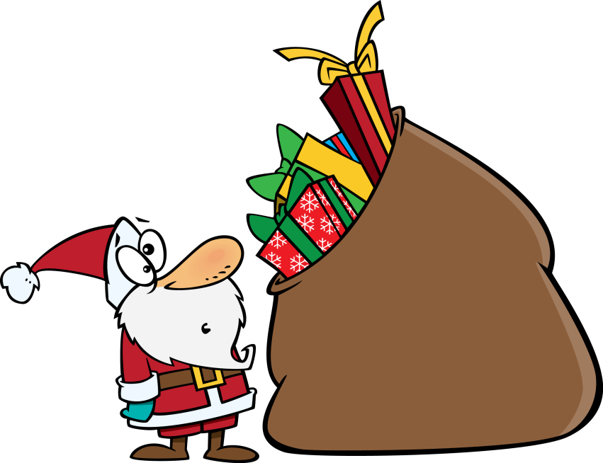
Something Santa holds
that rhymes with back.
sack

Slide 5
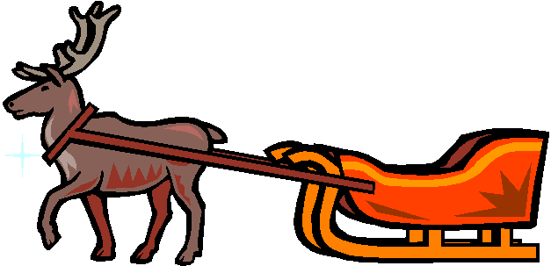
Something Santa drives that rhymes with day.
sleigh

Slide 6
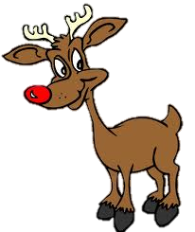
A Santa’s reindeer that rhymes with wolf.
Rudolph

Slide 7
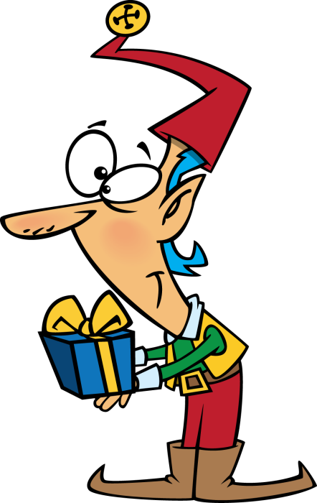
Someone who helps Santa that rhymes with shelf.
Elf

Slide 8
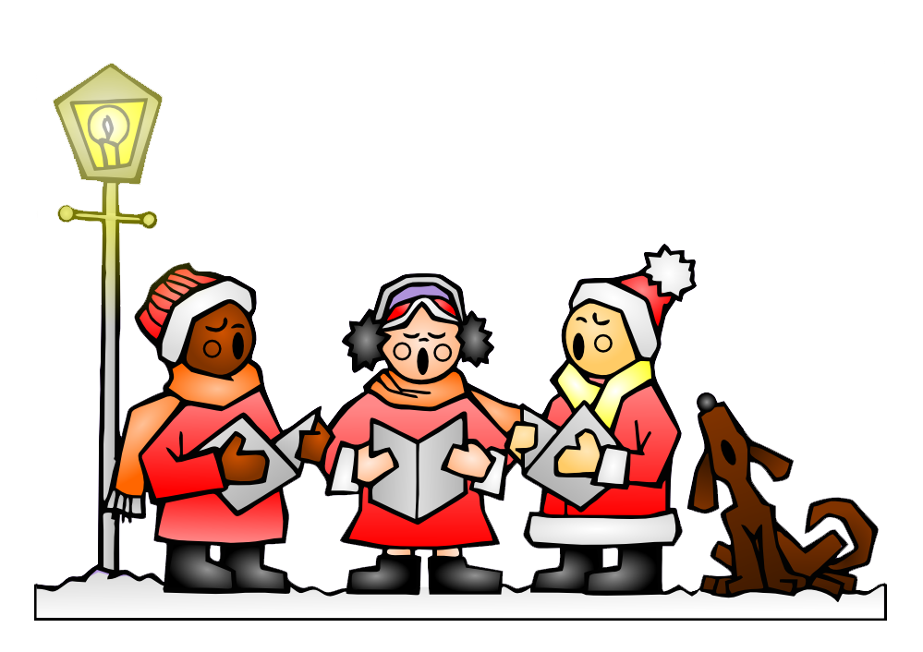
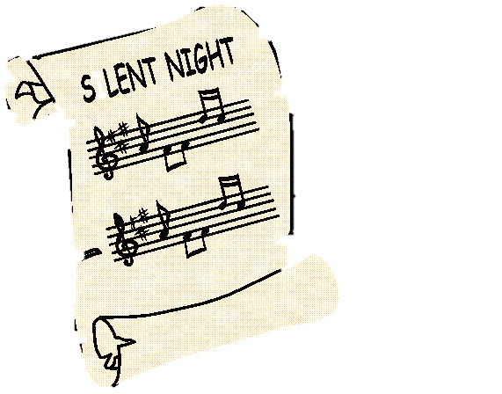
Something people sing at Christmas that rhymes with barrel.
carol

Slide 9
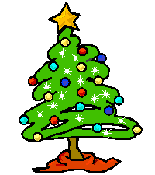
Something green you decorate that rhymes with see.
tree

Slide 10
Something you put on the top
of the tree that rhymes with guitar.
star

Slide 11
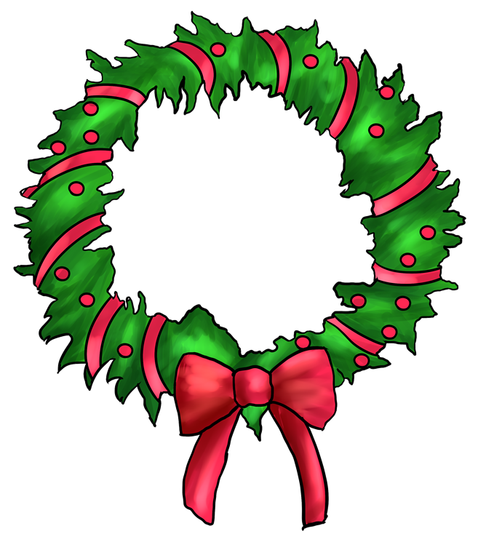
Something you put on the door
that rhymes with read.
wreath

Slide 12
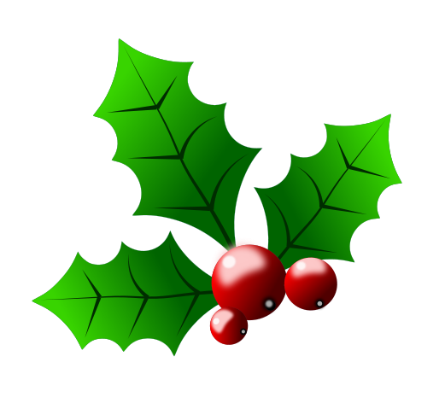
A Christmas ornament
that rhymes with lolly.
holly

Slide 13
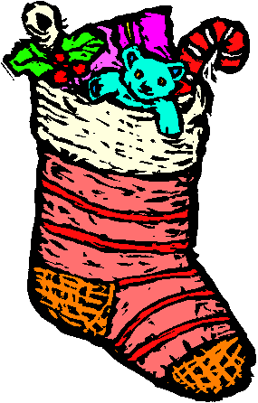
Something you hang by the fireplace that rhymes with rocking.
stocking

Slide 14
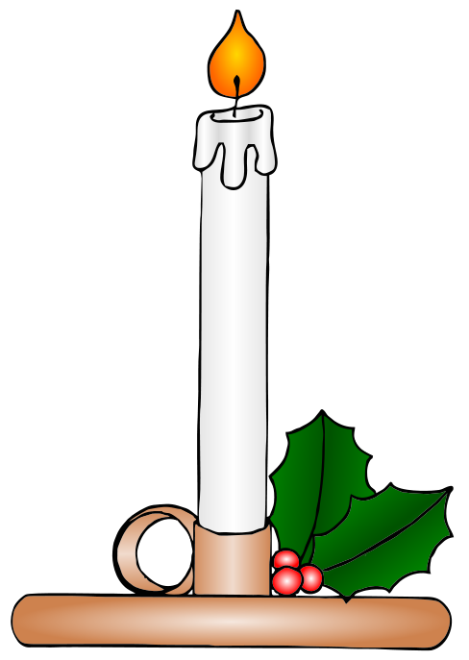
Something you light
that rhymes with handle.
candle

Slide 15
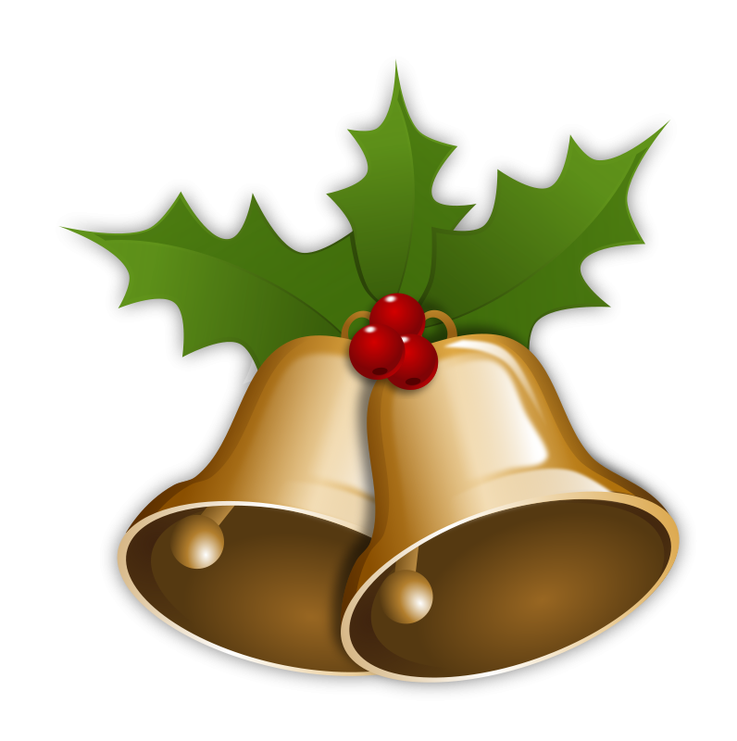
Something Santa rings
that rhymes with well.
bell

Slide 16
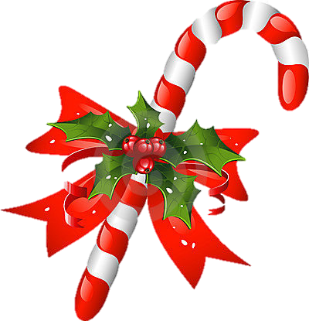
Something sweet
that rhymes with lane.
candy cane

Slide 17
Something people put on the roof that rhymes with rights.
lights

Slide 18
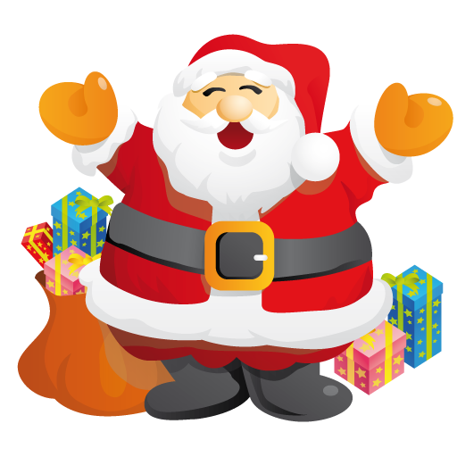
Merry Christmas!

Slide 19
SƯU TẦM: ĐOÀN VĂN DOANH, NAM TRỰC, NAM ĐỊNH
LINK NHÓM DÀNH CHO GV BỘ MÔN VẬT LÝ TRAO ĐỔI TÀI LIỆU VÀ CHUYÊN MÔN CT 2018
https://www.facebook.com/groups/299257004355186

