Slide 2



Unit
10
HOUSES IN THE FUTURE
LESSON 2: A CLOSER LOOK 1
1

Slide 3
LESSON 2: A CLOSER LOOK 1
LESSON 1: GETTING STARTED
WARM-UP
Game: Place it right
Vocabulary
PRESENTATION
Task 1: Put the words in the right column. (Ex. 1)
Task 2: Match and make phrases about what appliances can help us to do.
Task 3: Pair work: ask and answer questions about what appliances can help us to do.
PRACTICE
PRONUNCIATION
Task 4: Pronunciation: Stress in two-syllable words (words only).
Task 5: Stress in two-syllable words in sentences.
PRODUCTION
Task 6: Game: “Up and down”.
CONSOLIDATION
Wrap-up
Homework

Slide 4
WARM-UP
* Go to the board
* Stick the pictures of household appliances in the right posters
LIVING ROOM
PLACE IT RIGHT
BEDROOM
KITCHEN

Slide 5
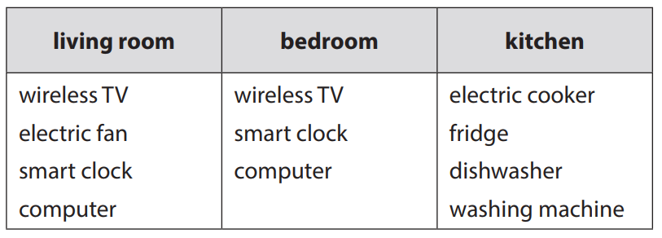
WARM-UP
Answer key:

Slide 6
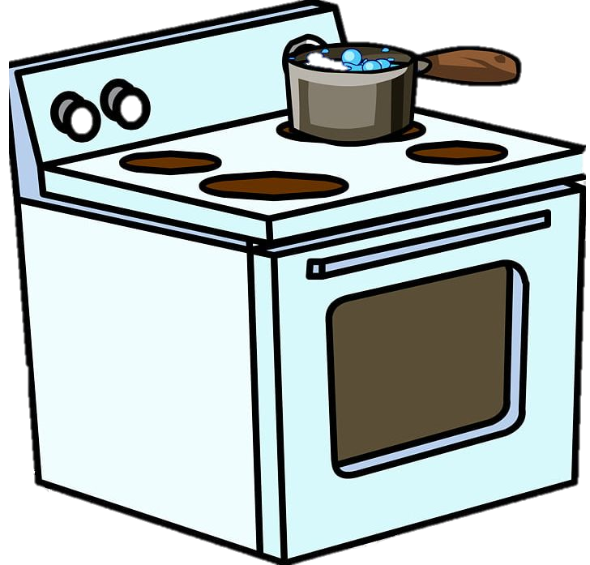
PRESENTATION
electric cooker (n)
/ɪˈlektrɪk ˈkʊkə(r)/
bếp điện

Slide 7
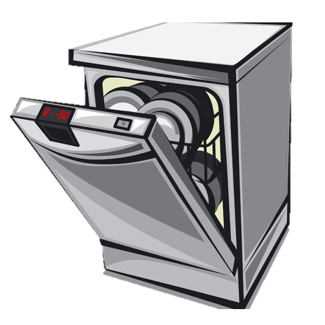
PRESENTATION
dish washer (n)
/dɪʃ ˈwɒʃə(r)/
máy rửa bát

Slide 8
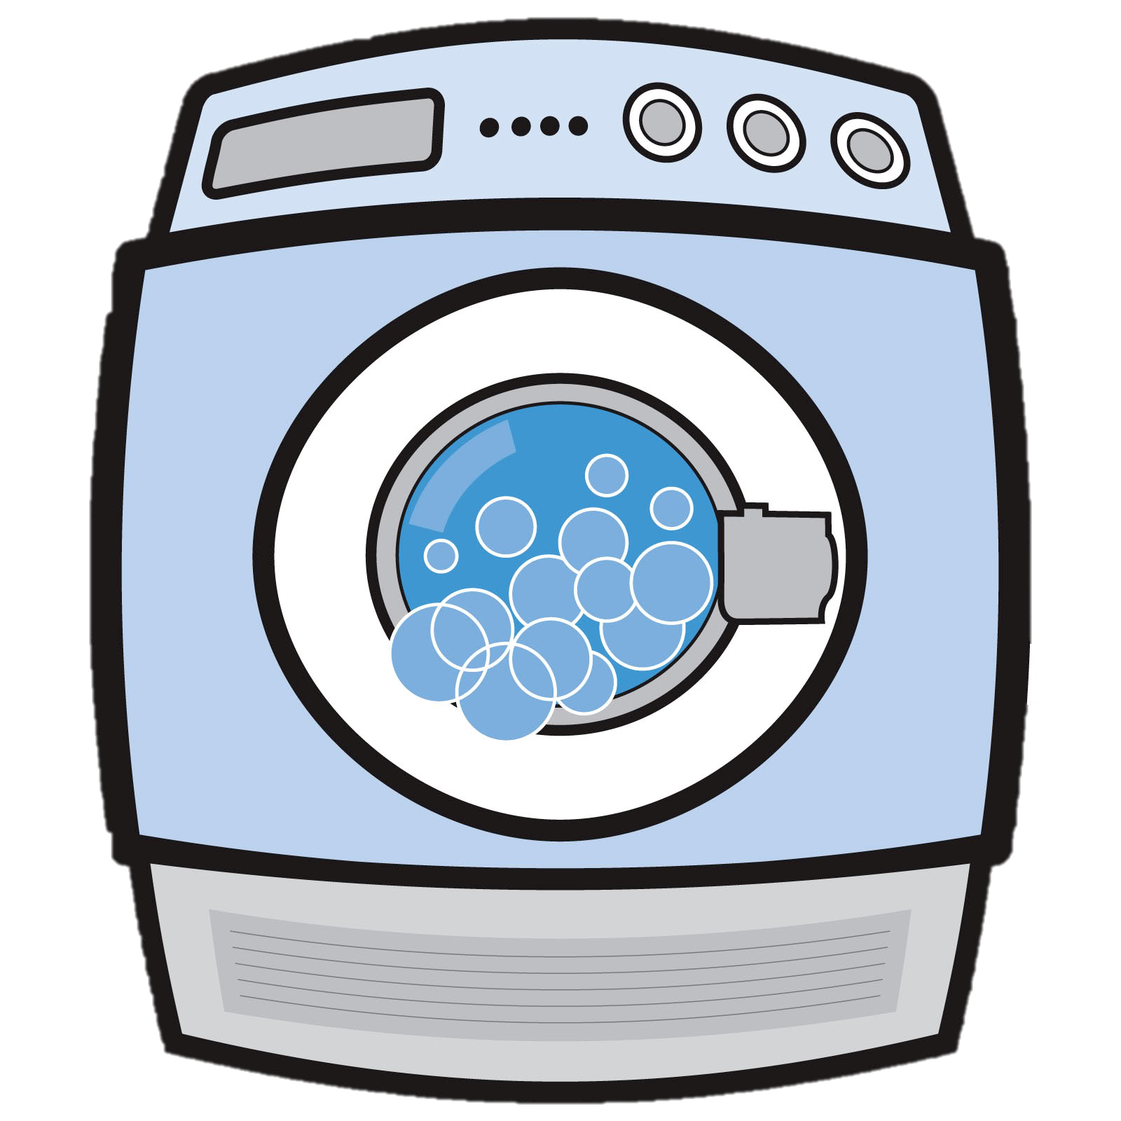
PRESENTATION
washing machine (n)
/ˈwɒʃiŋ məˈʃiːn/
máy giặt

Slide 9

PRESENTATION
wireless (a)
/ˈwaɪə(r)ləs/
không dây

Slide 10
PRESENTATION
New words | Pronunciation | Meaning
1. electric cooker (n) | /ɪˈlektrɪk ˈkʊkə(r)/ | bếp điện
2. dish washer (n) | /dɪʃ ˈwɒʃə(r)/ | máy rửa bát
3. washing machine (n) | /ˈwɒʃiŋ məˈʃiːn/ | máy giặt
4. wireless (adj) | /ˈwaɪə(r)ləs/ | không dây

Slide 11
PRACTICE
1
Put them in the appropriate columns. You may use some more than once
electric cooker
fridge
dishwasher
electric fan
washing machine
computer
wireless TV
smart clock
living room | bedroom | kitchen
wireless TV
wireless TV
fridge
electric fan
smart clock
electric cooker
smart clock
computer
dishwasher
computer
washing machine

Slide 12
PRACTICE
2
Match the appliances in A with what they can help us to do in B.
A
B
1. electric cooker
a. receive and send emails
2. dishwasher
b. keep food fresh
3. fridge
c. cook rice
4. washing machine
d. wash and dry dishes
5. computer
e. wash and dry clothes
What do you think these appliances can or might do more?

Slide 13

PRACTICE
3
Pair work: Ask and answer questions about what appliances can help us to do.
In pair
2 minutes.
Ask and answer.
Examples:
A: What does a wireless TV do?
B: It helps us watch TV programmes from space.

Slide 14

PRONUNCIATION
WORD-STRESS
4
4
Listen and repeat the words.
'picture 'robot 'bedroom
'kitchen 'housework 'palace
'village 'mountains
1. How many syllables in each word are there?
Two
2. What type of the words are there?
Noun
3. What stress does the noun fall on?
The first

Slide 15
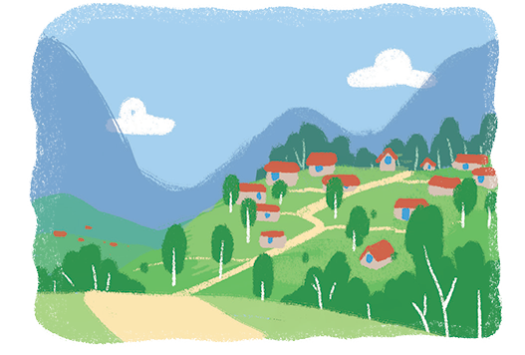
PRONUNCIATION
5
Listen and repeat the sentences. Pay attention to the stress of the underlined words.
1.The picture is on the wall of the bedroom.
2. The robot helps me to do the housework.
3. There's a very big kitchen in the palace.
4. Their village is in the mountains.
pic
bed
ro
house
kit
pa
vil
moun

Slide 16

PRODUCTION
UP AND DOWN
● Round 1: Teacher says 1-10 appliances. Students stand up for the ones in the kitchen, sit down for the ones in the bedroom.
● Round 2: Teacher says 1-10 words. Students stand up for the ones with the first stressed syllable, sit down for the second stressed syllable.

Slide 17

CONSOLIDATION
1
Wrap-up
What have we learnt in this lesson?
Vocabulary and structures about household appliances
Pronounce the two-syllable words correctly.

Slide 18
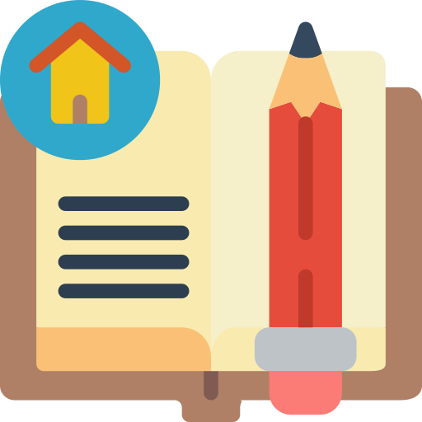
CONSOLIDATION
2
Homework
Write some sentences to describe at least 3 household appliances.

Slide 19






Website: hoclieu.vn
Fanpage: facebook.com/www.tienganhglobalsuccess.vn/

