Slide 1
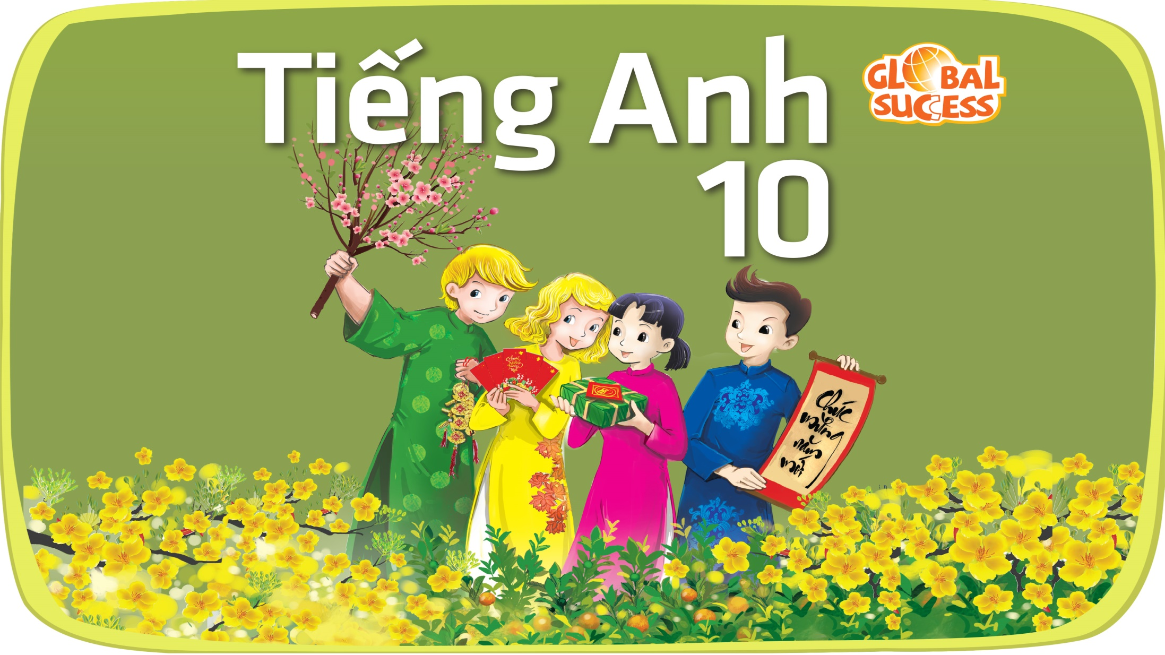

Slide 2

1
Unit
FAMILY LIFE
REVIEW 1
LESSON 3
SKILL 2_READING AND WRITING

Slide 3

Unit
1
1
FAMILY LIFE
Family Life
Unit
OBJECTIVES
Practice reading for general specific information about gender equality in sports;
practice writing a short paragraph about an international organisation.

Slide 4
LESSON 3
SKILL 2_ READING AND WRITING
Unit
GETTING STARTED
Quizzes
WARM-UP
Task 1: Read the text and match the highlighted words with their meanings. (p. 98)
Task 2: Read the text again and decide whether the statements are true (T) or false (F). (p. 98)
READING
WRITING
Write a paragraph (120 - 150 words) about an international organisation you have learnt about (e.g. UN, UNICEF, WTO). Use the outline below to help you. (p. 99)
Wrap up
Homework
CONSOLIDATION

Slide 5

LESSON 3
SKILL 2_ READING AND WRITING
Unit
GETTING STARTED
WARM-UP
Quizzes

Slide 6
LESSON 3
SKILL 2_ READING AND WRITING
Unit
GETTING STARTED
WARM-UP
Quizzes
1. In which country did rugby originate?
A. Canada B. England C. Pakistan D. New Zealand
2. What shape is a rugby ball?
A. perfectly round B. round with divots, like a big golf ball
C. Oval D. oval with pointed ends, like a U.S. football
3. What is the traditional/British word for a rugby field?
A. a rhomboid B. a rugger C. a venue D. a pitch

Slide 7
LESSON 3
SKILL 2_ READING AND WRITING
Unit
GETTING STARTED
WARM-UP
Quizzes
4. This organization, formed in 1949, is a military alliance among various North American and European states.
A. NATO B. ANZUS C. SEATO D. OECD
5. Where are the headquarters of the United Nations?
A. Belgium B. Switzerland C. New York D. France

Slide 8
LESSON 3
SKILL 2_ READING AND WRITING
Unit
GETTING STARTED
Quizzes
WARM-UP
Task 1: Read the text and match the highlighted words with their meanings. (p. 98)
Task 2: Read the text again and decide whether the statements are true (T) or false (F). (p. 98)
READING

Slide 9
READING
1
Task 1: Read the text and match the highlighted words with their meanings. (p. 98)
Gender equality in sports
In the Pacific Island of Fiji, a new sport programme enables both male and female school teachers to receive training as coaches. Rugby, which is often considered a male sport, is creating more opportunities for men and women in Fiji. For Kitiana Kaitu, a primary school teacher from Nasinu, Fiji, it was an honour to become a rugby coach. She has recently qualified as a coach and life skills trainer for this sport programme.
Sport can be used as a powerful tool to reject gender roles and build a healthy lifestyle. In the Pacific region, rugby is a particularly important sport. Kitiana Kaitu is now one of the highly skilled coaches who are discovering new ways to encourage both girls and boys in Fiji to play rugby
qualified
1. having enough knowledge and skills
2. give someone help or support
3. thought in a particular way
encourage
considered

Slide 10
READING
2
Task 2: Read the text again and decide whether the statements are true (T) or false (F). (p. 98)
 | T | F
1. Only male teachers are trained to become rugby coaches in Fiji.
2. Kitiana Kaitu is working at a primary school in Nasinu.
3. Kitiana is a qualified coach for the rugby programme.
4. Rugby and other sports can’t help change the expected behaviour for males and females in Fiji.
F
T
T
F

Slide 11
LESSON 3
SKILL 2_ READING AND WRITING
Unit
GETTING STARTED
Quizzes
WARM-UP
Task 1: Read the text and match the highlighted words with their meanings. (p. 98)
Task 2: Read the text again and decide whether the statements are true (T) or false (F). (p. 98)
READING
WRITING
Write a paragraph (120 - 150 words) about an international organisation you have learnt about (e.g. UN, UNICEF, WTO). Use the outline below to help you. (p. 99)

Slide 12
WRITING
1
Write a paragraph (120 - 150 words) about an international organisation you have learnt about (e.g. UN, UNICEF, WTO). Use the outline below to help you. (p. 99)
Sample answer:
UNICEF, also United Nations Children’s Fund, was formed in 1946. It works in over 190 countries to help improve health and education of children. Its main aims is to support the most disadvantaged children all over the world. In Viet Nam, UNICEF aims to protect children and make sure they are safe and healthy, and have access to education. UNICEF has brought many positive changes to Vietnamese children’s lives.
– Introduction: Name of organisation and when it was formed
– Development:
+ What is its role?
+ How does it help our country?
– Conclusion: Summary of the benefits

Slide 13
LESSON 3
SKILL 2_ READING AND WRITING
Unit
GETTING STARTED
Quizzes
WARM-UP
Task 1: Read the text and match the highlighted words with their meanings. (p. 98)
Task 2: Read the text again and decide whether the statements are true (T) or false (F). (p. 98)
READING
WRITING
Write a paragraph (120 - 150 words) about an international organisation you have learnt about (e.g. UN, UNICEF, WTO). Use the outline below to help you. (p. 99)
Wrap up
Homework
CONSOLIDATION

Slide 14
CONSOLIDATION
1
Wrap-up
Practice reading for general specific information about gender equality in sports;
Practice writing a short paragraph about an international organisation.

Slide 15
CONSOLIDATION
2
Homework
Prepare for Unit 9_ Getting started

Slide 16


