Slide 1


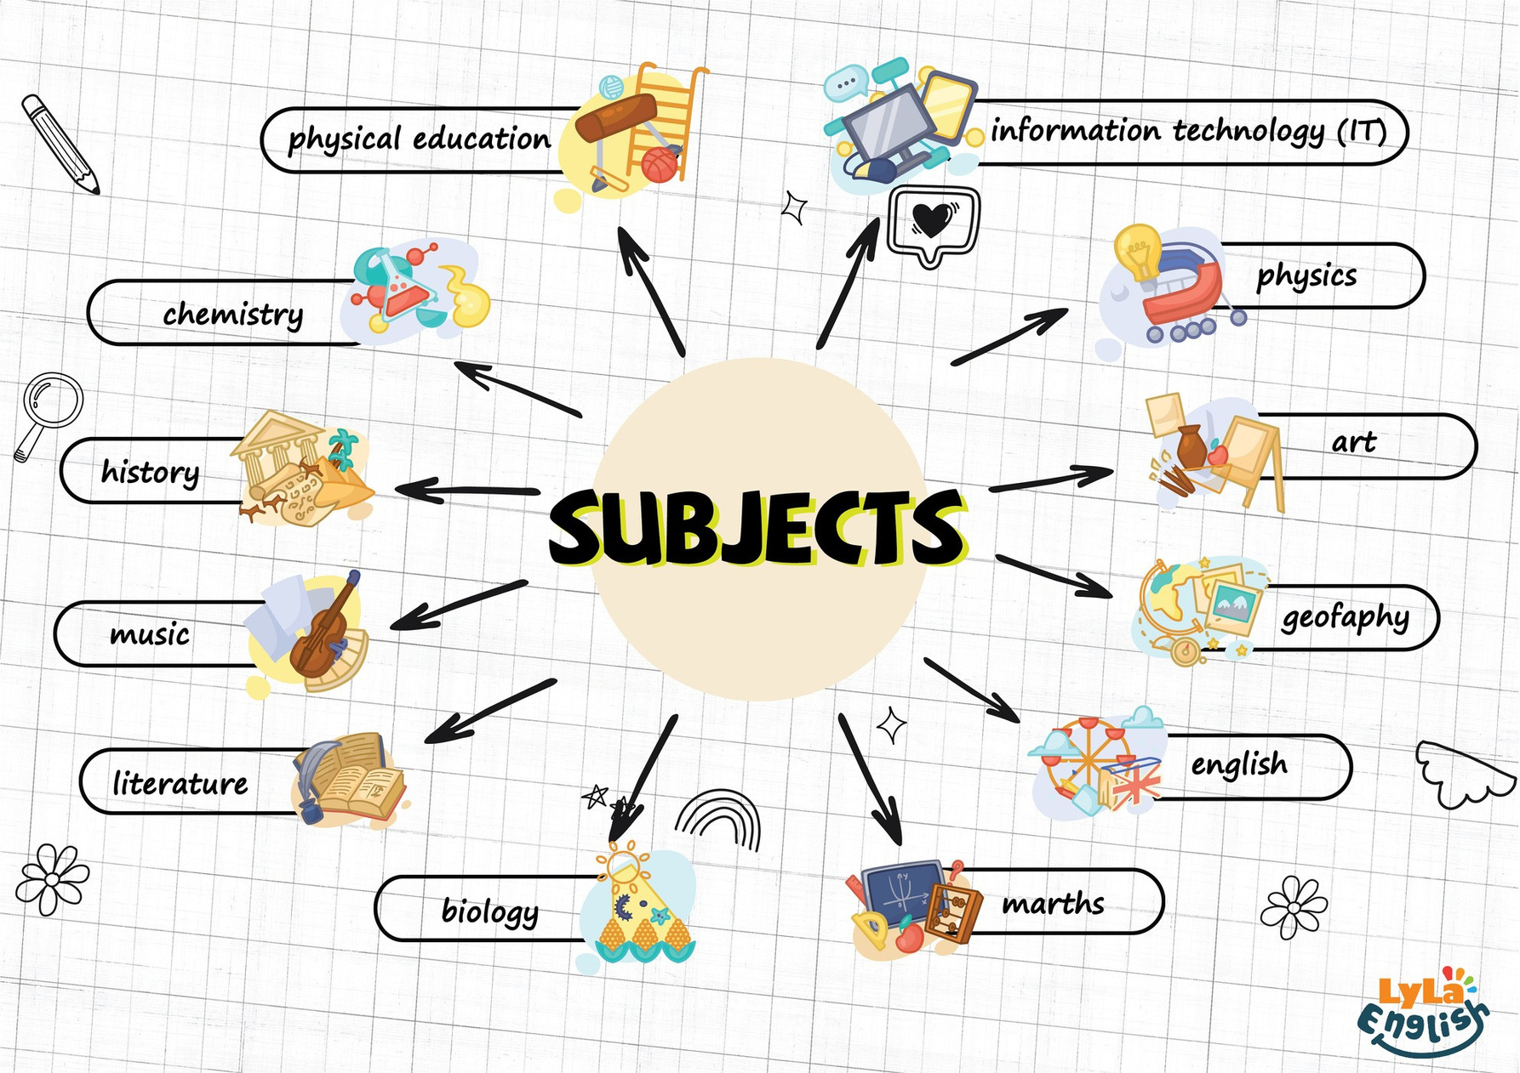


Slide 2




I. QUESTION
1. How many subject do you have at school?
- I have ... subjects.
2. What is your favorite subject?
- It’s ...
3. How often do you have Maths a week?
- ... times a week.
4. Who is your Maths teacher?
- Ms/Mr ...

Slide 3
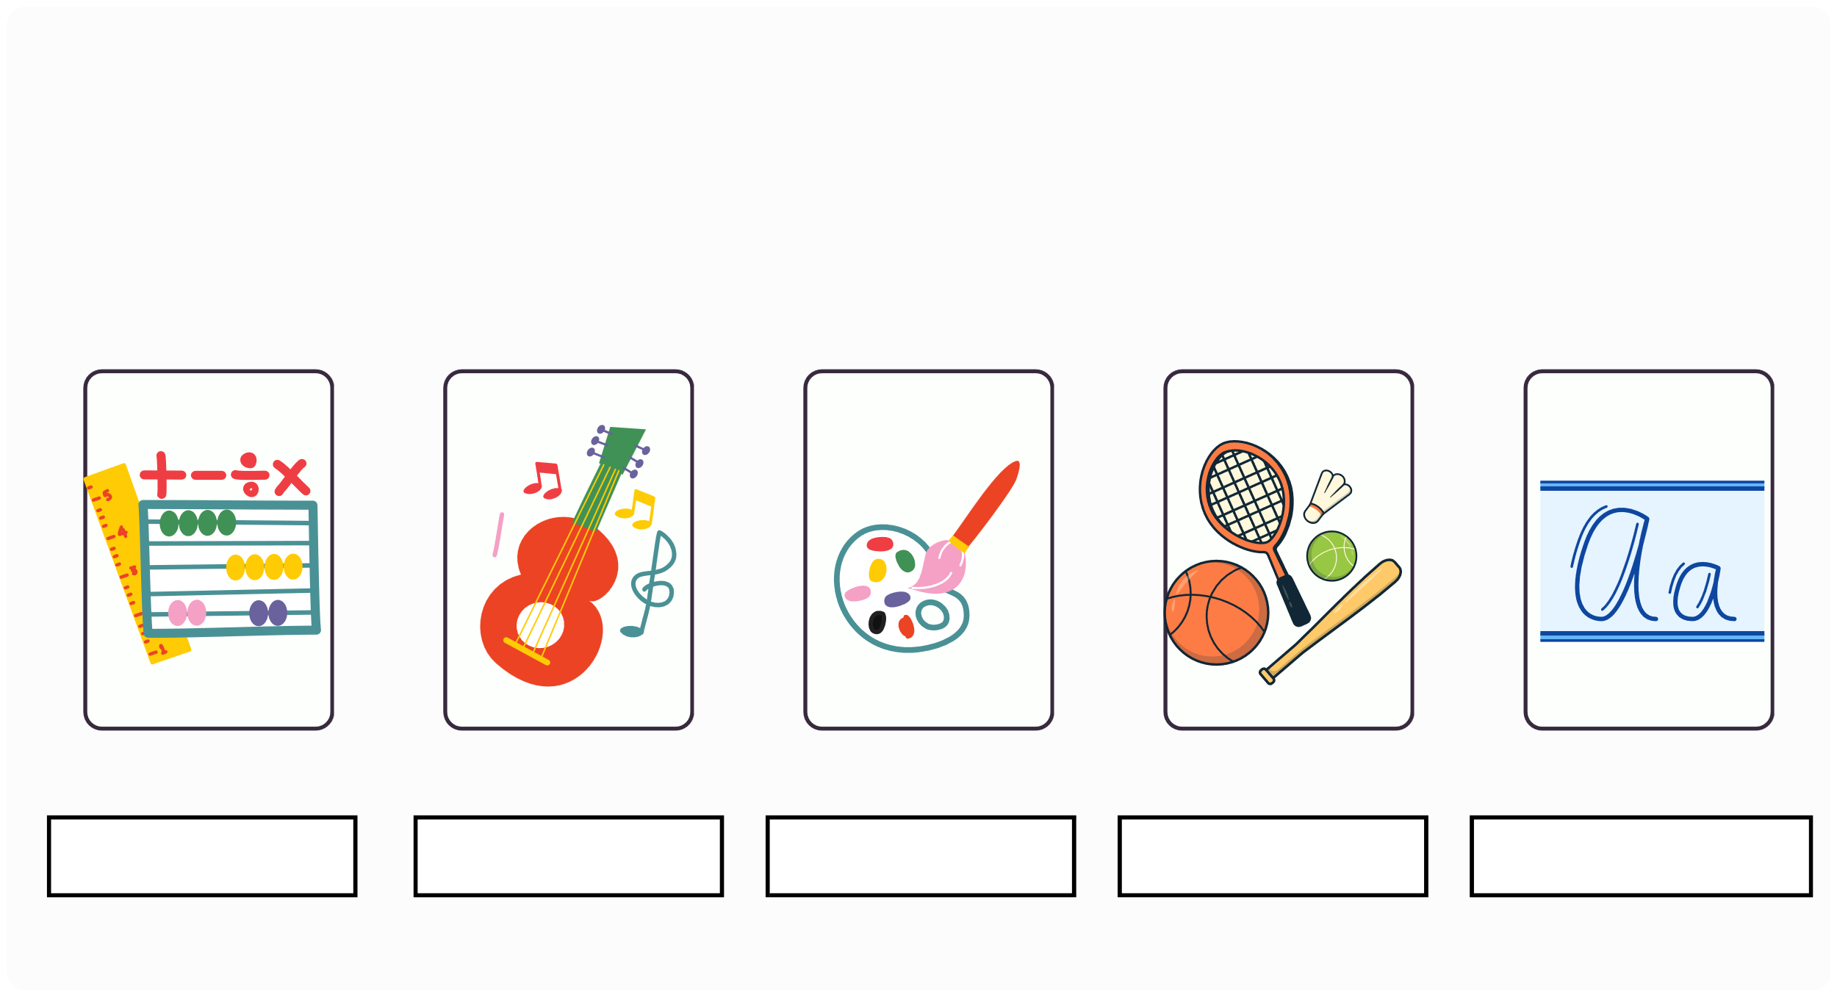
II. VOCABULARY
math
Maths
Music
Art
PE
Vietnamese

Slide 4

II. VOCABULARY
math
Biology
IT
History
English
Geography

Slide 5

III. EXERCISES:
1. Fill the school subjects:
Music
PE
Art
English
Maths

Slide 6
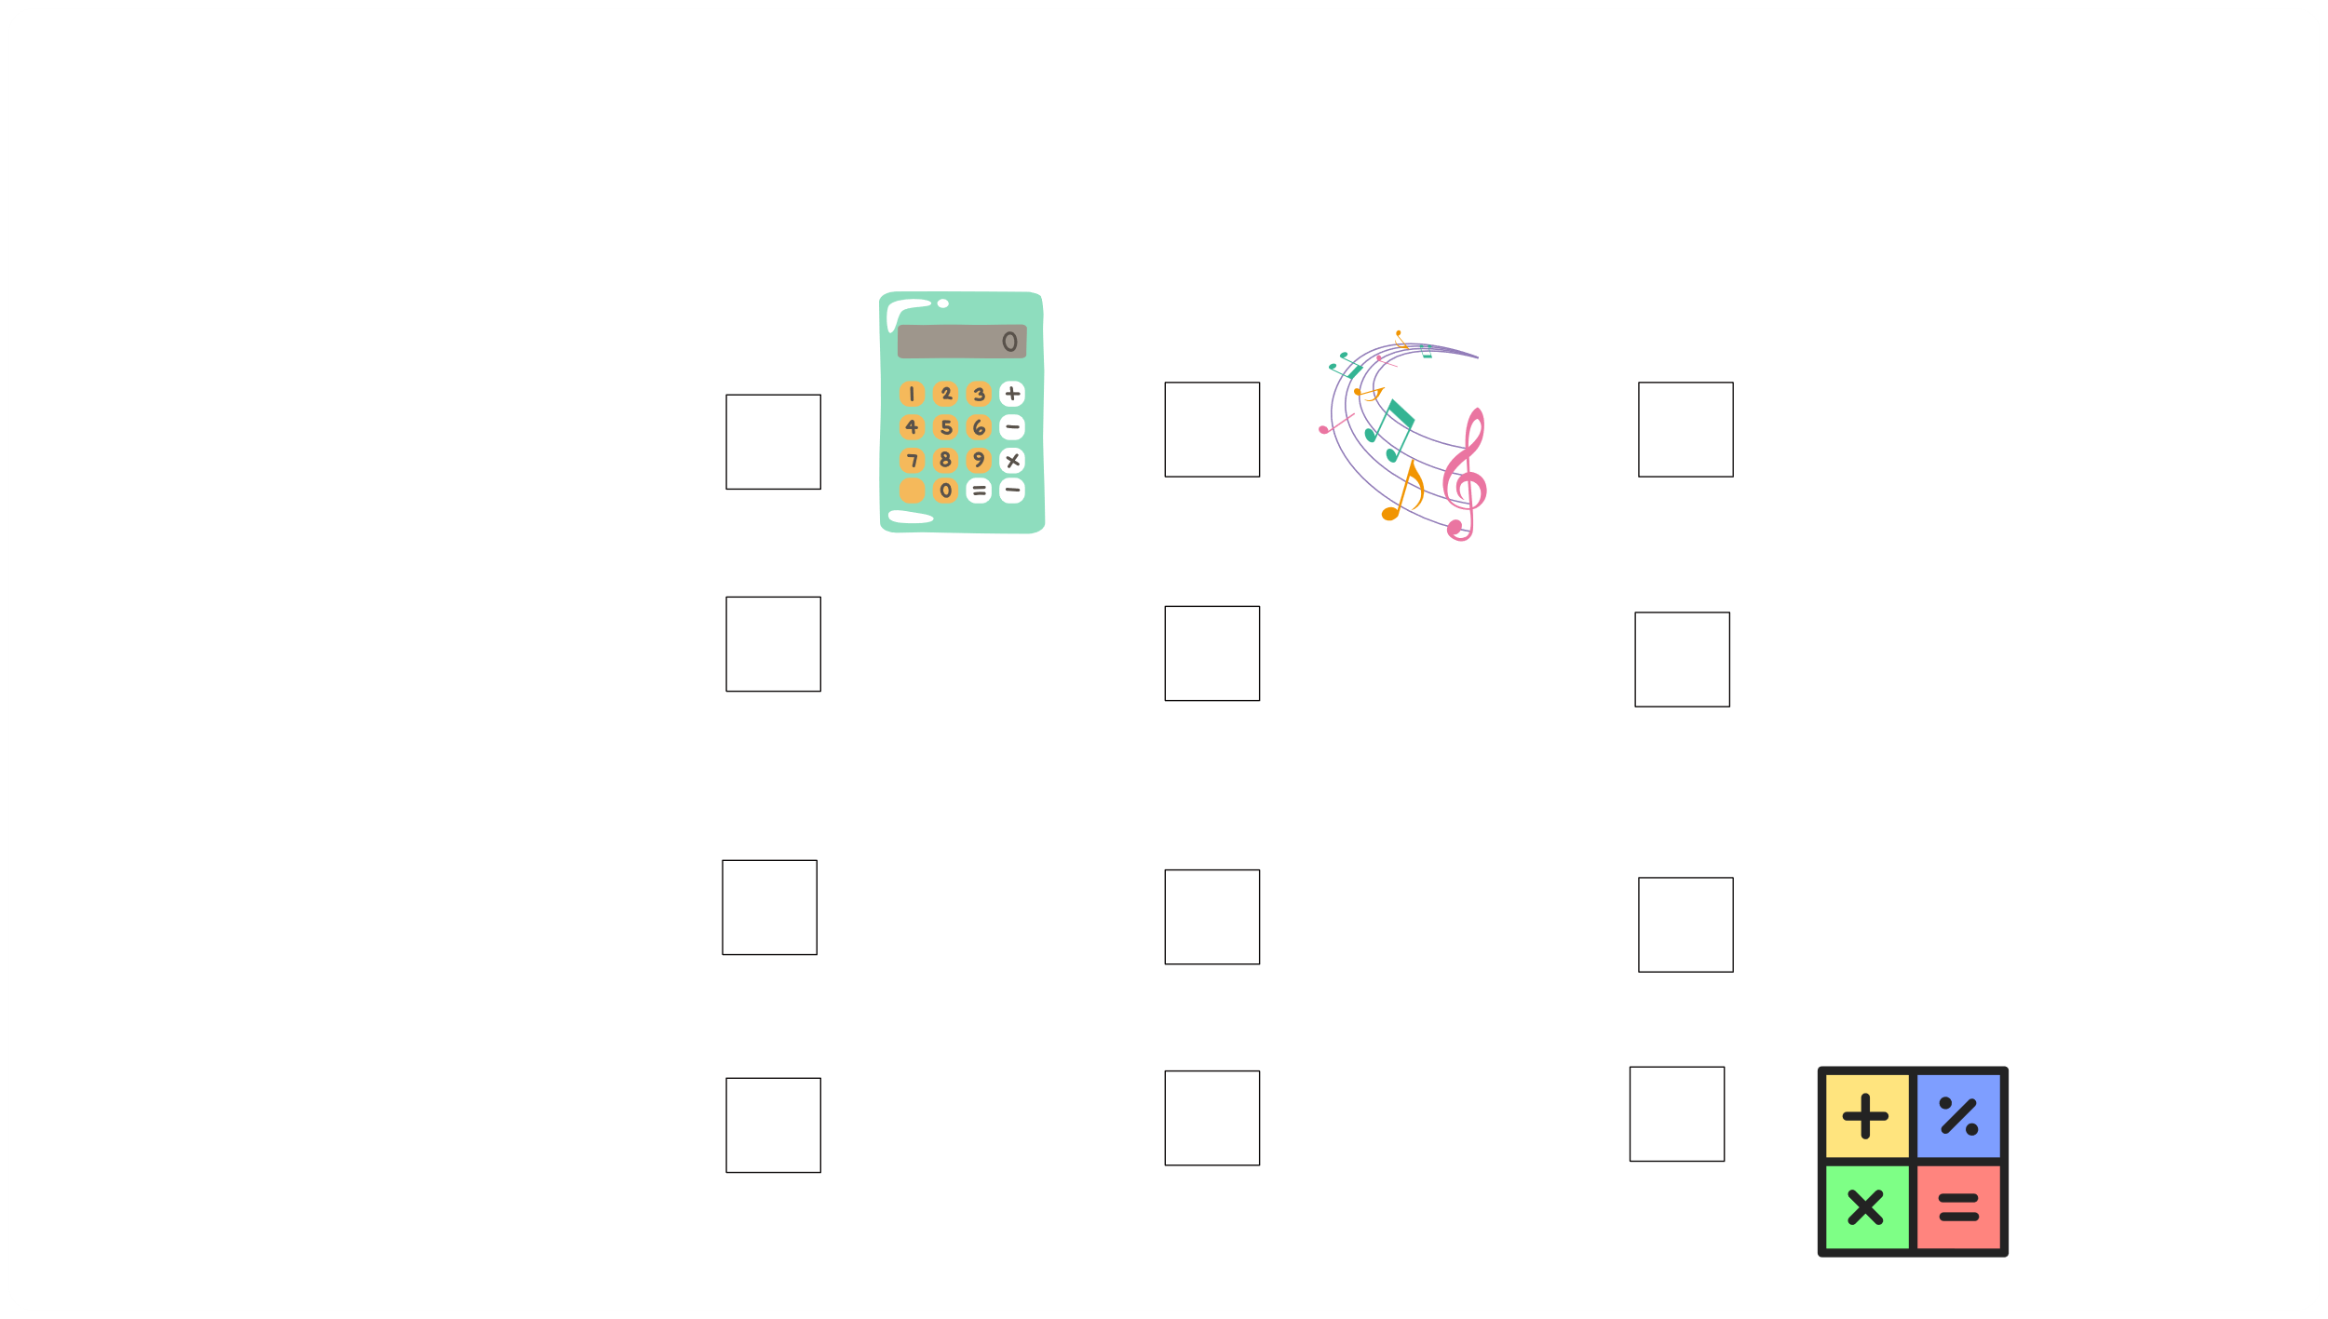









III. EXERCISES
2. Choose the correct answer:
Music
History
IT
Maths

Slide 7
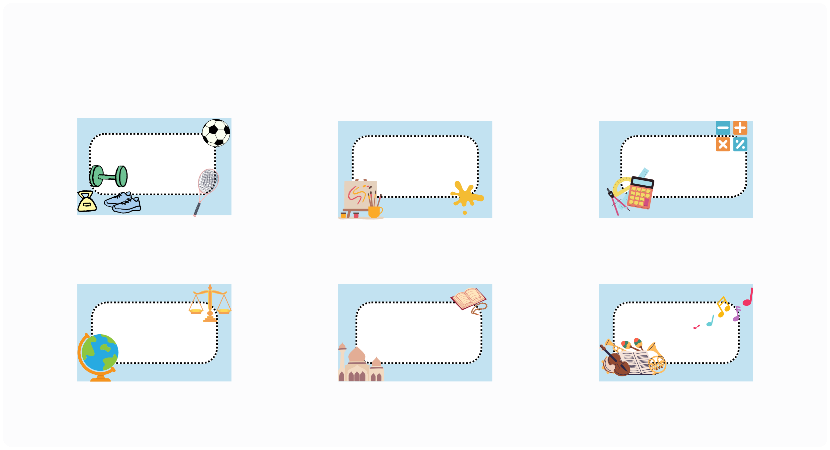
III. EXERCISES:
3. Write the names of subjects:

Slide 8

III. EXERCISES
4. Find and line the similar picture:

Slide 9



III. EXERCISES
5. Fill the words below:
s
)))))))))
M
B
s

Slide 10

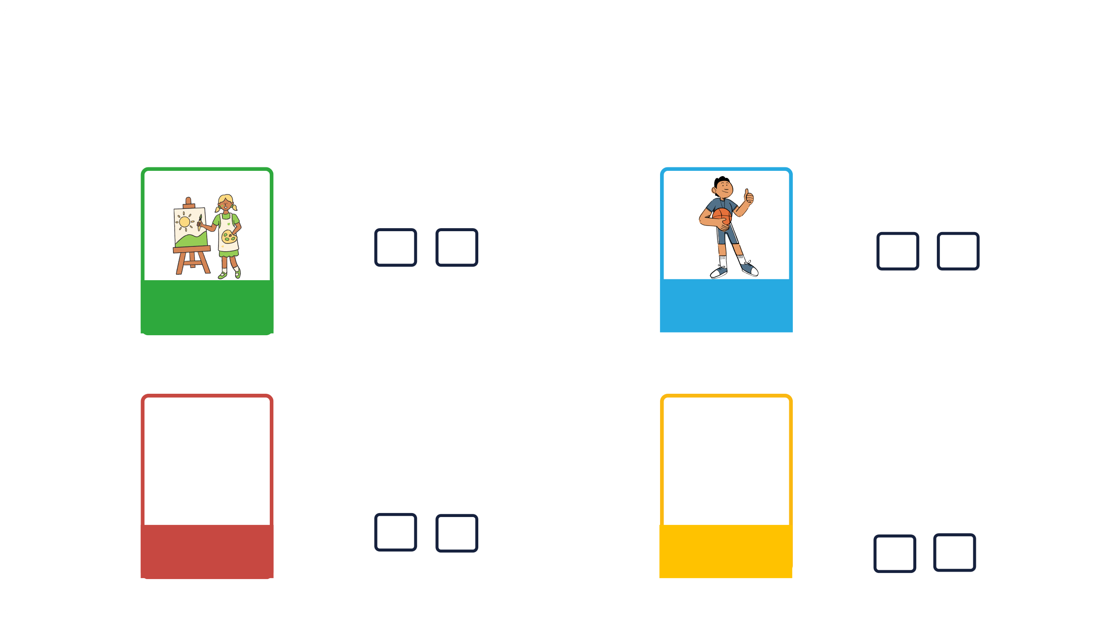


III. EXERCISES
6. Choose True or False:
art
art
PE
IT
English

Slide 11
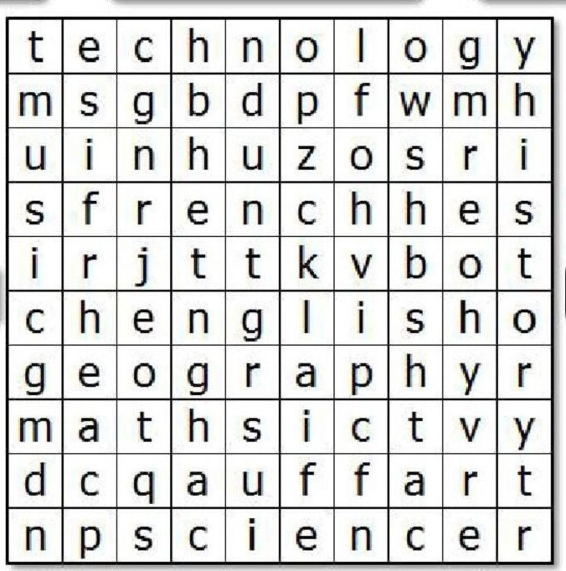
III. EXERCISES:
7. Find the subjects:
Music
Maths
Geography
English
Art

Slide 12



III. EXERCISES
8. Reorder the words:
u/m/i/c/s ...
a/t/m/s/h ...
h/s/i/r/o/t/y ...
b/o/i/o/l/y/g ...

