Slide 1
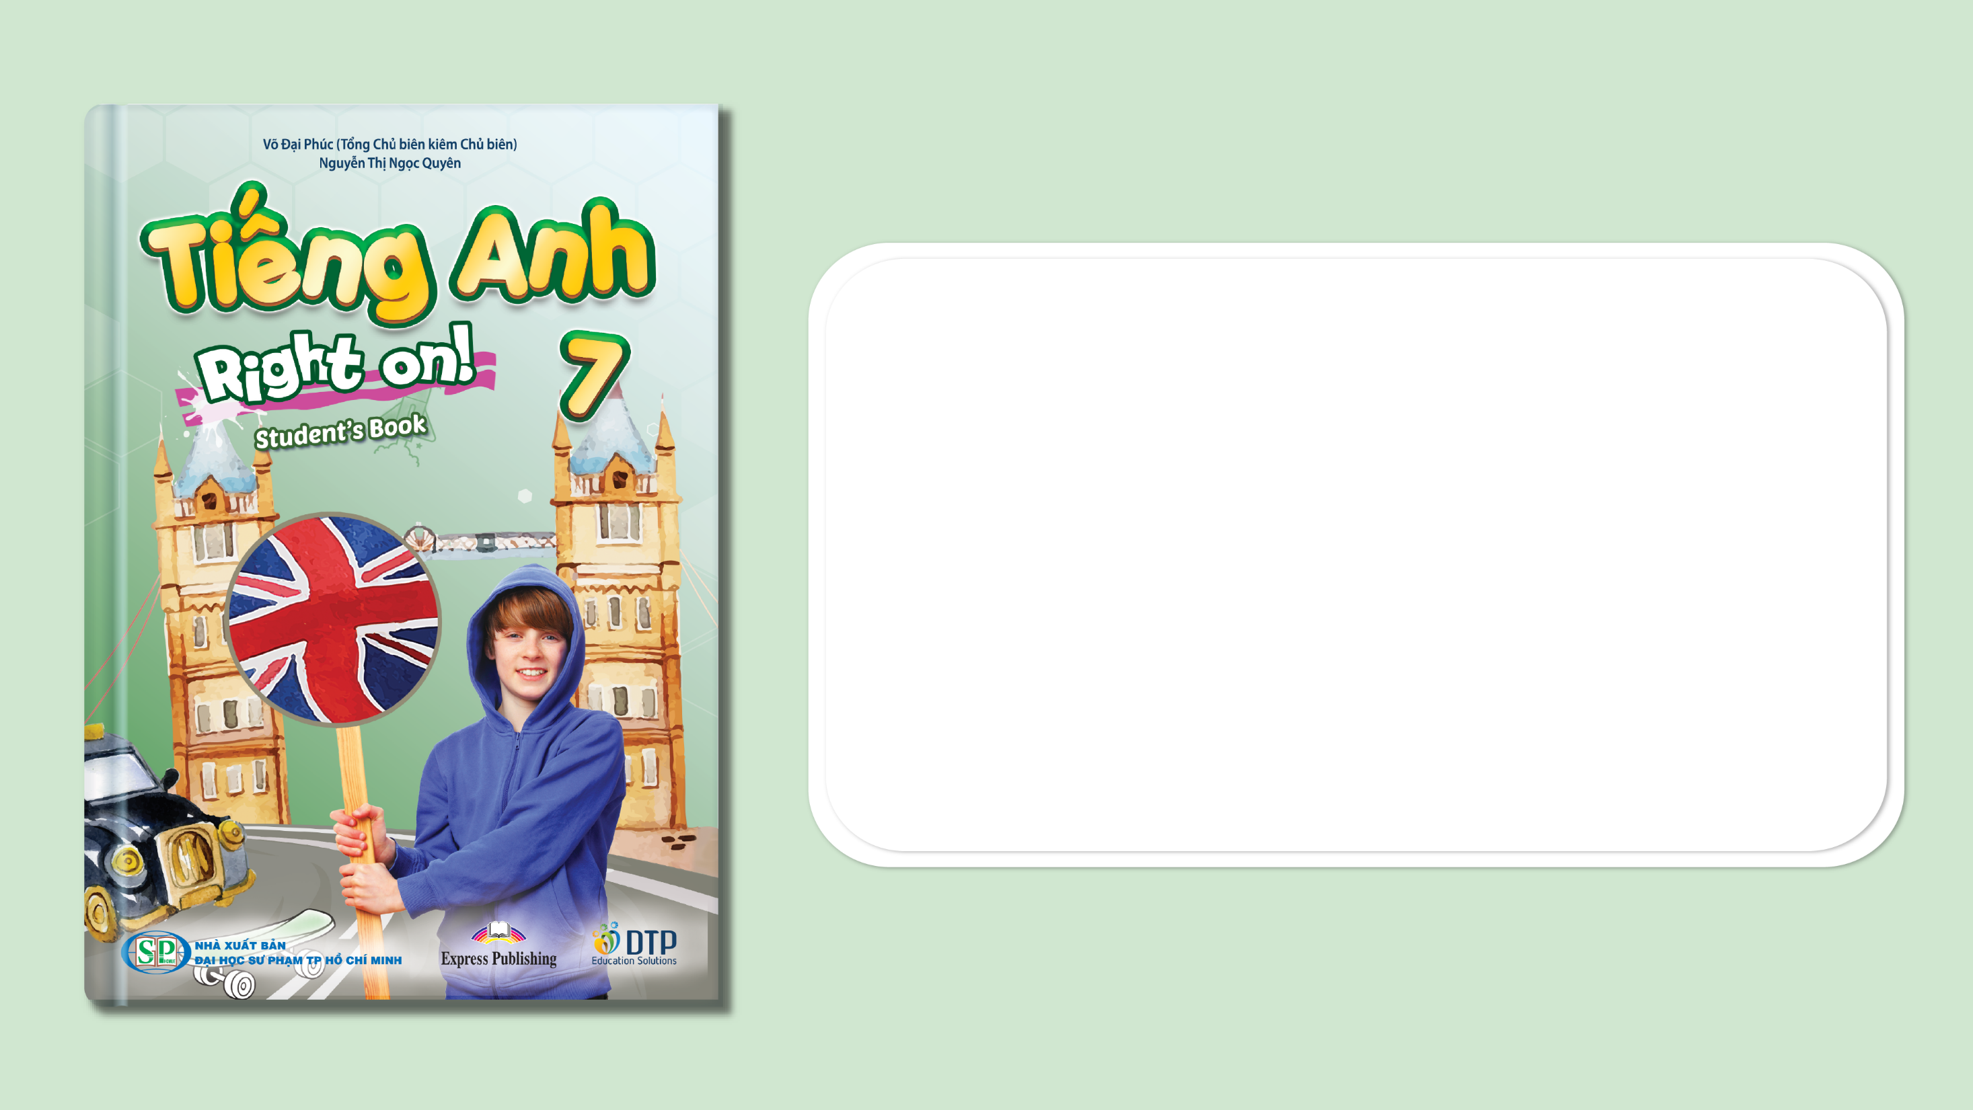
Unit 5: Travel & Transportation
Lesson 5e: Grammar
Page 86

Slide 2
Lesson Outline
Warm-up
Grammar
Consolidation
Wrap-up

Slide 3
Objectives
By the end of this lesson, students will be able to…
use structures: as ... as, not/so ... as, much + comparative.

Slide 4

WARM-UP

Slide 5

Teacher prepares 5 pairs of things (e.g. pencils and erasers, 2 notebooks, 2 pens, etc.), some pairs have equal prices and some have different prices. Teacher divides the whole class to some groups and asks them to compare the prices of each pair by saying: “A is as expensive as B.” or “A is not as expensive as B.”.
The group with the most correct answers is the winner.

Slide 6

It’s time to learn …

Slide 7

PRESENTATION
as ... as, not/so ... as, much + comparative

Slide 8
Choose suitable uses for the following structures:
• as ... as: ______________________________________
e.g. His car is as expensive as yours.
• not so/as ... as: __________________________________
e.g. Her house isn’t so/as big as yours.
• much + comparative: _____________________________
e.g. Planes are much faster than cars.
make comparative stronger
for two people, animals, things, etc. that aren’t the same
for two people, animals, things, etc. that are the same
for two people, animals, things, etc. that are the same
for two people, animals, things, etc. that aren’t the same
make comparative stronger

Slide 9
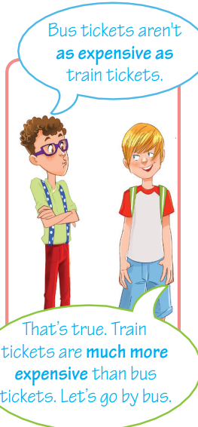
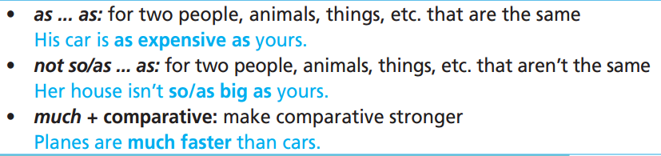
Remember:

Slide 10

PRACTICE

Slide 11
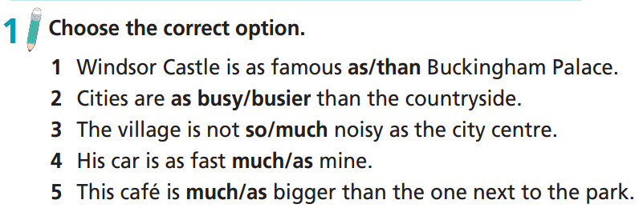

Slide 12
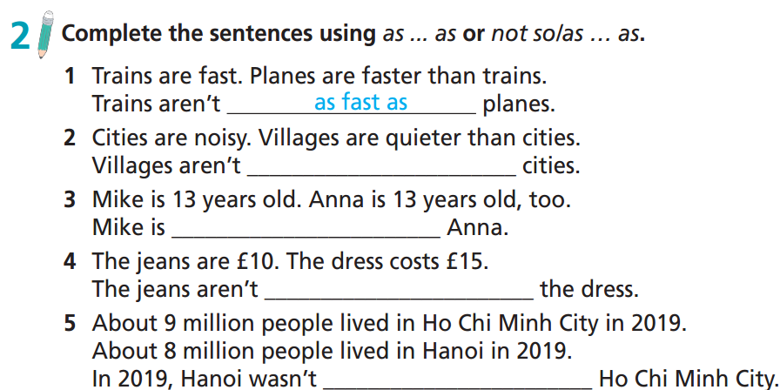
so/as noisy as
as old as
so/as expensive as
so/as crowded as

Slide 13
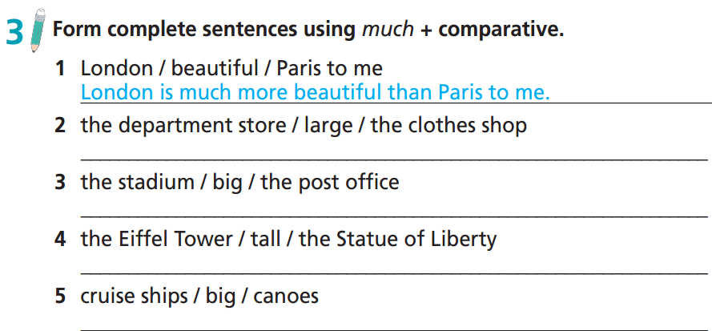
The department store is much larger than the clothes shop.
The stadium is much bigger than the post office.
The Eiffel Tower is much taller than the Statue of Liberty.
Cruise ships are much bigger than canoes.

Slide 14
Extra Practice
Grammar Bank, WB p. 73
57 ★ Choose the correct option.
1 The traffic is heavy/heavier on High Street than on Corner Street.
2 The market is as busy as/than the supermarket.
3 It takes longer/long to cross the city by car than on the underground train.
4 This part of town is much/more dangerous at night than in the daytime.
5 He feels more/much tired today than yesterday.
6 Tickets for the 2:30 performance are more cheap/cheaper than tickets for the 7:30 one.
7 Steve is more tall/taller than James.
8 This restaurant is more expensive/ expensiver than that one.
9 Alex is more good/better than Tom at maths.
10 Vietnamese cuisine is tasty/tastier than any other cuisine to me.

Slide 15
Extra Practice
Grammar Bank, WB p. 75
62 ★ Choose the correct option.
1 New York is as beautiful as/than London to me.
2 This museum is as/so interesting as the one we visited last week.
3 Julia isn’t so/much popular as her sister.
4 Departments stores are much/as nosier than clothes shops.
5 Villages aren’t so crowded as/than big cities.
6 Travelling by plane is much/so more comfortable than travelling by train.

Slide 16
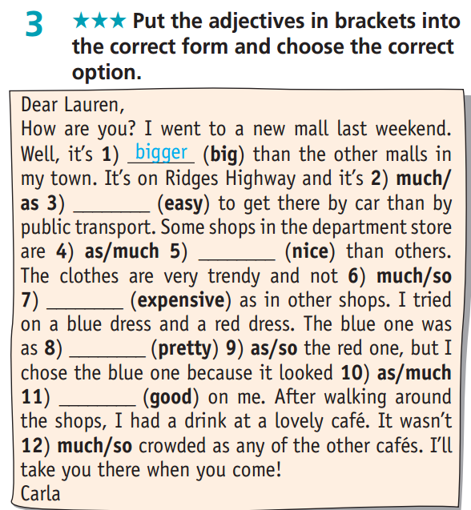
Extra Practice
WB p. 46
easier
nicer
expensive
pretty
better

Slide 17
PRODUCTION

Slide 18
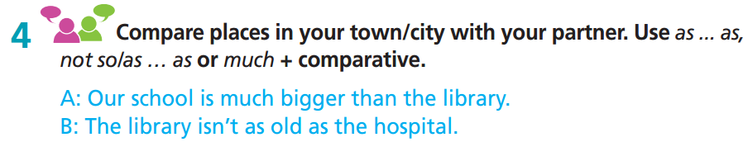
Work in pairs
My town/village is much quieter than the city centre.
The city centre isn’t as quiet as my town/ village.

Slide 19
Report about your comparison of places in your city/ town.
Hi, my name is ……. I live in ……. There are some similarities in places here. …… as …… as………. There are also some differences in this city/ town ……….. not so/as ……………

Slide 20

CONSOLIDATION

Slide 21
Write a paragraph (60-80 words) to compare things / places around you. Remember to use structures: as… as, not so/as … as, much + comparative.
E.g.
My school is not as famous as other schools in the town, but it is much larger than many others. It has many rooms and a large playground. My school is as old as me because my mum told me that it was built the year I was born. The canteen is as large as the library. Both are much larger than other rooms in the school.

Slide 22

WRAP-UP

Slide 23
Today’s lesson
Grammar
learn and practise structures: as ... as, not/so ... as, much + comparative.

Slide 24
Homework
Practise the grammar points and make sentences using them.
Do the exercises in TA 7 Right on WB (page 46)
Prepare the next lesson (page 87 SB)
Complete the grammar notes in TA 7 Right on Notebook (page 40)

Slide 25

Enjoy your day!

