Slide 1

Unit 1: Home and Places
Lesson 1: Progress Check 1
Page 34

Slide 2
Lesson Outline
Warm-up
Vocabulary
Grammar
Speaking
Consolidation
Wrap-up

Slide 3
Objectives
By the end of this lesson, students will be able to…
- Review vocabulary related to houses.
- Review grammar and structures: there is/ there are - some/any - possessive cases - this/these/that/those

Slide 4

WARM-UP

Slide 5
Choose the word whose underlined part is pronounced differently from that of the others.
1 A. rabbit B. parrot C. sofa D. cabinet
/ˈræbɪt/
/ ˈpærət/
/ˈsəʊfə/
/ ˈkæbɪnət/
2 A. city B. office C. tennis D. cousin
/ˈsɪti/
/ ˈɒfɪs/
/ˈtenɪs/
/ ˈkʌzən/
3 A. watch B. ball C. wall D. hall
/wɒtʃ/
/ bɔːl/
/wɔːl/
/hɔːl/

Slide 6

It’s time to learn …

Slide 7

Vocabulary

Slide 8
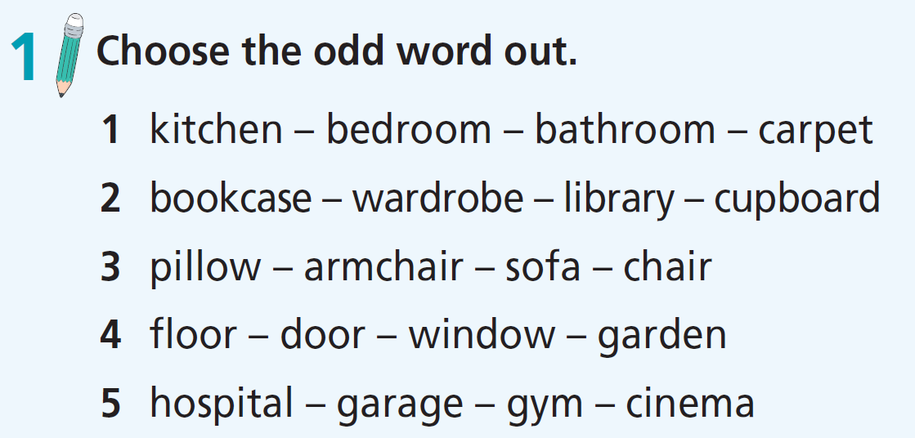

Slide 9
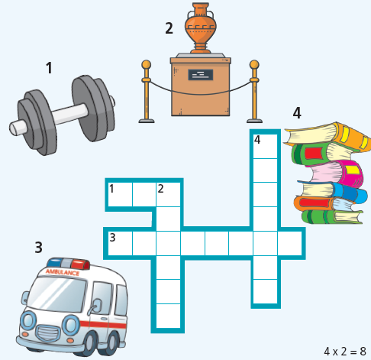
2 Find the places and complete the crossword.
1. GYM
2. MUSEUM
3. HOSPITAL
4. LIBRARY

Slide 10
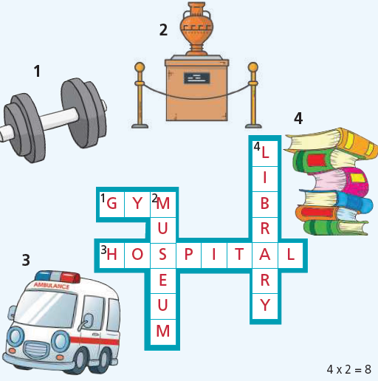
2 Find the places and complete the crossword.
1. GYM
2. MUSEUM
3. HOSPITAL
4. LIBRARY

Slide 11

Grammar

Slide 12
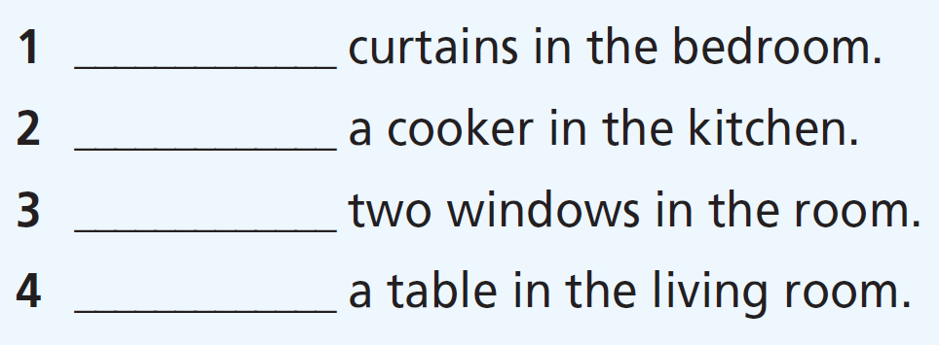
3. Fill in the gaps with there is or there are.
There are
There is
There are
There is

Slide 13
4. Fill in the gaps with some or any.
any
1 Are there __________ books on the desk?
2 There are __________ pillows on the bed.
3 There aren’t ____________ posters on the wall.
4 There are ____________ cupboards in the kitchen.
some
any
some

Slide 14
5. Choose the correct item.
1 These are the men’s/mens’ hats.
2 The sofa is under/opposite the chair.
3 These are the girls/girl’s dresses.
4 The carpet is above/in front of the bed.
5 The wardrobe is in/near the bed.

Slide 15
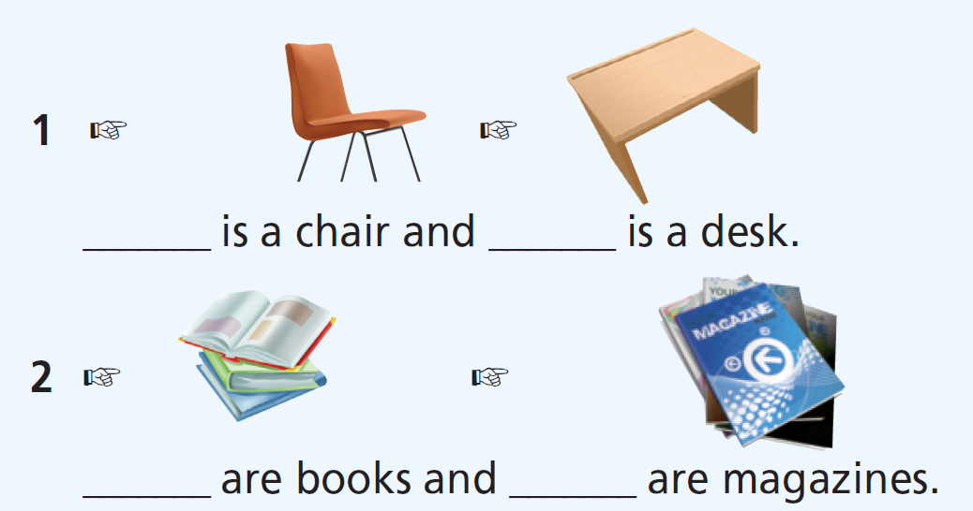
6. Fill in the gaps with this, these, that, or those.
That
this
These
those

Slide 16
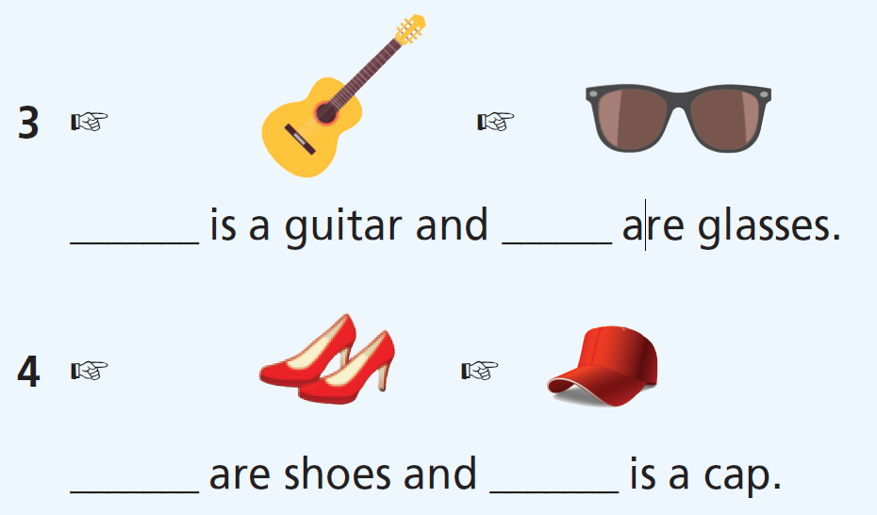
6. Fill in the gaps with this, these, that, or those.
That
these
Those
this

Slide 17
More Practice
WB p. 19
★ Fill in the gaps with some or any.
1 There are ___________ beautiful cottages in the countryside.
2 Are there ___________ parks in your neighbourhood?
3 There are __________ posters on the wall.
4 Are there ___________ chairs in the living room?
5 There are ___________ books on the table.
6 There aren’t ___________ students in the classroom.
some
any
some
any
some
any

Slide 18
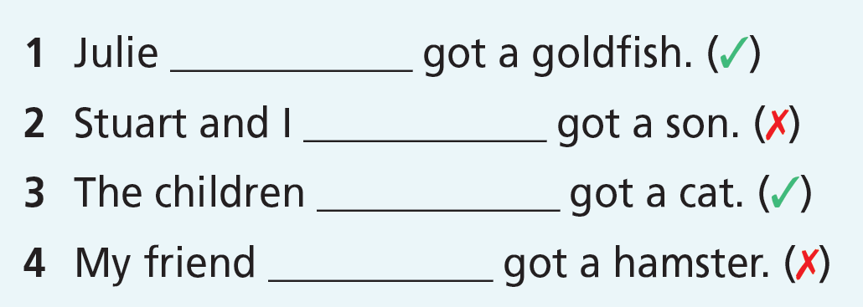
More Practice
WB p. 19
★ Fill in the gaps with have/haven’t or has/hasn’t.
has
haven’t
have
hasn’t

Slide 19

Speaking

Slide 20
Complete the dialogue with:
It’s great!
What’s your new house like?
Is there a balcony?
What’s your room like?
A: Hi, Paul! 1) ____________________________
B: Hi, Jessie! 2) ____________________________. It’s got a kitchen, a living room and a bathroom downstairs, and two bedrooms and a bathroom upstairs.
A: 3) ____________________________
B: It’s not very big. There’s a bed, a desk and a chair.
A: 4) ____________________________
B. Yes, there is.

Slide 21
Post-writing:
Peer Correction:
Work in pair and exchange your letters. Check and give comments to your friend’s letter. (Pay attention to punctuation)

Slide 22

CONSOLIDATION

Slide 23
Write a paragraph (about 40-60 words) to describe your house.

Slide 24

WRAP-UP

Slide 25
Today’s lesson
Vocabulary
- vocabulary related to houses.
Grammar
- there is/ there are
- some/any
- possessive cases
- this/these/that/those

Slide 26
Homework
Practise the vocabularies and grammar and make sentences using them.
Do the exercises in TA 6 Right on WB (pp. 18-19).
Prepare the next lesson (p. 35 SB).
Do Unit 1 Test 2 in Bài Tập Bổ Trợ TA 6 Right on (pp. 14-15).

Slide 27
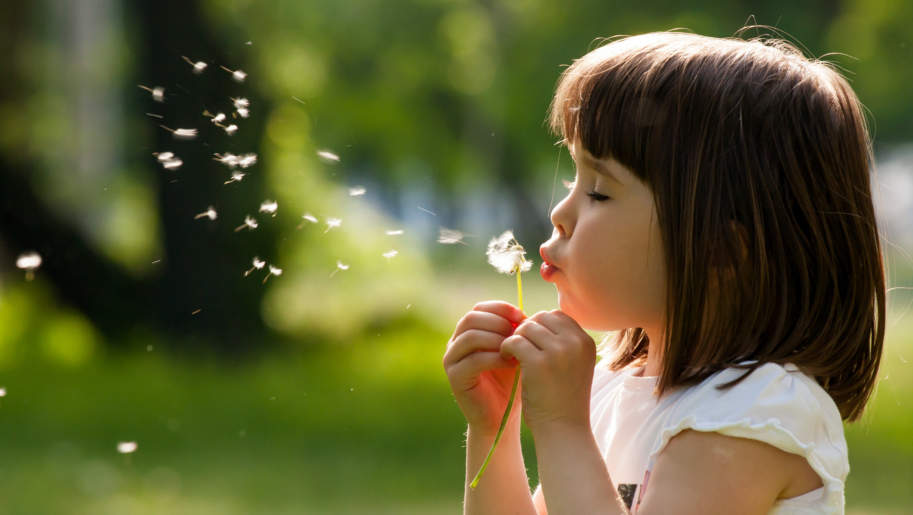
Enjoy your day!

