Slide 1

UNIT 4: DISASTERS
Review
page 93

Slide 2
Lesson Outline
Warm-up
Vocabulary
Grammar
Pronunciation
Writing
Consolidation
Wrap-up

Slide 3

By the end of this lesson, students will be able to…
Review the target language learnt in the unit
Practice test taking skills

Slide 4

WARM UP

Slide 5
In groups. Ask and answer the questions:
What should we do during a wildfire
a flood ?
an earthquake
What shouldn’t we do?

Slide 6

Vocabulary

Slide 7

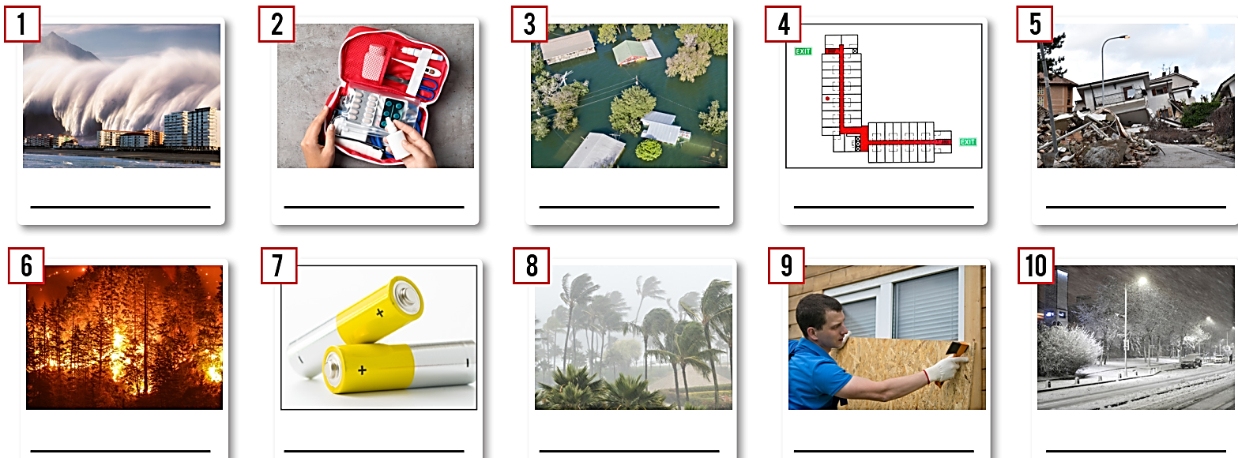
tsunami
first aid kit
flood
escape plan
earthquake
hurricane
blizzard
wildfire
batteries
board up

Slide 8
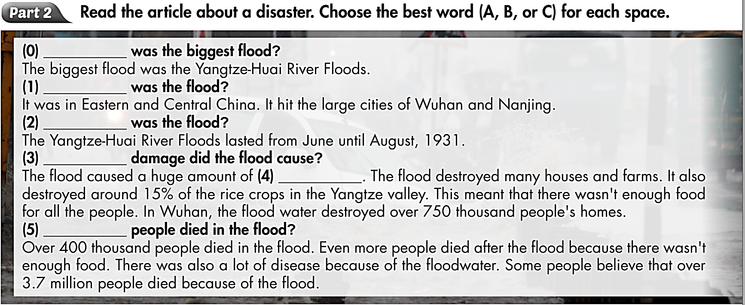
Read the article about a disaster. Choose the best answer (A, B, or C).
Extra Practice
p.53, WB
Example:
0. A. What B. How C. When
1. A. How B. How many C. Where
2. A. How many B. When C. What
3. A. When B. How C. How much
4. A. damage B. destroy C. lost
5. A. How many B. What C. How much

Slide 9
Grammar

Slide 10
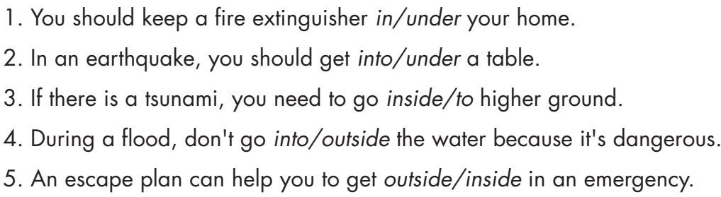

Slide 11
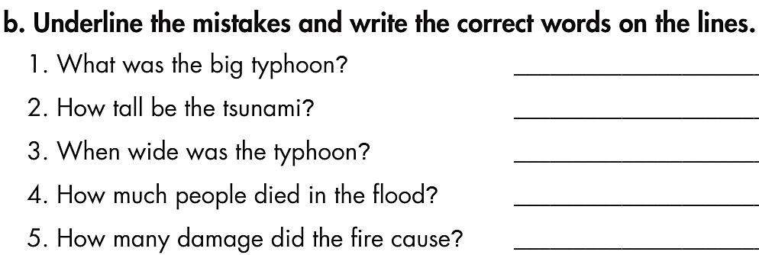
biggest
was
How
many
much

Slide 12
Pronunciation

Slide 13
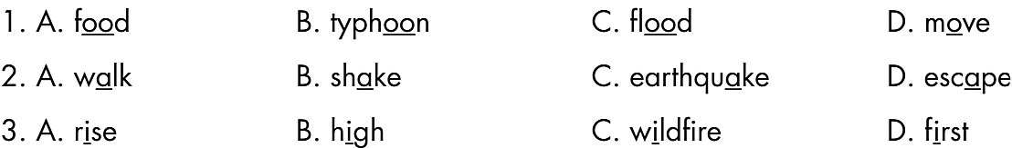

Slide 14
Writing

Slide 15
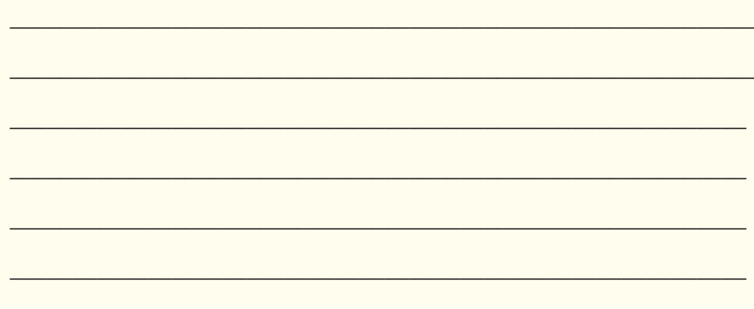
Pre - writing
Read the instruction quickly. Underline the key words.
What are we going to do?
Write an announcement from 80 to 100 words.

Slide 16

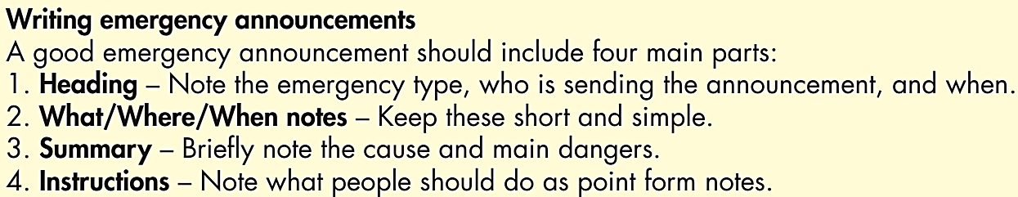
While - writing
Write an emergency announcement including 4 parts in the Writing Skill box.

Slide 17
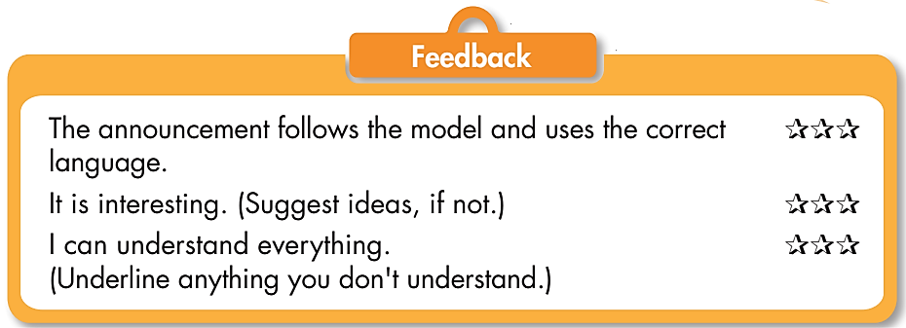
Post - writing
In pairs:
- Swap the writing.
- Check your partner’s writing for grammar and spelling mistakes (if any).
- Give feedback based on the Feedback form.

Slide 18

CONSOLIDATION

Slide 19
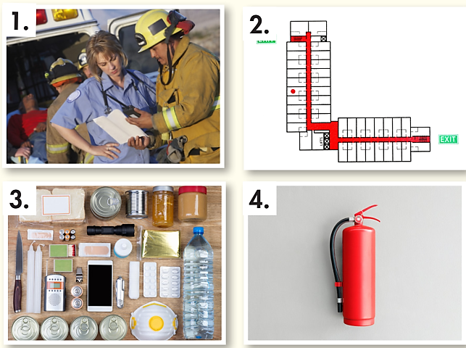
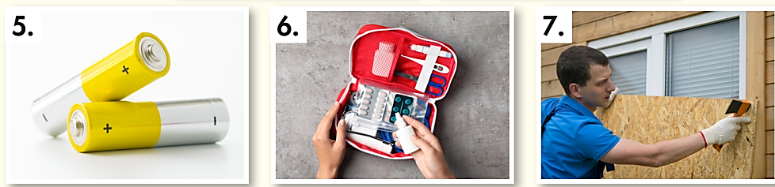

In pairs. Test your partner’s memory on the vocabulary in the pictures.

Slide 20
Listen and repeat.
______________
board up (phr v) /bɔːrd ʌp/ bịt kín
escape plan (n) /ɪˈskeɪp plæn/ sơ đồ thoát hiểm
fire extinguisher (n) /ˈfaɪər ɪkˌstɪŋɡwɪʃə/ bình cứu hỏa
first aid kit (n) /ˌfɜːrst ˈeɪd kɪt/ bộ sơ cứu
battery (n) /ˈbætəri/ pin
supplies (n) /'səplaɪz/ nhu yếu phẩm
stock up (phr v) /stɑːk ʌp/ dự trữ
emergency services (n) /ɪˈmɜːrdʒənsi sɜːrvɪsɪz/ dịch vụ cấp cứu, cứu hộ

Slide 21

WRAP-UP

Slide 22
Today’s lesson
Review the target language learnt in the unit
Practice test taking skills

Slide 23
Homework
Review Unit 4 about disasters.
Do the exercises on page 53, WB.
Prepare the next lesson (page 44, SB).
Play the consolidation games on www.eduhome.com.vn

Slide 24

Lesson 3
Stay positive and have a nice day!

