Slide 1


Slide 2

Unit
5
1
Unit
FAMILY LIFE
INVENTIONS
LESSON 7
COMMUNICATION AND CULTURE/ CLIL
Artificial intelligence

Slide 3

Unit
1
1
FAMILY LIFE
Family Life
Unit
OBJECTIVES
Practise making and respond to requests.
Know more information about computer hardware.

Slide 4
LESSON 7
COMMUNICATION AND CULTURE/ CLIL
WARM-UP
Card game
Task 1: Listen and complete the conversation.
Task 2: Role-play.
EVERYDAY ENGLISH
Task 1: Match the highlighted words with their meanings.
Task 2: Decide which one is most suitable.
CLIL
CONSOLIDATION
Wrap-up
Homework

Slide 5
LESSON 7
COMMUNICATION AND CULTURE/ CLIL
WARM-UP
Card game

Slide 6

CARD GAMES
Select word cards about computer
Stick the cards on sheets of A1 paper.
Stick the sheets of A1 paper on the walls/ board.
Laptop Screen
Hardware Software
Speed Document
Display Battery
Light Weight
Size Brand
Program Memory
Data

Slide 7
LESSON 7
COMMUNICATION AND CULTURE/ CLIL
WARM-UP
Card game
Task 1: Listen and complete the conversation.
Task 2: Role-play.
EVERYDAY ENGLISH

Slide 8

EVERYDAY ENGLISH
1
Listen and complete the conversation.
A. can you let me know about
B. Can you please recommend
C. Certainly
D. Feel free to ask me if you need further information
E. Sure
Tim: Hello. I’m looking for a laptop. (1) ________ a good one to me?
Shop assistant: (2) ________, but (3) ______ your needs first?
Tim: (4) ________. I’m a student, so I’d like a cheap and light laptop.
Shop assistant: Then I think this laptop is the best one for you. You can take a look at it. (5) ________.
B
C
A
E
D

Slide 9
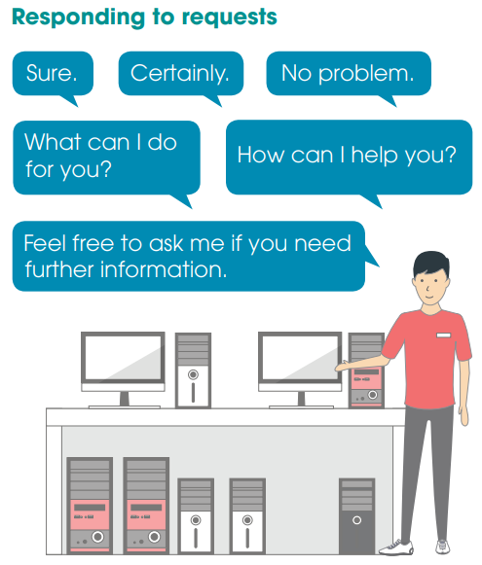
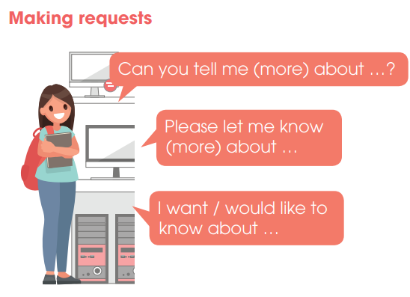
PRACTICE
2
Role-play

Slide 10
LESSON 7
COMMUNICATION AND CULTURE/ CLIL
WARM-UP
Card game
Task 1: Listen and complete the conversation.
Task 2: Role-play.
EVERYDAY ENGLISH
Task 1: Match the highlighted words with their meanings.
Task 2: Decide which one is most suitable.
CLIL

Slide 11
CLIL
1
Match the highlighted words and phrases with their meanings.
processor
RAM
displayed
storage space
store
shown
to keep something and use it later
the part of the computer that controls all other parts
a type of computer memory
the amount of information at computer can keep

Slide 12
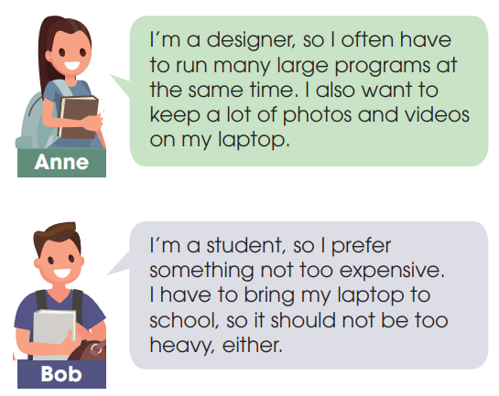
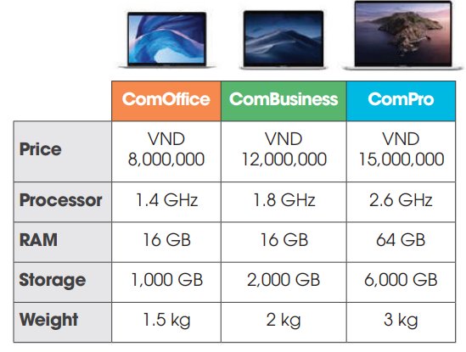
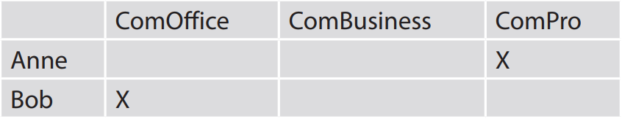
CLIL
2
Decide which one is most suitable for each person below.

Slide 13
LESSON 7
COMMUNICATION AND CULTURE/ CLIL
WARM-UP
Card game
Task 1: Listen and complete the conversation.
Task 2: Role-play.
EVERYDAY ENGLISH
Task 1: Match the highlighted words with their meanings.
Task 2: Decide which one is most suitable.
CLIL
CONSOLIDATION
Wrap-up
Homework

Slide 14
CONSOLIDATION
1
Wrap-up
Know how to make and respond to requests.
Know more information about computer hardware.

Slide 15
CONSOLIDATION
2
Homework
1. Prepare for the next lesson: Unit 5 – Looking back and project
2. Do exercises in the workbook

Slide 16

Website: hoclieu.vn
Fanpage: facebook.com/www.tienganhglobalsuccess.vn

