Slide 1

Unit 2: Fit for life
Lesson 2f: Skills
(Cont.)
Page 39

Slide 2
Lesson Outline
Warm-up
Vocabulary
Speaking
Listening
Writing
Consolidation
Wrap-up

Slide 3
Objectives
By the end of this lesson, students will be able to…
- learn and use vocabulary for activities in sports events: relay, high jump, long jump, tug of war, team building game.
- present the event to the class.
- write a paragraph describing a sports event at their school.

Slide 4

WARM-UP

Slide 5
Choose the word whose underlined part is pronounced differently from that of the others. Practise saying them.
1. A. brain B. Spain C. trainer D. curtain
/brein/ /speɪn/ /ˈtreɪnər/ /ˈkɜːtən/
2. A. decide B. replace C. believe D. accept
/dɪˈsaɪd/ /rɪˈpleɪs/ /bɪˈliːv/ /əkˈsept/
3. A. bright B. sick C. kind D. high
/braɪt/ /sɪk/ /kaɪd/ /ˈhaɪ/

Slide 6
Name some activities in a sports event in your school.

Slide 7

It’s time to learn …

Slide 8

Vocabulary

Slide 9
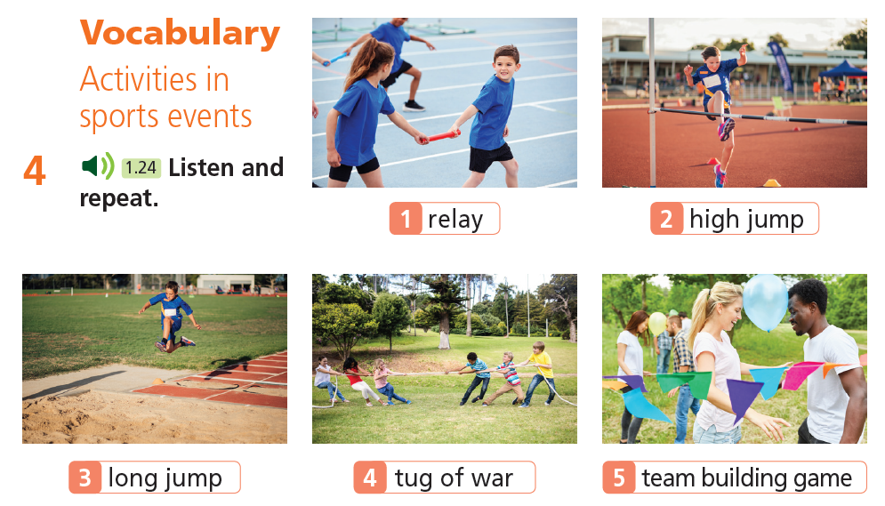


Slide 10
Vocabulary
Listen and repeat.
relay /ˈriːleɪ/ (n) môn chạy tiếp sức
high jump /ˈhaɪ ˌdʒʌmp/ (n) môn nhảy cao
long jump /ˈlɒŋ ˌdʒʌmp/ (n) môn nhảy xa
tug of war /ˌtʌɡ əv ˈwɔːr/ (n) trò chơi kéo co
team building game /ˈtiːm ˌbɪldɪŋ ɡeɪm/ (n) trò chơi kết nối đội, nhóm

Slide 11
Vocabulary
Listen and repeat.
•
relay /ˈriːleɪ/ (n) môn chạy tiếp sức
•
high jump /ˈhaɪ ˌdʒʌmp/ (n) môn nhảy cao
•
long jump /ˈlɒŋ ˌdʒʌmp/ (n) môn nhảy xa
•
tug of war /ˌtʌɡ əv ˈwɔːr/ (n) trò chơi kéo co
•
team building game /ˈtiːm ˌbɪldɪŋ ɡeɪm/ (n) trò chơi kết nối đội, nhóm

Slide 12

Speaking

Slide 13


Slide 14
6. Read the text again and make notes under the headings name of event, place, date and activities. Present the event to the class.
SCHOOL SPORTS DAY IN THE UK (By Harry John)
Every June in the UK, each school takes part in school sports day. This year, we held ours on 28th June. There were no lessons. We were all outside on the playing field.
The students were in many teams. We wore shorts and T-shirts in our team colour. We had events, like the 100-metre race but there were other games, too! I liked the three-legged race. You tie one leg to your partner’s and run. We also had sack races. You stand in a potato sack and hop to the finish line. This year I won!
There were races for our teachers and parents, too! This year, my science teacher won the teachers’ race. My dad didn’t take part in the parents’ race. He said he had a headache, but I think that was an excuse! My team didn’t win this year, but we had a lot of fun.
name of event
date
place
activities

Slide 15
Present the event to the class.
Suggested Answer
Name of event: school sports day
Place: school playing field
Date: 28th June
Activities: 100 metres race, three-legged race, sack race, teachers’ race, parents’ race
Harry’s school sports day is on 28th June at their school playing field. They hold this event every year. There are many races such as the 100-metre race, the teachers’ race and the parents’ race, so everyone can take part in!
They also have some special games like the three-legged race and the sack race. School sports day is a great day for all the family.

Slide 16

Listening

Slide 17
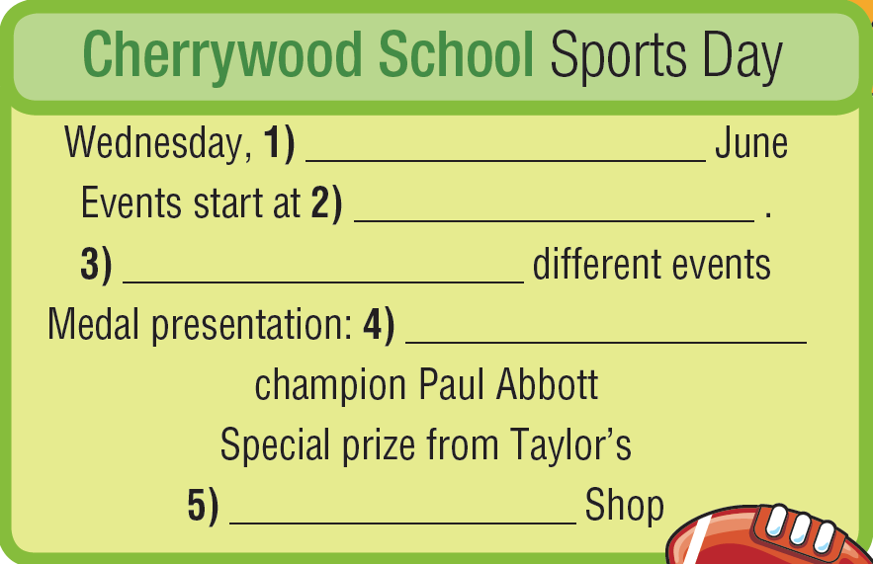
7. Listen to an announcement about a school sports day and fill in the gaps (1-5) in the poster.
Guess the answers.
date
time
number
activity
name

Slide 18
7. Listen to an announcement about a school sports day and fill in the gaps (1-5) in the poster.
8th
9:30
16
kickboxing
Sports

Slide 19

Writing

Slide 20

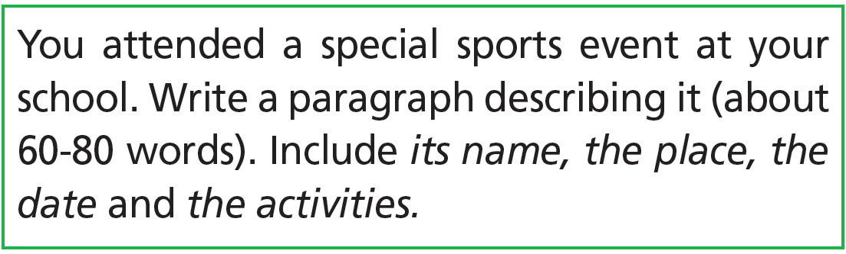
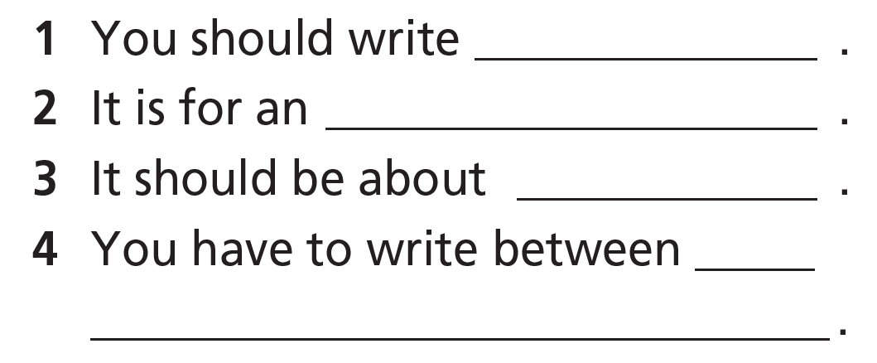
Pre-writing
Read the task. Underline the key words, then complete the sentences.
a paragraph
event
its name, the place, the date and the activities
60-80 words

Slide 21

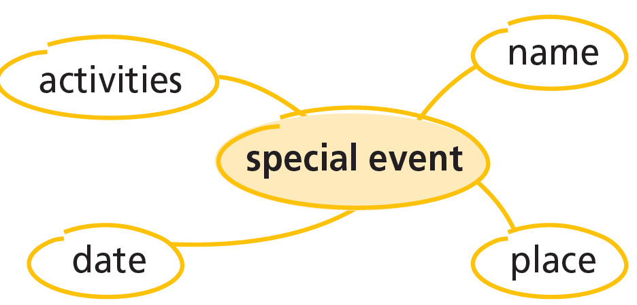
2. Read the model. Copy the spidergram into your notebook and complete it with information from the model.
Last week, I attended the Little Olympics. It was a fantastic event! It took place on our huge school playing field on Friday, 24th June. The day started with an amazing parade. Then, we competed in Olympic sports. My favourite was the team race at the end – the whole school gathered around the track to cheer the runners on. The Little Olympics was great! Everyone came together and had a lot of fun.

Slide 22
2. Read the model. Copy the spidergram into your notebook and complete it with information from the model.
Last week, I attended the Little Olympics. It was a fantastic event! It took place on our huge school playing field on Friday, 24th June. The day started with an amazing parade. Then, we competed in Olympic sports. My favourite was the team race at the end – the whole school gathered around the track to cheer the runners on. The Little Olympics was great! Everyone came together and had a lot of fun.
name
place
date
activities

Slide 23

3. Which adjective does the writer use to describe the event? the school playing field? the parade?
Last week, I attended the Little Olympics. It was a fantastic event! It took place on our huge school playing field on Friday, 24th June. The day started with an amazing parade. Then, we competed in Olympic sports. My favourite was the team race at the end – the whole school gathered around the track to cheer the runners on. The Little Olympics was great! Everyone came together and had a lot of fun.

Slide 24
4. Fill in each gap with amazing, peaceful, small or hot.
small
1 My school sports day was a(n) _______________ event because there were only 50 students at my school.
2 It was in July, so it was on a(n) _______________ day.
3 The gymnastics competition was my favourite part – the students did _______________ tricks!
4 Last year, the taekwondo club did a show. It was very _______________ and everyone was quiet while we watched it.
hot
amazing
peaceful

Slide 25
5 Brainstorming: Copy the spidergram in Exercise 2 into your notebook. Complete it with information about a special sports event at your school.
While-writing

Slide 26
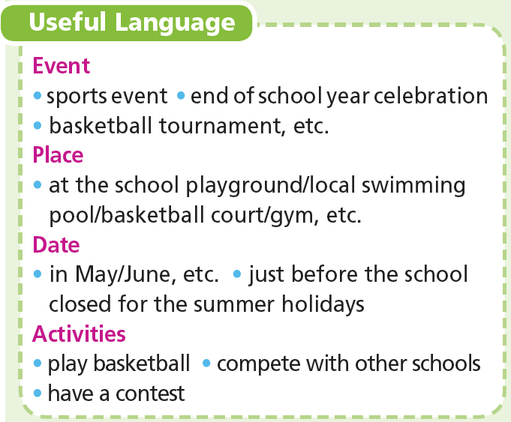
6. Use your notes in Exercise 5 and the phrases from the Useful Language box to write a paragraph about a special sports event at your school.
While-writing

Slide 27
Post-writing
Peer correction
Exchange your papers. Tick (✓) in the column “Yes” or “No“ if your friends’ writing meet the criteria.
Guideline
Criteria | Yes | No
Name of the event
Date
Place
Activities
Spelling mistakes | circle
Grammar mistakes | underline

Slide 28

CONSOLIDATION

Slide 29
8. You attended a special sports event at your school. Write a paragraph describing it (about 60-80 words). Include its name, the place, the date and the activities.

Slide 30

WRAP-UP

Slide 31
Today’s lesson
Vocabularies
Activities in sports events
Skills
Listening: an announcement about a school sports day
Writing: A paragraph about an event

Slide 32
Homework
Practise the vocabularies and make sentences using them.
Do the exercises in TA 7 Right on WB (page 21)
Practise the vocabulary in TA 7 Right on Notebook (page 17)
Prepare the next lesson (page 40 SB)
Do Unit 2 Test 1 in Bài Tập Bổ Trợ TA 7 Right on (pp. 20 & 21)

Slide 33
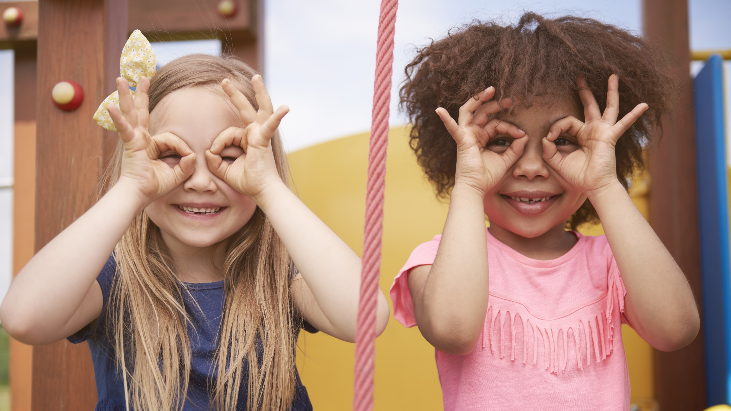
Enjoy your day!

