Slide 1







Slide 2







I don’t know.
What page is it?
Step aside, please!
Can you come here, please?
Step aside,
please!

Slide 3

What time is it?
What does this word mean?
Can I open the lesson?
I am finished.
What does this
word mean?

Slide 4
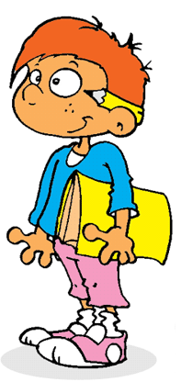
Can I go to the board?
Can I close the window?
May I go to the toilet?
Sorry I’m late.
Can I go
to the board?

Slide 5
Can I answer the question?
I don’t remember.
Can you repeat, please?
May I come in?
May I
come in?

Slide 6



I don’t understand!
What day is it today?
Can you help me?
Sorry, I forgot my books.
Sorry, I forgot
my books.

Slide 7

Can I try?
I didn’t do my homework.
How do you say … in English?
Where do I sit?
I didn’t do
my homework.

Slide 8


Can I switch on the lights?
Can I stand up?
What’s the homework?
I didn’t hear your question.
Can I switch
on the lights?

Slide 9


Can I borrow a pencil?
I need a pen.
May I pack my things?
Can I do this exercise?
Can I borrow
a pencil?

