Slide 1
VÒNG QUAY MAY MẮN
ÁP DỤNG CHO CÂU HỎI 4 ĐÁP ÁN

Slide 2
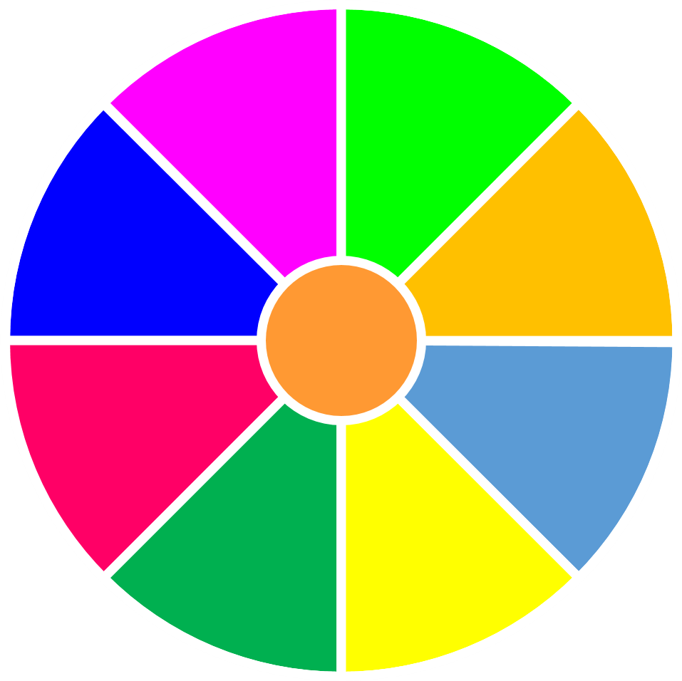
VÒNG QUAY
MAY MẮN
30
20
1
2
3
40
10
50
80
4
5
6
60
70
7
8
9
QUAY

Slide 3
Question 1?
A. right
B. wrong
C. wrong
D. wrong
QUAY VỀ

Slide 4
Question 2?
A. wrong
B. right
C. wrong
D. wrong
QUAY VỀ

Slide 5
Question 3?
A. right
B. wrong
C. wrong
D. wrong
QUAY VỀ

Slide 6
Question 4?
A. wrong
B. wrong
C. right
D. wrong
QUAY VỀ

Slide 7
Question 5?
A. wrong
B. right
C. wrong
D. wrong
QUAY VỀ

Slide 8
Question 6?
A. wrong
B. wrong
C. wrong
D. right
QUAY VỀ

Slide 9
Question 7?
A. wrong
B. right
C. wrong
D. wrong
QUAY VỀ

Slide 10
Question 8?
A. right
B. wrong
C. wrong
D. wrong
QUAY VỀ

Slide 11
Question 9?
A. wrong
B. wrong
C. right
D. wrong
QUAY VỀ

