Slide 1
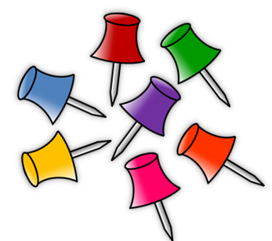
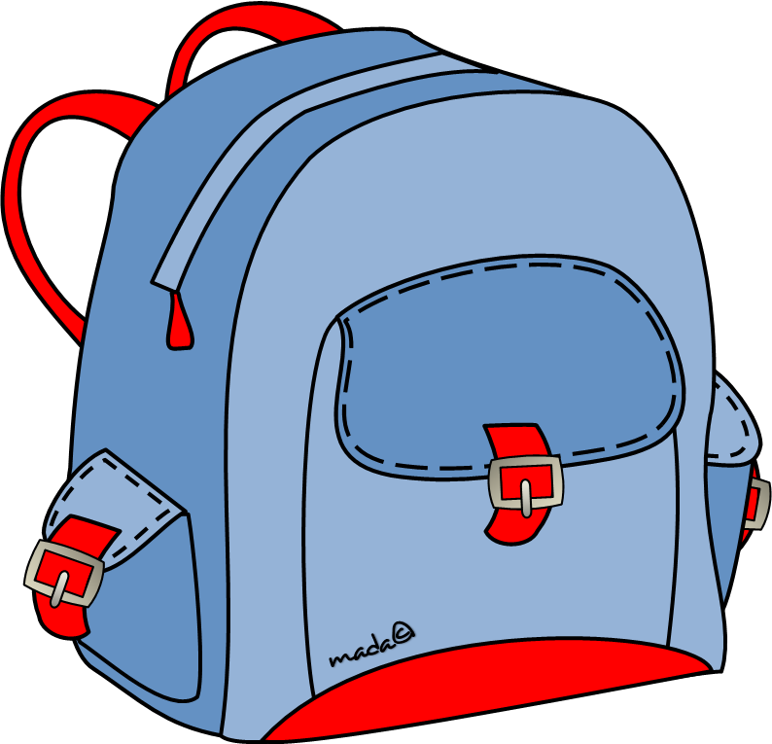
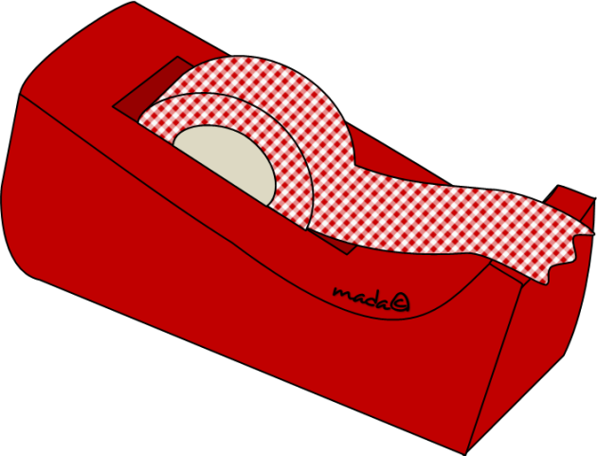
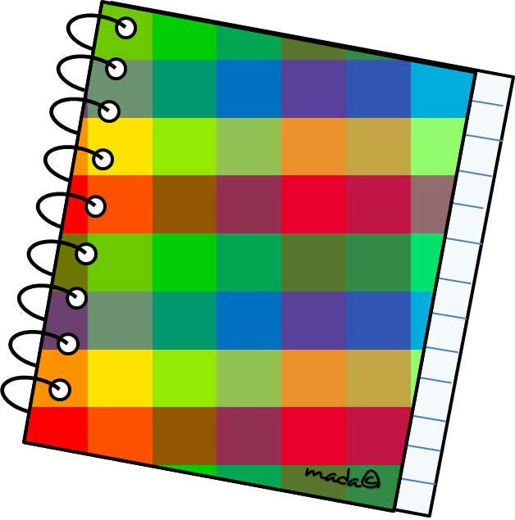
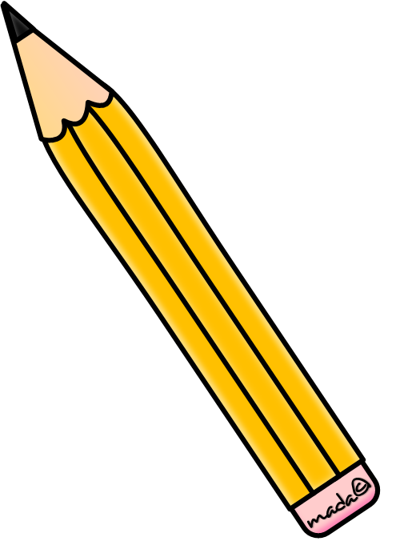
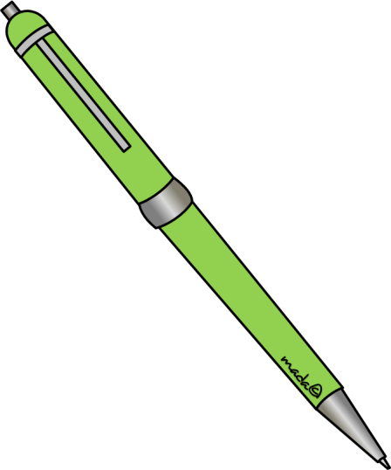
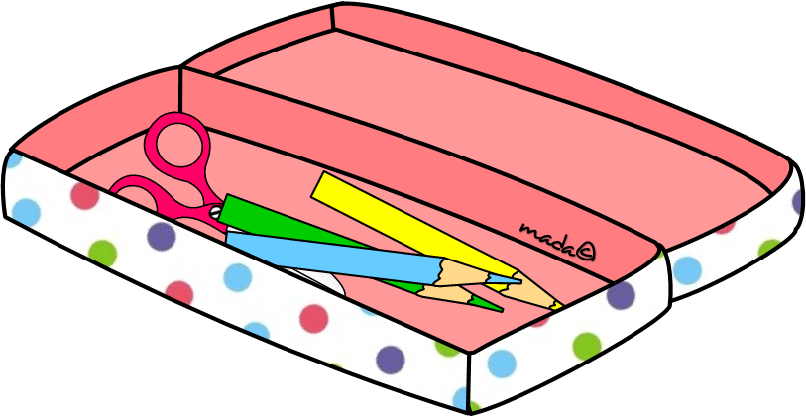
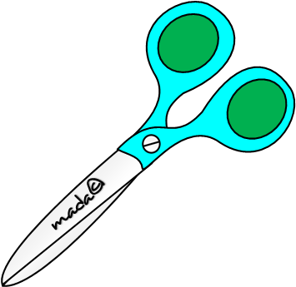
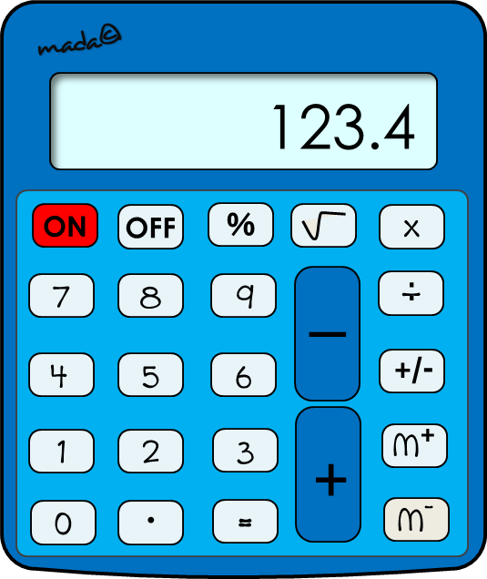
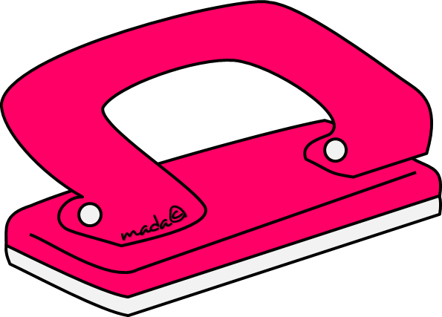
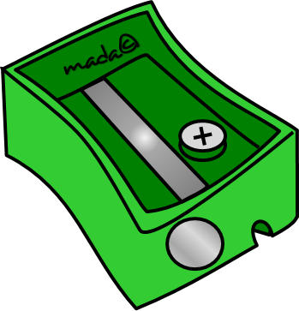
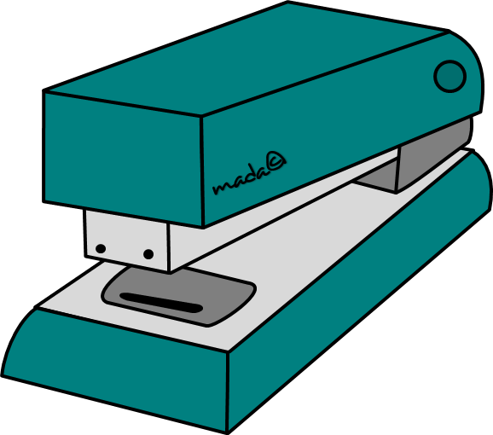
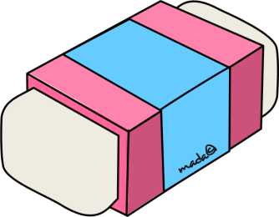
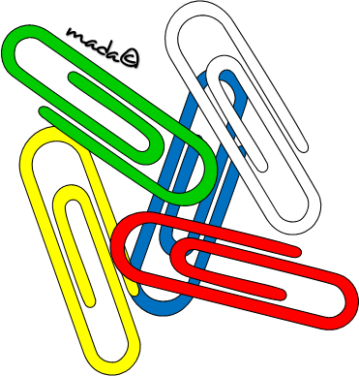
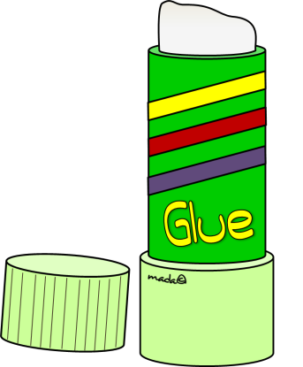
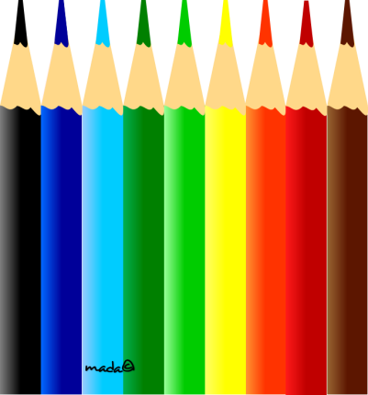
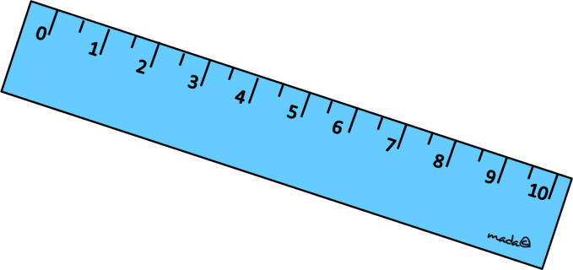

Slide 2
What is it?
pencil
school bag
ruler
rubber
stapler
calculator

Slide 3
What is it?
ballpoint
sharpener
pencil case
rubber
notebook
calculator

Slide 4
What is it?
ruler
sharpener
ballpoint
rubber
notebook
pencil

Slide 5
What is it?
ballpoint
sharpener
pencil case
rubber
notebook
calculator

Slide 6
What is it?
compass
stapler
pencil case
rubber
notebook
magnifying glass

Slide 7
What is it?
pencil
school bag
ruler
rubber
stapler
calculator

Slide 8
What is it?
glue
ballpoint
rubber
stapler
notebook
ruler

Slide 9
What is it?
compass
stapler
pencil case
rubber
notebook
hole puncher

Slide 10
What is it?
ballpoint
rubber
pencil case
ruler
notebook
compass

Slide 11
What is it?
ruler
sharpener
ballpoint
rubber
notebook
pencil

Slide 12
What is it?
pencil
school bag
ruler
rubber
stapler
calculator

Slide 13
What is it?
stapler
sharpener
Scotch tape
rubber
calculator
notebook

Slide 14
What is it?
ruler
glue
Scotch tape
rubber
calculator
sharpener

Slide 15
What is it?
ballpoint
rubber
pencil case
ruler
pencil
compass

Slide 16
What is it?
ballpoint
rubber
pencil case
ruler
pencil
compass

Slide 17
What are they?
textbooks
scissors
clips
notebooks
drawing pins
coloured pencils

Slide 18
What are they?
textbooks
scissors
clips
notebooks
drawing pins
coloured pencils

Slide 19
What are they?
textbooks
scissors
clips
notebooks
drawing pins
coloured pencils

Slide 20
What are they?
textbooks
scissors
clips
notebooks
drawing pins
coloured pencils

Slide 21
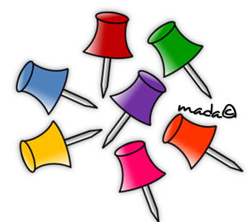
What are they?
textbooks
scissors
clips
notebooks
drawing pins
coloured pencils

Slide 22
SƯU TẦM: ĐOÀN VĂN DOANH, NAM TRỰC, NAM ĐỊNH
LINK NHÓM DÀNH CHO GV BỘ MÔN VẬT LÝ TRAO ĐỔI TÀI LIỆU VÀ CHUYÊN MÔN CT 2018
https://www.facebook.com/groups/299257004355186

