Slide 1

Unit 7: Toys
Lesson 4.3
Page 107

Slide 2
Lesson Outline
Warm-up
Reading
Writing
Consolidation
Wrap-up

Slide 3
Objectives
By the end of this lesson, students will be able to…
Vocabularies: Review numbers 11-20, addition, subtraction
Reading: Read to know about identifying and doing simple math with real objects.
Writing: Write about student's math problem.
Sentence patterns: I put six robots on my bed./ How many toys are on my bed?

Slide 4

WARM UP

Slide 5






Choose the right answer.
Click on the picture to choose the right answer.
eighteen
A.
B.
C.

Slide 6


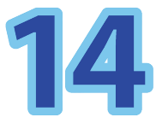
Choose the right answer.
twelve
A.
B.
C.

Slide 7



Choose the right answer.
twenty
A.
B.
C.

Slide 8

Choose the right answer.
__________
A.
listen
read
B.
clean
A.
C.
nineteen
eighteen
B.
seventeen
C.

Slide 9
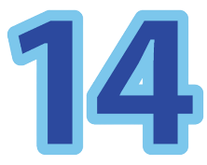
Choose the right answer.
___________
A.
fifteen
fourteen
C.
seventeen
B.

Slide 10

Choose the right answer.
________
A.
twelve
nineteen
C.
eleven
B.

Slide 11
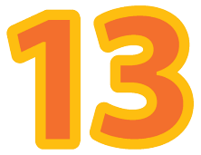
Choose the right answer.
_______
fifteen
A.
B.
thirteen
eighteen
C.

Slide 12

It’s time to learn …

Slide 13

Reading

Slide 14


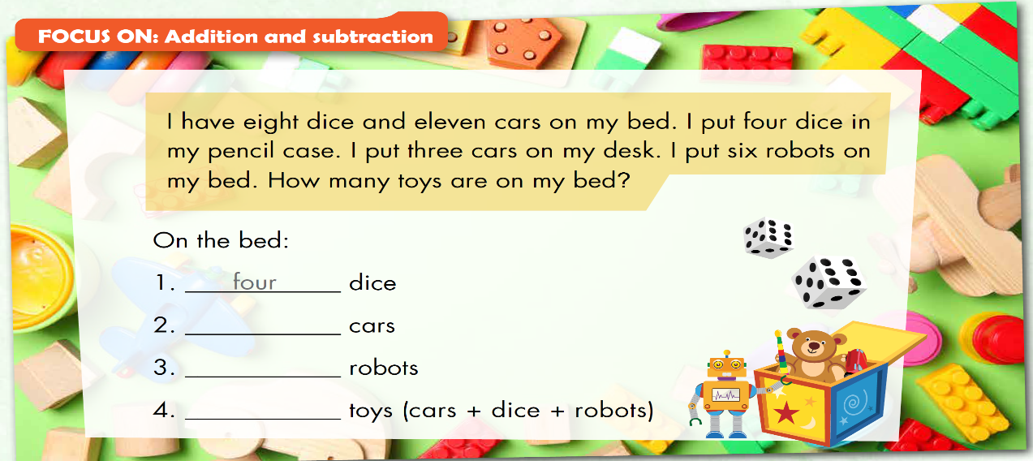
eight
six
eighteen

Slide 15
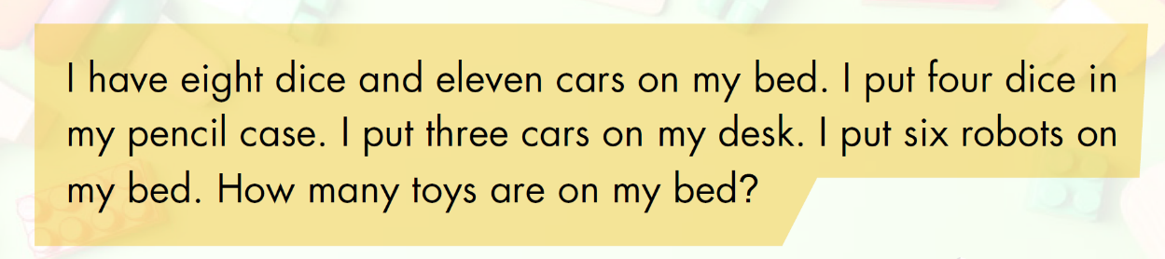
You have 5 minutes to read and remember the text.

Slide 16
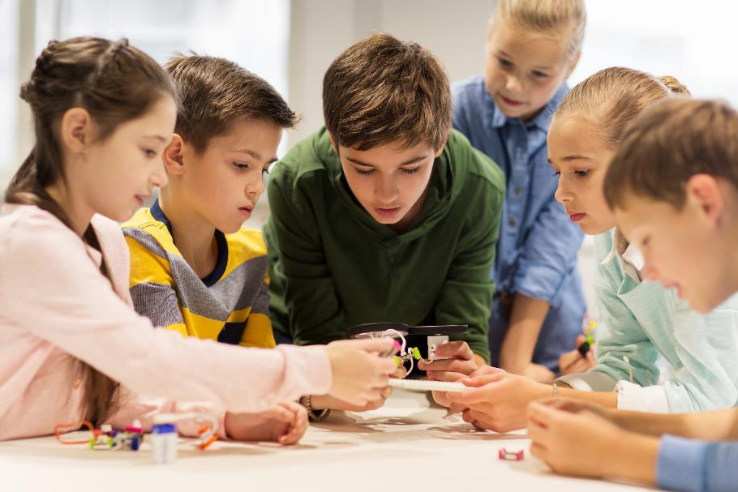
Let’s play a game

Slide 17


Slide 18




Eight dice minus four dice is four dice.
corrcet
right
wrong
incorrect
correct

Slide 19
Eleven cars minus three cars is nine cars.
Correct
wrong
right
incorrect
correct

Slide 20
How many robots do you have? - I have six robots.
corrcet
right
wrong
incorrect
correct

Slide 21

Writing

Slide 22
Pre-Writing
Matching – click on each box on the left to see the answer.
I have eight dice and
robots on my bed.
I put four dice in
my desk.
I put three cars on
my pencil case.
I put six
seven cars on my bed.

Slide 23




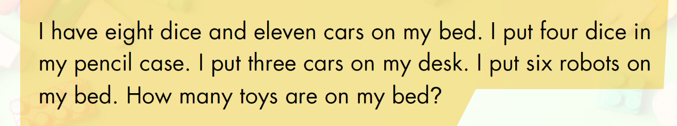

Slide 24
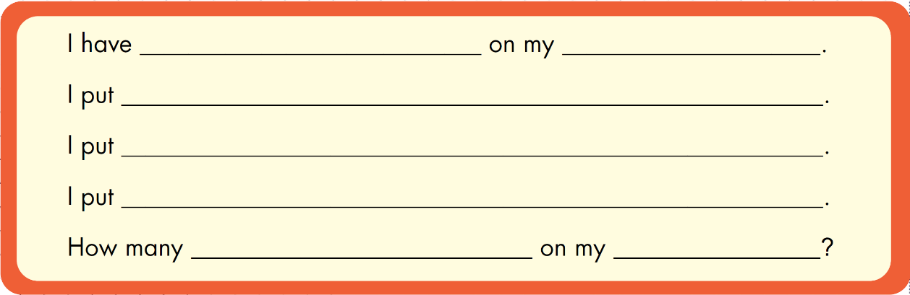

Slide 25


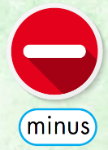
Hello, my name is……..I’m from……………………………………………………………………………………………………………………………………………………………………………………………………………..

Slide 26

CONSOLIDATION

Slide 27
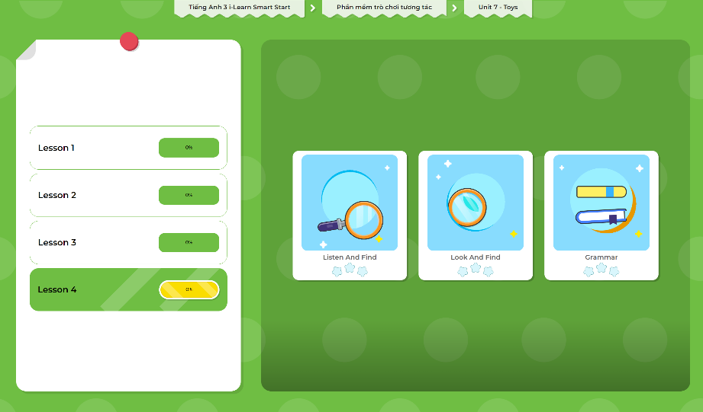
Extra Practice
DHA App
LET’S PLAY!
Click here to play the games

Slide 28

WRAP-UP

Slide 29
Today’s lesson
Vocabularies:
Review numbers 11-20, addition, subtraction
Sentence patterns:
I put six robots on my bed.
How many toys are on my bed?
Reading:
Read to know about identifying and doing simple math with real objects.
Writing:
Write about student's math problem.

Slide 30
Homework
Practice the vocabularies and structure; and make sentences using them.
Do the exercises in Tiếng Anh 3 i-Learn Smart Start WB (page 75)
Do the exercises in Tiếng Anh 3 i-Learn Smart Start Notebook (page 49)
Prepare the next lesson (page 108 SB)
Play the consolidation games in Tiếng Anh 3 i-Learn Smart Start DHA App on www.eduhome.com.vn

Slide 31

Enjoy your day!

