Slide 1
KET SPEAKING
Time allowed - 8-10 minutes
Normally you will do the speaking test with another candidate. The two of you will meet two examiners. One of the examiners will talk to you, the other does not participate in the conversations.
There are two parts to the speaking test:
Speaking part 1: short questions and answers between you and the examiner.
Speaking part 2: the examiner gives you some information or a card with some ideas for questions. You have to talk with the other candidate and ask or answer questions.
Scoring
The Speaking section is worth 25% of the total score for the exam.
How to prepare for KET Speaking:
Speak as much as you can, with your friends
Practise asking and answering questions about daily life
Practise giving information about yourself

Slide 2
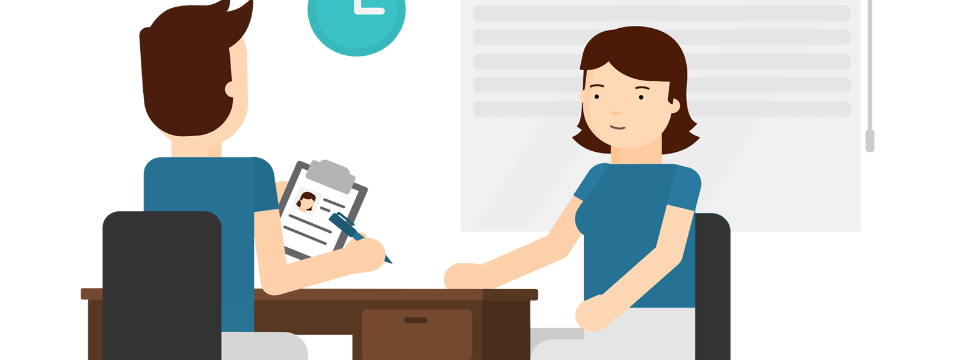
KEY ENGLISH TEST 6
Test 3 - Speaking

Slide 3

Part 1:
Student – examiner interaction
Section 1:
The examiner will ask you:
Your name
Where you come from?
Provide full-sentence answers

Slide 4

Part 1:
Student – examiner interaction
Section 2: You will be asked some questions that require longer answers. For example:
Why you like something
Details about a hobby…

Slide 5
Popular topic
family
best friend
hometown
your house
sport
computer
collecting
music

Slide 6
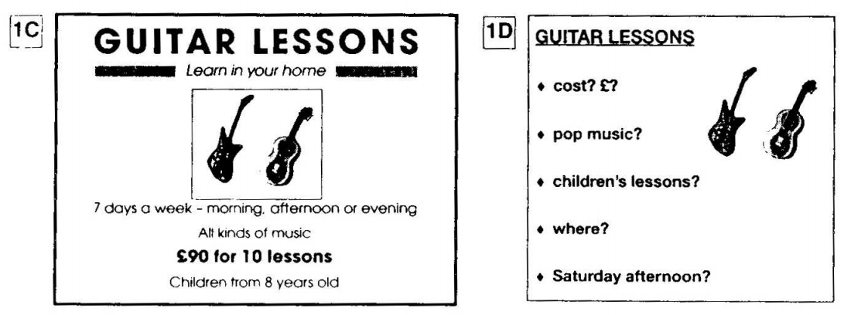
PART 2:
Student – student interaction
Ask and answer questions based on the cue cards
For example:
Do not just read from the cards. Answer in full sentences.
Pay attention to the grammar.

Slide 7
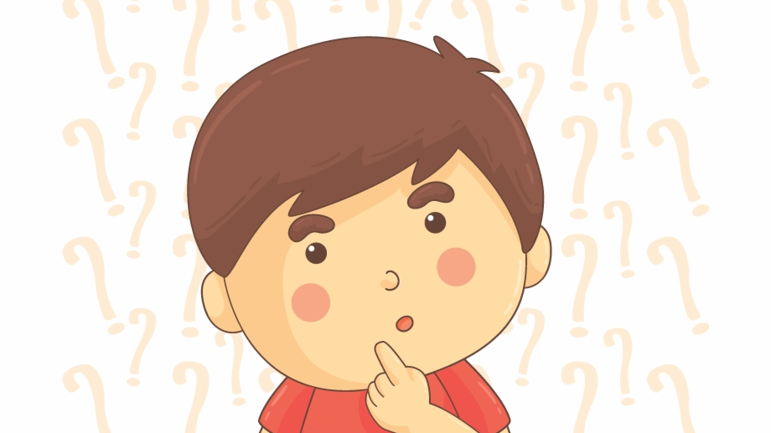
SPEAKING
PART 1

Slide 8
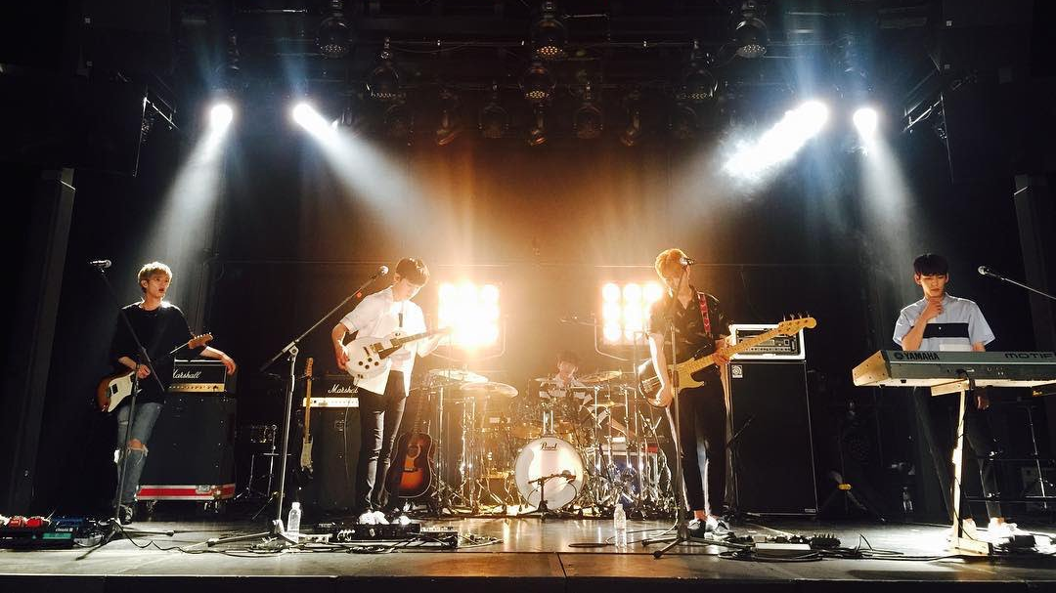
Part 1
Do you think it's important for children to learn to play a musical instrument?
Do children have to learn to play a musical instrument at school in your country?
Have you ever learned to play a musical instrument?
What do you think would be the most difficult musical instrument to learn to play?

Slide 9
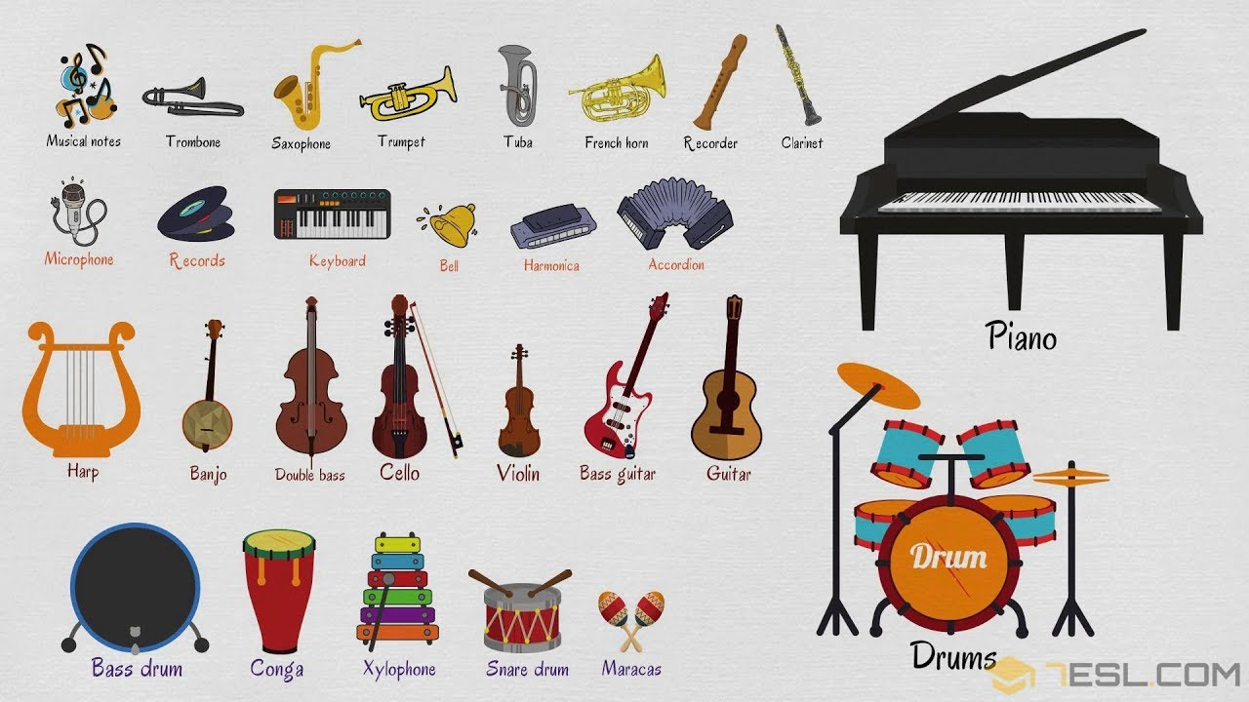

Slide 10
USEFUL VOCABULARY
background music: music that is played while something else is happening
a catchy tune: a song that is easy to remember and makes you want to sing it
classical music: music that is regarded as part of a long, formal tradition
to take up a musical instrument: to begin learning a musical instrument
taste in music: the music someone likes
to read music: to understand and follow written musical notes
to be tone deaf: to be unable to distinguish the different notes in music

Slide 11
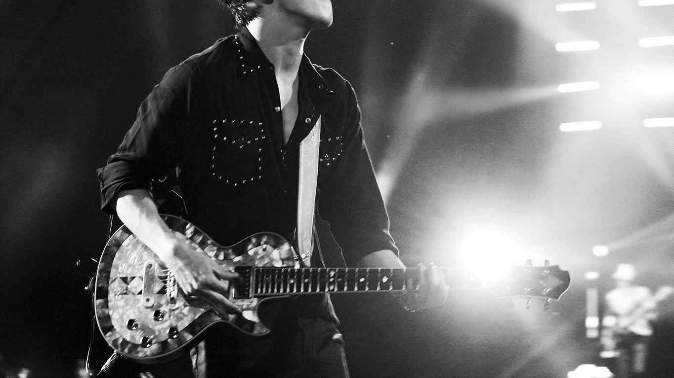
What do you think is the best age to start to learn to play a musical instrument?

Slide 12
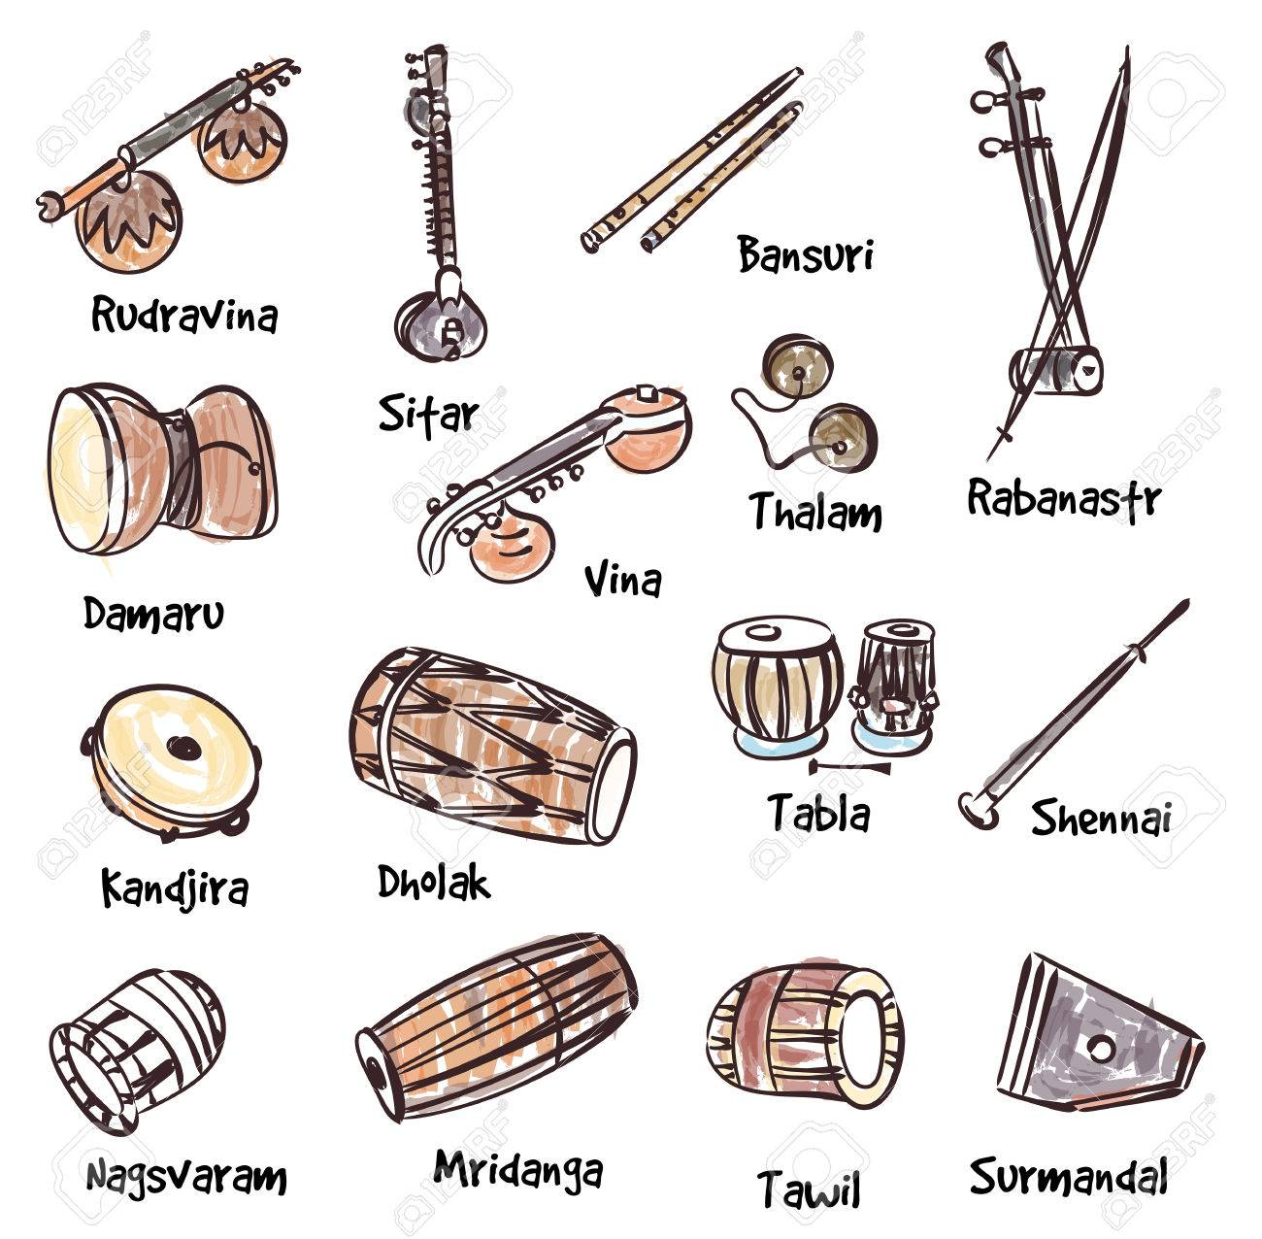
What traditional instrument are there in your country?

Slide 13
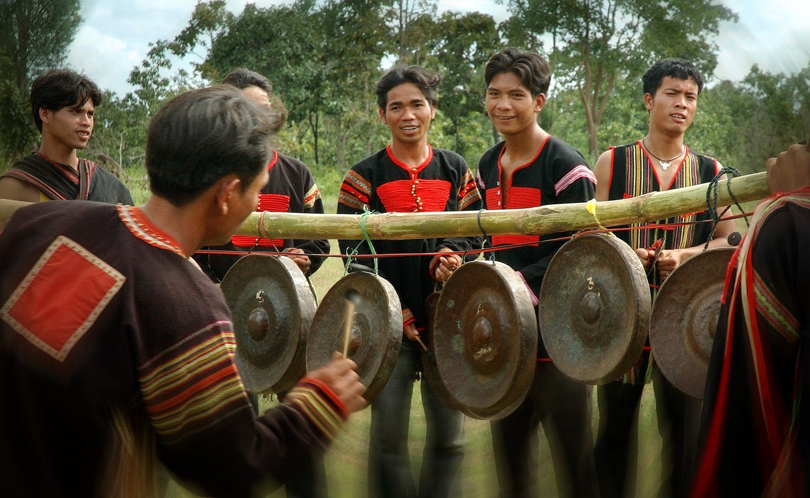
Do you think traditional musical instruments have a place in modern society?

Slide 14
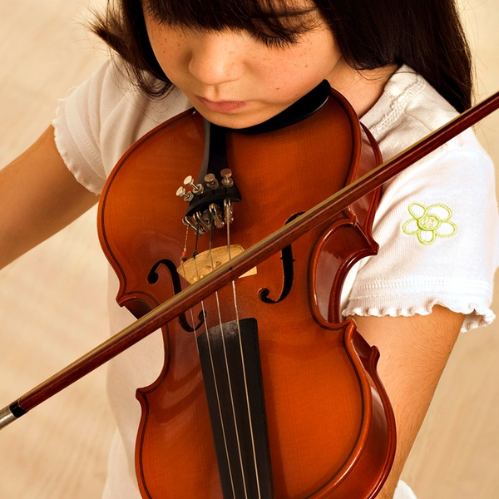
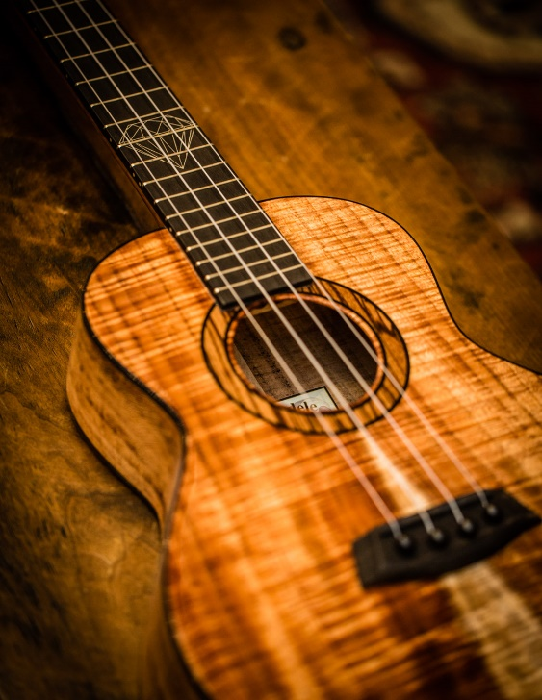
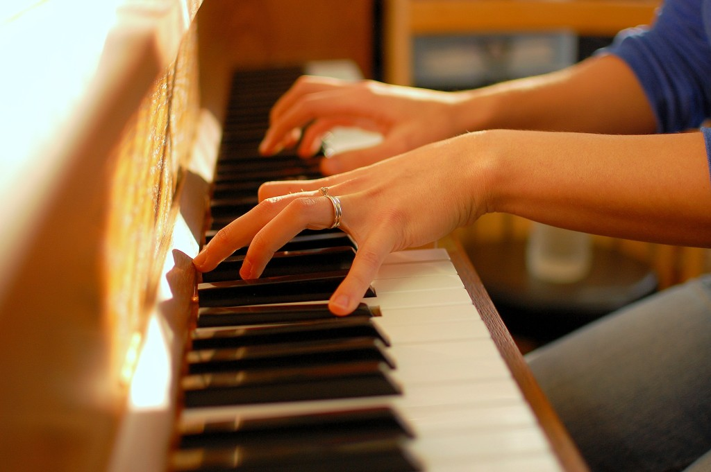
Talk about your favourite instrument.
What kind of instrument it is?
When did you hear it
Describe it briefly
And explain why you like it

Slide 15
SPEAKING PART 2
Asking and answering questions using these prompt cards

Slide 16

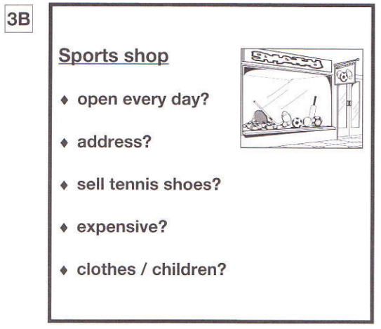
Ask and answer
Ask and answer questions using the words given.

Slide 17

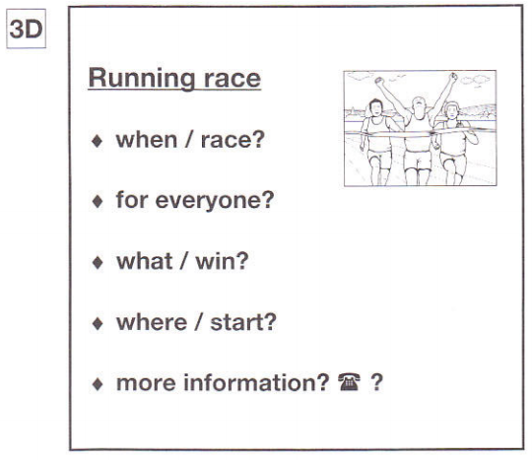
Ask and answer
Ask and answer questions using the words given.
What are other questions and answers you can think of?

Slide 18


Based on the given information, talk about Town Running Race.

