Slide 1


Slide 2

Unit
10
1
Unit
FAMILY LIFE
ECOTOURISM
LESSON 8
LOOKING BACK AND PROJECT

Slide 3

Unit
1
1
FAMILY LIFE
Family Life
Unit
OBJECTIVES
Review the vocabulary and grammar of Unit 10
Apply what they have learnt (vocabulary and grammar) into practice through a project

Slide 4
LESSON 8
LOOKING BACK AND PROJECT
Unit
WARM-UP
Watch the video and guess the name of the place.
Vocabulary
Choose the correct words to complete the conversation. (p. 118)
Pronunciation
Work in pairs. Role-play the conversation above. Try to use appropriate intonation. (p. 118)
Grammar
Put the verbs in brackets in the correct forms. (p. 118)
LOOKING BACK
PROJECT
Design an ecotour
CONSOLIDATION
Wrap-up
Homework

Slide 5
LESSON 8
LOOKING BACK AND PROJECT
Unit
WARM-UP
Watch the video and guess the name of the place.
Nhờ BTV insert video đã cắt vào đây.

Slide 6

WARM-UP
Trang An Ecotourism Complex

Slide 7
LESSON 8
LOOKING BACK AND PROJECT
Unit
WARM-UP
Watch the video and guess the name of the place.
Vocabulary
Choose the correct words to complete the conversation. (p. 118)
Pronunciation
Work in pairs. Role-play the conversation above. Try to use appropriate intonation. (p. 118)
Grammar
Put the verbs in brackets in the correct forms. (p. 118)
LOOKING BACK

Slide 8
VOCABULARY
Choose the correct words to complete the conversation.
Mai: Ms Hoa, what is (1) mass / sustainable tourism?
Ms Hoa: Well, the aim of this kind of tourism is to (2) protect / damage the environment, respect local culture, and keep (3) benefits / profits local.
Mai: Can you give me an example?
Ms Hoa: When travelling, we should not (4) litter / impact on the street. We should also be (5) aware / responsible of the local traditions and respect them.
Mai: So is this kind of tourism similar to (6) ecotourism / mass tourism?
Ms Hoa: Well, it’s a form of sustainable tourism because it has a positive (7) impact / craft on the environment.

Slide 9


PRONUNCIATION
Work in pairs. Role-play the conversation above. Try to use appropriate intonation.
Mai: Ms Hoa, what is sustainable tourism?
Ms Hoa: Well, the aim of this kind of tourism is to protect the environment, respect local culture, and keep profits local.
Mai: Can you give me an example?
Ms Hoa: When travelling, we should not litter on the street. We should also be aware of the local traditions and respect them.
Mai: So is this kind of tourism similar to ecotourism?
Ms Hoa: Well, it’s a form of sustainable tourism because it has a positive impact on the environment.

Slide 10
GRAMMAR
Put the verbs in brackets in the correct forms.
1. If I (be) ___________ you, I (live) ___________ with a host family so that I can learn more about the local culture.
2. If we (work) _________ together, we (be) _________ able to reduce the negative impact of tourism on the environment.
3. If we (allow) _________ more people to crowd the city centre, we (have) ______________ to deal with environmental pollution in the future.
4. If we (have) _________ enough money, we (go) ____________ on an ecotour to Finland. Instead, we’re staying in Viet Nam in the summer.
were / was
would live
work
will be
allow
will have
had
would go

Slide 11
LESSON 8
LOOKING BACK AND PROJECT
Unit
WARM-UP
Watch the video and guess the name of the place.
Vocabulary
Choose the correct words to complete the conversation. (p. 118)
Pronunciation
Work in pairs. Role-play the conversation above. Try to use appropriate intonation. (p. 118)
Grammar
Put the verbs in brackets in the correct forms. (p. 118)
LOOKING BACK
PROJECT
Design an ecotour

Slide 12
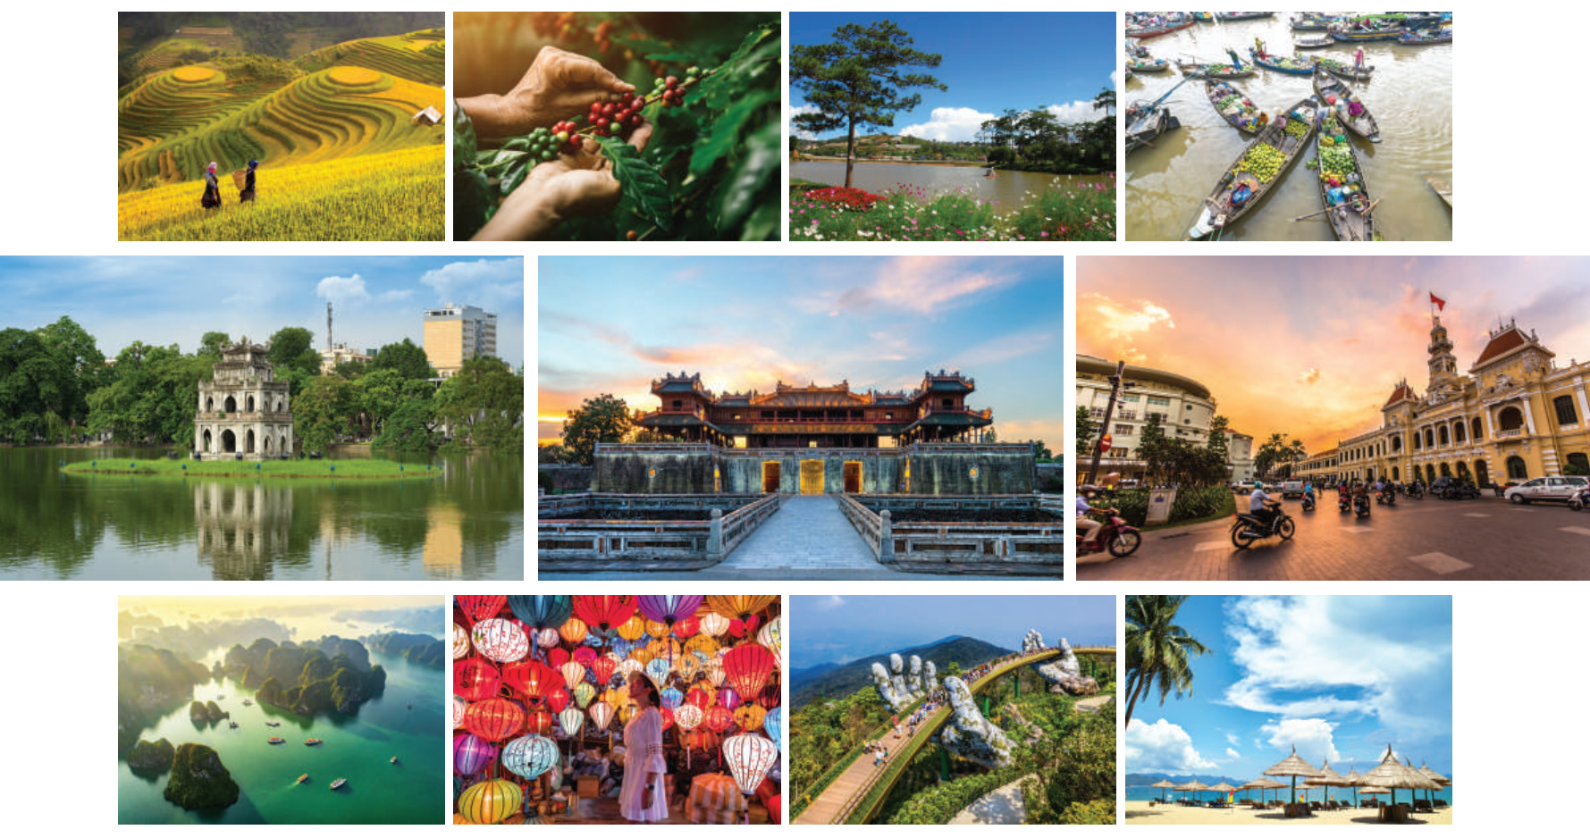
PROJECT
Design an ecotour
What is the local tourist attraction?
What is it famous for?
What can tourists do there?
What are some eco-friendly activities that tourists can do there?
Work in groups. Design an ecotour to a tourist attraction in your local area.
Present your ideas to the class. Use these questions as cues for your presentation.

Slide 13
LESSON 8
LOOKING BACK AND PROJECT
Unit
WARM-UP
Watch the video and guess the name of the place.
Vocabulary
Choose the correct words to complete the conversation. (p. 118)
Pronunciation
Work in pairs. Role-play the conversation above. Try to use appropriate intonation. (p. 118)
Grammar
Put the verbs in brackets in the correct forms. (p. 118)
LOOKING BACK
PROJECT
Design an ecotour
CONSOLIDATION
Wrap-up
Homework

Slide 14
CONSOLIDATION
1
Wrap-up
Review the vocabulary and grammar of Unit 10
Apply what they have learnt (vocabulary and grammar) into practice through a project

Slide 15
CONSOLIDATION
2
Homework
Do exercises in the workbook

Slide 16


