Slide 2
Unit 7: Our timetable
Lesson 3- period 5

Slide 3
Table of Contents
01
02
03
04
Warm up
Listen and repeat
Listen and circle
Let’s chant
Wrap up & fun conner
05

Slide 4
01
Warm up

Slide 6
02
Listen and repeat

Slide 8
03
Listen and circle

Slide 9
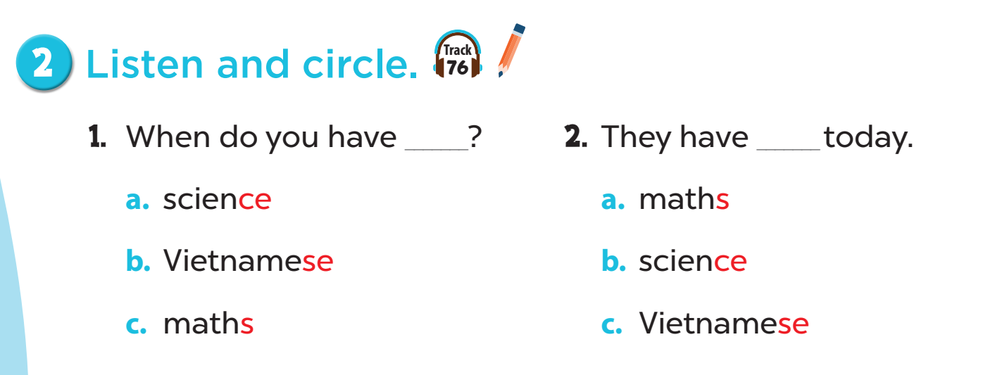

Slide 11
04
Let’s chant

Slide 13
05
Wrap up and fun time

Slide 14
Listen and clap
Notes:
Listen to the sound /s/ and clap if not don’t clap. Ex: Science /s/, “clap”, Maths /z/ “no clap”, Vietnamese /s/ “clap”…….

Slide 15
What have you learnt today? 2. What the core value of the lesson?

Slide 16
THANK YOU
Website: sachmem.vn; hoclieu.vn
Fanpage: www.facebook.com/sachmem.vn
Website: sachmem.vn; hoclieu.vn
Fanpage: www.facebook.com/sachmem.vn

