Slide 1

UNIT 7: TEENS
Lesson 1.2 – Grammar
Pages 65 & 66

Slide 2
Lesson Outline
Warm-up
Grammar
Practice
Consolidation
Wrap-up

Slide 3

By the end of this lesson, students will be able to…
- To practice and use Possessive pronouns correctly.

Slide 4



Slide 5

WARM UP

Slide 6
VOCABULARY REVIEW
Listen and repeat.
______________
game designer (n) /ɡeɪm dɪˈzaɪnər/ người thiết kế trò chơi
director (n) /dɪˈrektər/ đạo diễn
flight attendant (n) /ˈflaɪt əˌtendənt/ tiếp viên hàng không
journalist (n) /ˈdʒɜːrnəlɪst/ nhà báo
musician (n) /mjuːˈzɪʃn/ nhạc sĩ, nhạc công
veterinarian (n) /ˌvetərɪˈneriən/ bác sĩ thú y
vlogger (n) /ˈvlɑːɡər/ người làm vlog
engineer(n) /ˌendʒɪˈnɪr/ kĩ sư
dentist (n) /ˈdentɪst/ nha sĩ

Slide 7
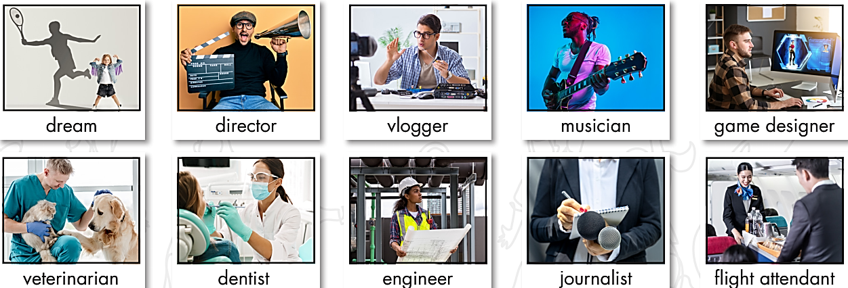

Work in pairs.
Test your partner’s memory about jobs.
What does a/an __________ do?
A veterinarian is a doctor who takes care of sick or hurt animals.

Slide 8
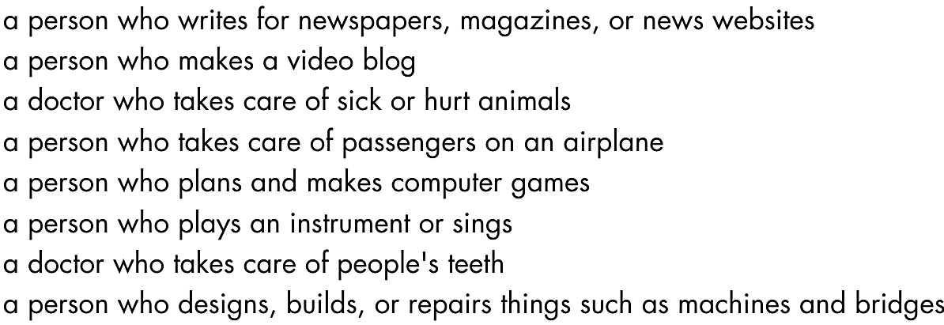
What is a/an __________ ?

Slide 9

Grammar
Presentation

Slide 10

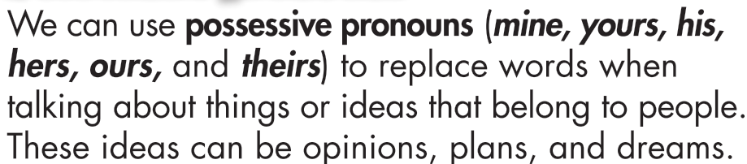
Read.
A: My dream is to be a doctor. What's yours?
B: Mine is to become a game designer.

Slide 11
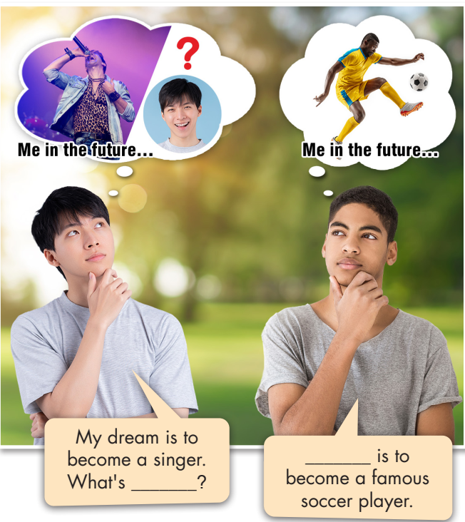
a. Read about possessive pronouns and fill in the blanks.

Slide 12


b. Listen and check your answers. Listen again and repeat.



Mine
yours

Slide 13
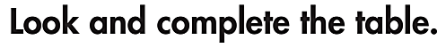
Extra Practice
WB, page 39
PRONOUN | POSSESSIVE ADJECTIVE | POSSESSIVE PRONOUN
I | _____ | _____
You | _____ | _____
He | _____ | _____
She | _____ | _____
We | _____ | _____
They | _____ | _____
It | _____ | _____
my
mine
your
yours
his
his
her
hers
our
ours
their
theirs
its
its

Slide 14

a. Read the examples.
My dream job is to become a vlogger.
A: What's yours?
B: Mine is to be a doctor.
C&D: Ours is to become famous.
A: What's your sister's dream?
B: Hers is to be a teacher.
A: What's theirs?
B: Theirs is to open a restaurant.

Slide 15

Practice

Slide 16
Now, practice the conversation with a partner.
a. Fill in the blanks with the correct possessive pronouns.
Jane: You didn't go to school yesterday. We talked about our dreams.
Jack: Cool. What's (1) ______?
Jane: (2) ______ is to become a journalist. What's (3) ______?
Jack: (4) ______ is to become a musician. What about Mary?
Jane: (5) ______ is to be a famous director.
Jack: That isn't easy. How about John? Is (6) ______ to open a café? He talks about it all the time.
Jane: Yes. Can you guess what Mark and Peter's is? They have the same dream.
Jack: Really? Hmm, is (7) ______ to become engineers?
Jane: No, (8) ______ isn't to be engineers. They want to become famous game designers.
Jack: Cool.
yours
Mine
yours
Mine
Hers
his
theirs
theirs

Slide 17
b. Rewrite the underlined parts using possessive pronouns.
My dream is to become a dentist and her dream is to become a vlogger.
_______________________________________________________
His dream is to be a veterinarian. What's your dream?
_______________________________________________________
My sisters' dream isn't the same as mine. Their dream is to be flight
attendants.
_______________________________________________________
My dream is to buy a house for my father. His dream is to open a café.
_______________________________________________________
Their dream is to become rich. Our dream is to be famous.
_______________________________________________________
. . . and hers is to become a vlogger.
What’s yours?
Theirs is to be flight attendants.
His is to open a café.
Ours is to be famous.

Slide 18
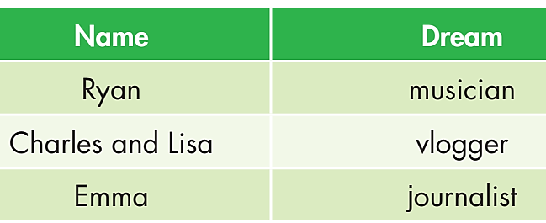
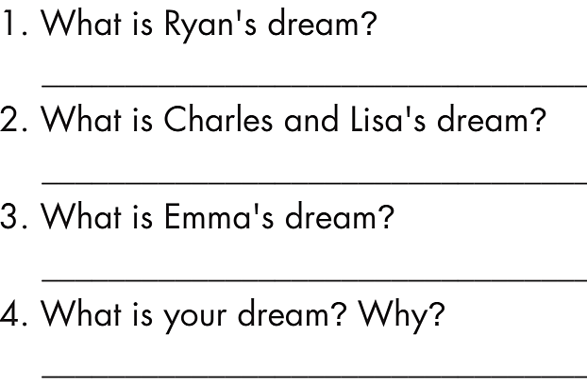
Look at the information and answer the questions using
possessive pronouns.
Extra Practice
WB, page 39
His is to be a musician.
Theirs is to be vloggers.
Hers is to be journalist.
Mine is to . . . because . . .

Slide 19
Production

Slide 20

c. In pairs: Talk about your favorite actors, vloggers, and musicians.

Slide 21

CONSOLIDATION

Slide 22
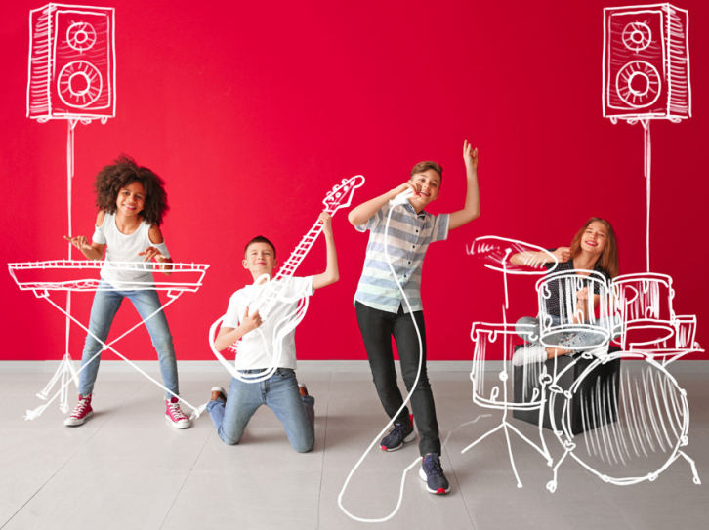
In pairs. Look at the people in the picture.
What are their dreams?

Slide 23

WRAP-UP

Slide 24
Today’s lesson
Grammar:
-To practice and use Possessive pronouns correctly.
Speaking:
- To practice speaking, using Possessive pronouns.

Slide 25
Homework
Review how to use Possessive pronouns.
Do the exercises on page 39, WB.
Do the exercises in Tiếng Anh 8 i-Learn Smart World Notebook, Page 58.
Prepare the next lesson (pages 66 & 67, SB).
Play the consolidation games on www.eduhome.com.vn

Slide 26

Lesson 3
Stay positive and have a nice day!

