Slide 1
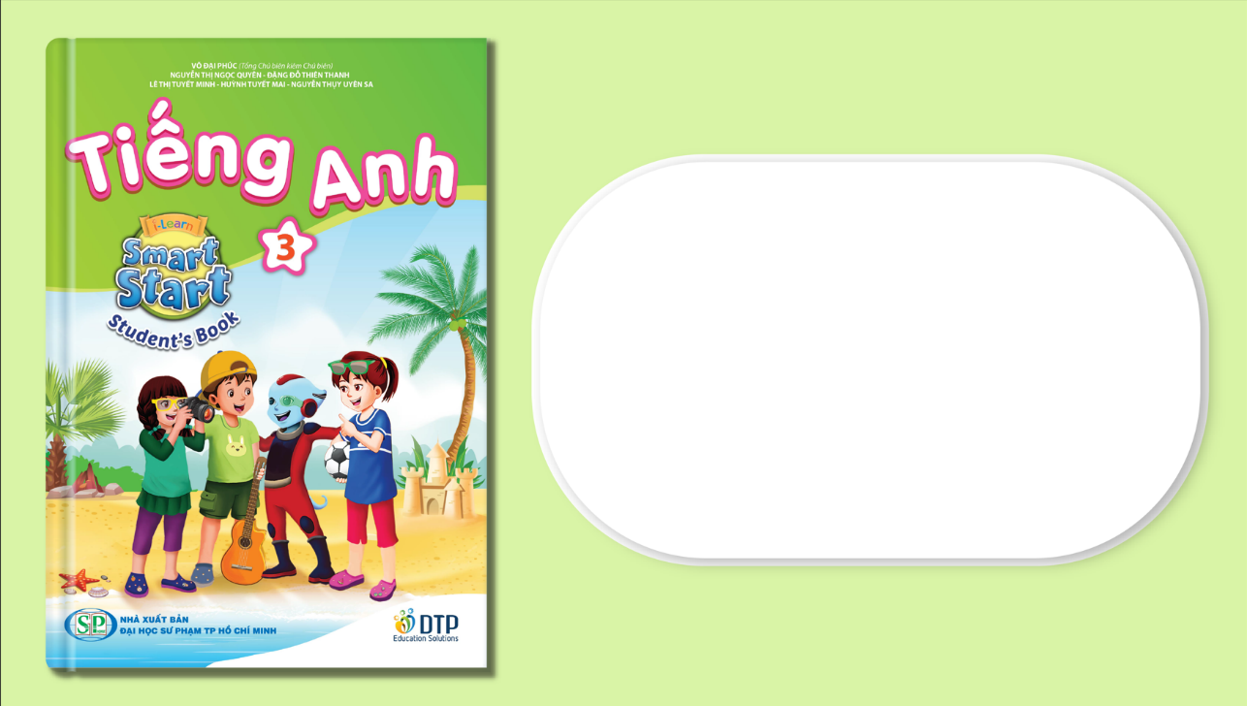
Unit 3: School
Lesson 4.2
Page 48

Slide 2
Lesson Outline
Warm-up
Reading
Listening
Consolidation
Wrap-up

Slide 3
Objectives
By the end of this lesson, students will be able to understand a paragraph about color making and know how to make some new colors from certain ones.
Vocabulary: green, orange, pink, purple, gray, favorite
Structure: What's your favorite color?
- My favorite color is orange.
I can make orange with yellow and red.

Slide 4

WARM UP

Slide 5
Telepathy Game
?

Slide 6
How to play
Make 2 teams.
Students read and choose the corect answers.
- They get 1 point for each corect answer.

Slide 7
Telepathy Game
1

Slide 8


Red and white make….
pink
yellow

Slide 9
The answer is…
PINK

Slide 10
Telepathy Game
2

Slide 11


Blue and yellow make…
orange
green

Slide 12
The answer is…
GREEN

Slide 13
Telepathy Game
3

Slide 14

Blue and red make…
purple
pink

Slide 15
The answer is…
PURPLE

Slide 16
Telepathy Game
4

Slide 17
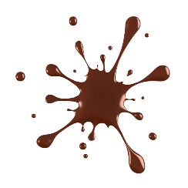

Black and white make….
brown
gray

Slide 18
The answer is…
GRAY

Slide 19
Telepathy Game
5

Slide 20
Red and yellow make….
orange
purple

Slide 21
The answer is…
ORANGE

Slide 22

It’s time to learn …

Slide 23
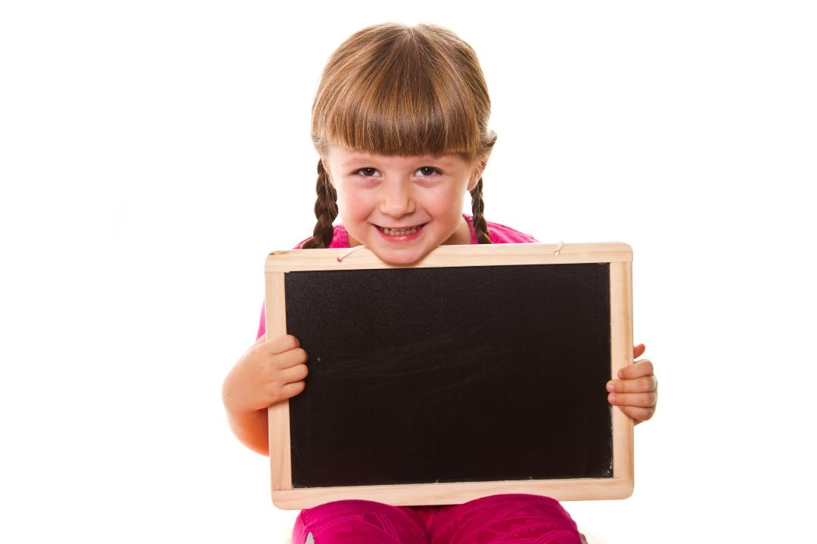
Presentation

Slide 24
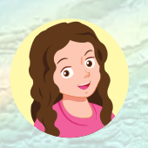
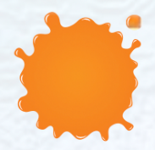
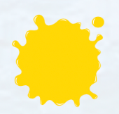
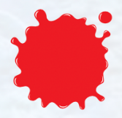
Let’s read!
I can make ……………with ………… and …………

Slide 25
How about green, brown, and pink?
Let’s do the reading to find out
how to make them.

Slide 26
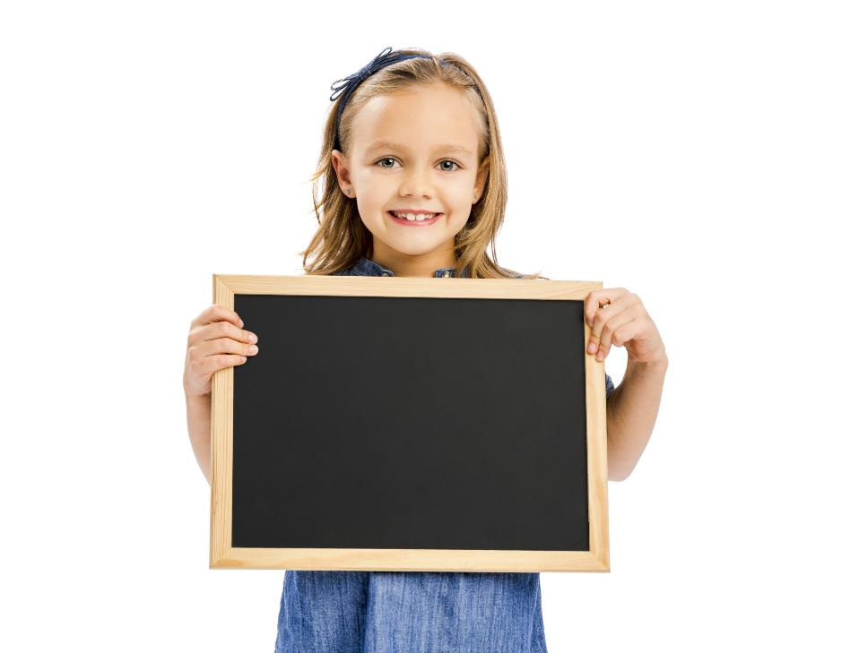
Reading

Slide 27

Have students read the text individually.
Read the text as a whole class.

Slide 28

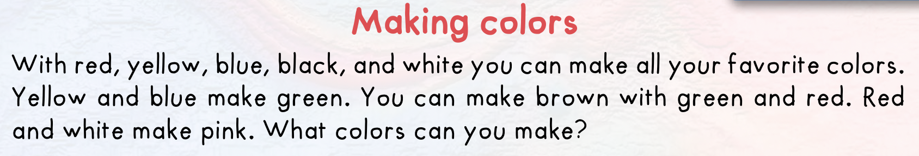

Slide 29
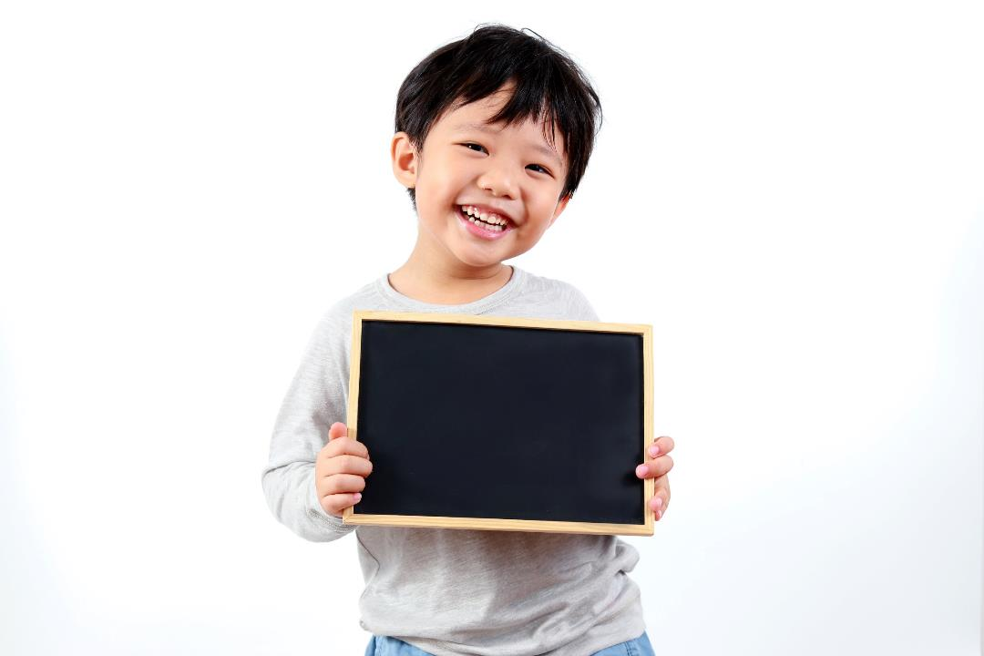
Practice

Slide 30

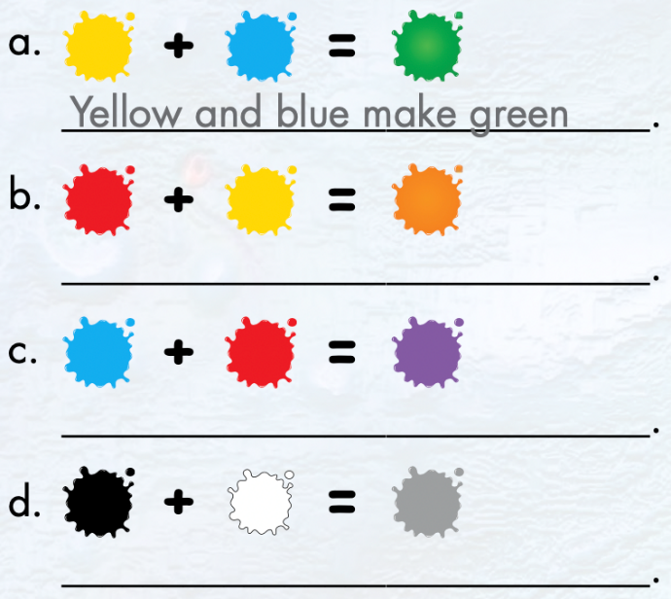

Slide 31
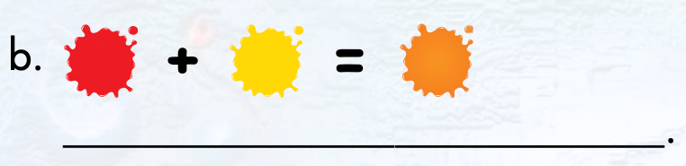
Red and yellow make orange

Slide 32
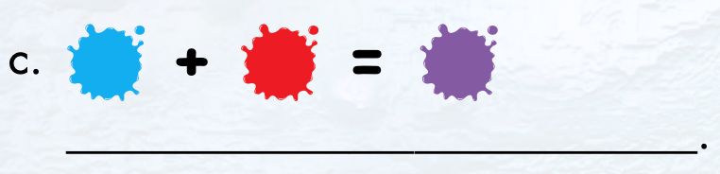
Blue and red make purple

Slide 33
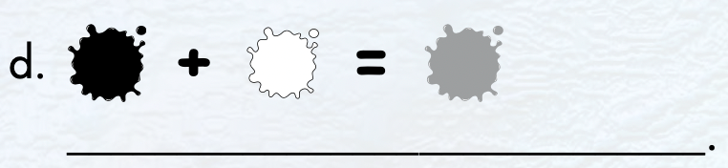
Black and white make gray

Slide 34
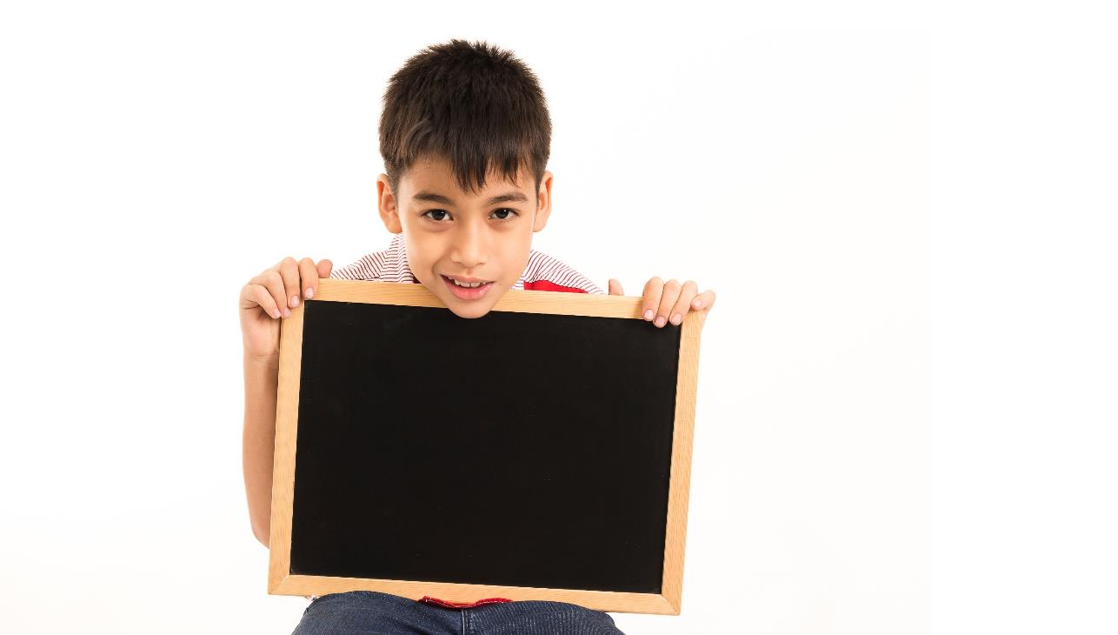
Writing

Slide 35

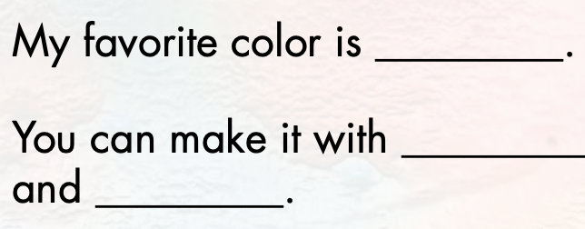
pink
red
white

Slide 36
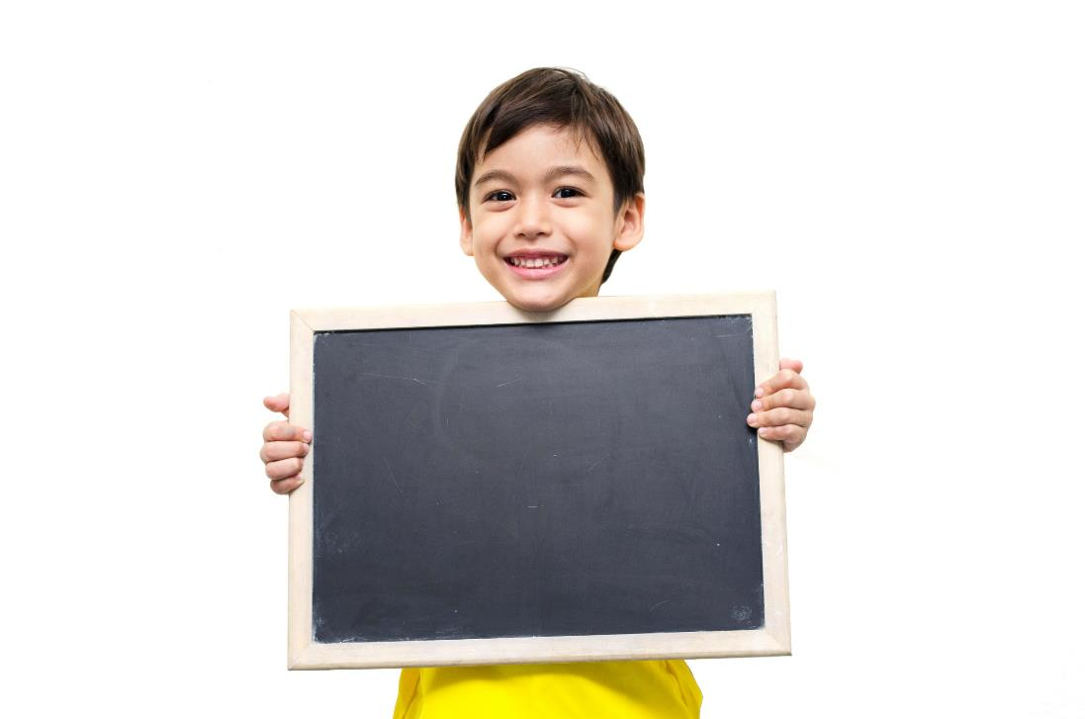
Listening

Slide 37
Pre-Listening
Look at the pictures and answer these questions.

Slide 38
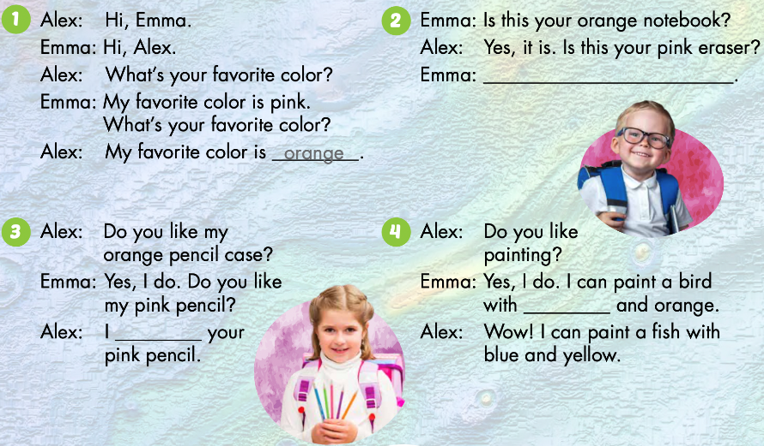
Who are talking?
What are they talking about?

Slide 39



Click on the icon to hear the sound

Slide 40

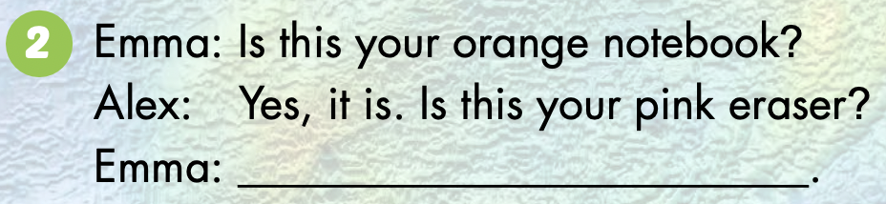
Let’s check!
Yes, it is

Slide 41
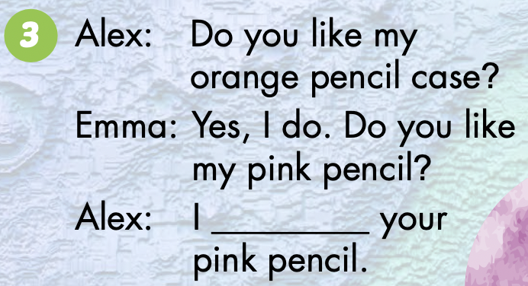
love

Slide 42
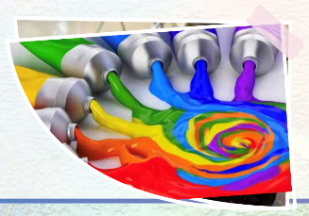
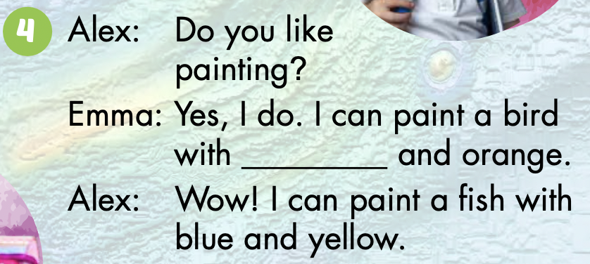
green

Slide 43
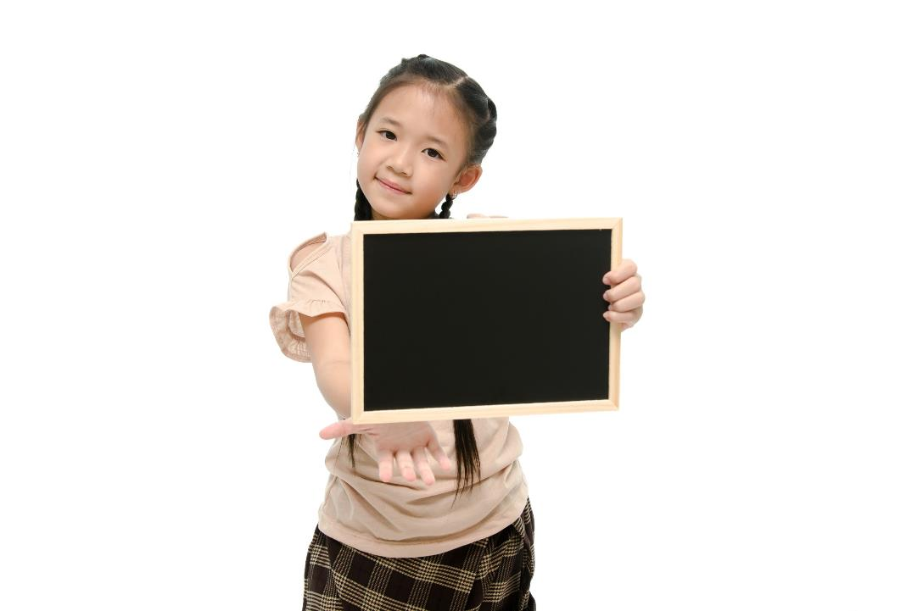
Speaking

Slide 44



Yes, it is
green
love

Slide 45

CONSOLIDATION

Slide 46
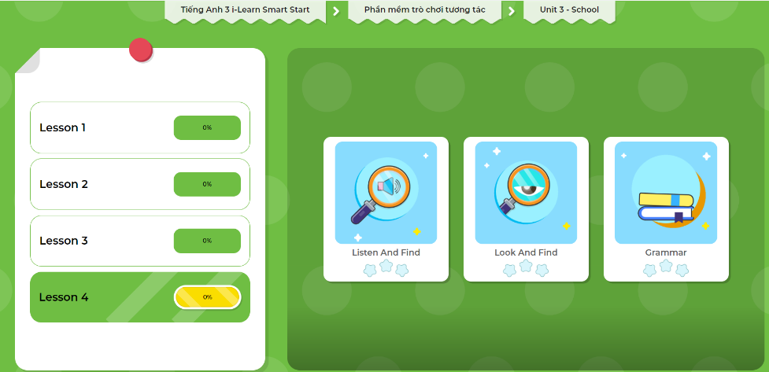
Extra Practice
DHA App
Let’s play!
Click here to play the game.

Slide 47

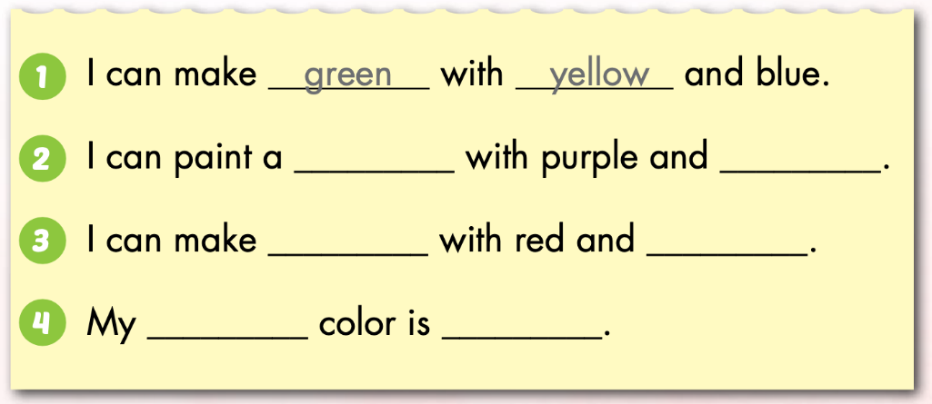
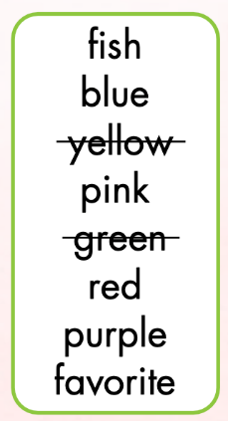
Extra Practice
WB p. 35
Click on the icon to hear the sound

Slide 48
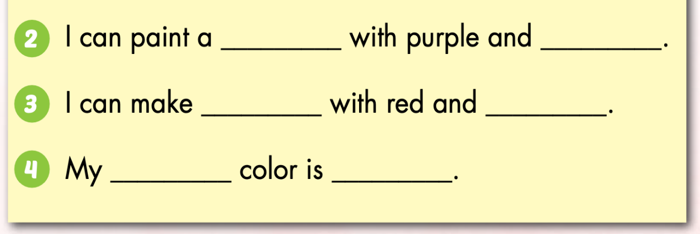
Let’s check!
fish
red
purple
blue
favorite
pink

Slide 49
Let’s play!
Find someone who…
Elicit questions
Find someone who… | Names
likes blue
doesn’t like red
like brown
Ask students to move around to ask questions
Write the name of that person next to the prompt
Notes:
134722862

Slide 50

WRAP-UP

Slide 51
Lesson 3
Today’s lesson
Vocabularies
green, orange, pink, purple, gray, favorite
Structures/ Sentence patterns
What's your favorite color?
- My favorite color is orange.
I can make orange with yellow and red.

Slide 52
Lesson 3
Homework
Learn by hearts vocabularies and make sentences using them.
Do the exercises on page 34 WB
Do the exercises in Tiếng Anh 3 i-Learn Smart Start Notebook on page 25.
Prepare the next lesson (page 49 SB)

Slide 53
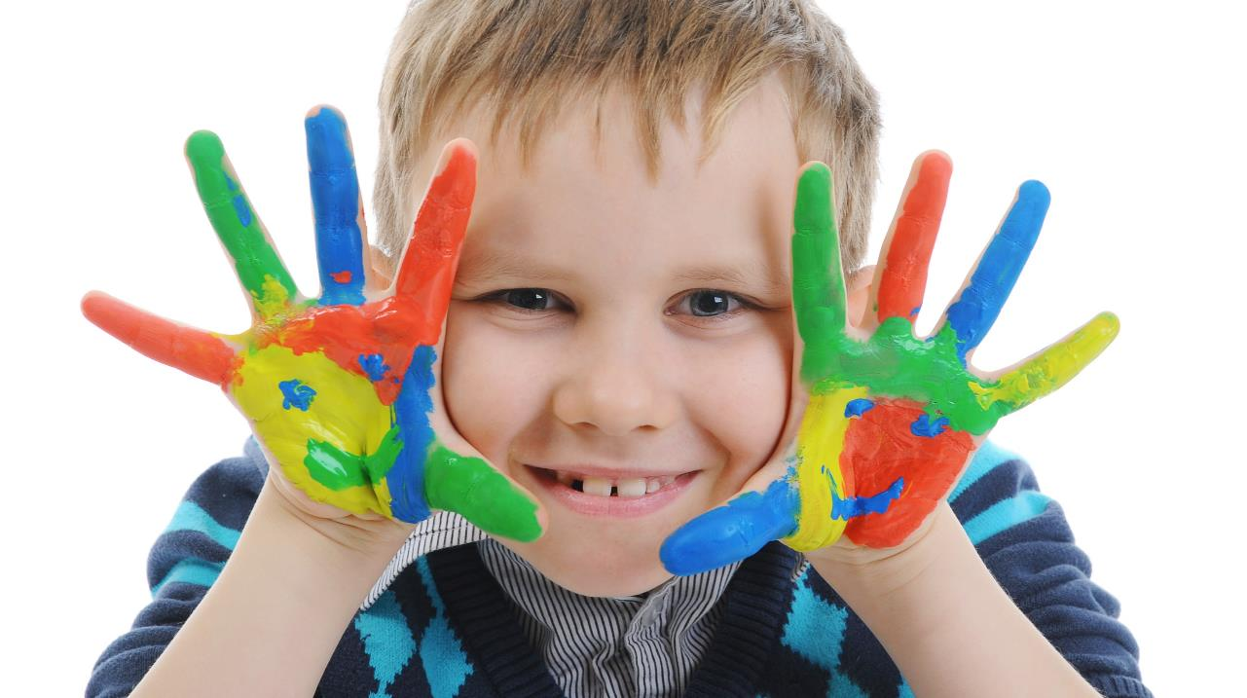
Enjoy your day!

Slide 54
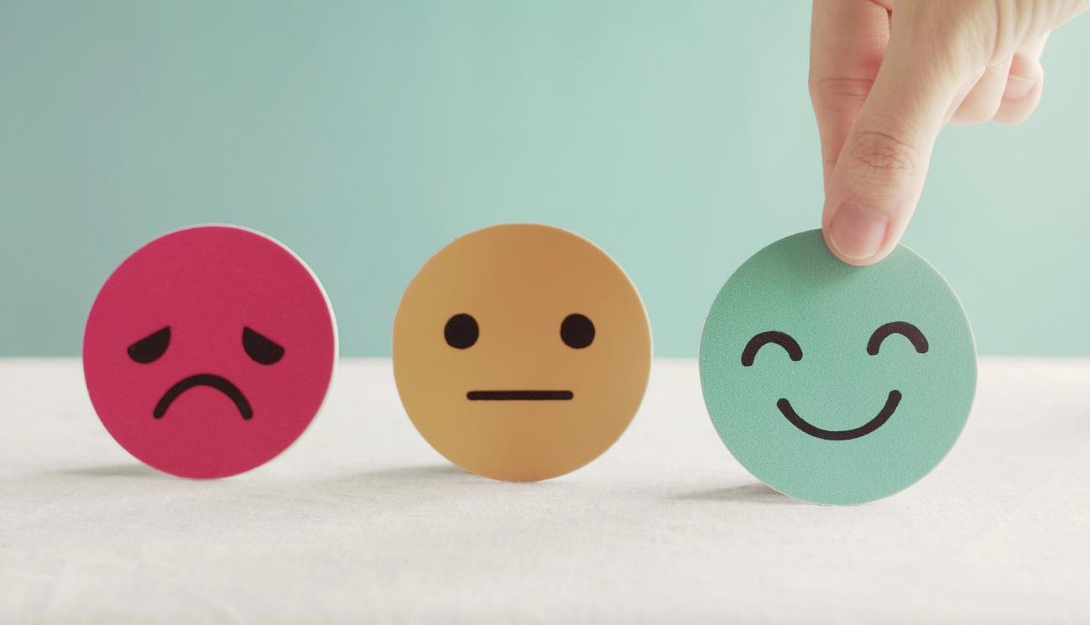
Lesson 3
Stay positive and have a nice day!

