Slide 1


Slide 2

Unit
9
1
Unit
FAMILY LIFE
Protecting The Environment
LESSON 5
LISTENING
Saving endangered animals

Slide 3

Unit
1
1
FAMILY LIFE
Family Life
Unit
OBJECTIVES
Listen for specific information in a conversation about ways to protect endangered animals.

Slide 4
LESSON 5
LISTENING
Unit
GETTING STARTED
WARM-UP
Ocean rescue game
Pre-listening
Task 1: Work in pairs and answer the question.
Task 2: Listen to the conversation and tick (✔) T (True) or F (False).
Task 3: Listen to the conversation again and complete the notes.
While-listening
Post-listening
Task 4: Work in groups and answer the question
CONSOLIDATION
Wrap-up
Home work

Slide 5
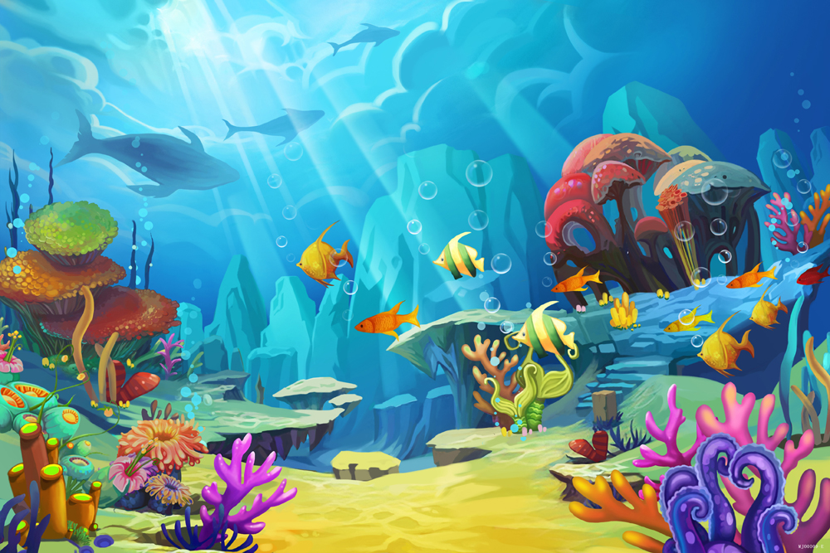



LESSON 5
LISTENING
WARM-UP
OCEAN RESCUE

Slide 6
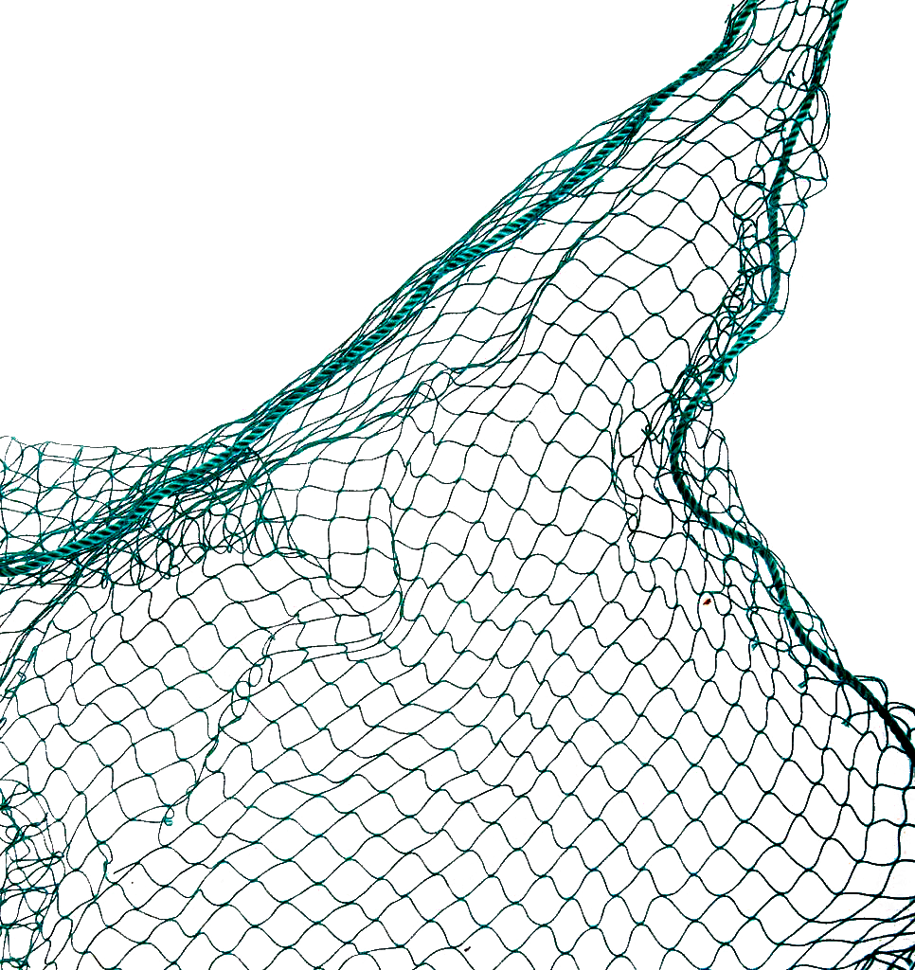
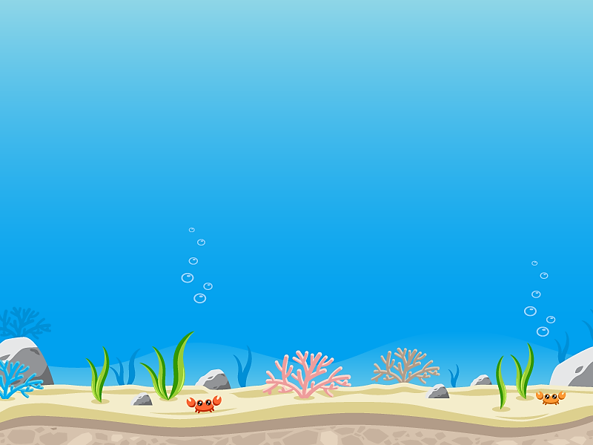






LESSON 5
LISTENING
WARM-UP
It is a large heavy animal with very thick skin and either one or two horns on its nose.
Bắt đầu!
A. An elephant
B. A crocodile
C. A hippo
D. A rhino
HẾT GIỜ

Slide 7

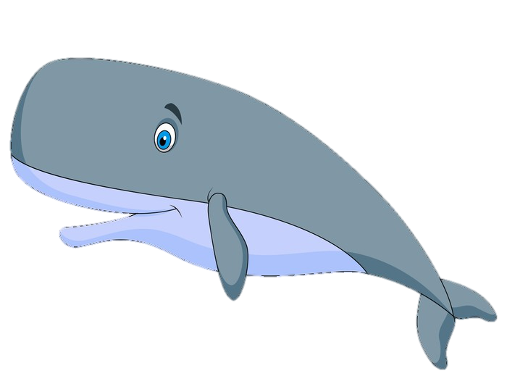

LESSON 5
LISTENING
WARM-UP
Bắt đầu!
Rhinos are large animals found
in rivers and lakes in …............
A. America
B. South Africa
C. Europe
D. Australia
HẾT GIỜ

Slide 8
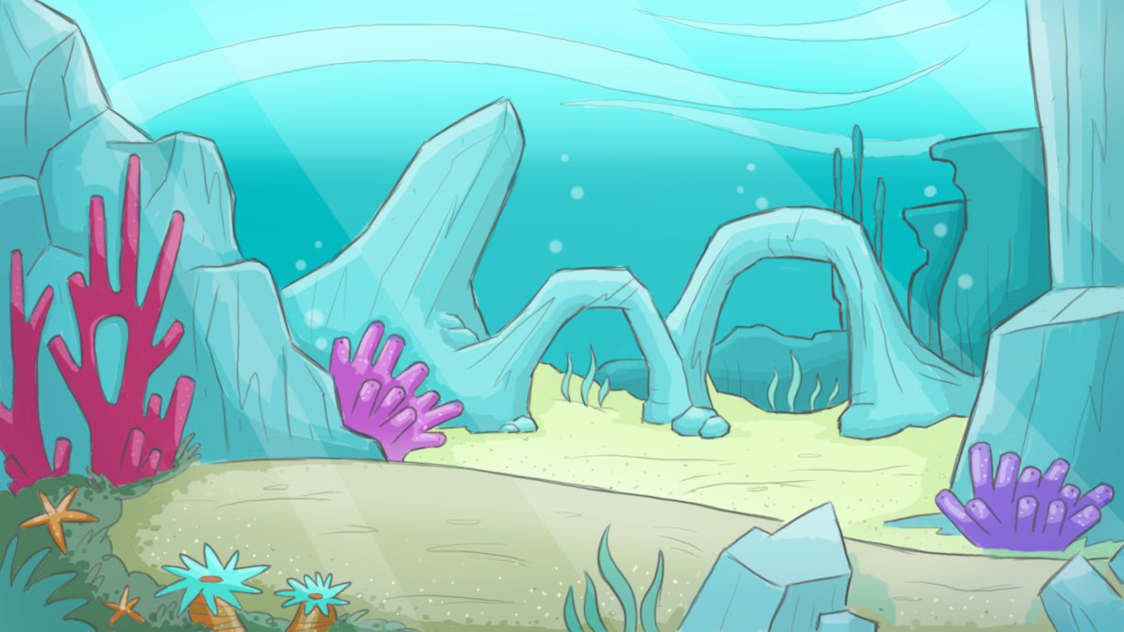
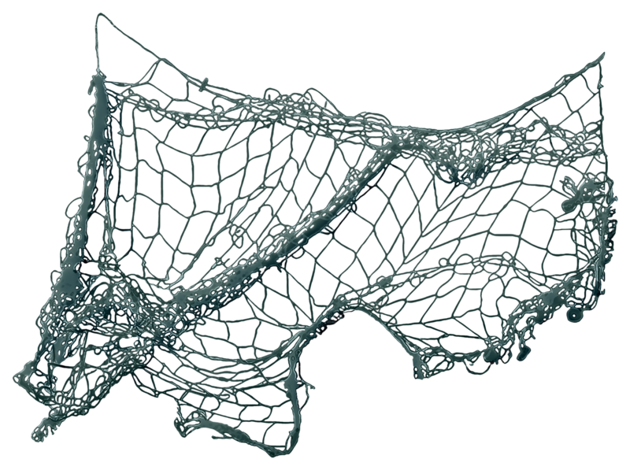


LESSON 5
LISTENING
WARM-UP
Bắt đầu!
Rhinos are threatened by
illegal hunting and loss of …............
A. habitat
B. water
C. river
D. ocean
HẾT GIỜ

Slide 9




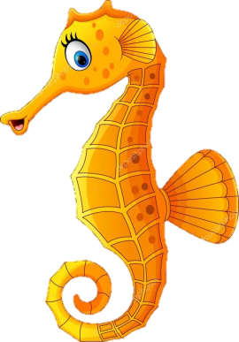
LESSON 5
LISTENING
WARM-UP
Bắt đầu!
The tiger is the largest living …........., and lives in forest habitats.
A. panda
B. lion
C. cat
D. pangolin
HẾT GIỜ

Slide 10
LESSON 5
LISTENING
WARM-UP
Bắt đầu!
Tigers are endangered animals and there are not more than ….........tigers in the wild now.
A. 35
B. 350
C. 3500
D. 35000
HẾT GIỜ

Slide 11
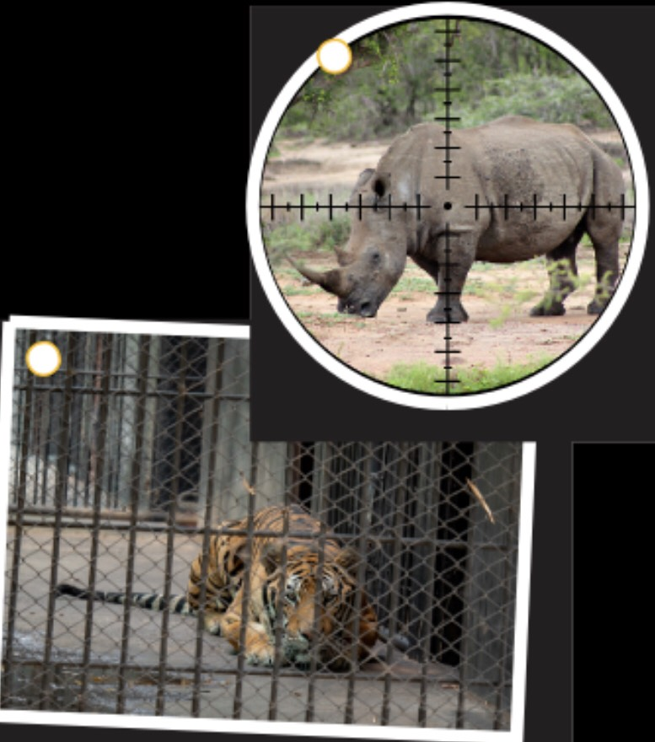
LESSON 5
LISTENING
GETTING STARTED
PRE-LISTENING
Pairwork
Answer the question:
What is happening to the animals in the picture?
Answer:
- Picture a: The rhino is being hunted.
- Picture b: The wild tiger is being kept in a cage. / The wild tiger is being held in captivity.

Slide 12
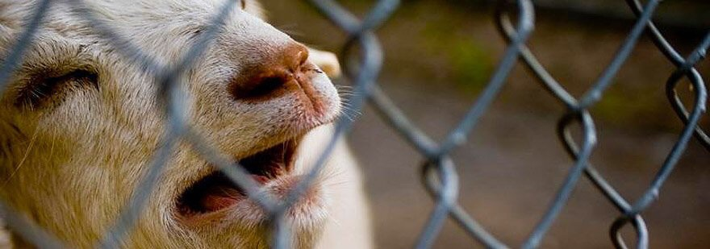

PRESENTATION
suffering (n)
/ˈsʌfərɪŋ/
physical or mental pain

Slide 13

PRESENTATION
ban (v)
/bæn/
to decide or say officially that something is not allowed

Slide 14
PRESENTATION
New words | Pronunciation | Meaning
suffering | /ˈsʌfərɪŋ/ | physical or mental pain
ban | /bæn/ | to decide or say officially that something is not allowed

Slide 15

LESSON 5
LISTENING
GETTING STARTED
While listening
Individual work
2. Nam and Mai are talking about Mai’s project on ways to save endangered animals. Listen to the conversation and decide whether the statements are (T) or false(F).
 | T | F
1.Mai will complete her mid-term project in two weeks.
2. Nam believes that people should first be made aware of the importance of the problem.
3. Mai thinks that illegal hunting may not destroy wild animals’ natural habitats.
4. Nam believes that illegal hunting can be prevented by banning wildlife trade.
✓
✓
✓
✓

Slide 16
LESSON 5
LISTENING
Unit
GETTING STARTED
While listening
Individual work
Listen to the conversation again and complete the notes. Use ONE word for each gap
Ways to save endangered animals
Helping people understand the (1)……………………………….of the problem. Introducing strict (2)………………………………….to prevent people from illegal hunting. Banning wildlife (3)…………………………………… Avoiding products made from endangered(4) …………………..parts.
importance
laws
trade
animal

Slide 17
POST LISTENING
GROUPWORK
- Groups of 5, answer the questions:
Which is the most effective way to save endangered animals? Why?
- Each group prepares a 3-min summary on the most effective way to save endangered animals.
- Take turns presenting the summary of their discussions to the whole class.

Slide 18
CONSOLIDATION
1
Wrap-up
Listen for main idea and specific information in a conversation about ways to protect endangered animals.

Slide 19
CONSOLIDATION
2
Homework
Do exercises in the workbook

Slide 20


