Slide 2
Unit 5
The world of work
LESSON III
READING
Jobs advertisements

Slide 3
LESSON III
READING
WARM-UP
Flash game
PRE-READING
Task 1: Work in pairs. Look at the pictures and discuss what you know about the jobs.
Vocabulary
Task 2: Read the adverts and choose the correct meanings of the highlighted words and phrases.
Task 3: Read the adverts again and choose the most suitable headline for each one.
Task 4: Read the adverts again and decide which job is most suitable for the following people. Write 1, 2, 3, 4, or 5.
WHILE-READING
POST-READING
Task 5: Work in pairs. Discuss the following questions.
CONSOLIDATION
Wrap-up
Homework

Slide 4

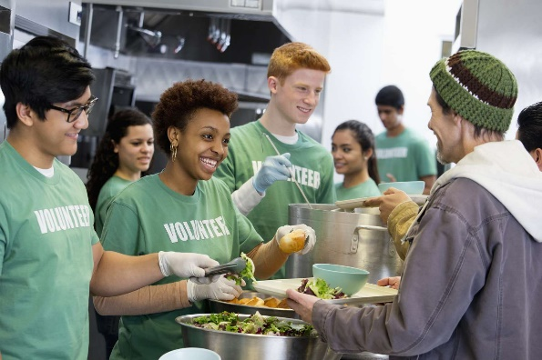



WARM-UP
What is this job?
Fast
Medium
Slow

Slide 5


WARM-UP
What is this job?
shop assistant
volunteer
babysitter
product reviewer
teaching assistant

Slide 6
PRE-READING
1
Work in pairs. Look at the pictures and discuss what you know about the jobs.

Slide 7


PRE-READING
unpaid (adj)
/ˌʌnˈpeɪd/
not receiving payment for work that they do

Slide 8

PRE-READING
wage (n)
/weɪdʒ/
a regular amount of money that you earn, usually every week or every month, for work or services

Slide 9

PRE-READING
donation (n)
/dəʊˈneɪʃn/
something that is given to a person or an organization such as a charity, in order to help them

Slide 10

PRE-READING
overtime pay (n)
/ˈəʊvətaɪm peɪ/
extra money that an employee receives for working more hours than their regular work schedule

Slide 11

PRE-READING
responsibility (n)
/rɪˌspɒnsəˈbɪləti/
a moral duty to do something or to help or take care of somebody because of your job, position,...

Slide 12
PRE-READING
Form | Pronunciation | Meaning | Vietnamese equivalent
1. unpaid (adj) | /ˌʌnˈpeɪd/ | not receiving payment for work that they do | không được trả lương
2. wage (n) | /weɪdʒ/ | a regular amount of money that you earn, usually every week or every month, for work or services | tiền công (trả theo giờ hoặc theo khối lượng công việc)
3. donation (n) | /dəʊˈneɪʃn/ | something that is given to a person or an organization such as a charity, in order to help them | đồ từ thiện, quyên góp
4. overtime pay (n) | /ˈəʊvətaɪm peɪ/ | extra money that an employee receives for working more hours than their regular work schedule | tiền ngoài giờ
5. responsibility (n) | /rɪˌspɒnsəˈbɪləti/ | a moral duty to do something or to help or take care of somebody because of your job, position,... | nhiệm vụ

Slide 13
WHILE-READING
2
Read the adverts and choose the correct meanings of the highlighted words and phrases.
A. jobs which are available for someone to do
1. vacancies
B. all the jobs in a company
A. able to change quickly according to the situation
2. flexible
B. able to stick to the chosen job
A. articles expressing opinions about new products, books, films, ..
3. reviews
B. the act of reading materials to prepare for an exam
4. on-the-jobs training
A. the work experience you need to get a job
B. teaching employees how to do a job at their workplace
A. not regular; for a short period of time
5. casual
B. permanent; long-term

Slide 14

WHILE-READING
2
Read the adverts and choose the correct meanings of the highlighted words and phrases.
A. jobs which are available for someone to do
1. vacancies
B. all the jobs in a company
A. able to change quickly according to the situation
2. flexible
B. able to stick to the chosen job
A. articles expressing opinions about new products, books, films, etc.
3. reviews
B. the act of reading materials to prepare for an exam

Slide 15
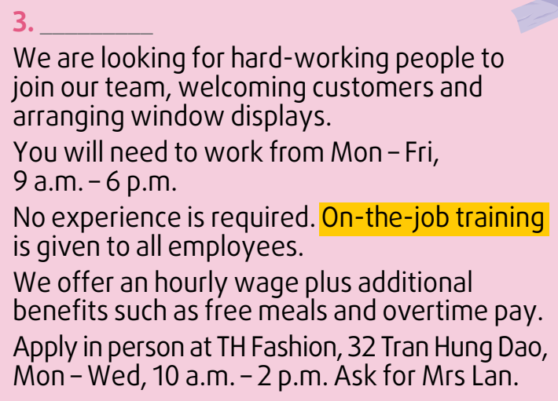
WHILE-READING
2
Read the adverts and choose the correct meanings of the highlighted words and phrases.
4. on-the-jobs training
A. the work experience you need to get a job
B. teaching employees how to do a job at their workplace

Slide 16
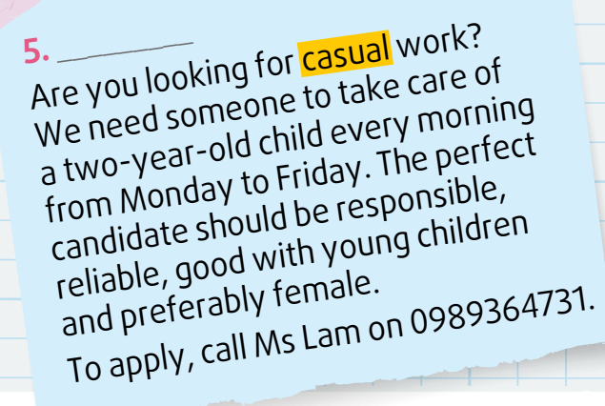
WHILE-READING
2
Read the adverts and choose the correct meanings of the highlighted words and phrases.
5. casual
A. not regular; for a short period of time
B. permanent; long-term

Slide 17
WHILE-READING
3
Read the adverts again and choose the most suitable headline for each one.
A. Shop assistant wanted
Adverts 1
B. Volunteers needed
Adverts 2
C. Job vacancies: Teaching assistants
Adverts 3
D. Babysitter wanted
Adverts 4
E. Want to be a product reviewer?
Adverts 5

Slide 18
WHILE-READING
3
Read the adverts again and choose the most suitable headline for each one.
E. Want to be a product reviewer?
Adverts 1

Slide 19

WHILE-READING
3
Read the adverts again and choose the most suitable headline for each one.
B. Volunteers needed
Adverts 2

Slide 20
WHILE-READING
3
Read the adverts again and choose the most suitable headline for each one.
A. Shop assistant wanted
Adverts 3

Slide 21
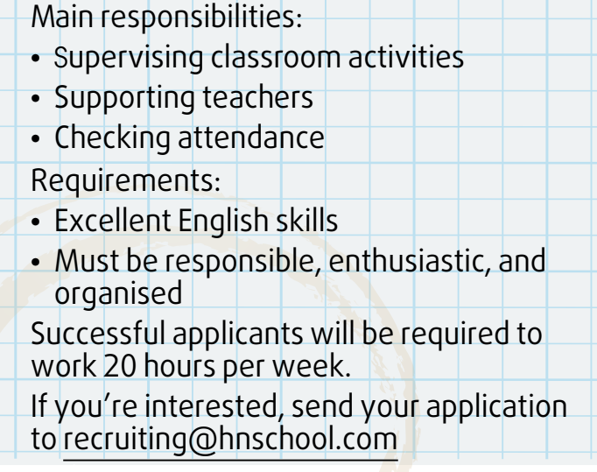
WHILE-READING
3
Read the adverts again and choose the most suitable headline for each one.
C. Job vacancies: Teaching assistants
Adverts 4

Slide 22
WHILE-READING
3
Read the adverts again and choose the most suitable headline for each one.
D. Babysitter wanted
Adverts 5

Slide 23
WHILE-READING
Look at the answers again
E. Want to be a product reviewer?
Adverts 1
B. Volunteers needed
Adverts 2
A. Shop assistant wanted
Adverts 3
C. Job vacancies: Teaching assistants
Adverts 4
D. Babysitter wanted
Adverts 5

Slide 24
WHILE-READING
4
Read the adverts again and decide which job is most suitable for the following people. Write 1, 2, 3, 4, or 5.
 | Job
a. A person without any knowledge or skills for the job.
b. A woman who loves playing with kids and helping them grow.
c. A person who is available to do unpaid work on Saturdays and Sundays.
d. A person who speaks English extremely well.
e. A person who is interested in technology and can express his/her opinions well.
3. shop assistant
5. babysitter
2. volunteer
4. teaching assistant
1. product reviewer

Slide 25

POST-READING
5
Work in pairs. Discuss the following questions.
Which of the jobs in the adverts do you find the most interesting? Why?
I find the teaching assistant job the most interesting because it will give me the opportunity to improve my English skills. It will be exciting to supervise classroom activities and help teachers plan their lessons. It will also be a great job to list on my CV.

Slide 26
CONSOLIDATION
1
Wrap-up
What have you learned today?
Some vocabulary related to Job advertisements
Reading for specific information about Job advertisements
Discuss the job you find the most interesting.

Slide 27
CONSOLIDATION
2
Homework
Learn by heart vocabulary
Do exercises in the workbook.
Talk about the job you find the most interesting with your friends.
Prepare for the next lesson.

Slide 28
Website: hoclieu.vn
Fanpage: facebook.com/www.tienganhglobalsuccess.vn

