Slide 1

Unit 5: London Was Great!
Lesson 5b: Grammar
Page 91

Slide 2
Lesson Outline
Warm-up
Grammar
Consolidation
Wrap-up

Slide 3
Objectives
By the end of this lesson, students will be able to…
- learn and practise Past Simple of irregular verbs.

Slide 4

WARM-UP

Slide 5
Write the Past Simple form of the following verbs.
help: ______________
arrive: ______________
play: ______________
enjoy: ______________
study: ______________
stop: ______________
live: ______________
wash: ______________
helped
arrived
played
enjoyed
studied
stopped
lived
washed

Slide 6
Not all verbs follow the rule of adding “-ed” to form Past Simple form.
see → saw
eat → ate
drink → drank
go → went
Irregular verbs

Slide 7

It’s time to learn …

Slide 8
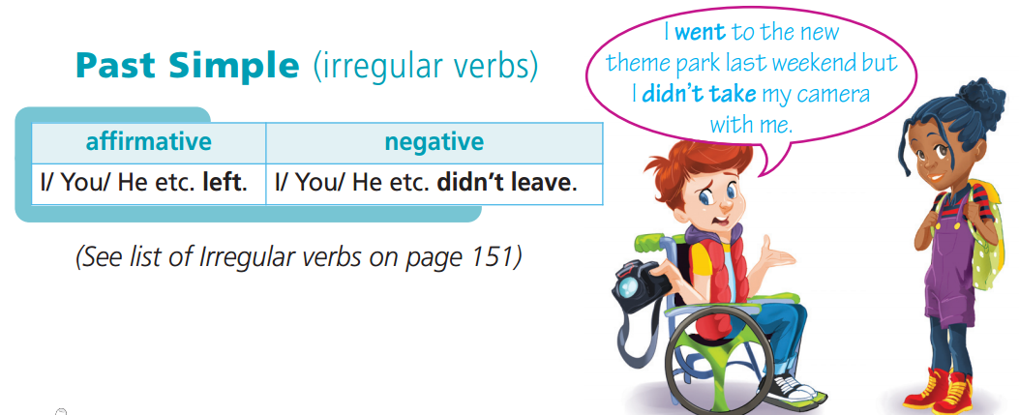

Slide 9
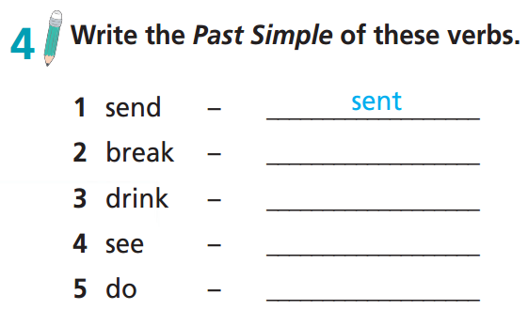
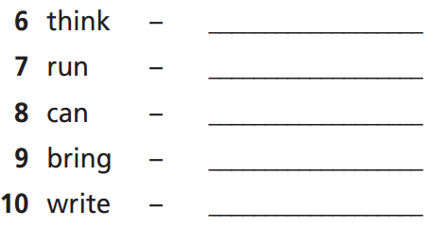
thought
ran
broke
drank
could
brought
saw
did
wrote

Slide 10
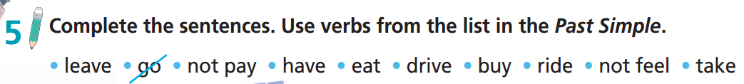
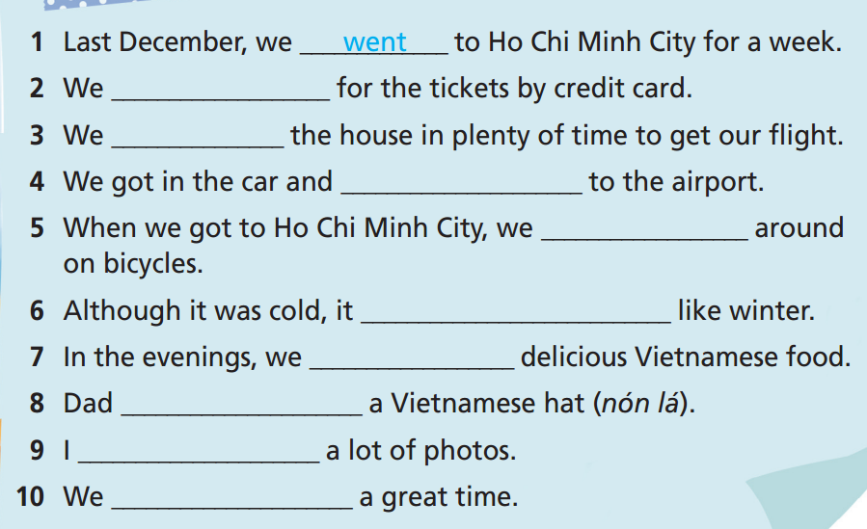
didn’t pay
left
drove
rode
didn’t feel
ate
bought
took
had

Slide 11
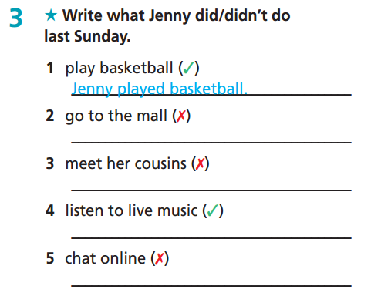
Extra-practice
WB-p. 45
Jenny didn’t go to the mall.
Jenny didn’t meet her cousins.
Jenny listened to live music.
Jenny didn’t chat online.

Slide 12
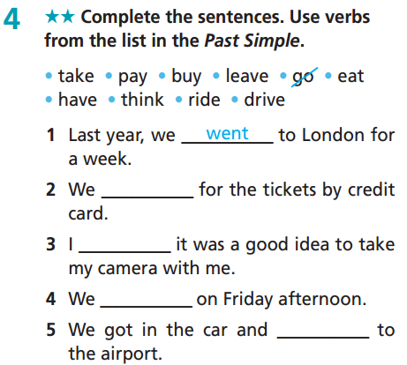
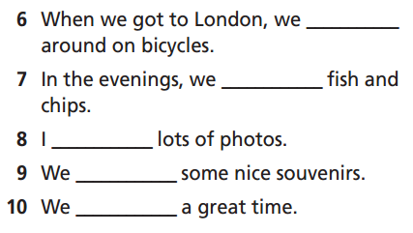
Extra-practice
WB-p.45
rode
ate
took
bought
paid
had
thought
left
drove

Slide 13
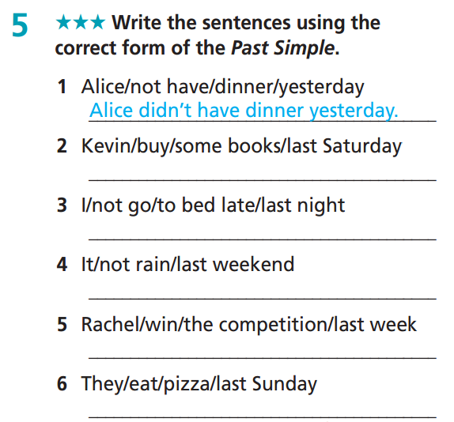
Extra-practice
WB-p.45
Kevin bought some books last Saturday.
I didn’t go to bed late last night.
It didn’t rain last weekend.
Rachel won the competition last week.
They ate pizza last Sunday.

Slide 14
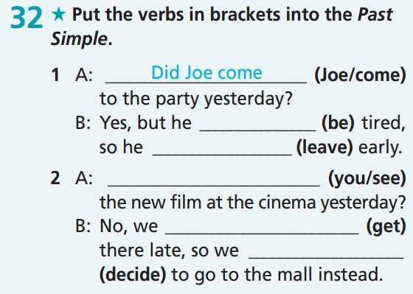
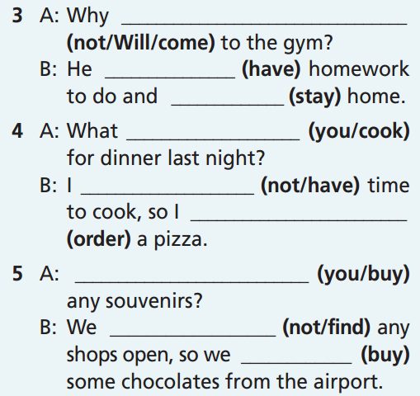
Extra-practice
GB-p. 71
didn’t Will come
had
stayed
was
did you cook
left
Did you see
didn’t have
ordered
got
decided
Did you buy
didn’t find
bought

Slide 15
Turn the following sentences into negative.
Mary played badminton this weekend.
→ Mary didn’t play badminton this weekend.
2. My mother cooked dinner yesterday evening.
→ My mother didn’t cook dinner yesterday evening.
3. All the students went to the museum last week.
→ All the students didn’t go to the museum last week.
4. Alan sang very well at the party last night.
→ Alan didn’t sing very well at the party last night.

Slide 16
Choose the best answer from A, B, C.
Yesterday, I __________ at the cinema with my family.
am
was
were
2. They __________ late for school last Friday.
am
was
were

Slide 17
Choose the best answer from A, B, C.
3. Mary is happy now but yesterday she __________ happy.
is
was
wasn’t
4. We __________ home to go to the airport.
leave
leaved
left

Slide 18
Choose the best answer from A, B, C.
5. We ___________ Julie in town last Sunday.
are
see
saw
6. She ___________ to the cinema three times last week.
goes
went
goed

Slide 19
Odd one out.
played ordered went
waited bought helped
enjoyed paid thought
rode arrived left
is was were

Slide 20
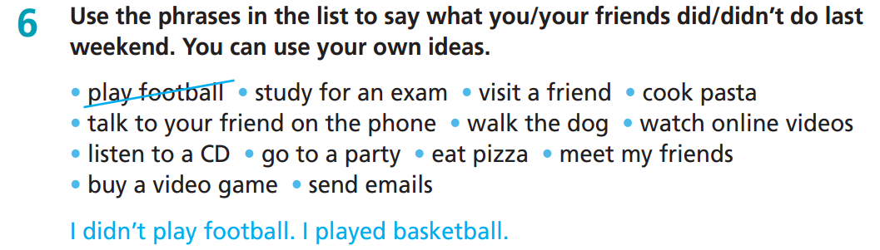

Slide 21
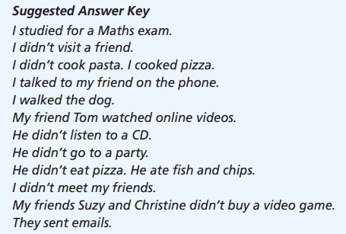

Slide 22
Storytelling
T starts the story "Yesterday, I went out."
T plays a piece of music and asks students to pass an object such as a pencil case (not throw) around. Sometimes, T stops the music. The student who is holding the object at the time the music stops will have to add a sentence that uses a verb in the past to continue the story.
Example: Yesterday, I went out. I went to the supermarket. I bought ……….. I saw ……… I was …..

Slide 23

CONSOLIDATION

Slide 24
Write some sentences about what you did/didn’t do last week.
I am writing about activities during last week. I went to school from Monday to Friday. My mother took me to school by motorbike. I didn’t have classes on Saturday and Sunday. At break time, I played with my friends at the schoolyard. I bought some candies at the school canteen. My friend borrowed some money from me. He didn’t give me back my money.

Slide 25

WRAP-UP

Slide 26
Today’s lesson
Grammar
Learn and practise Past Simple of irregular verbs.

Slide 27
Homework
Practise grammar and make sentences using them.
Do the exercises in TA 6 Right on WB (p. 45).
Complete the grammar notes in TA 6 Right on Notebook (p. 48).
Prepare for the next lesson (p. 92 SB).

Slide 28
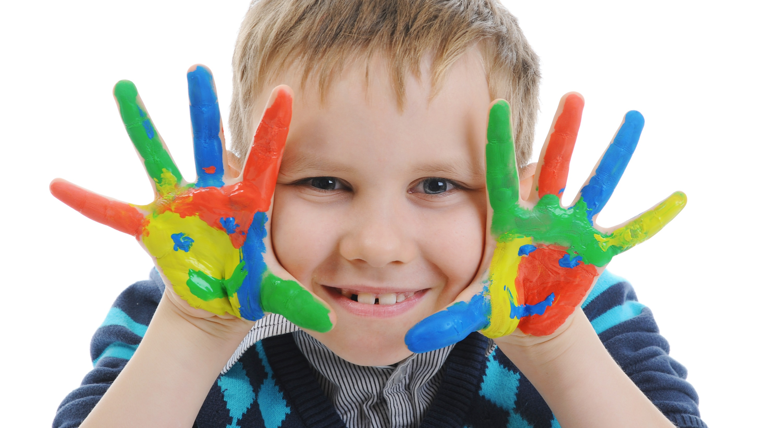
Enjoy your day!

