Slide 1

Unit 4: Community Services
Lesson 2.3: Pronunciation & Speaking
Page 33

Slide 2



LESSON OUTLINE
Consolidation

Slide 3

By the end of this lesson, students will be able to…
pronounce the ending ‘-ed’ of regular verbs in the Past Simple tense.
talk about what you did to help the community, using the Past Simple tense.

Slide 4

WARM-UP

Slide 5

Work in pairs.
Choose the word whose main stress is placed
differently from the others.
1. A. amazing B. fantastic C. exciting D. horrible
2. A. picture B. morning C. money D. reuse
3. A. suggest B. arrive C. finish D. enjoy
/əˈmeɪzɪŋ/
/fænˈtæstɪk/
/ɪkˈsaɪtɪŋ/
/ˈhɔːrəbl/
/ˈpɪktʃər/
/ˈmɔːrnɪŋ/
/ˈmʌni/
/ˌri:ˈju:z/
/səˈdʒest/
/əˈraɪv/
/ˈfɪnɪʃ/
/ɪnˈdʒɔɪ/

Slide 6
Work in pairs.
Choose the word whose underlined part is
pronounced differently from that of the other words.
1. A. idea B. children C. kitten D. fishing
2. A. cans B. books C. parks D. plants
3. A. puppet B. talent C. member D. dinner
/aɪˈdi:ə/
/ˈtʃɪldrən/
/ˈkɪtn/
/ˈfɪʃɪŋ/
/kænz/
/bʊks/
/pɑːrks/
/plænts/
/ˈpʌpɪt/
/ˈtælənt/
/ˈmembər/
/ˈdɪnər/

Slide 7
Match a verb with an appropriate noun to make a correct verb phrase.
Work in pairs
VERBS
clean up
bake
plant
donate
raise
recycle
wash
NOUNS
money
paper
beaches
trees
cars
food
cookies

Slide 8



Slide 9
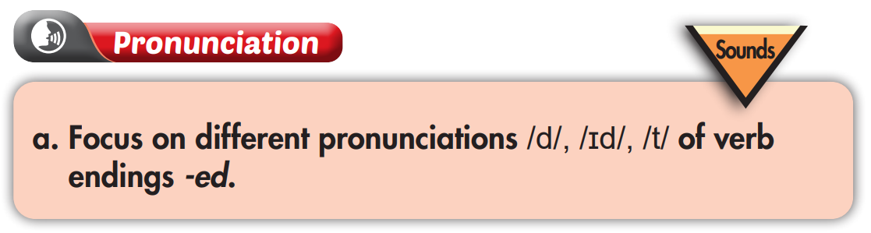
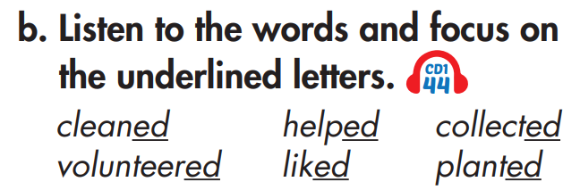

Listen again and repeat

Slide 10
Complete the ‘-ed’ pronunciation rules with /t/, /id/, or /d/:
1. If the verb before ‘-ed’ ends with the sound 't' or 'd', then
‘-ed’ is pronounced ……………
Ex: want – wanted need – needed
2. If the word before ‘-ed’ ends with the sound 'p', 'f', 's', 'ch', 'sh', 'k', then ‘-ed’ is pronounced …………..
Ex: stop – stopped laugh – laughed miss – missed
watch – watched wash – washed cook – cooked
3. For other words, ‘-ed’ is pronounced …………….
Ex: clean – cleaned organize – organized
/id/
/t/
/d/

Slide 11
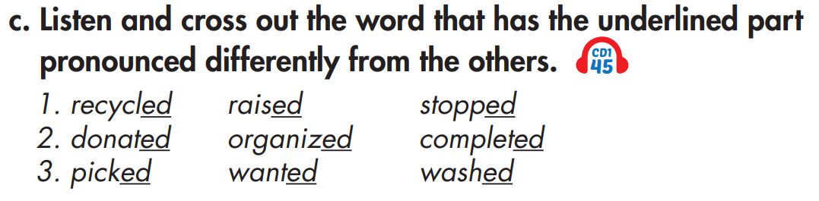
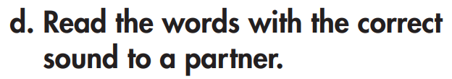

Listen again and repeat

Slide 12
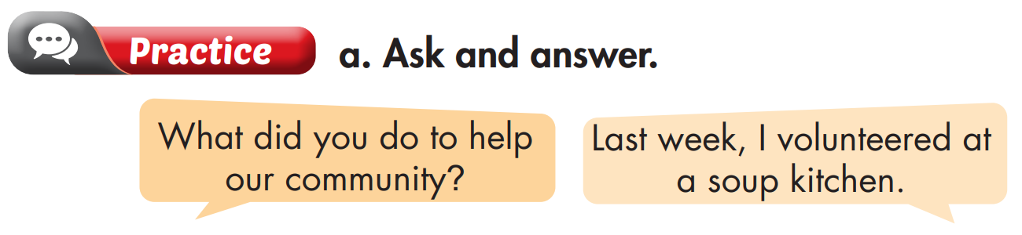
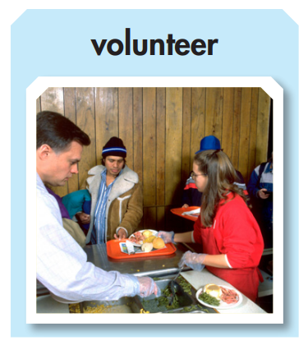
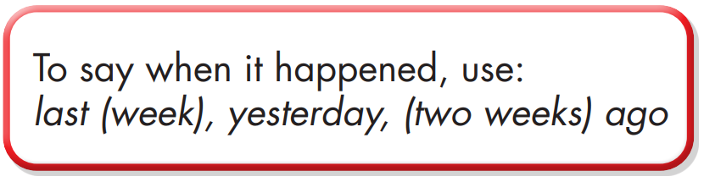

Slide 13

Last week, I recycled bottles.
What did you do to help our community?
I recycled paper three days ago.

Slide 14
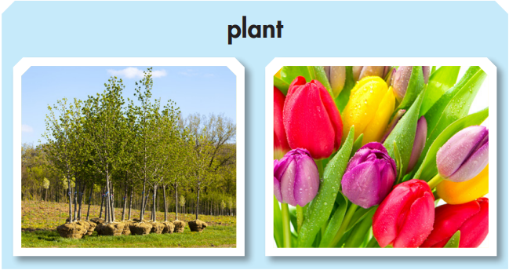
Last week, I planted trees.
What did you do to help our community?
I planted flowers yesterday.

Slide 15

Two weeks ago, I donated old clothes.
What did you do to help our community?
Last month, I donated old books.
I donated food yesterday.

Slide 16
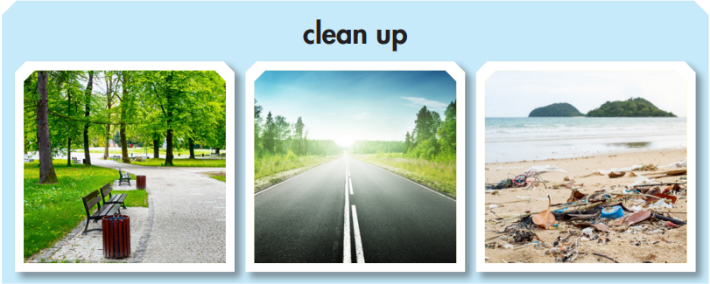
I cleaned up the park near my house yesterday.
What did you do to help our community?
I cleaned up streets two days ago.
I cleaned up the local beach last week.

Slide 17

Last month, I donated my old books.
What did you do to help our community?
Last summer, I volunteered at the local hospital.

Slide 18
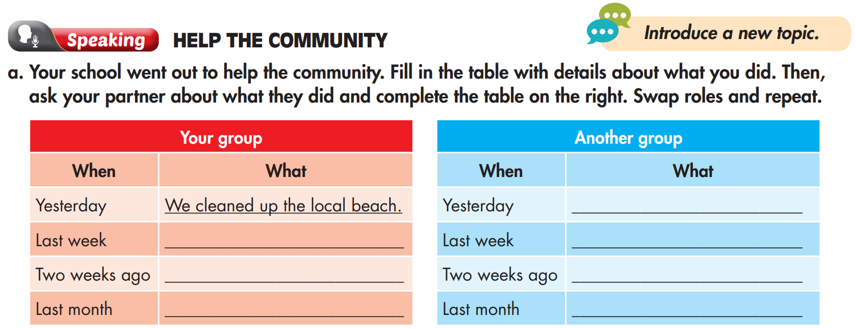

Slide 19
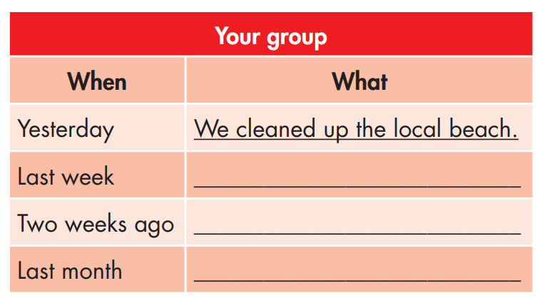
Fill in the table with details about what you did:
We planted flowers in the park.
We donated old clothes.
We volunteered at the soup kitchen.

Slide 20
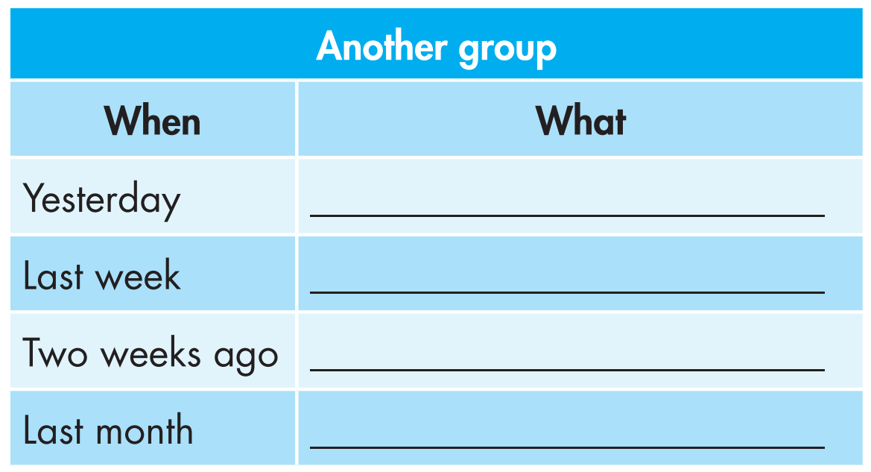
Ask your partner about what they did and complete the table on the right. Swap roles and repeat.
What did you do to help our community?
They donated old books.
We donated old books yesterday.

Slide 21

Let’s talk about what we did to help our community.
Yesterday, we cleaned up the local beach. We planted flowers in the park last week. Two weeks ago, we donated old clothes to the poor children in the area. We volunteered at the soup kitchen last month. How about you? What did you do?

Slide 22

CONSOLIDATION

Slide 23
Write about what your friends did to help the community, using the words and information you asked in speaking Task a. (About 50-70 words)

Slide 24

WRAP-UP

Slide 25
Today’s lesson
Pronunciation:
- Practice pronouncing the ending ‘-ed’ of regular verbs in the Past Simple tense.
Speaking & Writing:
- Talk about what you did to help the community, using the Past Simple tense.

Slide 26
Homework
Practice pronouncing the ending ‘-ed’ of the verbs in the Simple Past tense.
Practice talking about activities to help the community, using the Past Simple tense.
Prepare the next lesson (page 34 SB).
Play the consolidation games in Tiếng Anh 10 i-Learn Smart World DHA App on www.eduhome.com.vn

Slide 27

Lesson 3
Stay positive and have a nice day!

