Slide 1

Unit 3: Arts and Music
Lesson 3b: Grammar
Page 48

Slide 2
Lesson Outline
Warm-up
Grammar
Consolidation
Wrap-up

Slide 3
Objectives
By the end of this lesson, students will be able to…
use will correctly.
ask and answer about future.

Slide 4

WARM-UP

Slide 5

Work in pairs.
JUMBLED WORDS
Rearrange the letters to make meaningful words.
1. Certon
2. Baletl
3. Poaulptino
4. Fumosa
5. Acarbots

Slide 6
JUMBLED WORDS
Rearrange the letters to make meaningful words.
1. Certonc
2. Baletl
3. Poaulptino
4. Fumosa
5. Acarbots
1. Concert
2. Ballet
3. Population
4. Famous
5. Acrobats
ANSWER

Slide 7

It’s time to learn …

Slide 8

Presentation

Slide 9
Examples
1. Let’s go to a concert tomorrow. You’ll love it.

Slide 10
Lead in
1. What tense do we use in sentence 1?
Future Simple (will).
2. What do we use will for?
on-the-spot decisions; predictions based on what we think, believe or imagine; promises; offers.

Slide 11
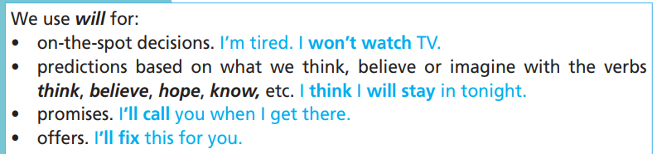
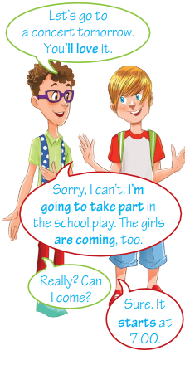
S + will + bare-infinitive
+
You will love it.
S + won’t + bare-infinitive
Structure:
-
You won’t love it.
?
Will + S + bare-infinitive?
Will you love it?

Slide 12

Practice

Slide 13
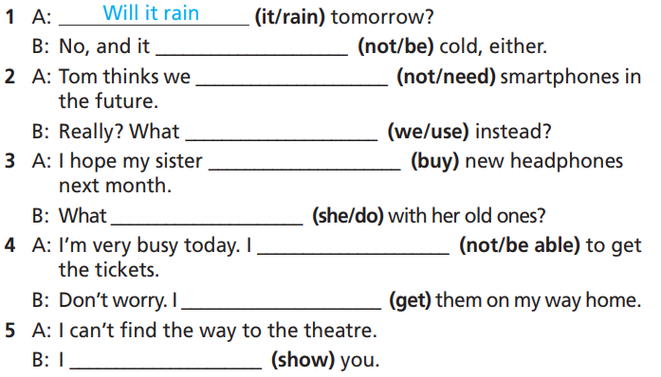
Practice
1 Use will or won’t and the verbs in brackets to complete the gaps.
How many sentences are there?
→ There are 5.
What are you going to do?
Use will or won’t and the verbs in brackets to complete the gaps.

Slide 14
Practice
1 Use will or won’t and the verbs in brackets to complete the gaps.
1 A: ____________(it/rain) tomorrow?
B: No, and it ________________ (not/be) cold, either.
2 A: Tom thinks we _________________ (not/need) smartphones in the future.
B: Really? What _____________________ (we/use) instead?
3 A: I hope my sister _____________ (buy) new headphones next month.
B: What ________________ (she/do) with her old ones?
Will it rain
won’t be
won’t need
will we use
will buy
will she do

Slide 15
Practice
1 Use will or won’t and the verbs in brackets to complete the gaps.
4 A: I’m very busy today. I _______________ (not/be able) to get the tickets.
B: Don’t worry. I _____________ (get) them on my way home.
5 A: I can’t find the way to the theatre.
B: I _____________ (show) you.
won’t be able
will get
will show

Slide 16
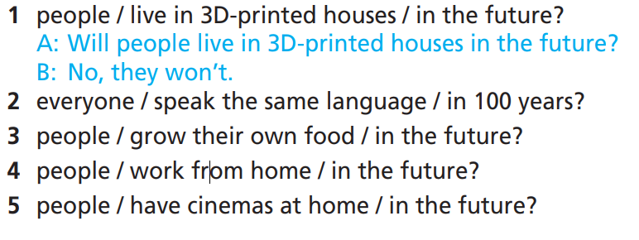
Practice
2 Ask and answer using the prompts and will or won’t.
How many sentences questions and
answer will you make?
→ 4 questions and 4 answers.
What will you use?
Use will or won’t.

Slide 17
Practice
2 Ask and answer using the prompts and will or won’t.
1. people / live in 3D-printed houses / in the future?
A: Will people live in 3D-printed houses in the future?
B: No, they won’t.
2. everyone / speak the same language / in 100 years?
A: Will everyone speak the same language in 100 years?
B: Yes, they will. / No, they won’t.

Slide 18
Practice
2 Ask and answer using the prompts and will or won’t.
3. people / grow their own food / in the future?
4. people / work from home / in the future?
5. people / have cinemas at home / in the future?
A: Will people grow their own food in the future?
B: Yes, they will. / No, they won’t.
A: Will people work from home in the future?
B: Yes, they will. / No, they won’t.
A: Will people have cinemas at home in the future?
B: Yes, they will. / No, they won’t.

Slide 19
Extra Practice
Grammar bank, page 69
Complete the sentences with the correct form of will and the verbs in brackets.
1. I’ve got a lesson now, but I ____________ (call) you later.
2. They ____________ (not/allow) you to ride on the roller coaster. I think you’re too short.
3. Tony is late, but he promises he ____________ (arrive) soon.
will call
won’t allow
will arrive

Slide 20
Extra Practice
Grammar bank, page 69
Complete the sentences with the correct form of will and the verbs in brackets.
4. My head hurts. I ____________ (not/go) to football practice today.
5. I did my homework this morning, so I _________ (wash) the car.
6. Oh no, we missed the last bus. – Don’t worry, we ________ (take) a taxi.
won’t go
will wash
will take

Slide 21

Production

Slide 22

What will 2060 be like? Think about transportation,
housing, jobs, food, entertainment and education.
Tell the class.

Slide 23
Suggested Answer Key
I think that in 2060 we will have ﬂying cars and buses. Houses will have computers to control the functions of the house such as lighting, heating, etc. Everyone will work from home. Many people will grow their own food. Everyone will be able to watch a play or listen to a concert from the comfort of their house. Children won’t have to go to school because they will have their classes online.

Slide 24

CONSOLIDATION

Slide 25

Work in pairs.
Now, practise the conversation with your partner.
1 A: Will people live in 3D-printed houses in the future?
B: No, they won’t.
2 A: Will everyone speak the same language in 100 years?
B: Yes, they will. / No, they won’t.

Slide 26

Work in pairs.
Now, practise the conversation with your partner.
3 A: Will people grow their own food in the future?
B: Yes, they will. / No, they won’t.
4 A: Will people work from home in the future?
B: Yes, they will. / No, they won’t.
5 A: Will people have cinemas at home in the future?
B: Yes, they will. / No, they won’t.

Slide 27

WRAP-UP

Slide 28
Today’s lesson
Grammar: Practise and use will correctly.
Speaking: Ask and answer about the future.

Slide 29
Homework
Practise the grammar point and make sentences using them.
Do the exercises in TA 7 Right on WB (page 27).
Prepare the next lesson (page 49 SB).

Slide 30
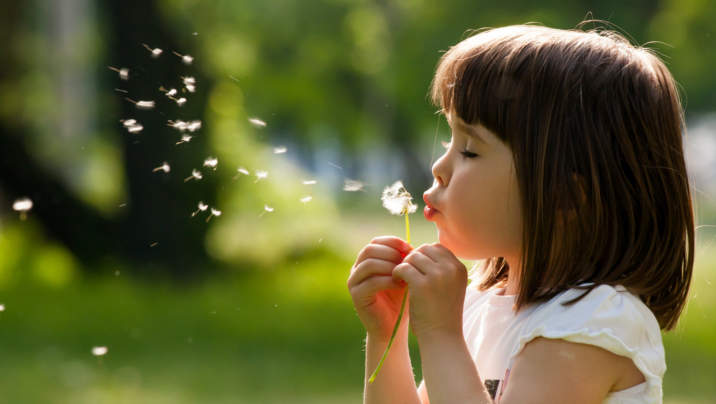
Enjoy your day!

