Slide 1
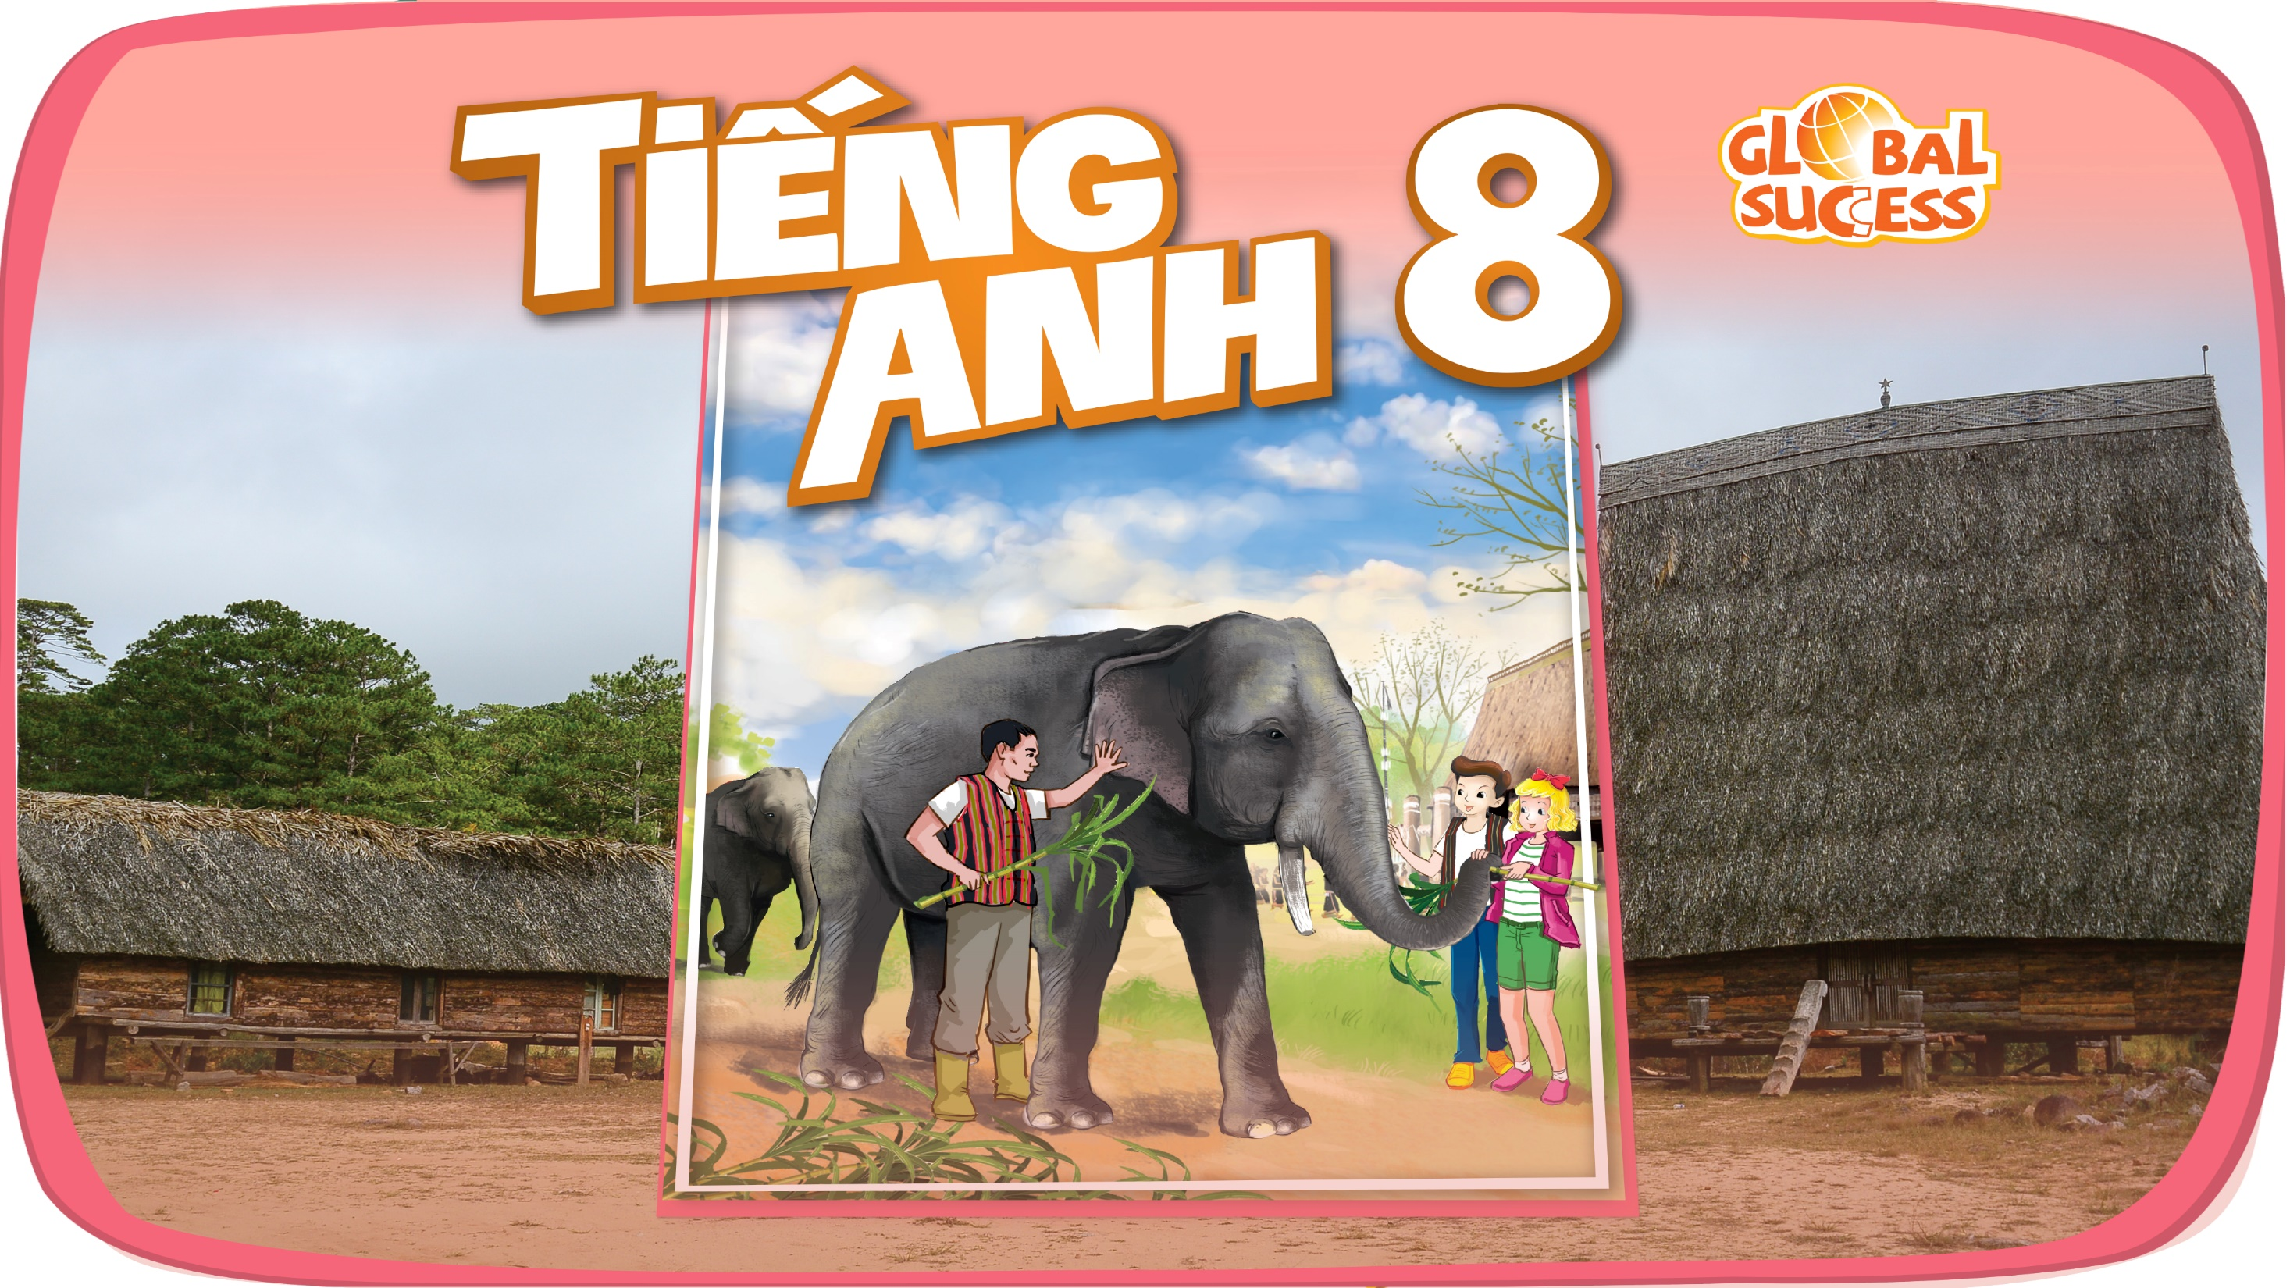

Slide 2


Unit
9
NATURAL DISASTERS
Unit
ETHNIC GROUPS OF VIET NAM
LESSON 4: COMMUNICATION
LESSON 3: A CLOSER LOOK 2
Unit
HOBBIES

Slide 3
LESSON 4: COMMUNICATION
WARM-UP
Answering the questions.
Vocabulary
Task 1: Listen and read the dialogue.
Task 2: Practise giving and responding to bad news.
EVERYDAY ENGLISH
Task 3: Read. Decide which natural disaster each person below is talking about.
Task 4: Choose the correct answer to each question..
Task 5: Work in pairs. Compare your answers. Then check your answers.
KNOWLEDGE OF NATURAL DISASTERS
CONSOLIDATION
Wrap-up
Homework

Slide 4
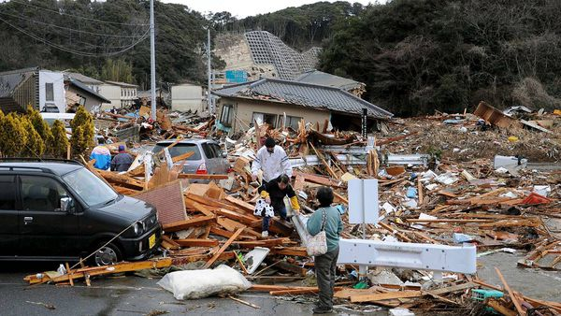
WARM-UP
1. What do you see in the picture?
2. How do you feel?

Slide 5
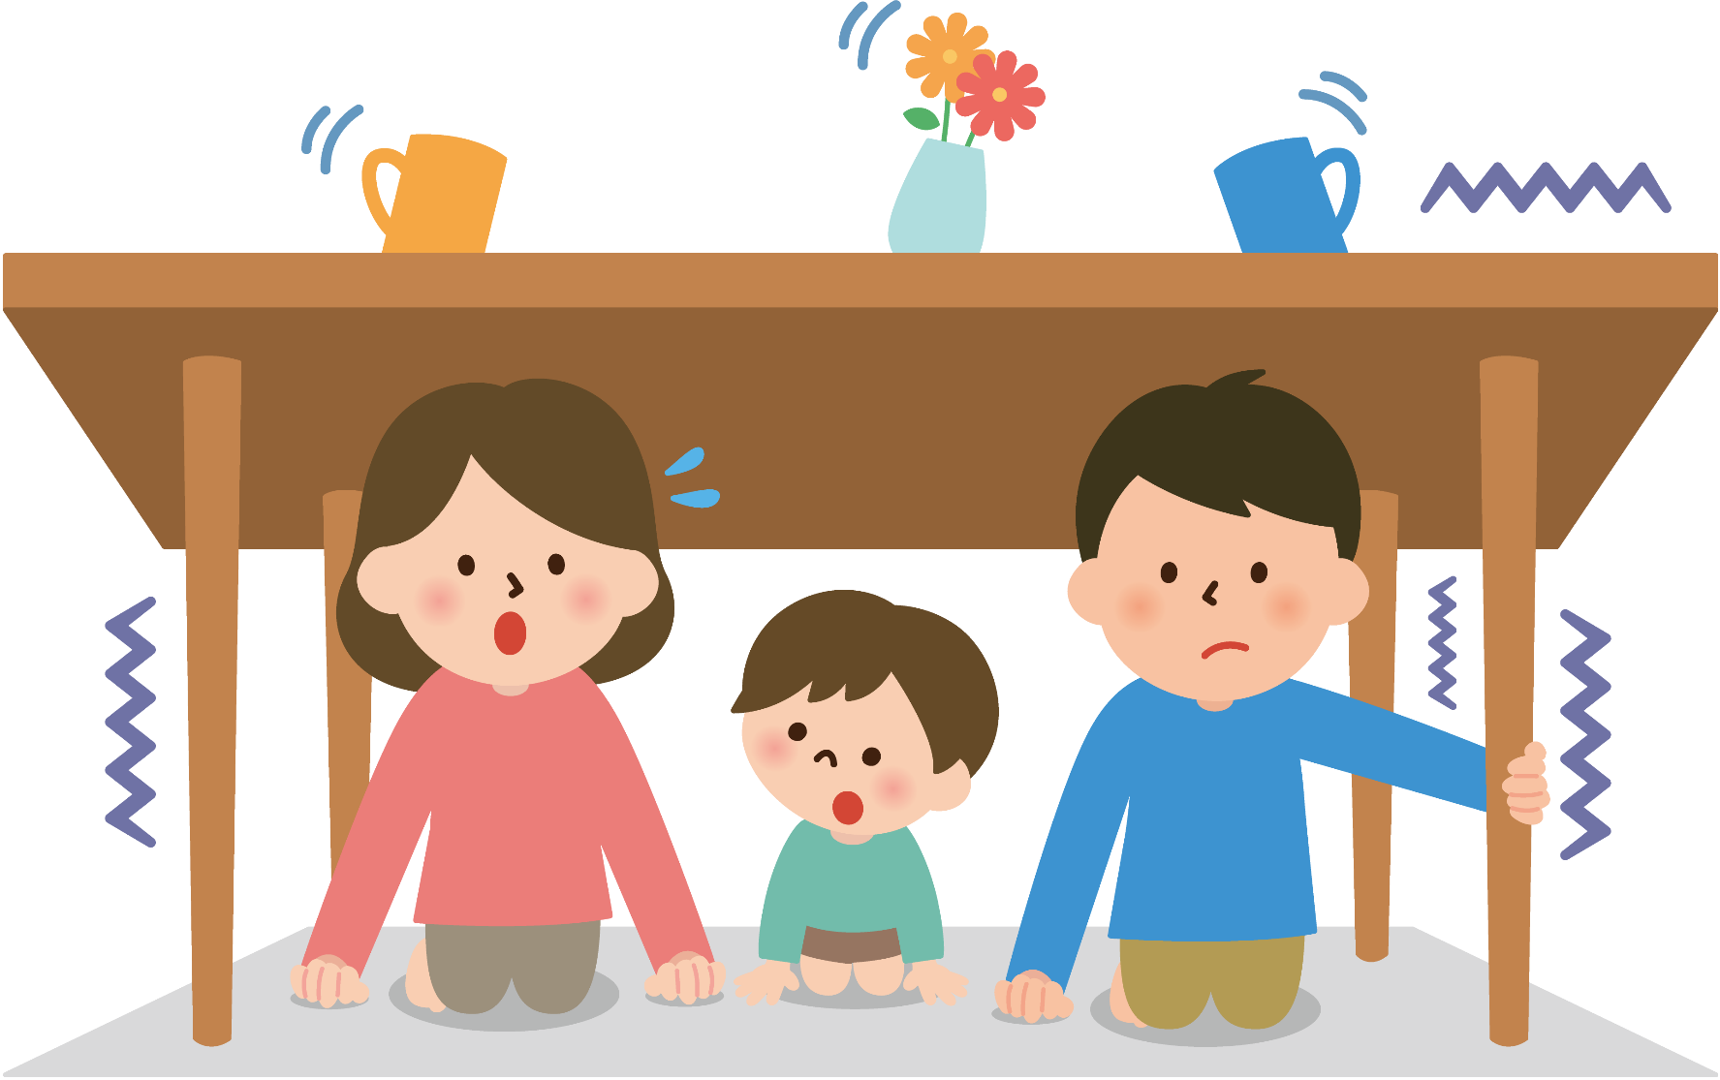

EVERYDAY ENGLISH
shake (v)
/ʃeɪk/
rung, lắc

Slide 6
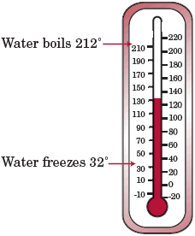
EVERYDAY ENGLISH
Fahrenheit (n)
/ˈfærənhaɪt/
độ F (đo nhiệt độ)

Slide 7
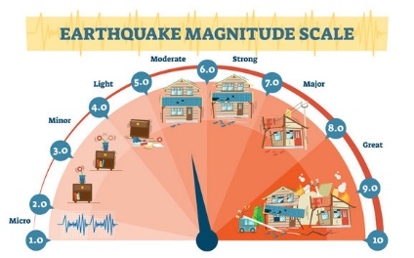
EVERYDAY ENGLISH
Richter scale (n)
/ˈrɪktə skeɪl/
Độ rích te (đo độ mạnh của động đất)

Slide 8
EVERYDAY ENGLISH
New words | Pronunciation | Meaning
1. shake (v) | /ʃeɪk/ | rung, lắc
2. Fahrenheit (n) | /ˈfærənhaɪt/ | độ F (đo nhiệt độ)
3. Richter scale (n) | /ˈrɪktə skeɪl/ | độ rích te (đo độ mạnh của động đất)

Slide 9
EVERYDAY ENGLISH
shake
Fahrenheit
Richter scale

Slide 10
EVERYDAY ENGLISH
1
Listen and read the dialogue below. Pay attention to the highlighted sentences.
Mark: Phong, why are you so sad?
Phong: My grandparents called this morning. A flood destroyed their house.
Mark: I’m sorry to hear that.
Phong: It also damaged all of their crops.
Mark: That’s awful. I hope your grandparents are safe.

Slide 11
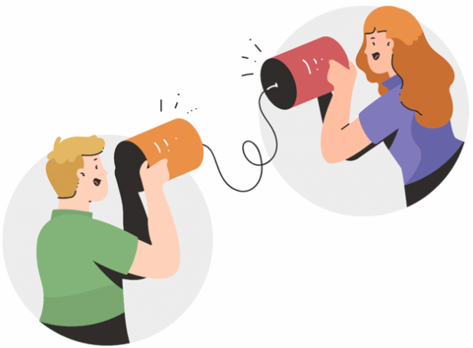
EVERYDAY ENGLISH
2
Work in pairs. Practise giving and responding to bad news in the following situations.
You have a friend in a mountainous area. A landslide destroyed his family’s garden yesterday. You share this news with your classmate.
You hear that a big earthquake hit a city. You share this news with your classmate.

Slide 12
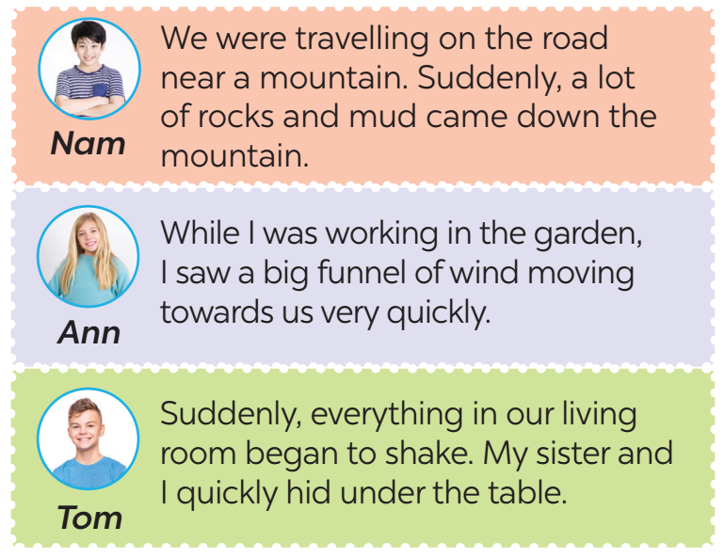
KNOWLEDGE OF NATURAL DISASTERS
3
Read the short passages below. Decide which natural disaster each person below is talking about.
landslide
tornado
earthquake

Slide 13
KNOWLEDGE OF NATURAL DISASTERS
4
Choose the correct answer to each question to see how much you know about natural disasters.
Question 1: Which of these may cause landslides?
A. Heavy rain. B. Wind. C. Lightning.
Question 2: Which of these activities may cause landslides?
A. Littering. B. Cutting down trees. C. Polluting the air.
Question 3: What scale is used for measuring earthquakes?
A. Fahrenheit scale. B. Celsius scale. C. Richter scale.

Slide 14
KNOWLEDGE OF NATURAL DISASTERS
4
Choose the correct answer to each question to see how much you know about natural disasters.
Question 4: What natural disaster can an earthquake cause?
A. A flood. B. A landslide. C. A tornado.
Question 5: What do tornadoes form from?
A. An earthquake. B. A flood. C. A thunderstorm.
Question 6: Where do tornadoes mostly happen?
A. In the USA. B. In the UK. C. In Viet Nam.

Slide 15
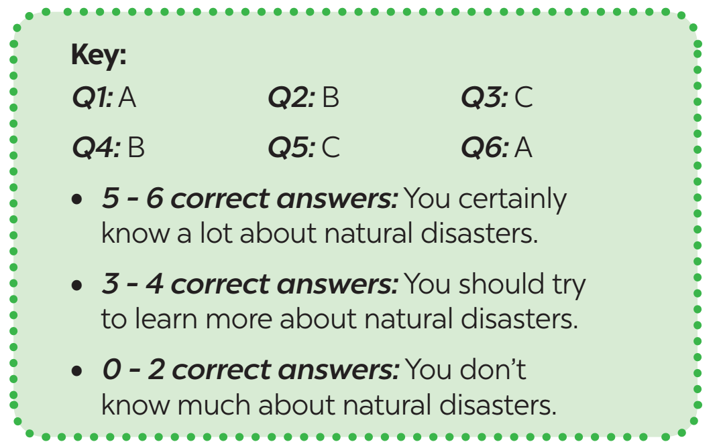

KNOWLEDGE OF NATURAL DISASTERS
5
Work in pairs. Compare your answers. Then check your answers with the key below. How many points did each of you get?

Slide 16

CONSOLIDATION
1
Wrap-up
In this lesson, you have:
learnt new words related to natural disasters.
learnt how to give and respond to bad news.

Slide 17

CONSOLIDATION
2
Homework
Learn the new words by heart .
Do exercises in the workbook.
Prepare for Lesson 5 – Skills 1.

Slide 18

Website: hoclieu.vn
Fanpage: facebook.com/tienganhglobalsuccess.vn/

