Slide 1
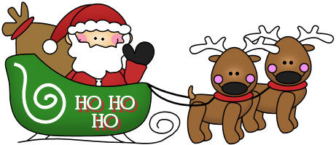
Christmas - GAME

Slide 2
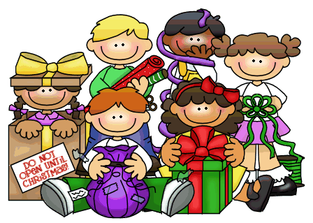
Choose the right option.
GREAT
carols
presents
sleigh

Slide 3
Choose the right option.
GREAT
elf
girl
present

Slide 4
Choose the right option.
GREAT
snowman
holly
lights

Slide 5
Choose the right option.
GREAT
Santa
snowman
elf

Slide 6
Choose the right option.
GREAT
sleigh
presents
tree

Slide 7
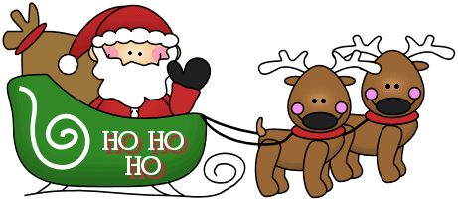
Choose the right option.
GREAT
elf
sleigh
snowman

Slide 8
Choose the right option.
GREAT
reindeer
elves
snowmen

Slide 9
Choose the right option.
GREAT
gingerbread
candy
holly

Slide 10
Choose the right option.
GREAT
gingerbread
candy cane
lights

Slide 11
Choose the right option.
GREAT
gingerbread
candy cane
tree

Slide 12
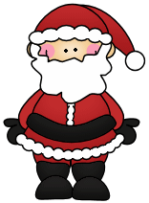
Choose the right option.
GREAT
snowman
elf
Santa

Slide 13
Choose the right option.
GREAT
gingerbread
stocking
candy

Slide 14
Choose the right option.
GREAT
holly
elves
carols

Slide 15
SƯU TẦM: ĐOÀN VĂN DOANH, NAM TRỰC, NAM ĐỊNH
LINK NHÓM DÀNH CHO GV BỘ MÔN VẬT LÝ TRAO ĐỔI TÀI LIỆU VÀ CHUYÊN MÔN CT 2018
https://www.facebook.com/groups/299257004355186

