Slide 1

UNIT 7: INVENTIONS
Lesson 2.1 – Vocabulary & Listening
Page 59

Slide 2




Lesson 2.1
LESSON OUTLINE
Consolidation

Slide 3
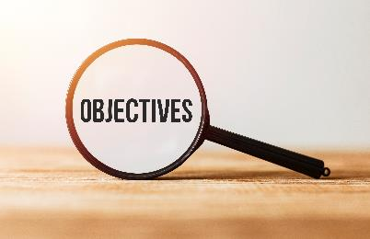
By the end of this lesson,
students will be able to …
- practice and learn vocabularies for weird inventions.
- practice listening for specific information.
- practice functional English (Checking comprehension).

Slide 4
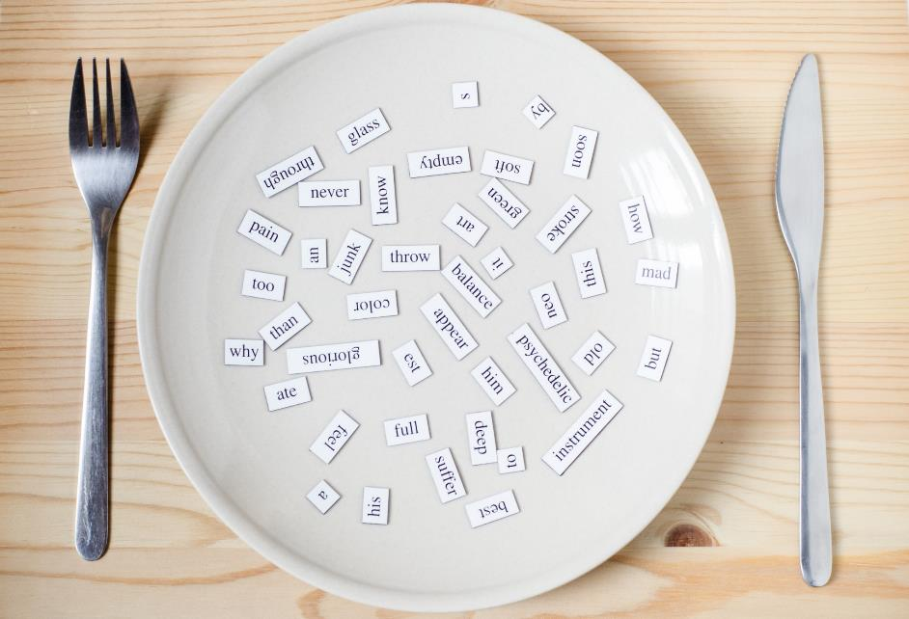
New words
portable
automatically
private
strap
fashionable
attach

Slide 5



Slide 6

Work in pairs.
Which invention do you like most? Why?
I like … most. Because it …

Slide 7



Slide 8

Listen and repeat. Click each phrase to hear the sound
portable (adj) / ˈpɔːrtəbl / có thể mang theo, xách tay
automatically (adv) / ˌɔːtəˈmætɪkli / một cách tự động
private (a) / ˈpraɪvət / riêng tư
strap (v) / stræp / buộc bằng dây, đai
fashionable (a) / ˈfæʃnəbl / hợp thời trang
attach (v) / əˈtætʃ / gắn vào, dán vào
Notes:
GV click vào từng cụm nghe âm thanh

Slide 9

a. Circle the correct definitions for the underlined words.
1. I like this laptop. It's small and light and very portable. You really can take it anywhere.
a. easy to carry and move b. easy to use
2. My computer goes into sleep mode automatically if I don't use it for ten minutes.
a. without needing a person to control it
b. with taking a long time to work
3. The hotel is very nice. Every room has a private bathroom.
a. for everyone to use
b. for one person/one group of people to use

Slide 10
4. The ﬂight was terrible! I had to strap myself in really tight.
a. fasten somebody or something in place
b. let somebody or something move around
5. He buys new clothes all the time and he always wants to look the same as everyone else. He's so fashionable!
a. following any style b. following a popular style
6. You need to attach the printer to the computer with this cable.
a. join one thing to another
b. take one thing away from another thing

Slide 11

b. In pairs: use these words to describe the pictures.
I think the girl's dress is very fashionable

Slide 12
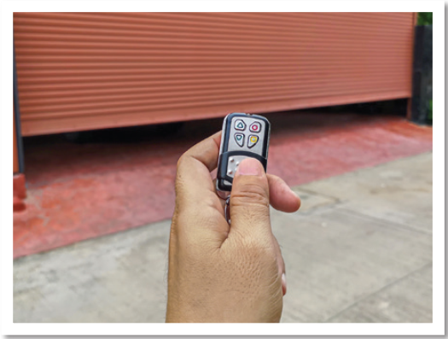
I use the remote control to open and close the door automatically.

Slide 13
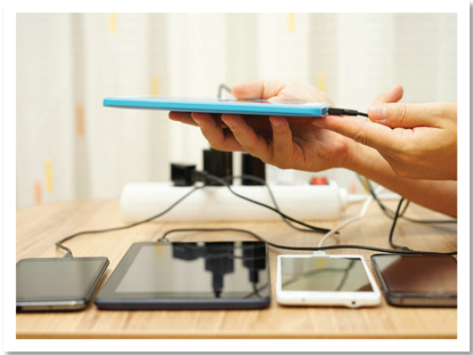
She uses this cable to attach to the smart phone.

Slide 14
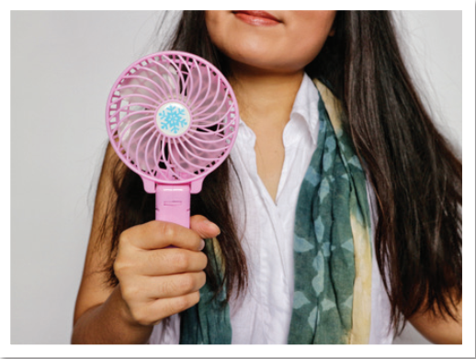
This fan is small and portable.

Slide 15
Extra Practice
WB, page 40
Fill in the blanks using the words in Task a
1. Can you help me ______________ the box onto the motorbike? I don't want it to fall off when I drive.
2. Last summer, we went to a resort that has a ______________ beach. Only the guests at the resort can use it.
3. This device is very small, lightweight, and ______________ . You can carry it with you everywhere.
strap
private
portable

Slide 16
4. The air conditioner will turn off ______________ if there is no one in the room for more than twenty minutes.
5. A hit TV show has made this style of dress become ______________ again. At least one out of seven girls asks for
this style when shopping at our store.
6. Please print the email and ______________ it to your form before sending to our office.
automatically
fashionable
attach

Slide 17
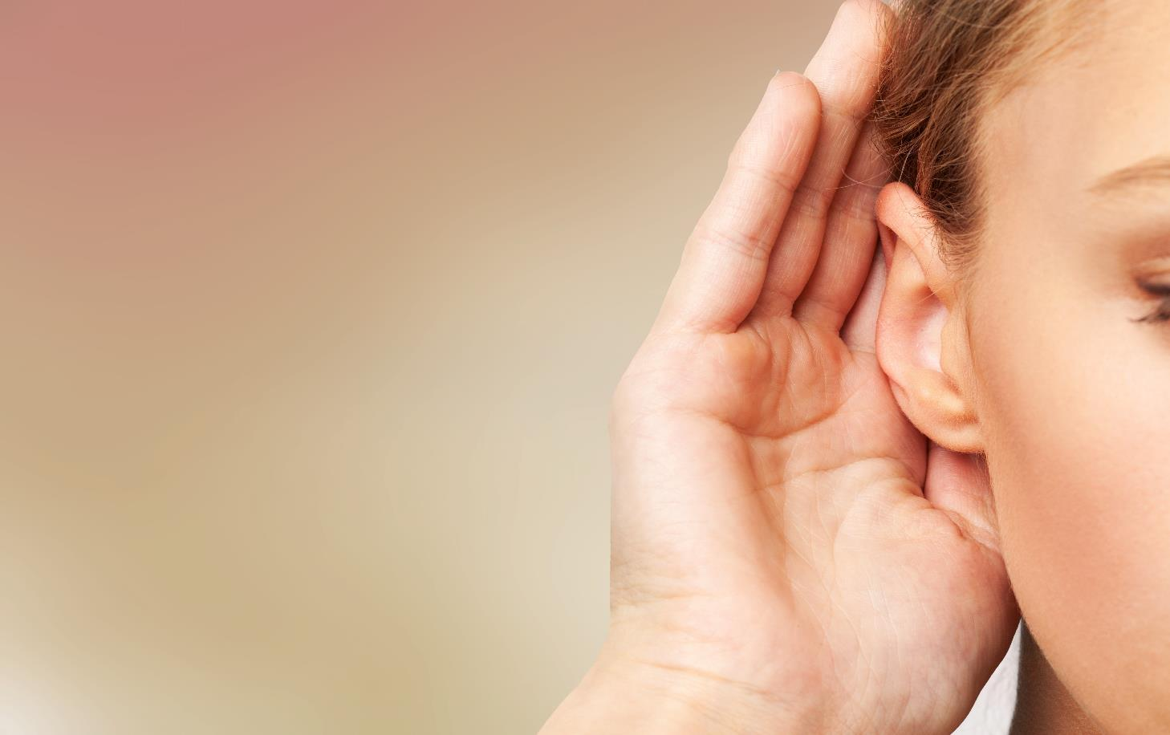


Slide 18
Pre-Listening
Underline the key words/phrases.
a. Listen to Đức talking to his friend, Bonnie, about inventions. How many inventions do they talk about?
Numbers

Slide 19
Pre-Listening
1. What can the crawling mop clean?
a. babies b. clothes c. the ﬂoor
2. What did Đức read an article about?
a. new inventions b. weird inventions c. cool inventions
strange

Slide 20
Pre-Listening
3. What does the keyboard attach to?
a. a light b. your legs c. your tablet
4. What does Bonnie think of geeky jeans?
a. They're not fashionable.
b. They're not portable.
c. They're not comfortable.

Slide 21
While-Listening
Listen and answer the question “How many inventions do they talk about?”
→ 2 inventions

Slide 22
While-Listening
Listen twice and circle the answers.
1. What can the crawling mop clean?
a. babies b. clothes c. the ﬂoor
2. What did Đức read an article about?
a. new inventions b. weird inventions c. cool inventions

Slide 23
While-Listening
3. What does the keyboard attach to?
a. a light b. your legs c. your tablet
4. What does Bonnie think of geeky jeans?
a. They're not fashionable.
b. They're not portable.
c. They're not comfortable.

Slide 24
While-Listening
Listen again and number the phrases in the Conversation Skill box in the order you hear them.
Do you know what I mean?
1
Am I making sense?
2

Slide 25

Scripts
Đức: Hey, Bonnie, look what I bought!
Bonnie: What's that?
Đức: It's a crawling mop.
Bonnie: What's it for?
Đức: It's a mop which attaches to baby clothes. When the baby crawls around, they will clean the ﬂoor. Do you know what I mean?
Bonnie: Ah, OK.
Đức: I bought it after reading an article about weird inventions.
Bonnie: What other weird inventions are there?
Đức: There are lots. Geeky jeans are my favorite.
They're for people who want to type but don't want
to carry a keyboard.

Slide 26
Bonnie: I don't get it. How do you type without a keyboard?
Đức: The keyboard is built into the jeans.
Bonnie: How does that work?
Đức: The keyboard is very light and is located on the legs. It connects to your tablet through a wireless USB. You just need to sit down and start typing. Am I making sense?
Bonnie: I can't really picture how they look.
Đức: Let me fnd a picture. Here!
Bonnie: Well, they don't look very fashionable. And they're taking "portable" to the next level.
Đức: Haha, yeah. You can use it anywhere you can sit down, and that's basically everywhere!
Bonnie: Yeah, I wonder who would...

Slide 27
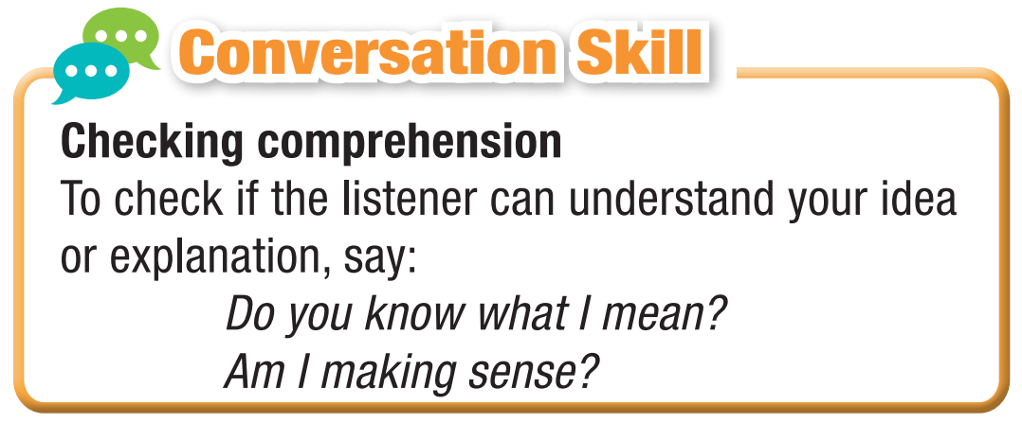

Slide 28
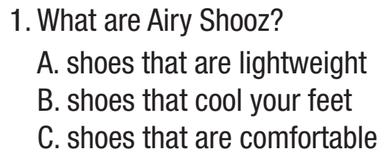
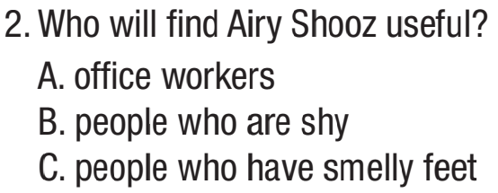
Extra Practice
WB, page 40
First, underline the key words.
Then, listen and choose the correct answers.

Slide 29
Extra Practice
WB, page 40
1. What are attached to the Airy Shooz?
mini air conditioners
2. When do the batteries charge?
when you walk
3. How can you order Airy Shooz?
by visiting their website
4. What does the code SMELLNOMORE give you?
15% off

Slide 30

Scripts
M: Are you someone who suffers from smelly feet? Do people at the office complain or make jokes about them? Yes? Well, worry no more! Introducing the Airy Shooz, designed to keep your feet cool, dry, and smelling fresh all year round!
The Airy Shooz are special shoes that have mini air conditioners attached to them. These air conditioners suck fresh air in through tiny holes on the top of the shoes and blow the air out through two holes on the bottom. Each air conditioner has a battery which charges when you walk.

Slide 31
Don't walk much? Don't worry! The Airy Shooz only need a few steps to keep bad smells away.
With Airy Shooz, you'll never be embarrassed about your feet again! Visit www.airyshooz.com today and rescue your smelly feet! Enter the code SMELLNOMORE to get fifteen percent for your purchase! That's SMELLNOMORE for fifteen percent off.
Wherever you go, the Airy Shooz have got you covered!

Slide 32
Post Listening
Work in pairs.
What do you think of geeky jeans?

Slide 33

Consolidation

Slide 34
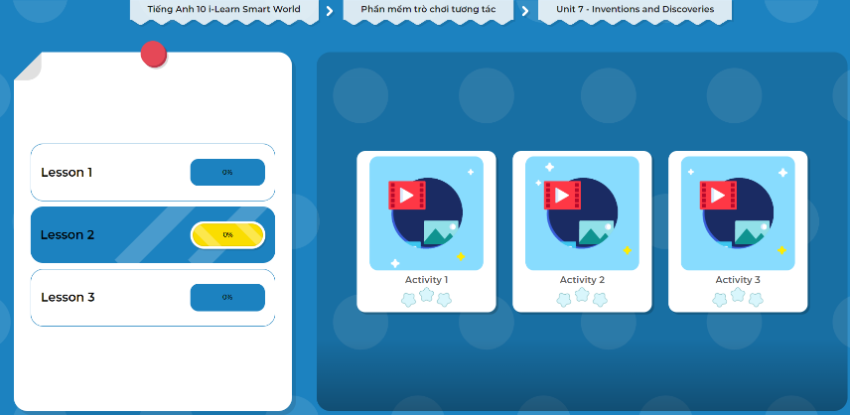
Extra Practice
DHA on Eduhome
Let’s Play!
Click here to play the games.

Slide 35

WRAP-UP

Slide 36
Today’s lesson
Vocabulary: related to weird inventions
Listening: for key information
Speaking: talk about weird inventions
Conservation skills: Checking comprehension

Slide 37
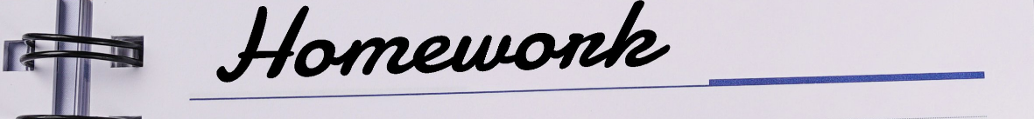
Learn by heart vocabularies and make sentences using them.
Do the exercises in WB on page 40 (Reading).
Do the exercises in Tiếng Anh 10 i-Learn Smart World Notebook on page 40.
Prepare the next lesson - Grammar on page 57 in SB.
Play the consolidation games in Tiếng Anh 10 i-Learn Smart World DHA App on www.eduhome.com.vn

