Slide 1


Slide 2

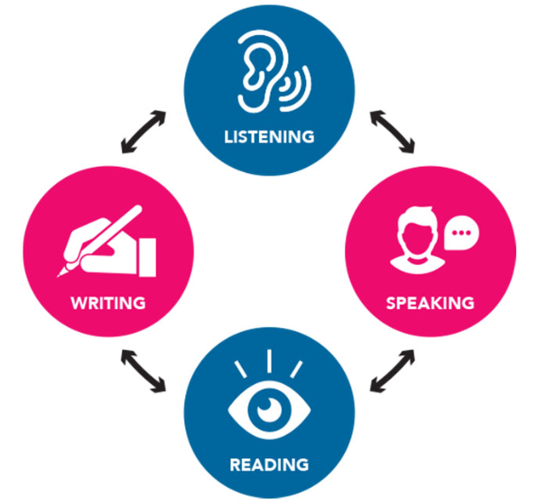
REVIEW
4
Units 10 – 11 - 12
LESSON 2: SKILLS
1

Slide 3
LESSON 2: SKILLS
WARM-UP
Race at the board.
Task 1: Read the notices. Tick the appropriate box(es).
READING
Task 2: Work in pairs. Ask and answer about a device or an app you use for studying. Report your partner’s answers to the class.
SPEAKING
LISTENING
Task 3: Listen to Mark talking about the solar system. Fill in each blank with no more than TWO words.
Task 4: Write a paragraph (80 - 100 words) about your favourite means of communication.
WRITING
Wrap-up
Homework
CONSOLIDATION

Slide 4
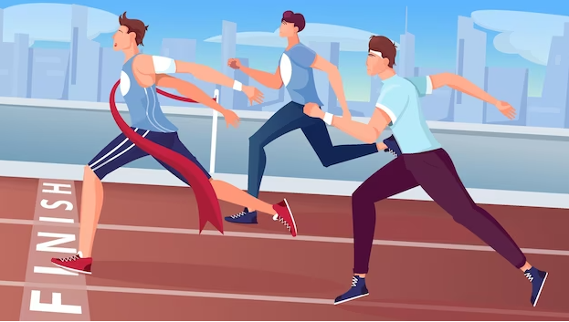
WARM-UP
- Work in teams.
- One students from each team comes to the board.
- Teacher asks a question or gives a problem.
- The first person to write the correct answer on the board wins a point for their team. (The students at the board only get one try.)
- If they all miss the question, teacher takes the answer from the first person in the audience who raises their hand.
RACE AT THE BOARD
Write on the board the list of future technology you expect to see in the future in 2 minutes.

Slide 5
WARM-UP
RACE AT THE BOARD
1. This is an object or machine that has been invented for a particular purpose. What is it?
Write on the board the list of future technology you expect to see in the future in 2 minutes.
Device

Slide 6
WARM-UP
RACE AT THE BOARD
2. What do you call a computer programme?
Application

Slide 7
WARM-UP
RACE AT THE BOARD
3. It includes the sun and the group of planets that move around the sun. What is it?
Solar system

Slide 8
WARM-UP
RACE AT THE BOARD
4. Can you name some means of communication?
post card, phone, TV, radio, newspaper, internet….

Slide 9
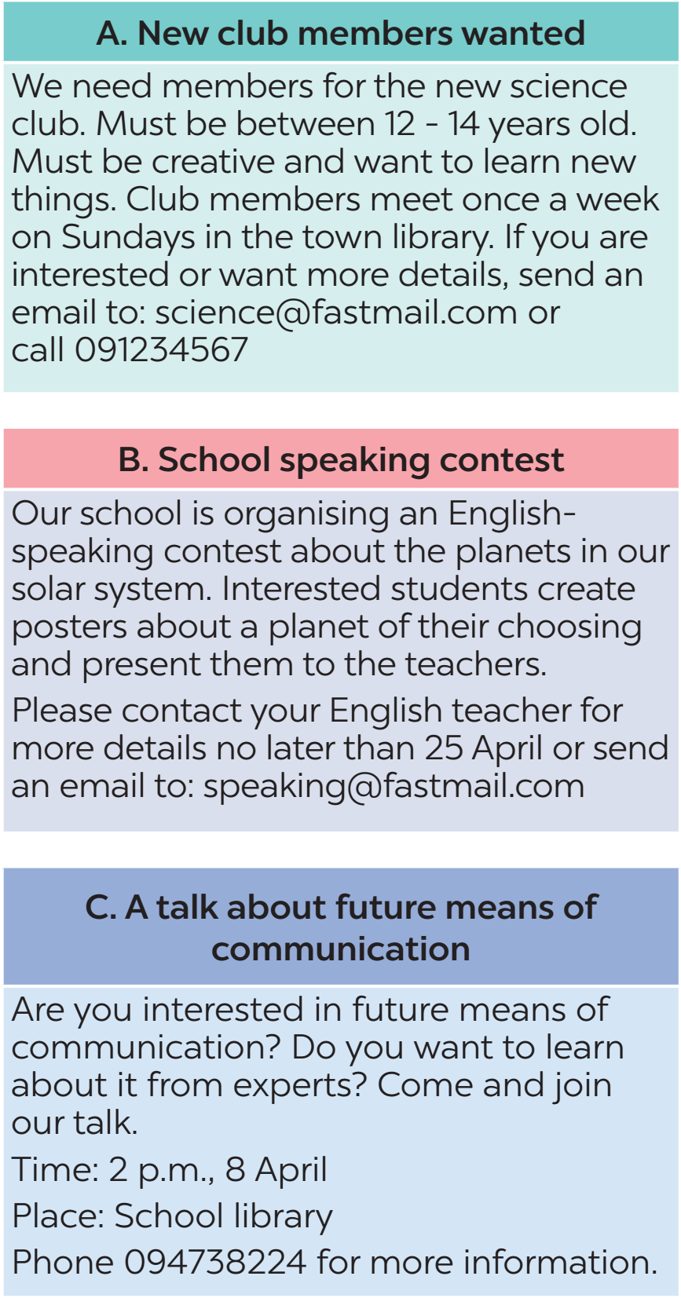
READING
1
Read the notices. Tick the appropriate box(es).

Slide 10

READING
1
Read the notices. Tick the appropriate box(es).
Statements | A | B | C
1. This notice mentions the age of the participants.
2. Participants give a presentation.
3. Participants discuss ways of communication in the future.
4. Participants meet once a week.
5. Interested people call for more details.

Slide 11
SPEAKING
2
Work in pairs. Ask and answer about a device or an app you use for studying. Report your partner’s answers to the class.
Example:
Raz plus is an amazing app. It helps me study English more effectively. I use it almost everyday. I can read a lot of books in both fiction and non-fiction. It also helps me improve my pronunciation by listening and recording. But I need to buy its account so as to use it.
1. What kind of device / app is it?
2. How often do you use it?
3. What are the benefits of using it?
4. Are there any problems using it?

Slide 12

LISTENING
3
Listen to Mark talking about the solar system. Fill in each blank with no more than TWO words.
1. Many of the planets in our solar system have _______.
2. The four inner planets are quite small and have ____________.
3. The asteroid belt has millions of rocky _______.
4. The outer planets are _______ and mostly made up of gas.
5. These outer planets all have thick layers of clouds and _____ around them.
moons
rocky surfaces
objects
huge
rings

Slide 13
WRITING
4
Write a paragraph (80 - 100 words) about your favourite means of communication. You may use the following questions as cues.
1. What is your favourite means of communication?
2. How often do you use it?
3. What are the benefits of using it?
4. Do you think you will use it in the future?

Slide 14
WRITING
4
Write a paragraph (80 - 100 words) about your favourite means of communication. You may use the following questions as cues.
Suggested answer:
My favourite means of communication is the mobile phone. I use it every day to talk with almost anyone, from my family members to friends. It is a very convenient way of communicating with people because it is small and portable. In addition, I can send them messages and even make video calls. If my phone is connected to the Internet, it will be much better. The reason is that I can send and receive emails through it or access various websites to update news and information. In the future, I will continue using my mobile phone to communicate.

Slide 15

CONSOLIDATION
1
Wrap-up
What have we learnt in this lesson?
Read for general and specific information;
Talk about study apps and devices;
Listen for specific information about the solar system;
Write a paragraph about means of communication;

Slide 16

CONSOLIDATION
2
Homework
- Do the exercises in the workbook.
- Prepare for the final test.

Slide 17

Website: hoclieu.vn
Fanpage: facebook.com/tienganhglobalsuccess.vn/

