Slide 1


Slide 2

Unit
9
1
Unit
FAMILY LIFE
Protecting The Environment
LESSON 2
LANGUAGE

Slide 3

Unit
1
1
FAMILY LIFE
Family Life
Unit
OBJECTIVES
Revise sentence stress and become aware of rhythm in speaking
Understand and put words/ phrases related to the environment to good use
Revise and practice the reported speech with statements and questions

Slide 4
LESSON 2
LANGUAGE
Unit
GETTING STARTED
WARM-UP
Video watching
PRONUNCIATION
Rhythm
Task 1: Listen and repeat.
Task 2: Mark the stressed syllables. Then practice saying the sentences.
VOCABULARY
Environment
Task 1: Match the words/ phrases to their meanings .
Task 2: Complete the sentences
GRAMMAR
Reported Speech
Task 1: Choose the correct words.
Task 2: Change the sentences into reported speech
PRODUCTION
Wrap-up
Home work

Slide 5
LESSON 2
LANGUAGE
Unit
GETTING STARTED
WARM-UP
Fill in each blank one word with its given initial to complete Mr. Earth story
Hi, I am Mr. Earth. In the beginning, the Earth is beautiful. It has provided us shelter, food and natural (1) r_ _ _ _ _ _ _ _. But the Earth isn’t taken care well by the human. Forests are (2) d_ _ _ _ _ _ _ and trees are chopped down. Rubbish are (3) d_ _ _ _ _ into the river and (4) t_ _ _ _ _ everywhere in the street. Factories produce (5) c_ _ _ _ _ _ _ that will pollute the air and water. Animals’ homeland are destroyed by (6) d_ _ _ _ _ _ _ _ _ _ _ _. The fish are sad because the ocean is polluted. Mr Earth is sad because he and his family have lost their beautiful homeland. But we can protect the environment and save Mr. Earth. Firstly, we need to save (7) e_ _ _ _ _ wisely: Turn off the tap after using water and switch off the light after using it. Secondly, we need to learn how to make planet earth a better place to stay: Keep our environment clean, plant more trees, classify rubbish based on its (8) m_ _ _ _ _ _ _ and throw it correctly, create environmental (9) a_ _ _ _ _ _ _ _ and organise community clean up. Thirdly, we need to reuse items smartly. We can (10) r_ _ _ _ _ _ and reuse simple items that we use daily. We can make a difference. It all starts from ME and YOU. Let’s work together to protect our environment and make this world a better place.

Slide 6
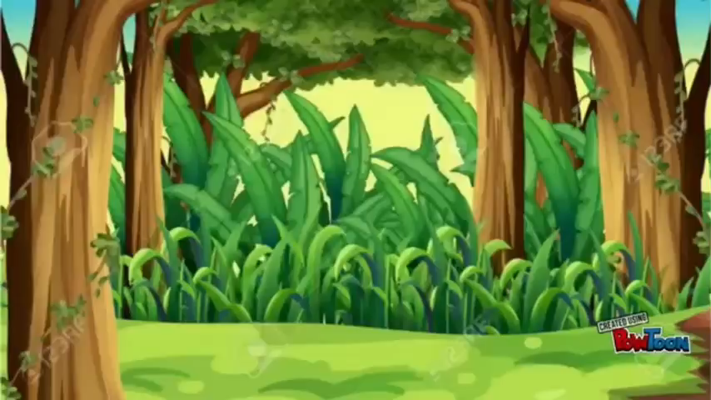
LESSON 2
LANGUAGE
Unit
GETTING STARTED
WARM-UP
WATCH THE VIDEO AND CHECK

Slide 7
LESSON 2
LANGUAGE
Unit
GETTING STARTED
WARM-UP
KEY
Hi, I am Mr. Earth. In the beginning, the Earth is beautiful. It has provided us shelter, food and natural (1) resources. But the Earth isn’t taken care well by the human. Forests are (2) destroyed and trees are chopped down. Rubbish are (3) dumped into the river and (4) thrown everywhere in the street. Factories produce (5) chemical that will pollute the air and water. Animals’ homeland are destroyed by (6) deforestation. The fish are sad because the ocean is polluted. Mr Earth is sad because he and his family have lost their beautiful homeland. But we can protect the environment and save Mr. Earth. Firstly, we need to save (7) energy wisely: Turn off the cap after using water and switch off the light after using it. Secondly, we need to learn how to make planet earth a better place to stay: Keep our environment clean, plant more trees, classify rubbish based on its (8) material and throw it correctly, create environmental (9) awareness and organise community clean up. Thirdly, we need to reuse items smartly. We can (10) recycle and reuse simple items that we use daily. We can make a difference. It all starts from ME and YOU. Let’s work together to protect our environment and make this world a better place.

Slide 8
PRONUNCIATION - RHYTHM
1
Listen and repeat. Pay attention to the stressed words in the sentences.
1. 'Don’t 'pick the 'flowers when you 'go to the 'park.
2. The 'students 'clean the 'school 'playgrounds 'every week'end.
3. 'What’s 'happening with the 'polar 'bears?
4. Did you 'watch the docu'mentary about 'air pol'lution?

Slide 9
PRONUNCIATION - RHYTHM
2
Mark the stressed syllables in the words in bold. Then practise saying the sentences with a natural rhythm.
1. Don’t feed the animals in the zoo while they are resting.
2. The teacher asked his students to focus on their work.
3. What were you doing when I rang you up an hour ago?
4. Are you reading the book about endangered animals in the world?

Slide 10
PRONUNCIATION - RHYTHM
2
Mark the stressed syllables in the words in bold. Then practise saying the sentences with a natural rhythm.
KEY
1. Don’t feed the animals in the zoo while they are resting.
2. The teacher asked his students to focus on their work.
3. What were you doing when I rang you up an hour ago?
4. Are you reading the book about endangered animals in the world?

Slide 11

VOCABULARY - ENVIRONMENT
1
Match the words or phrases to their meaning
 | 1. biodiversity | a. the variety of plants and animals in a particular area
 | 2. habitat | b. animals and plants that grow in natural conditions
 | 3. ecosystem | c. changes in the world’s weather, especially an increase in temperature
 | 4. wildlife | d. the natural environment in which a plant or an animal live
 | 5. climate change | e. All the plants and animals in an area and the way they affect each other and the environment
KEYS: 1.a 2.d 3.e 4.b 5.c

Slide 12
VOCABULARY - ENVIRONMENT
2
Complete the sentences using the correct form of the words and phrases in 1
Biodiversity
________ is important because plants and animals depend on each other to survive.
A new series of educational programmes shows the importance of ________ to humans.
Their work involves protecting and creating natural ________ for plants and animals.
Countries need to work together to deal with global issues such as deforestation and ____
Pollution can have serious effects on the balance of ________ .
wildlife
habitats
climate change____ .
ecosystem

Slide 13
GRAMMAR – REPORTED SPEECH
1
Underline the correct word or phrase to complete each sentence.
Minh’s teacher asked him if he was / is ready to present the following day.
Nam’s father suggested / denied that Nam should focus on one aspect of the problem.
Tuan said he would complete his project the following week / next week.
Mai asked / said her teacher where she could get the information from.
Phong said he handed / had handed in his project the previous day.

Slide 14
GRAMMAR – REPORTED SPEECH
1
Underline the correct word or phrase to complete each sentence.
Minh’s teacher asked him if he was / is ready to present the following day.
Nam’s father suggested / denied that Nam should focus on one aspect of the problem.
Tuan said he would complete his project the following week / next week.
Mai asked / said her teacher where she could get the information from.
Phong said he handed / had handed in his project the previous day.

Slide 15
GRAMMAR – REPORTED SPEECH
2
Change these sentences into reported speech
1. “The burning of coal leads to air pollution,” Mrs Le explained.
…...................................................................................................................
2. “I have to present my paper on endangered animals next week,” Nam said.
=> …...................................................................................................................
3. “Do human activities have an impact on the environment?” Linda asked the speaker.
…...................................................................................................................
4. “What environmental project does your school do?” Nam asked Mai.
=> …...................................................................................................................
5. “I will read more articles before writing the essay, Nam,” Tom said.
=> …...................................................................................................................

Slide 16
GRAMMAR – REPORTED SPEECH
2
Change these sentences into reported speech
KEY:
1. “The burning of coal leads to air pollution,” Mrs Le explained.
Mrs Le explained that the burning of coal led / leads to air pollution.
2. “I have to present my paper on endangered animals next week,” Nam said.
Nam said he had to present his paper on endangered animals the following week.
3. “Do human activities have an impact on the environment?” Linda asked the speaker.
Linda asked the speaker if human activities had / have an impact on the environment.
4. “What environmental project does your school do?” Nam asked Mai.
Nam asked Mai what environmental projects her school did.
5. “I will read more articles before writing the essay, Nam,” Tom said.
=> Tom said to / told Nam that he would read more articles before writing the essay.

Slide 17

PRODUCTION
1
Revision game
There are 7 questions.
Choose the correct answers.

Slide 18

PRODUCTION
1
Revison game
To speak with a natural rhythm, it is important to have the right combination of ______________ syllables.
stressed
unstressed
stress and unstress
stressed and unstressed

Slide 19
PRODUCTION
1
Revison game
How many stressed words are there in the following sentence?
“Are you watching the film about protecting the environment in the world?”
4
5
6
7

Slide 20
PRODUCTION
1
Revison game
_______ is the number and types of plants and animals that exist in a particular area or in the world generally
Biodiversity
Habitat
Ecosystem
Wildlife

Slide 21
PRODUCTION
1
Revison game
With so many areas of woodland being cut down, a lot of wildlife is losing its natural ___________ .
biodiversity
habitat
ecosystem
wildlife

Slide 22
PRODUCTION
1
Revison game
When reporting questions, we often use the verb ask and the word order for ____________ and omit the question marks.
questions
statements
imperative
A &B are correct

Slide 23
PRODUCTION
1
Revison game
David’s father ____________ that he should focus on one aspect of the environmental problem in his upcoming presentation.
denied
suggested
asked
complained

Slide 24
PRODUCTION
1
Revison game
Mai_____________ her teacher where she could get the information from.
asked
said
denied
advised

Slide 25

PRODUCTION
1
Revison game

Slide 26
PRODUCTION
2
Homework
Do exercises in the Workbook

Slide 27


