Slide 1

UNIT 6: COMMUNITY LIFE
Lesson 2.1 – Vocabulary & Reading
Page 51

Slide 2



LESSON OUTLINE
Consolidation

Slide 3

By the end of this lesson,
students will be able to …
practice and learn vocabularies for sports facilities and community services.
practice reading for the purpose of the text and specific information.

Slide 4
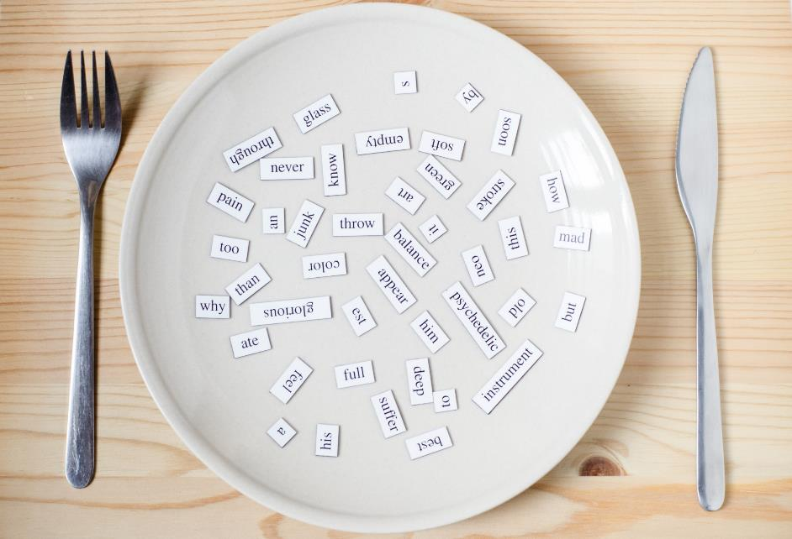
New words
locker
member
equipment
racket

Slide 5



Slide 6

Work in pairs.
Do you ever go to the sports center?
How often do you go there?
What kind of sports do you like?
What do you need to do that sport?

Slide 7



Slide 8

Listen and repeat. Click each phrase to hear the sound.
locker (n) /ˈlɑːkər/ ngăn tủ cá nhân có khóa
member (n) /ˈmembər/ thành viên
equipment (n) /ɪˈkwɪpmənt/ trang thiết bị
racket (n) /ˈrækɪt/ cái vợt
Notes:
GV click vào từng cụm nghe âm thanh

Slide 9

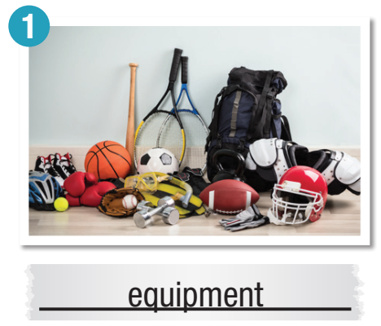
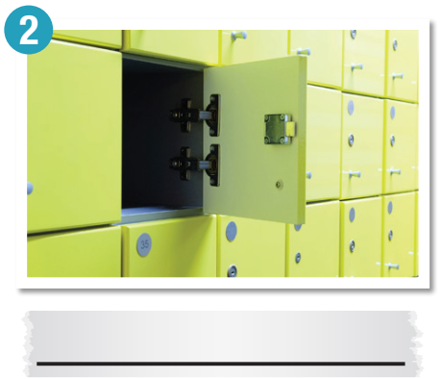
a. Match the words with the pictures.
Listen and repeat.
locker

Slide 10
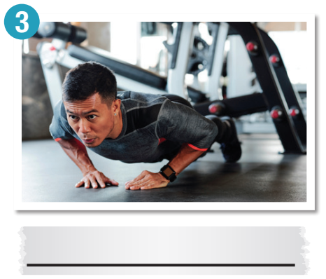
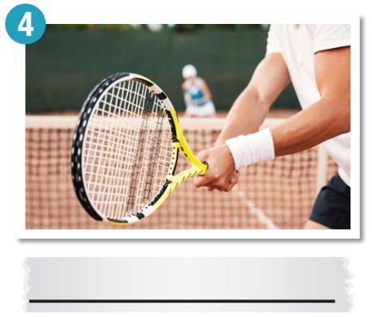
member
racket

Slide 11
b. Circle the correct definitions for the underlined words. Listen and repeat.
1. I want to book a hotel room for my vacation tomorrow. I'll book it online because it's so easy.
a. arrange to stay in a place at a future time
b. ask someone to meet you in the future
2. I forgot to return books to the library on time. I had to pay three dollars because I was late.
a. use something for a long time
b. give something back

Slide 12
3. I keep my umbrella, raincoat, and school books in my bag.
a. put something in one place for a time
b. forget where you put something
4. It costs two dollars to rent the rackets and balls.
a. pay to use and then return to the owner afterwards
b. pay to use and take home afterwards

Slide 13

Extra Practice
WB, page 34
b. Fill in the blanks using the correct form of the verbs.
return
return
1. My new phone broke, so I am going to _______________ it to the store.
2. We're looking for a house to _______________ in the area.
3. She _______________ tickets for her trip to Chicago yesterday.
4. You can _______________ your clothes, bags, and money in a locker when you're working out at the gym.
rent
booked
keep
Notes:
Taken from TA 10 i-Learn Smart World WB, page 2

Slide 14

Work in pairs.
Are you a member of any clubs? What club would you like to join? Tell your partner.
I'm a member of a Vovinam club. It's really fun. I love it!

Slide 15



Slide 16
Underline the key words/phrases.
Pre-Reading
a. Read the notice at Đà Nẵng Sports Center. What is the purpose of the notice?
to tell members how to use the center
to tell members about what they can do at the center

Slide 17
Đà Nẵng Sports Center – Get Fit and Have Fun!
Thank you for using Đà Nẵng Sports Center. We would like to remind everyone of the following guidelines:
1. Cards must be shown by all members at the front desk.
2. Money should be kept in a locker. Locker keys are at the front desk.
3. Gym equipment should not be taken out of the gym. Members should not use their own gym equipment.
4. All gym equipment must be cleaned after use.
5. Sports clothing must be worn by all members using the center.

Slide 18
6. Sports equipment can be rented at the front desk (40,000 VND/hour).
7. All rented sports equipment should be returned to the front desk after use.
8. Tennis courts may be booked up to two days before use (220,000 VND/hour).
Thank you for your understanding. If you have any questions relating to sports equipment, please ask the gym staff.
For all other questions, please ask at the front desk.

Slide 19
b. Now, read and circle True, False, or Doesn't say
Every member has a member card.
True False Doesn't say
2. The gym owns all the equipment members can use there. True False Doesn't say
3. Members must wear swimming caps in the pool.
True False Doesn't say
4. It costs 20,000 VND to rent sports equipment for each hour. True False Doesn't say

Slide 20
While-Reading
Skim the notice. Answer the question
“What is the purpose of the notice?”
→ 1. to tell members how to use the center

Slide 21
b. Now, read and circle True, False, or Doesn't say
Scan the notice and circle
Every member has a member card.
True False Doesn't say
2. The gym owns all the equipment members can use there. True False Doesn't say
3. Members must wear swimming caps in the pool.
True False Doesn't say
4. It costs 20,000 VND to rent sports equipment for each hour. True False Doesn't say

Slide 22
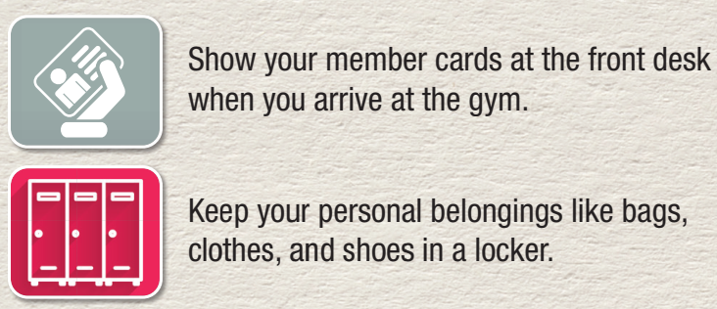
Extra Practice
WB, page 34
Pre-Reading
Underline the key words/phrases.
a. Read the text and circle the best title
1. How to Join the Gym 2. Do's and Don'ts at the Gym

Slide 23
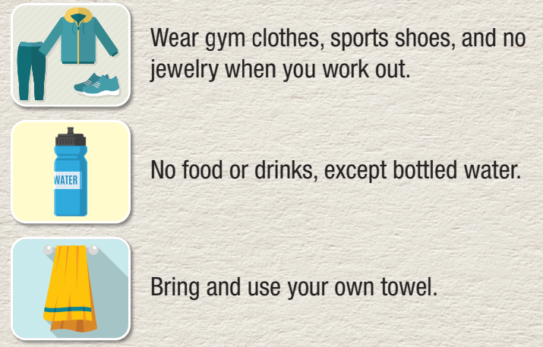

Slide 24
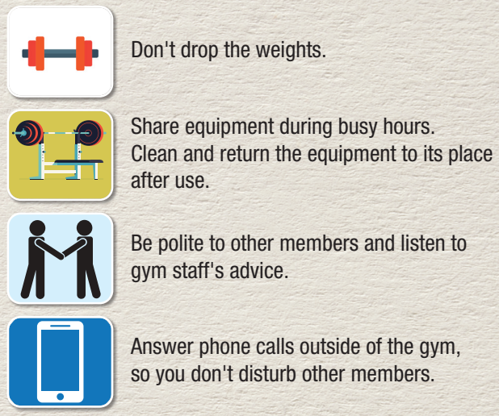

Slide 25
While-Reading
Skim the notice and choose the best title.
→ 2. Do's and Don'ts at the Gym

Slide 26
b. Read the text again and answer the questions.
Scan the notice and answer the questions
1. What must be shown at the front desk? ___________________________________
2. Where should members' personal belongings be kept? ___________________________________
3. What mustn't be worn when you work out? ___________________________________
member cards
in a locker
jewelry

Slide 27
4. Should towels be brought to the gym? ___________________________________
5. What mustn't be dropped? ___________________________________
6. What should be cleaned and returned after use? ___________________________________
7. Can phone calls be answered on the gym ﬂoor? ___________________________________
Yes
the weights
the equipment
No

Slide 28

Post-Reading
Work in pairs.
Do you think that all the rules are important? Are there any other rules that the sports center should have?

Slide 29

Consolidation

Slide 30
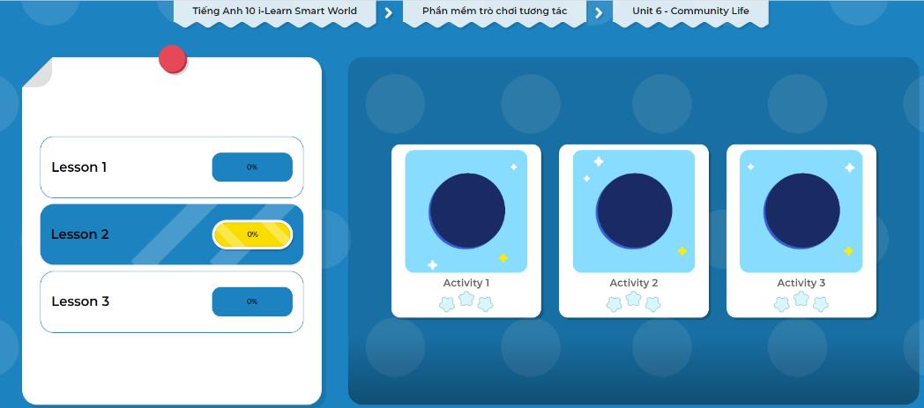
Extra Practice
DHA on Eduhome
Let’s Play!
Click here to play the games.

Slide 31

WRAP-UP

Slide 32
Today’s lesson
Vocabulary: sports facilities and community services
Reading: the purpose of the text and specific information

Slide 33
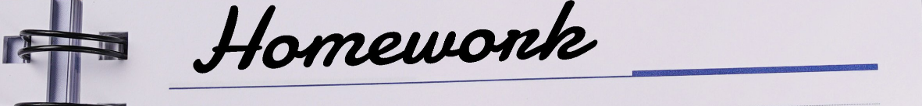
Learn by heart vocabularies and make sentences using them.
Do the exercises in Tiếng Anh 10 i-Learn Smart World Notebook on page 34.
Prepare the next lesson - Grammar on page 52 in SB.
Play the consolidation games in Tiếng Anh 10 i-Learn Smart World DHA App on www.eduhome.com.vn

