Slide 2
REVIEW 2
LESSON 2: SKILLS

Slide 3


REVIEW 2: SKILLS
LESSON 1: GETTING STARTED
WARM-UP
Chatting
READING
Task 1: Match the heading with the paragraphs.
Task 2: Choose the correct answer A, B or C.
SPEAKING
Task 3: Ask and answer.
LISTENING
Task 4: True or false.
WRITING
Task 5: Complete the paragraph
CONSOLIDATION
Wrap-up
Homework

Slide 4
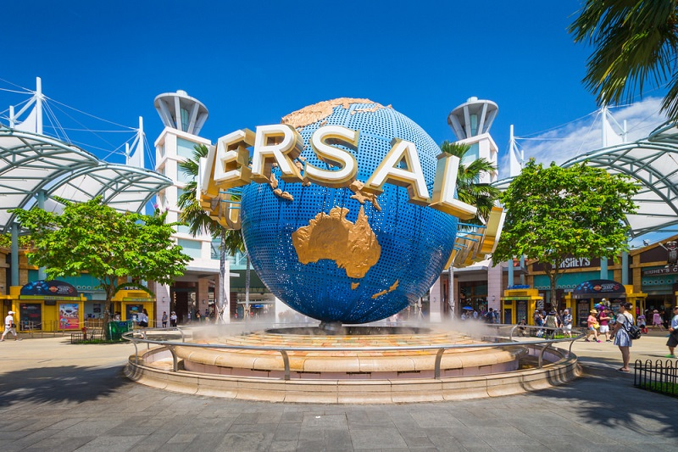
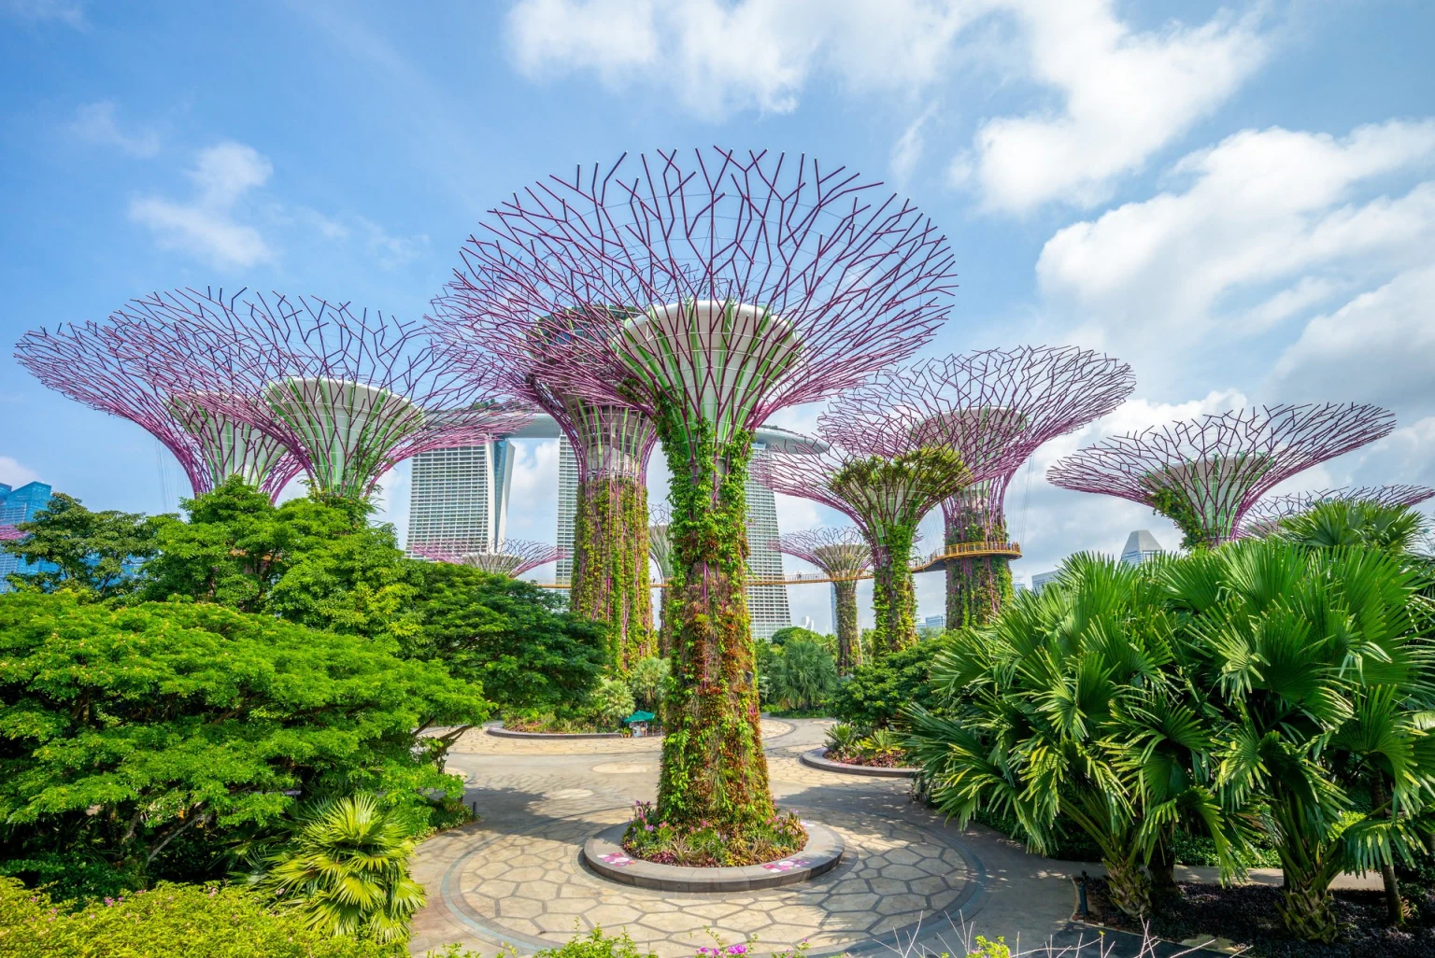
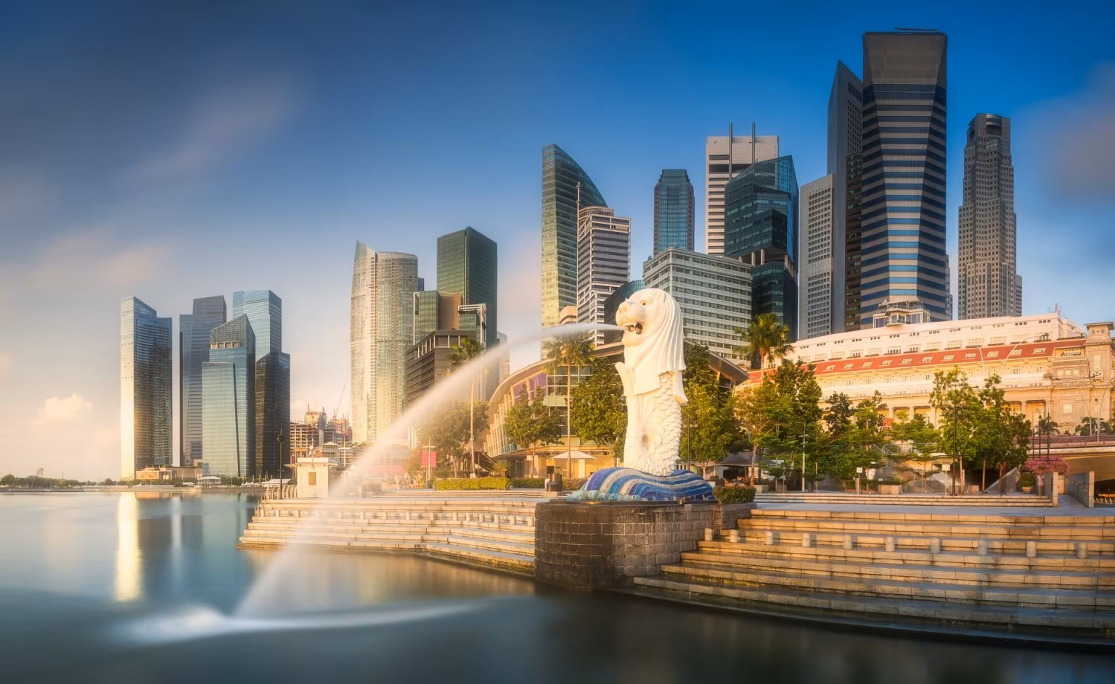
WARM-UP
Chatting
Do you want to visit Singapore?
Do you know what is Singapore famous for?

Slide 5
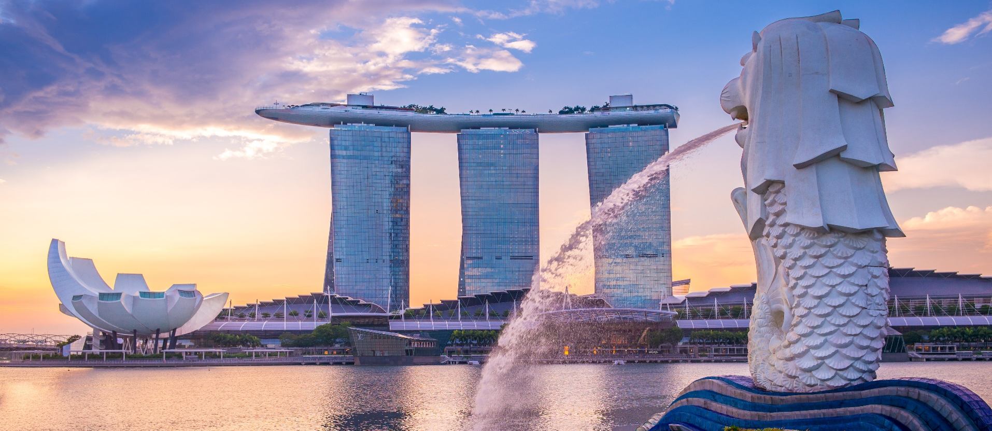
READING
1
Read the passage and match the headings (A, B, C) with the paragraphs.
Visit Singapore

Slide 6
READING
1
A.
Family
B.
Nature
C.
Culture
B
1. ______
There are many parks in this country. You can visit them, and enjoy beautiful plants and flowers, or do outdoor activities: cycling or boating. You can also go to the zoo to see animals in real life.
C
2. ______
Go to places like Chinatown and Little India to learn about the people and cultures of China and India. There you can see how they live, try their food, and buy souvenirs. There are festivals too. They attract a lot of visitors.
A
3. ______
Families looking for exciting activities for both children and adults should go to Sentosa. There are so many things for you to see and to do there, so you will never get bored.

Slide 7
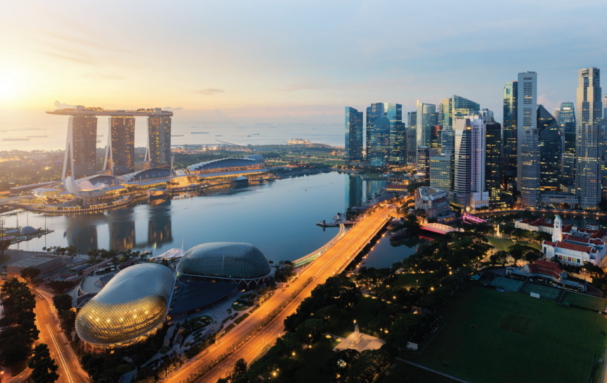
READING
2
Read the passage again and choose the correct answer A, B, or C.

Slide 8
READING
2
Read the passage again and choose the correct answer A, B, or C.
1. You can find beautiful plants and flowers in ______.
A. a park B. Chinatown C. Sentosa
2. You can see different kinds of animals in real life in a ______.
A. zoo B. park C. town

Slide 9
READING
2
Read the passage again and choose the correct answer A, B, or C.
3. You can ______ in places like Chinatown.
A. watch animals B. watch festivals C. do outdoor activities
4. ______ has interesting activities for both children and parents.
A. Little India B. The zoo C. Sentosa

Slide 10

SPEAKING
3
Work in pairs. Read the passage ‘Visit Singapore’ again and make a list of the places. Take turns to ask and find out which place your partner wants to visit and why.
Example:
A: Which place do you want to visit?
B: The zoo.
A: Why do you want to visit it?
B: I want to see the animals.

Slide 11

LISTENING
4
Mai’s family is talking to a travel agent about their trip to Singapore.
Listen and tick () T (True) or F (False)
2
 |  | T | F
1. | Mai’s visit to Singapore is four days.
2. | They won’t go to the National Park.
3. | The visit to Sentosa takes a full day.
4. | The Sea Aquarium is a zoo for fish.
5. | The Light and Sound Show is in the afternoon.





Audio script

Slide 12

AUDIO SCRIPT
Travel agent: Here we have a four-day programme for you ...
Mai’s mother: Do we visit somewhere natural?
Travel agent: Oh yes. We have two days for nature: one day at the National Park and one day at the zoo.
Mai’s mother: How about Sentosa?
Travel agent: Sentosa is a ‘must’ for families. We spend one day there.
Mai’s mother: Is it enough?
Travel agent: We start early and return late. There we visit the Sea Aquarium ...
Mai’s mother: What is it?
Travel agent: It’s a zoo for fish.
Mai’s mother: Great.
Travel agent: In the evening we will watch the Light and Sound Show. And the last day is for ...

Slide 13

WRITING
4
5
Complete this paragraph to describe the place you live.
I live in (1) _______. Life is very (2) _______ here. There is / are (3) _______ (places) in my neighbourhood.
At weekends, my friends and I often go to (4) _______ where we can (5) _______ (activities). That’s our favourite place.

Slide 14

CONSOLIDATION
4
1
5
Wrap-up
What have you learnt today?
2
5
Homework
Prepare for the next lesson:
Unit 7 – Lesson 1

Slide 15






Website: hoclieu.vn
Fanpage: facebook.com/www.tienganhglobalsuccess.vn/

