Slide 1

Unit 6: Clothes
Lesson 4.3
Page 93

Slide 2
Lesson Outline
Warm-up
Reading
Writing
Consolidation
Wrap-up

Slide 3
Objectives
By the end of this lesson, students will be able to talk about their school uniforms.
Vocabulary: Uniform, polo shirt, sneakers, tie.
Structure: What do you wear at school?
I wear a blue tie.
Do you like your uniform?
Yes, I do.

Slide 4

WARM UP

Slide 5

What it is behind these boxes?
Uniform

Slide 6
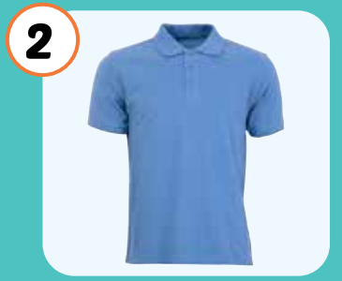
What it is behind these boxes?
Polo shirt

Slide 7
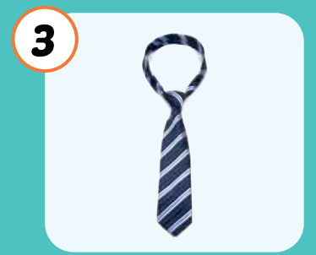
What it is behind these boxes?
tie

Slide 8
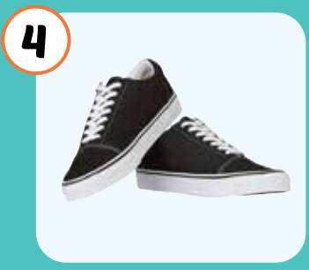
What it is behind these boxes?
sneakers

Slide 9

It’s time to learn …

Slide 10

Reading

Slide 11


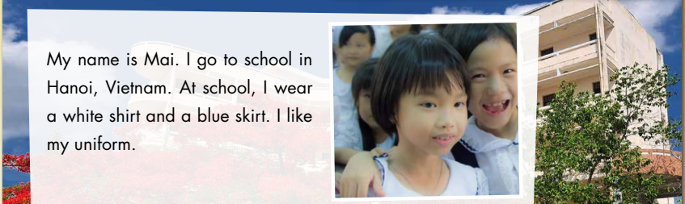



Slide 12


Slide 13


Slide 14


Slide 15
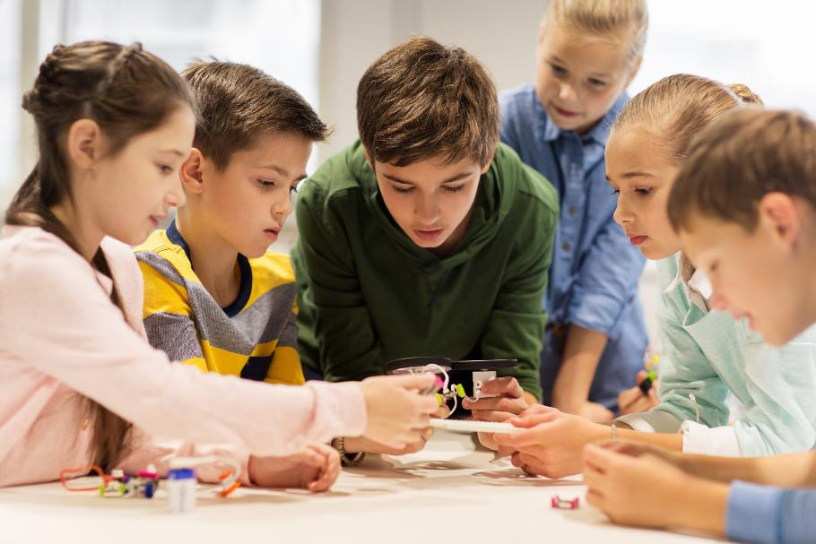
Let’s play a game

Slide 16
Continue the lesson
3
4
2
1
7
8
5
6
The class is divided into 2 groups.
Each group takes turn to choose the star.
Teacher click on each star chosen by students. Students answer the questions. If they have the correct answer, they earn the points for each question.
There is one lucky and one unlucky star
LUCKY STAR

Slide 17
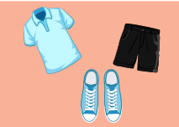
I wear black shorts.
FALSE
TRUE
10 POINT

Slide 18
I wear a white polo shirt.
TRUE
FALSE
15 POINT

Slide 19

CONGRATULATION. YOU EARN 30 POINTS

Slide 20
I wear blue sneakers.
TRUE
FALSE
10 POINT

Slide 21

I like my uniform.
TRUE
FALSE
15 POINT

Slide 22

OH, NO.YOU LOSE 20 POINTS

Slide 23

Writing

Slide 24
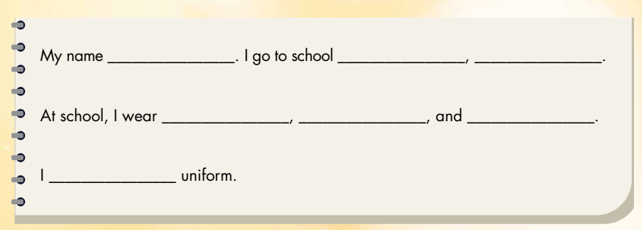

Slide 25

Hello, my name is……..
I’m from……………………………………………………… ……………………………………………………………………………………………………………………………………………..

Slide 26

CONSOLIDATION

Slide 27
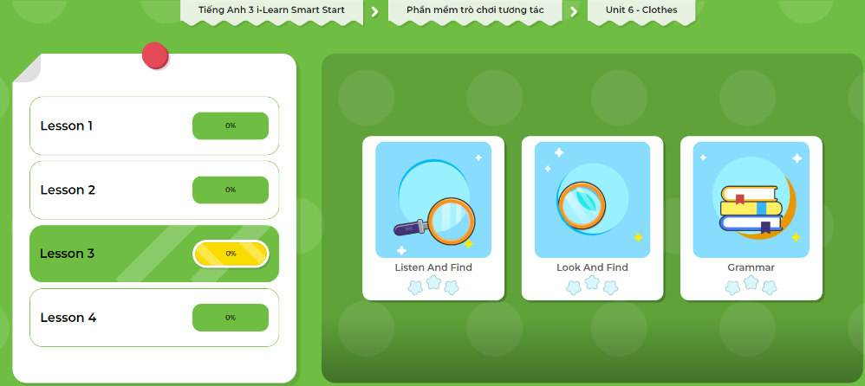
Extra Practice
DHA App
LET’S PLAY!
Click here to play the games

Slide 28

WRAP-UP

Slide 29
Lesson 3
Today’s lesson
Reading
Writing

Slide 30
Lesson 3
Homework
Practice the vocabularies and structure; and make sentences using them.
Do the exercises in Tiếng Anh 3 i-Learn Smart Start WB (page 65).
Do the exercises in Tiếng Anh 3 i-Learn Smart Start Notebook (page 43).
Prepare the next lesson (page 94 SB).
Play the consolidation games in Tiếng Anh 3 i-Learn Smart Start DHA App on www.eduhome.com.vn

Slide 31

Enjoy your day!

