Slide 1

Unit 4: Community Services
Lesson 1.2: Grammar
Page 29

Slide 2


LESSSON OUTLINE
Consolidation

Slide 3

By the end of this lesson, students will be able to…
make suggestions, using should, Let’s, How about.

Slide 4

WARM-UP

Slide 5
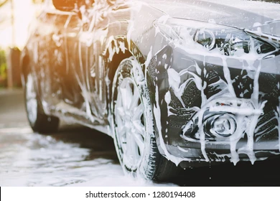
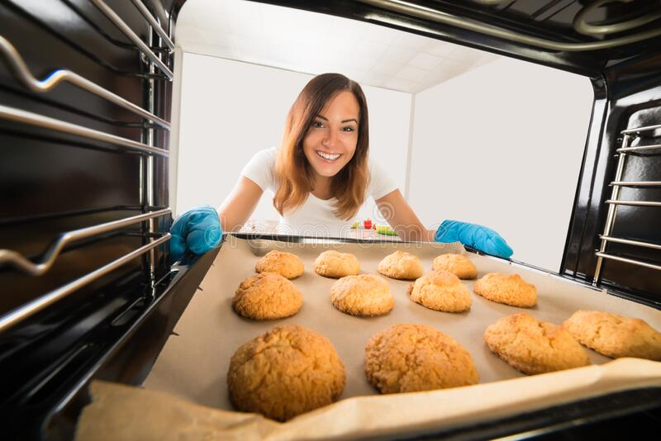

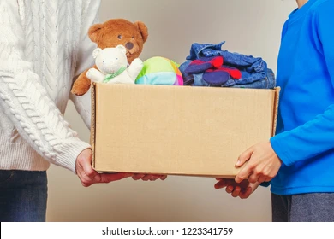
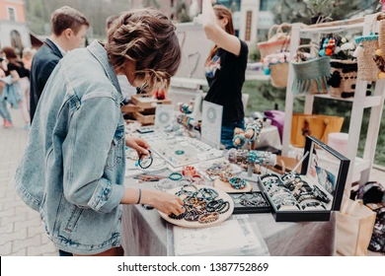

Look at the pictures and name the activities:
baking cookies, having a craft fair, washing cars, organizing an art show, designing posters, donating old clothes
washing cars
baking cookies
218838597
designing posters
1461521012
donating old clothes
having a craft fair
organizing an art show

Slide 6

PRESENTATION
I think we should + …
Let’s + …
How about + …?

Slide 7
Look at three sentences and complete the structure with the correct verb form.
I think we should organize a fun run.
Let’s wash cars.
How about selling cakes?
How about we sell cakes?
I think we should + .
Let’s + .
How about + ?
How about + ?
bare infinitive
bare infinitive
V-ing
S + V (Present Simple)
Making suggestions

Slide 8

Let’s not wash cars.
Let’s not + …
Bare infinitive
Negative suggestions

Slide 9
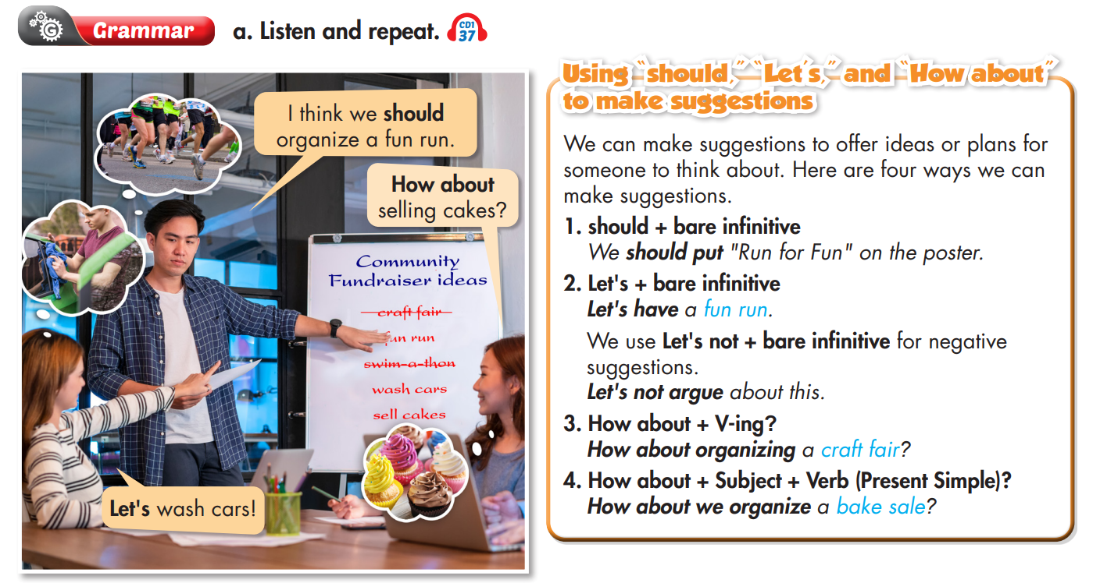


Slide 10

PRACTICE

Slide 11
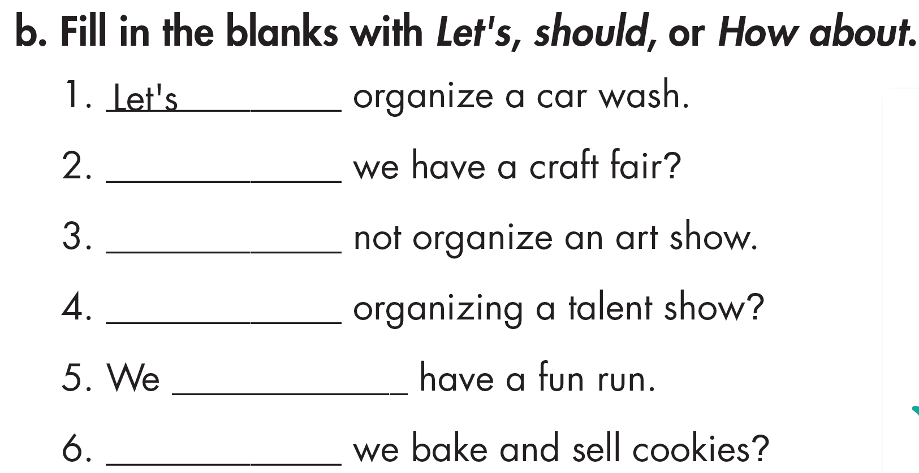
Work in pairs, fill in the blanks with should, let’s or How about and give reasons for your answers.
How about
Let’s
How about
should
How about

Slide 12
Work in pairs, circle the correct words and explain why.
1. A bake sale will raise more money than a craft fair. Let's/Let's not make some pies to sell this weekend.
2. We should/shouldn't charge money for the fun run. More people will come if it's free.
3. Let's/Let's not have the craft fair at the school gym. It's too small to fit a lot of people.

Slide 13
Work in pairs, circle the correct words and explain why.
4. My teacher said we should/shouldn't ask our parents to donate old clothes because we don't need them.
5. The weather report said it will rain this weekend. We should/shouldn't have the event outside.
6. I'm not very good at designing posters. Let's/Let's not ask your sister to help because she's an artist.

Slide 14
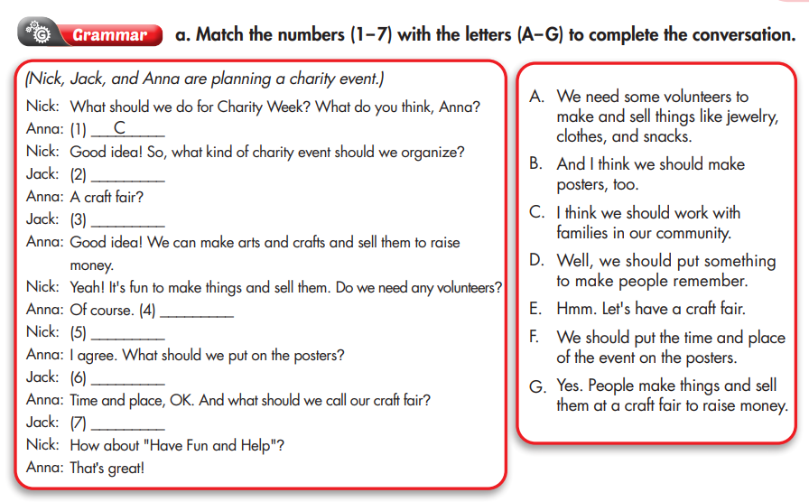
Extra Practice
WB p. 21
E
G
A
B
F
D

Slide 15
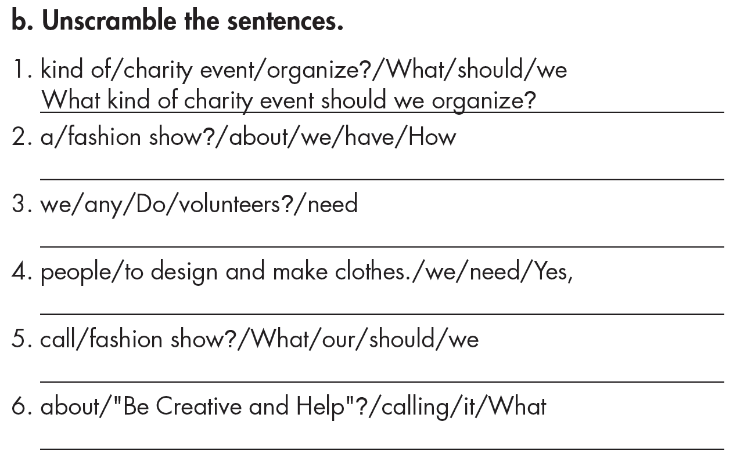
Work in pairs. Discuss how to do this exercise.
Extra Practice
WB p. 21
How about we have a fashion show?
Do we need any volunteers?
Yes, we need people to design and make clothes.
What should we call our fashion show?
What about calling it “Be Creative and Help”?

Slide 16
PRODUCTION

Slide 17
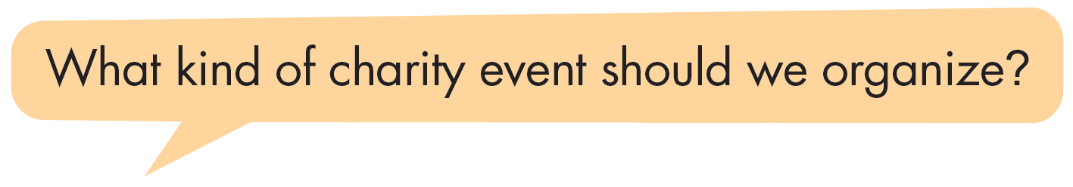

Work in pairs, ask and answer about charity events you should organize to help poor students at your school.
I think we should have a fun run.
How about “Run for Friends”?

Slide 18

CONSOLIDATION

Slide 19
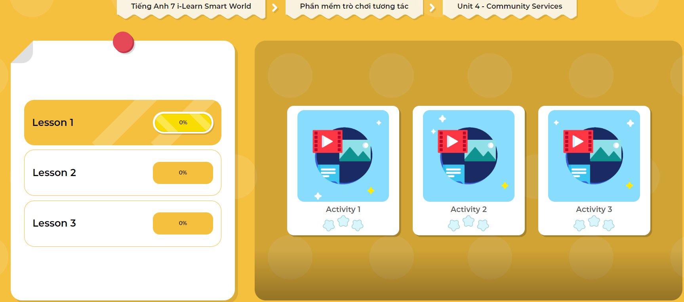
LET’S PLAY!
Click here to play the games

Slide 20
Write five suggestions on how to help poor students at your school, using the structures you learned today. (About 50 words)

Slide 21

WRAP-UP

Slide 22
Today’s lesson
Grammar
I think we should + bare infinitive.
Let’s + bare infinitive.
How about + V-ing?
How about + S + V (simple present)?
Let’s not + bare infinitive. (for negative suggestions)

Slide 23
Homework
Review the grammar point and make sentences using it.
Do the exercises on page 21 WB.
Complete the grammar notes in Tiếng Anh 7 i-Learn Smart World Notebook (page 23).
Prepare the next lesson (page 30 SB).
Play the consolidation games in Tiếng Anh 7 i-Learn Smart World DHA App on www.eduhome.com.vn

Slide 24

Lesson 3
Stay positive and have a nice day!

