Slide 1
KEY ENGLISH TEST 2
SPEAKING TEST 2

Slide 2
KET SPEAKING
Time allowed - 8-10 minutes
Normally you will do the speaking test with another candidate. The two of you will meet two examiners. One of the examiners will talk to you, the other does not particpate in the conversations.
There are two parts to the speaking test:
Speaking part 1: short questions and answers between you and the examiner
Speaking part 2: the examiner gives you some information or a card with some ideas for questions. You have to talk with the other candidate and ask or answer questions.
How to prepare for KET Speaking
Speak as much as you can, with your friends
Practise asking and asnwering questions about daily life
Practise giving information about yourself

Slide 3
PART 1:
Remember to add more details to your answer to make it longer
Do you like reading?
What sort of books do you like?
Do you often read books in your free time?
Where do you often buy books?
Have you ever read an e-book?
Talk about your favorite book that you have read

Slide 4

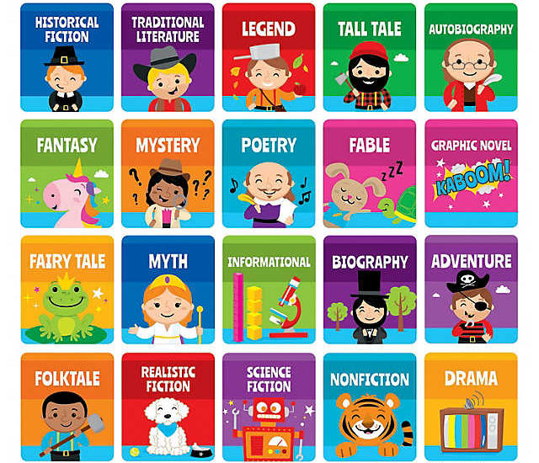
BOOK GENRES

Slide 5

E-BOOK
PRINTED BOOK

Slide 6

Sample answers:
Do you like reading?
What sort of books do you like?
Do you often read books in your free time?
Where do you often buy books?
Have you ever read an e-book?
Yes, I am a big fan of reading books.
I like reading many types of books, such as comic books, thriller books and even classical novels
Yes. I spend most of my freetime on reading as a way to relax and broaden my knowledge.
I often by books from Tiki, an online shopping website because the price is much cheaper than that in the bookshop.
Yes, of course. Reading E-books is a perfect alternative if you can’t afford some books that you want to read.

Slide 7
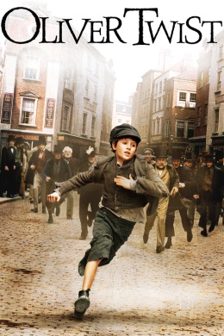
A FAVORITE BOOK
The answer should be at least 3 sentences
Helpful outline and vocabulary
Name – Author
book
Content of the book
For example: My favorite book is Oliver Twist by Charles Dicken. It is about the journey of an orphanage boy in the Victorian period. This book is very interesting and attractive that you can’t put it down.
Reasons why you like it

Slide 8
SPEAKING
PART 2
Asking and answering questions using these prompt cards

Slide 9

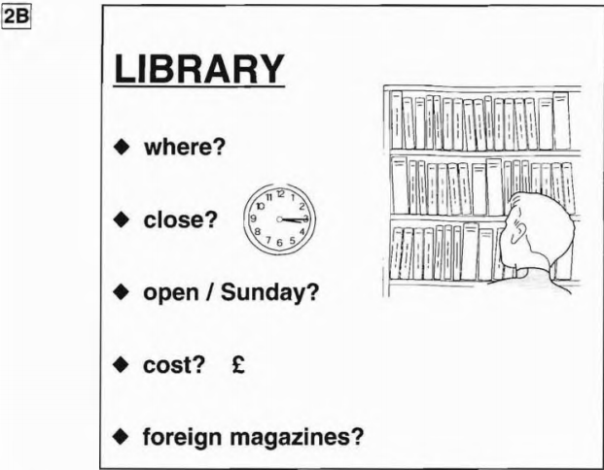
Where is the library?
What time does it close?
Does it open on Sunday?
How much is the entrance fee?
Does it have foreign magazines?
Can you think of other questions or other ways to ask and answer?

Slide 10
TALK ABOUT THE LIBRARY
Imagine that you are the manager of the library. Introduce it, using the given information

Slide 11
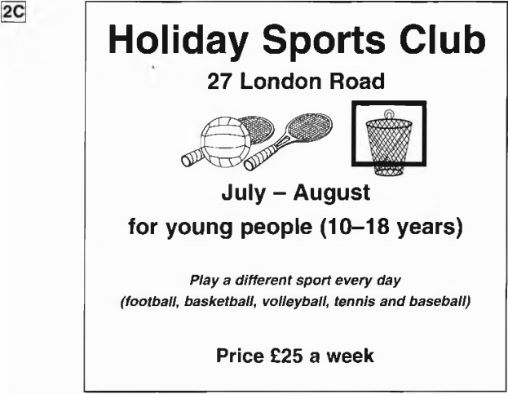
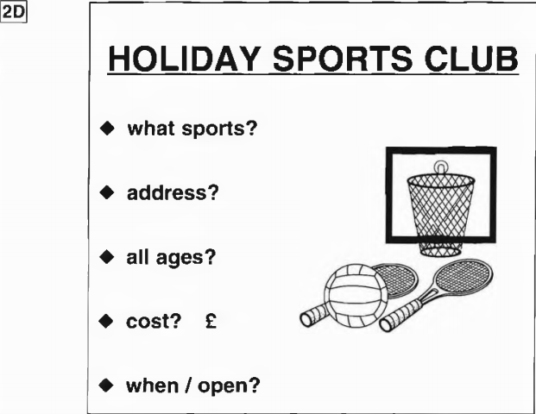
What sports can you play in the sports club?
What is its address?
Is this sports club for people of all ages?
How much does it cost a week?
When does it open?

