Slide 2
Unit 2
A multicultural world
LESSON 3
READING
Globalisation and cultural diversity

Slide 3
LESSON 3
READING
WARM-UP
- Video watching
PRE-READING
- Task 1: Discuss the questions.
- Vocabulary
WHILE-READING
- Task 2: Match each section with a heading.
- Task 3: Choose the correct answer A, B, or C.
POST-READING
- Task 4: Discussion.
CONSOLIDATION
- Wrap-up
- Homework

Slide 4
WARM-UP
Video watching
- Work as 2 groups.
- Watch the video carefully and try to remember as many details as possible.
- Teacher shows questions on the slide, Ss raise their hands and say BINGO to grab the chance to answer.
- If the answer is correct ➔ one point.
- The team with higher score will be the winner.

Slide 5

WARM-UP
Video watching
Notes:
Link: https://www.youtube.com/watch?v=zfn0XHCfDHA

Slide 6
WARM-UP
Question 1:
Fill in the blanks (1 point for each)
Environmental problems of globalisation includes global warming, the _________ of natural resources and the production of harmful chemicals.
depletion

Slide 7
WARM-UP
Question 2:
Fill in the blank
Polluting industries, logging forest and exploiting __________ are consequences of globalisation.
labour

Slide 8
WARM-UP
Question 3:
Fill in the blank
Loss of __________ is another effect of globalisation.
culture

Slide 9
WARM-UP
Question 4:
Fill in the blank
Globalisation supports faster_____________ growth and quicker access to new technology.
economic

Slide 10

PRE-READING
1
Work in pairs. Discuss the questions:
1. What is globalisation?
2. How does globalisation affect local cultures?

Slide 11


PRE-READING
globalisation (n)
/ˌɡləʊbəlaɪˈzeɪʃn/
the fact that different cultures and economic systems around the world are becoming connected and similar to each other because of the influence of large multinational companies and of improved communication

Slide 12
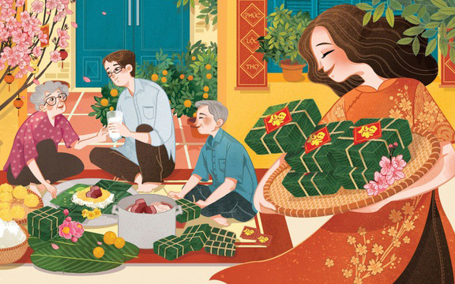
PRE-READING
custom (n)
/ˈkʌstəm/
an accepted way of behaving or of doing things in a society or a community

Slide 13
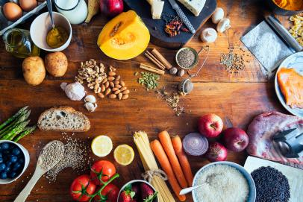
PRE-READING
ingredient (n)
/ɪnˈɡriːdiənt/
one of the things from which something is made, especially one of the foods that are used together to make a particular dish

Slide 14
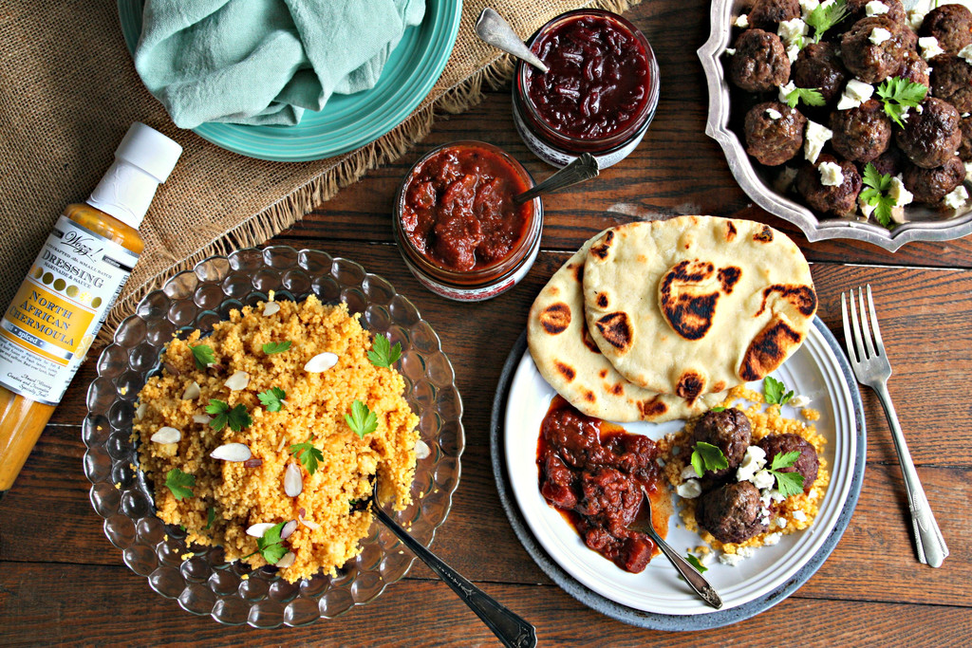
PRE-READING
speciality (n)
/ˌspeʃiˈæləti/
a type of food or product that a restaurant or place is famous for because it is so good

Slide 15

PRE-READING
captivate (v)
/ˈkæptɪveɪt/
to keep somebody’s attention by being interesting, attractive, etc.

Slide 16

PRE-READING
keep up with (ph.v)
/kiːp ʌp wɪð/
to continue to be in contact with somebody

Slide 17
PRE-READING
Form | Pronunciation | Meaning | Vietnamese equivalent
1. globalisation (n) | /ˌɡləʊbəlaɪˈzeɪʃn/ | the fact that different cultures and economic systems around the world are becoming connected and similar to each other because of the influence of large multinational companies and of improved communication | sự toàn cầu hoá
2. custom (n) | /ˈkʌstəm/ | an accepted way of behaving or of doing things in a society or a community | phong tục
3. ingredient (n) | /ɪnˈɡriːdiənt/ | one of the things from which something is made, especially one of the foods that are used together to make a particular dish | nguyên liệu

Slide 18
PRE-READING
Form | Pronunciation | Meaning | Vietnamese equivalent
4. speciality (n) | /ˌspeʃiˈæləti/ | a type of food or product that a restaurant or place is famous for because it is so good | đặc sản
5. captivate (v) | /ˈkæptɪveɪt/ | to keep somebody’s attention by being interesting, attractive, etc. | làm say đắm
6. keep up with (ph.v) | /kiːp ʌp wɪð/ | to continue to be in contact with somebody | theo kịp

Slide 19
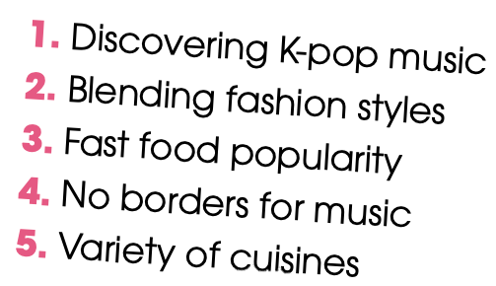
WHILE-READING
2
Read the article and match each section (A–C) with a heading (1–5). There are TWO extra headings.
3. Fast food population
A. _______________________
4. No borders for music
B. _______________________
2. Blending fashion styles
C. _______________________

Slide 20
WHILE-READING
3
Read the article again and choose the correct answer A, B, or C.
1. How has globalisation affected people’s eating habits?
  A. It has decreased the popularity of traditional food.
  B. It has limited people’s food choices to local dishes.
  C. Local people are trying new cuisines.
2. Which of the following is NOT mentioned as something that local people can try in Viet Nam?
  A. Dishes from other cultures using ingredients grown in Viet Nam.
  B. Traditional dishes using international ingredients.
  C. A Japanese dish of cooked rice and raw fish.

Slide 21
WHILE-READING
3
Read the article again and choose the correct answer A, B, or C.
3. What can be inferred from the passage about music?
  A. Music has connected people across cultures.
  B. Teens around the world love listening to K-pop music.
  C. It is easier to organise music festivals.
  4. How has globalisation affected fashion?
A. It has introduced more traditional elements in fashion design.
B. It has promoted the exchange of fashion ideas and styles from around the world.
C. It has made it easier for people to create their own clothes.

Slide 22
WHILE-READING
3
Read the article again and choose the correct answer A, B, or C.
5. What is the purpose of the article?
A. To discuss the positive impacts of globalisation on cultures.
B. To introduce features of new cultures to readers.
C. To explain how globalisation can help people have the same experiences.

Slide 23
POST-READING
4
Work in groups. Discuss the following question.
What are some other effects of globalisation on cultural diversity? Give some examples in the context of Viet Nam
Suggested answers:
Globalisation can foster cultural exchange, enabling individuals from different backgrounds to learn from one another, celebrate diversity, and develop a deeper appreciation for varied cultural expressions.

Slide 24
CONSOLIDATION
1
Wrap-up
What have you learnt today?
Some lexical items about globalisation and cultural identity.
Reading skills for general ideas and for specific information about globalisation and cultural identity.

Slide 25
CONSOLIDATION
2
Homework
Do exercises in the workbook.
Prepare for Lesson 4.

Slide 26
Website: hoclieu.vn
Fanpage: facebook.com/www.tienganhglobalsuccess.vn

